Slide 1
Uninformed Search

Slide 2
Search Algorithms
Uninformed Blind search
  Breadth-first
  uniform first
  depth-first
  Iterative deepening depth-first
  Bidirectional
  Branch and Bound
Informed Heuristic search
  Greedy search, hill climbing, Heuristics
Important concepts:
  Completeness
  Time complexity
  Space complexity
  Quality of solution

Slide 3
Tree-based Search
Basic idea:
  Exploration of state space by generating successors of already-explored states (a.k.a. expanding states).
  Every state is evaluated: is it a goal state?
In practice, the solution space can be a graph, not a tree
  E.g., 8-puzzle
  More general approach is graph search
  Tree search can end up repeatedly visiting the same nodes
    Unless it keeps track of all nodes visited
    …but this could take vast amounts of memory

Slide 4


Tree search example

Slide 5

Tree search example

Slide 6


Tree search example

Slide 7
Tree search example
This “strategy” is what differentiates different search algorithms

Slide 8

States versus Nodes
A state is a (representation of) a physical configuration
A node is a data structure constituting part of a search tree contains info such as: state, parent node, action, path cost g(x), depth
The Expand function creates new nodes, filling in the various fields and using the SuccessorFn of the problem to create the corresponding states.

Slide 9
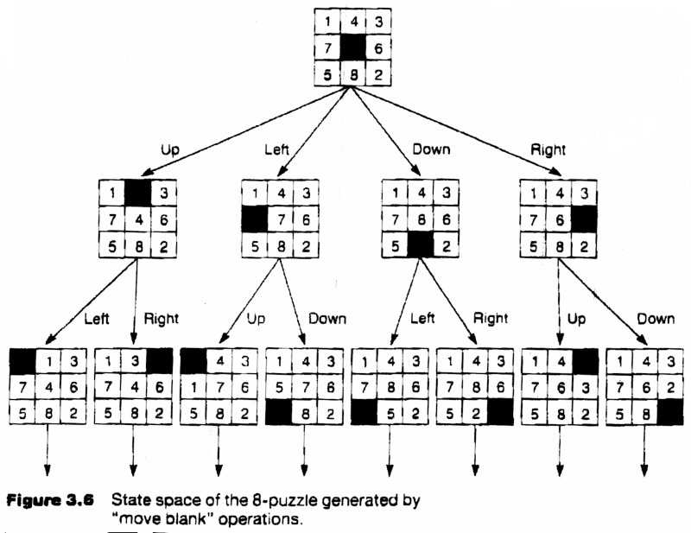
Search Tree for the 8 puzzle problem

Slide 10
Search Strategies
A search strategy is defined by picking the order of node expansion
Strategies are evaluated along the following dimensions:
  completeness: does it always find a solution if one exists?
  time complexity: number of nodes generated
  space complexity: maximum number of nodes in memory
  optimality: does it always find a least-cost solution?
Time and space complexity are measured in terms of
  b: maximum branching factor of the search tree
  d: depth of the least-cost solution
  m: maximum depth of the state space (may be ∞)

Slide 11
Breadth-First Search (BFS)
Expand shallowest unexpanded node
Fringe: nodes waiting in a queue to be explored, also called OPEN
Implementation:
  For BFS, fringe is a first-in-first-out (FIFO) queue
  new successors go at end of the queue
Repeated states?
  Simple strategy: do not add parent of a node as a leaf

Slide 12
Example: Map Navigation
State Space:
S = start, G = goal, other nodes = intermediate states, links = legal transitions
A
B
C
S
G
D
E
F

Slide 13
BFS Search Tree
A
B
C
S
G
S
D
E
F
Queue = {S}
Select S
Goal(S) = true?
If not, Expand(S)

Slide 14
BFS Search Tree
A
B
C
S
G
S
D
E
F
A
D
Queue = {A, D}
Select A
Goal(A) = true?
If not, Expand(A)

Slide 15
BFS Search Tree
A
B
C
S
G
S
D
E
F
A
D
Queue = {D, B, D}
Select D
Goal(D) = true?
If not, expand(D)
B
D

Slide 16
BFS Search Tree
A
B
C
S
G
S
D
E
F
A
D
A
Queue = {B, D, A, E}
Select B
etc.
B
D
E

Slide 17
BFS Search Tree
A
B
C
S
G
S
D
E
F
A
D
B
D
A
E
C
E
S
E
S
B
B
F
Level 3
Queue = {C, E, S, E, S, B, B, F}

Slide 18
BFS Search Tree
A
B
C
S
G
S
D
E
F
A
D
B
D
A
E
C
E
S
E
S
B
B
F
D
F
A
B
F
D
C
E
A
C
G
Level 4
Expand queue until G is at front
Select G
Goal(G) = true

Slide 19
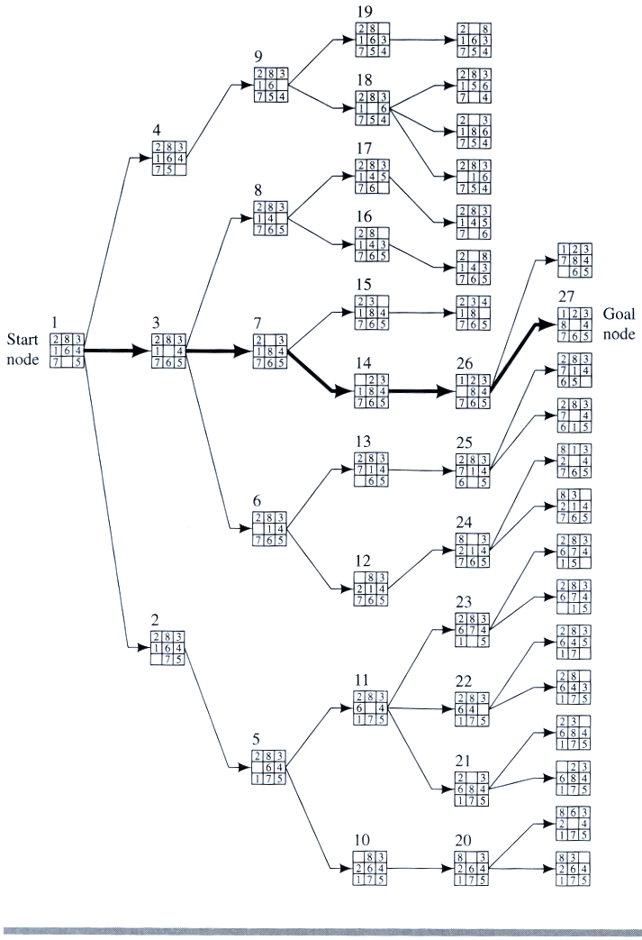
Breadth-First Search

Slide 20
Depth-First Search (BFS)
Expand deepest unexpanded node
Implementation:
  For DFS, fringe is a first-in-first-out (FIFO) queue
  new successors go at beginning of the queue
Repeated nodes?
  Simple strategy: Do not add a state as a leaf if that state is on the path from the root to the current node

Slide 21
DFS Search Tree
A
B
C
S
G
S
D
E
F
A
D
Queue = {A,D}

Slide 22
DFS Search Tree
A
B
C
S
G
S
D
E
F
A
D
B
D
Queue = {B,D,D}

Slide 23
DFS Search Tree
A
B
C
S
G
S
D
E
F
A
D
B
D
Queue = {C,E,D,D}
C
E

Slide 24
DFS Search Tree
A
B
C
S
G
S
D
E
F
A
D
B
D
Queue = {D,F,D,D}
C
E
D
F

Slide 25
DFS Search Tree
A
B
C
S
G
S
D
E
F
A
D
B
D
Queue = {G,D,D}
C
E
D
F
G

Slide 26
Evaluation of Search Algorithms
Completeness
  does it always find a solution if one exists?
Optimality
  does it always find a least-cost (or min depth) solution?
Time complexity
  number of nodes generated (worst case)
Space complexity
  number of nodes in memory (worst case)
Time and space complexity are measured in terms of
  b: maximum branching factor of the search tree
  d: depth of the least-cost solution
  m: maximum depth of the state space (may be ∞)

Slide 27
Breadth-First Search (BFS) Properties
Complete? Yes
Optimal? Only if path-cost = non-decreasing function of depth
Time complexity O(b^{d})
Space complexity O(b^{d})
Main practical drawback? exponential space complexity

Slide 28
Complexity of Breadth-First Search
Time Complexity
  assume (worst case) that there is 1 goal leaf at the RHS at depth d
  so BFS will generate
  = b + b²+ ..... + b^{d} + b^{d+1} - b
  = O (b^{d+1})
Space Complexity
  how many nodes can be in the queue (worst-case)?
  at depth d there are b^{d+1} unexpanded nodes in the Q = O (b^{d+1})
d=0
d=1
d=2
G
d=0
d=1
d=2
G

Slide 29
What is the Complexity of Depth-First Search?
Time Complexity
  maximum tree depth = m
  assume (worst case) that there is 1 goal leaf at the RHS at depth d
  so DFS will generate O (b^{m})
Space Complexity
  how many nodes can be in the queue (worst-case)?
  at depth m we have b nodes
  and b-1 nodes at earlier depths
  total = b + (m-1)*(b-1) = O(bm)
d=0
d=1
d=2
G
d=0
d=1
d=2
d=3
d=4

Slide 30
Depth-First Search (DFS) Properties
Complete?
  Not complete if tree has unbounded depth
Optimal?
  No
Time complexity?
  Exponential
Space complexity?
  Linear

Slide 31
Comparing DFS and BFS
Time complexity: same, but
  In the worst-case BFS is always better than DFS
  Sometime, on the average DFS is better if:
    many goals, no loops and no infinite paths
BFS is much worse memory-wise
    DFS is linear space
    BFS may store the whole search space.
In general
    BFS is better if goal is not deep, if infinite paths, if many loops, if small search space
    DFS is better if many goals, not many loops,
    DFS is much better in terms of memory

Slide 32
DFS with a depth-limit L
Standard DFS, but tree is not explored below some depth-limit L
Solves problem of infinitely deep paths with no solutions
  But will be incomplete if solution is below depth-limit
Depth-limit L can be selected based on problem knowledge
  E.g., diameter of state-space:
    E.g., max number of steps between 2 cities
  But typically not known ahead of time in practice

Slide 33
Depth-First Search with a depth-limit, L = 5

Slide 34
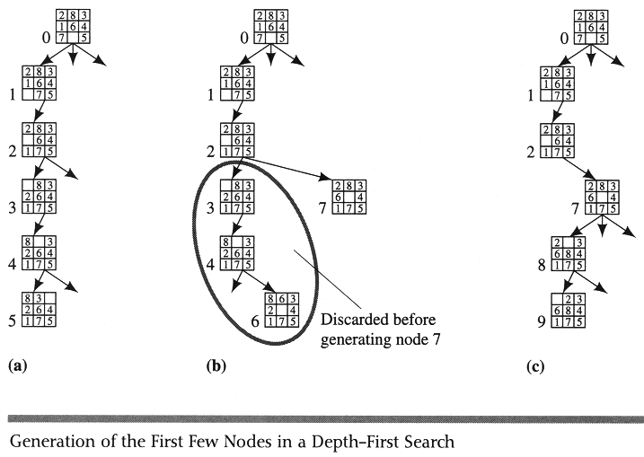
Depth-First Search with a depth-limit

Slide 35
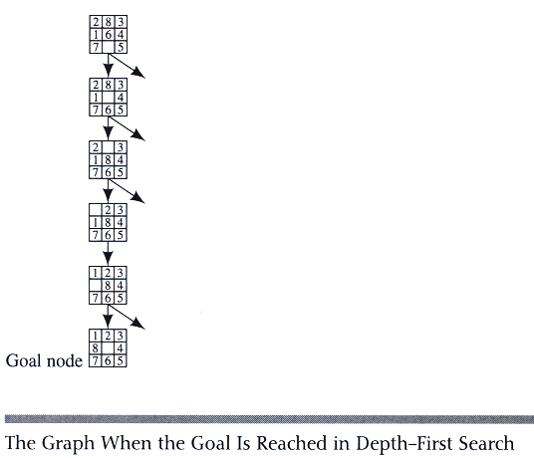

Slide 36
Iterative Deepening Search (IDS)
Run multiple DFS searches with increasing depth-limits
Iterative deepening search
L = 1
While no solution, do
  DFS from initial state S₀ with cutoff L
  If found goal,
  stop and return solution,
  else, increment depth limit L

Slide 37

Iterative deepening search L=0

Slide 38

Iterative deepening search L=1

Slide 39

Iterative deepening search L=2

Slide 40

Iterative Deepening Search L=3

Slide 41
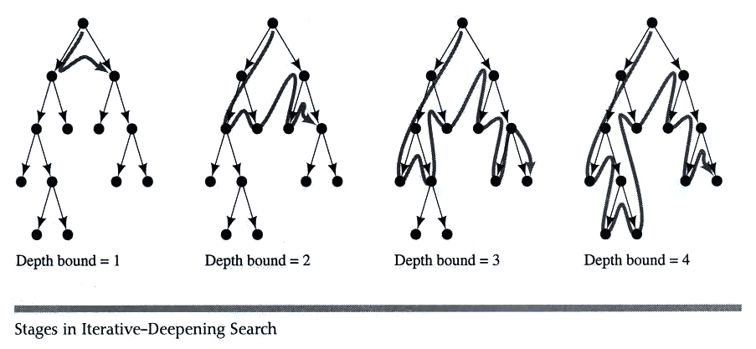
Iterative deepening search

Slide 42
Properties of Iterative Deepening Search
Space complexity = O(bd)
    (since its like depth first search run different times, with maximum depth limit d)
Time Complexity
    b + (b+b²) + .......(b+....b^{d}) = O(b^{d})
    (i.e., asymptotically the same as BFS or DFS to limited depth d in the worst case)
Complete?
  Yes
Optimal
  Only if path cost is a non-decreasing function of depth
IDS combines the small memory footprint of DFS, and has the completeness guarantee of BFS

Slide 43
IDS in Practice
Isn’t IDS wasteful?
  Repeated searches on different iterations
  Compare IDS and BFS:
    E.g., b = 10 and d = 5
    N(IDS) ~ db + (d-1)b² +…… b^{d} = 123,450
    N(BFS) ~ b + b² +…… b^{d} = 111,110
    Difference is only about 10%
      Most of the time is spent at depth d, which is the same amount of time in both algorithms
In practice, IDS is the preferred uniform search method with a large search space and unknown solution depth

Slide 44
Bidirectional Search
Idea
  simultaneously search forward from S and backwards from G
  stop when both “meet in the middle”
  need to keep track of the intersection of 2 open sets of nodes
What does searching backwards from G mean
  need a way to specify the predecessors of G
    this can be difficult,
    e.g., predecessors of checkmate in chess?
  what if there are multiple goal states?
  what if there is only a goal test, no explicit list?
Complexity
  time complexity at best is: O(2 b^{(d/2)}) = O(b ^{(d/2)})
  memory complexity is the same

Slide 45
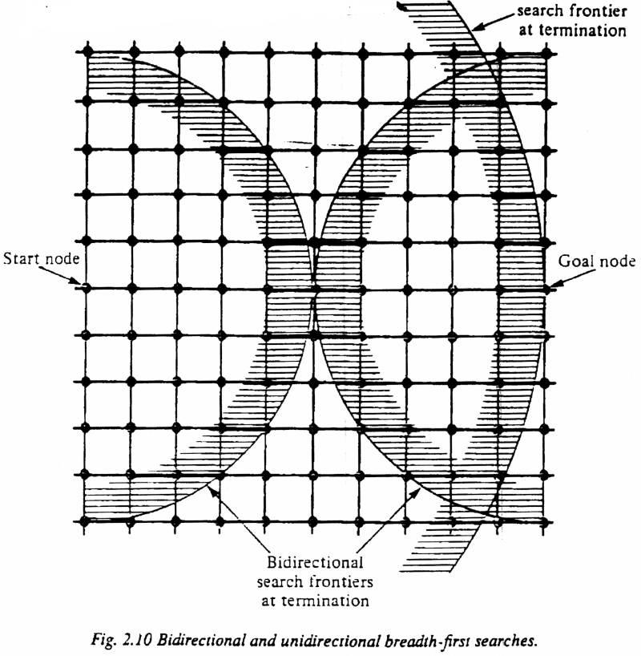
Bi-Directional Search

