Slide 1
Informed search

Slide 2
Outline
Informed = use problem-specific knowledge
Which search strategies?
  Best-first search and its variants
Heuristic functions?
  How to invent them
Local search and optimization
  Hill climbing, local beam search, genetic algorithms,…

Slide 3
A strategy is defined by picking the order of node expansion

Slide 4
Best-first search
General approach of informed search:
  Best-first search: node is selected for expansion based on an evaluation function f(n)
Idea: evaluation function measures distance to the goal.
  Choose node which appears best
Implementation:
  fringe is queue sorted in decreasing order of desirability.
  Special cases: greedy search, A* search

Slide 5
A heuristic function
[dictionary]“A rule of thumb, simplification, or educated guess that reduces or limits the search for solutions in domains that are difficult and poorly understood.”
  h(n) = estimated cost of the cheapest path from node n to goal node.
  If n is goal then h(n)=0
  More information later.

Slide 6
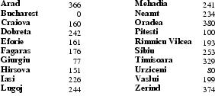
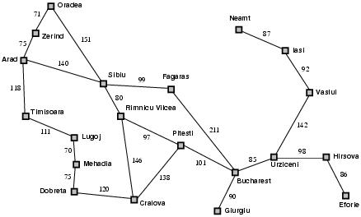
Romania with step costs in km
h_{SLD}=straight-line distance heuristic.
h_{SLD} can NOT be computed from the problem description itself
In this example f(n)=h(n)
  Expand node that is closest to goal
  = Greedy best-first search

Slide 7
Greedy search example
Arad (366)
Assume that we want to use greedy search to solve the problem of travelling from Arad to Bucharest.
The initial state=Arad

Slide 8
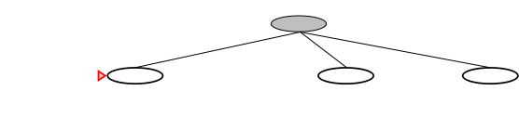
Greedy search example
Arad
Sibiu(253)
Zerind(374)
Timisoara
(329)
The first expansion step produces:
  Sibiu, Timisoara and Zerind
Greedy best-first will select Sibiu.

Slide 9
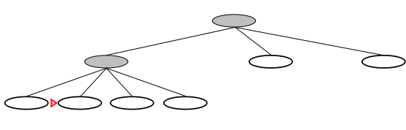
Greedy search example
Arad
Sibiu
Arad
(366)
Rimnicu Vilcea
(193)
Fagaras
(176)
Oradea
(380)
If Sibiu is expanded we get:
  Arad, Fagaras, Oradea and Rimnicu Vilcea
Greedy best-first search will select: Fagaras

Slide 10
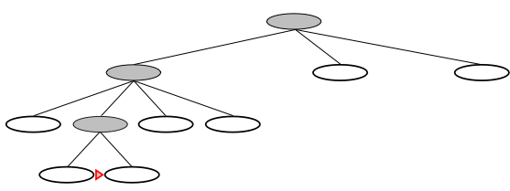
Greedy search example
Arad
Sibiu
Fagaras
Sibiu
(253)
Bucharest
(0)
If Fagaras is expanded we get:
  Sibiu and Bucharest
Goal reached !!
  Yet not optimal (see Arad, Sibiu, Rimnicu Vilcea, Pitesti)

Slide 11
Greedy search, evaluation
Completeness: NO (cfr. DF-search)
  Check on repeated states
  Minimizing h(n) can result in false starts, e.g. Iasi to Fagaras.

Slide 12

Greedy search, evaluation
Completeness: NO (cfr. DF-search)
Time complexity?
  Cfr. Worst-case DF-search
  (with m is maximum depth of search space)
  Good heuristic can give dramatic improvement.

Slide 13
Greedy search, evaluation
Completeness: NO (cfr. DF-search)
Time complexity:
Space complexity:
  Keeps all nodes in memory

Slide 14
Greedy search, evaluation
Completeness: NO (cfr. DF-search)
Time complexity:
Space complexity:
Optimality? NO
  Same as DF-search

Slide 15
A* search
Best-known form of best-first search.
Idea: avoid expanding paths that are already expensive.
Evaluation function f(n)=g(n) + h(n)
  g(n) the cost (so far) to reach the node.
  h(n) estimated cost to get from the node to the goal.
  f(n) estimated total cost of path through n to goal.

Slide 16
A* search
A* search uses an admissible heuristic
  A heuristic is admissible if it never overestimates the cost to reach the goal
  Are optimistic
    Formally:
    1. h(n) <= h*(n) where h*(n) is the true cost from n
    2. h(n) >= 0 so h(G)>= 0 for any goal G.
    e.g. h_{SLD}(n) never overestimates the actual road distance

Slide 17
Romania example

Slide 18
A* search example
Find Bucharest starting at Arad
  f(Arad) = c(??,Arad)+h(Arad)=0+366=366

Slide 19

A* search example
Expand Arrad and determine f(n) for each node
  f(Sibiu)=c(Arad,Sibiu)+h(Sibiu)=140+253=393
  f(Timisoara)=c(Arad,Timisoara)+h(Timisoara)=118+329=447
  f(Zerind)=c(Arad,Zerind)+h(Zerind)=75+374=449
Best choice is Sibiu

Slide 20
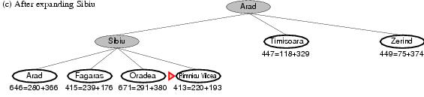
A* search example
Expand Sibiu and determine f(n) for each node
  f(Arad)=c(Sibiu,Arad)+h(Arad)=280+366=646
  f(Fagaras)=c(Sibiu,Fagaras)+h(Fagaras)=239+179=415
  f(Oradea)=c(Sibiu,Oradea)+h(Oradea)=291+380=671
  f(Rimnicu Vilcea)=c(Sibiu,Rimnicu Vilcea)+
  h(Rimnicu Vilcea)=220+192=413
Best choice is Rimnicu Vilcea

Slide 21
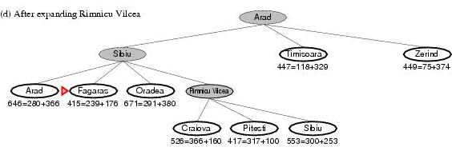
A* search example
Expand Rimnicu Vilcea and determine f(n) for each node
  f(Craiova)=c(Rimnicu Vilcea, Craiova)+h(Craiova)=360+160=526
  f(Pitesti)=c(Rimnicu Vilcea, Pitesti)+h(Pitesti)=317+100=417
  f(Sibiu)=c(Rimnicu Vilcea,Sibiu)+h(Sibiu)=300+253=553
Best choice is Fagaras

Slide 22
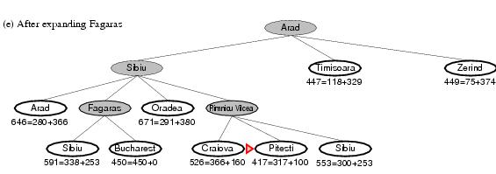
A* search example
Expand Fagaras and determine f(n) for each node
  f(Sibiu)=c(Fagaras, Sibiu)+h(Sibiu)=338+253=591
  f(Bucharest)=c(Fagaras,Bucharest)+h(Bucharest)=450+0=450
Best choice is Pitesti !!!

Slide 23
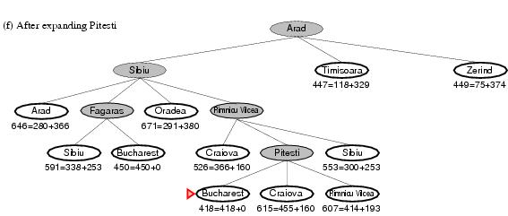
A* search example
Expand Pitesti and determine f(n) for each node
  f(Bucharest)=c(Pitesti,Bucharest)+h(Bucharest)=418+0=418
Best choice is Bucharest !!!
  Optimal solution (only if h(n) is admissable)
Note values along optimal path !!

Slide 24
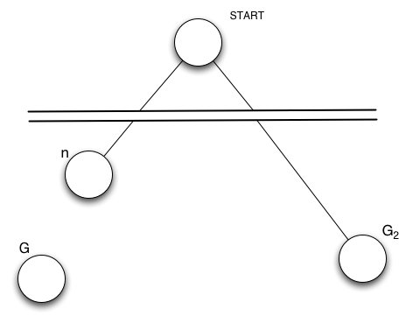
Optimality of A*(standard proof)
Suppose suboptimal goal G₂ in the queue.
Let n be an unexpanded node on a shortest to optimal goal G.
    f(G₂ ) = g(G₂ ) since h(G₂ )=0
    > g(G) since G₂ is suboptimal
    >= f(n) since h is admissible
    Since f(G₂) > f(n), A* will never select G₂ for expansion

Slide 25
BUT … graph search
Discards new paths to repeated state.
  Previous proof breaks down
Solution:
  Add extra bookkeeping i.e. remove more expsive of two paths.
  Ensure that optimal path to any repeated state is always first followed.
    Extra requirement on h(n): consistency (monotonicity)

Slide 26
A* search, evaluation
Completeness: YES
  Since bands of increasing f are added
  Unless there are infinitely many nodes with f<f(G)

Slide 27
A* search, evaluation
Completeness: YES
Time complexity:
  Number of nodes expanded is still exponential in the length of the solution.

Slide 28
A* search, evaluation
Completeness: YES
Time complexity: (exponential with path length)
Space complexity:
  It keeps all generated nodes in memory
  Hence space is the major problem not time

Slide 29
Learning to search better
All previous algorithms use fixed strategies.
Agents can learn to improve their search by exploiting the meta-level state space.
  Each meta-level state is a internal (computational) state of a program that is searching in the object-level state space.
  In A* such a state consists of the current search tree
A meta-level learning algorithm from experiences at the meta-level.

Slide 30

Heuristic functions
E.g for the 8-puzzle
  Avg. solution cost is about 22 steps (branching factor +/- 3)
  Exhaustive search to depth 22: 3.1 x 10¹⁰ states.
  A good heuristic function can reduce the search process.

Slide 31
Heuristic functions
E.g for the 8-puzzle knows two commonly used heuristics
h₁ = the number of misplaced tiles
  h₁(s)=8
h₂ = the sum of the distances of the tiles from their goal positions (manhattan distance).
  h₂(s)=3+1+2+2+2+3+3+2=18

Slide 32
Heuristic quality
Effective branching factor b*
  Is the branching factor that a uniform tree of depth d would have in order to contain N+1 nodes.
  Measure is fairly constant for sufficiently hard problems.
    Can thus provide a good guide to the heuristic’s overall usefulness.
    A good value of b* is 1.

Slide 33
Heuristic quality and dominance
Is h₂ always better than h₁? – yes
A* using h₂ will never expand more nodes than A* using h₁
We saw earlier that every node with f(n) < C* will surely be expanded
This is the same as saying that every node with
h(n) < C* - g(n) will surely be expanded
h₂ is at least as big as h₁ for all nodes
  every node that this expanded by A* search with h₂ will also surely be expanded with h₁
  h₁might cause other nodes to be expanded as well
Always better to use a heuristic function with higher values

Slide 34
Inventing admissible heuristics
Admissible heuristics can be derived from the exact solution cost of a relaxed version of the problem:
  Relaxed 8-puzzle for h₁ : a tile can move anywhere
    As a result, h₁(n) gives the shortest solution
  Relaxed 8-puzzle for h₂ : a tile can move to any adjacent square.
    As a result, h₂(n) gives the shortest solution.
The optimal solution cost of a relaxed problem is no greater than the optimal solution cost of the real problem.
Is it still admissible?

Slide 35
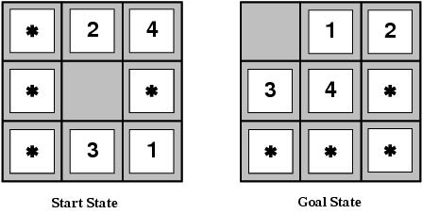
Inventing admissible heuristics
Admissible heuristics can also be derived from the solution cost of a subproblem of a given problem.
This cost is a lower bound on the cost of the real problem.
Pattern databases store the exact solution to for every possible subproblem instance.
  The complete heuristic is constructed using the patterns in the DB

Slide 36
Inventing admissible heuristics
Another way to find an admissible heuristic is through learning from experience:
  Experience = solving lots of 8-puzzles
  An inductive learning algorithm can be used to predict costs for other states that arise during search.

Slide 37
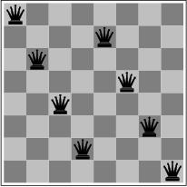
Local search and optimization
Previously: systematic exploration of search space.
  Path to goal is solution to problem
YET, for some problems path is irrelevant.
  E.g 8-queens
Different algorithms can be used
  Local search

Slide 38
Local search and optimization
Local search= use single current state and move to neighboring states.
Advantages:
  Use very little memory
  Find often reasonable solutions in large or infinite state spaces.
Are also useful for pure optimization problems.
  Find best state according to some objective function.
  e.g. survival of the fittest as a metaphor for optimization.
State space – location (state) and elevation (value of heuristic cost function or objective function)

Slide 39

Local search and optimization

Slide 40
Hill-climbing search
“is a loop that continuously moves in the direction of increasing value”
  It terminates when a peak is reached.
Hill climbing does not look ahead of the immediate neighbors of the current state.
Does not maintain a search tree
Hill-climbing chooses randomly among the set of best successors, if there is more than one.
Hill-climbing a.k.a. greedy local search

Slide 41
Hill-climbing search
function HILL-CLIMBING( problem) return a state that is a local maximum
input: problem, a problem
local variables: current, a node.
neighbor, a node.
current ← MAKE-NODE(INITIAL-STATE[problem])
loop do
neighbor ← a highest valued successor of current
if VALUE [neighbor] ≤ VALUE[current] then return STATE[current]
current ← neighbor

Slide 42
Hill-climbing example
8-queens problem (complete-state formulation)
  Each state has 8 Queens on the board – one per column .
Successor function – returns all possible states generated by moving a single queen to another square in the same column – each state has 8x7=56 successors.
Heuristic function h(n): the number of pairs of queens that are attacking each other (directly or indirectly).

Slide 43
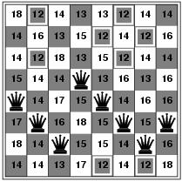

Hill-climbing example
a)
b)
a) shows a state of h=17 and the h-value for each possible successor.
b) A local minimum in the 8-queens state space (h=1).
Takes five steps to go from (a) to (b)

Slide 44
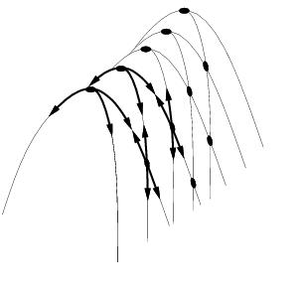
Drawbacks
Local Maxima = local maximum that is higher than each of its neighboring states, but lower than the global maximum – previous figure is a local Maxima
Ridge = sequence of local maxima difficult for greedy algorithms to navigate
Plateaux = an area of the state space where the evaluation function is flat – no uphill exit seems to exist
Gets stuck 86% of the time – 8 Queens problem

