Slide 1
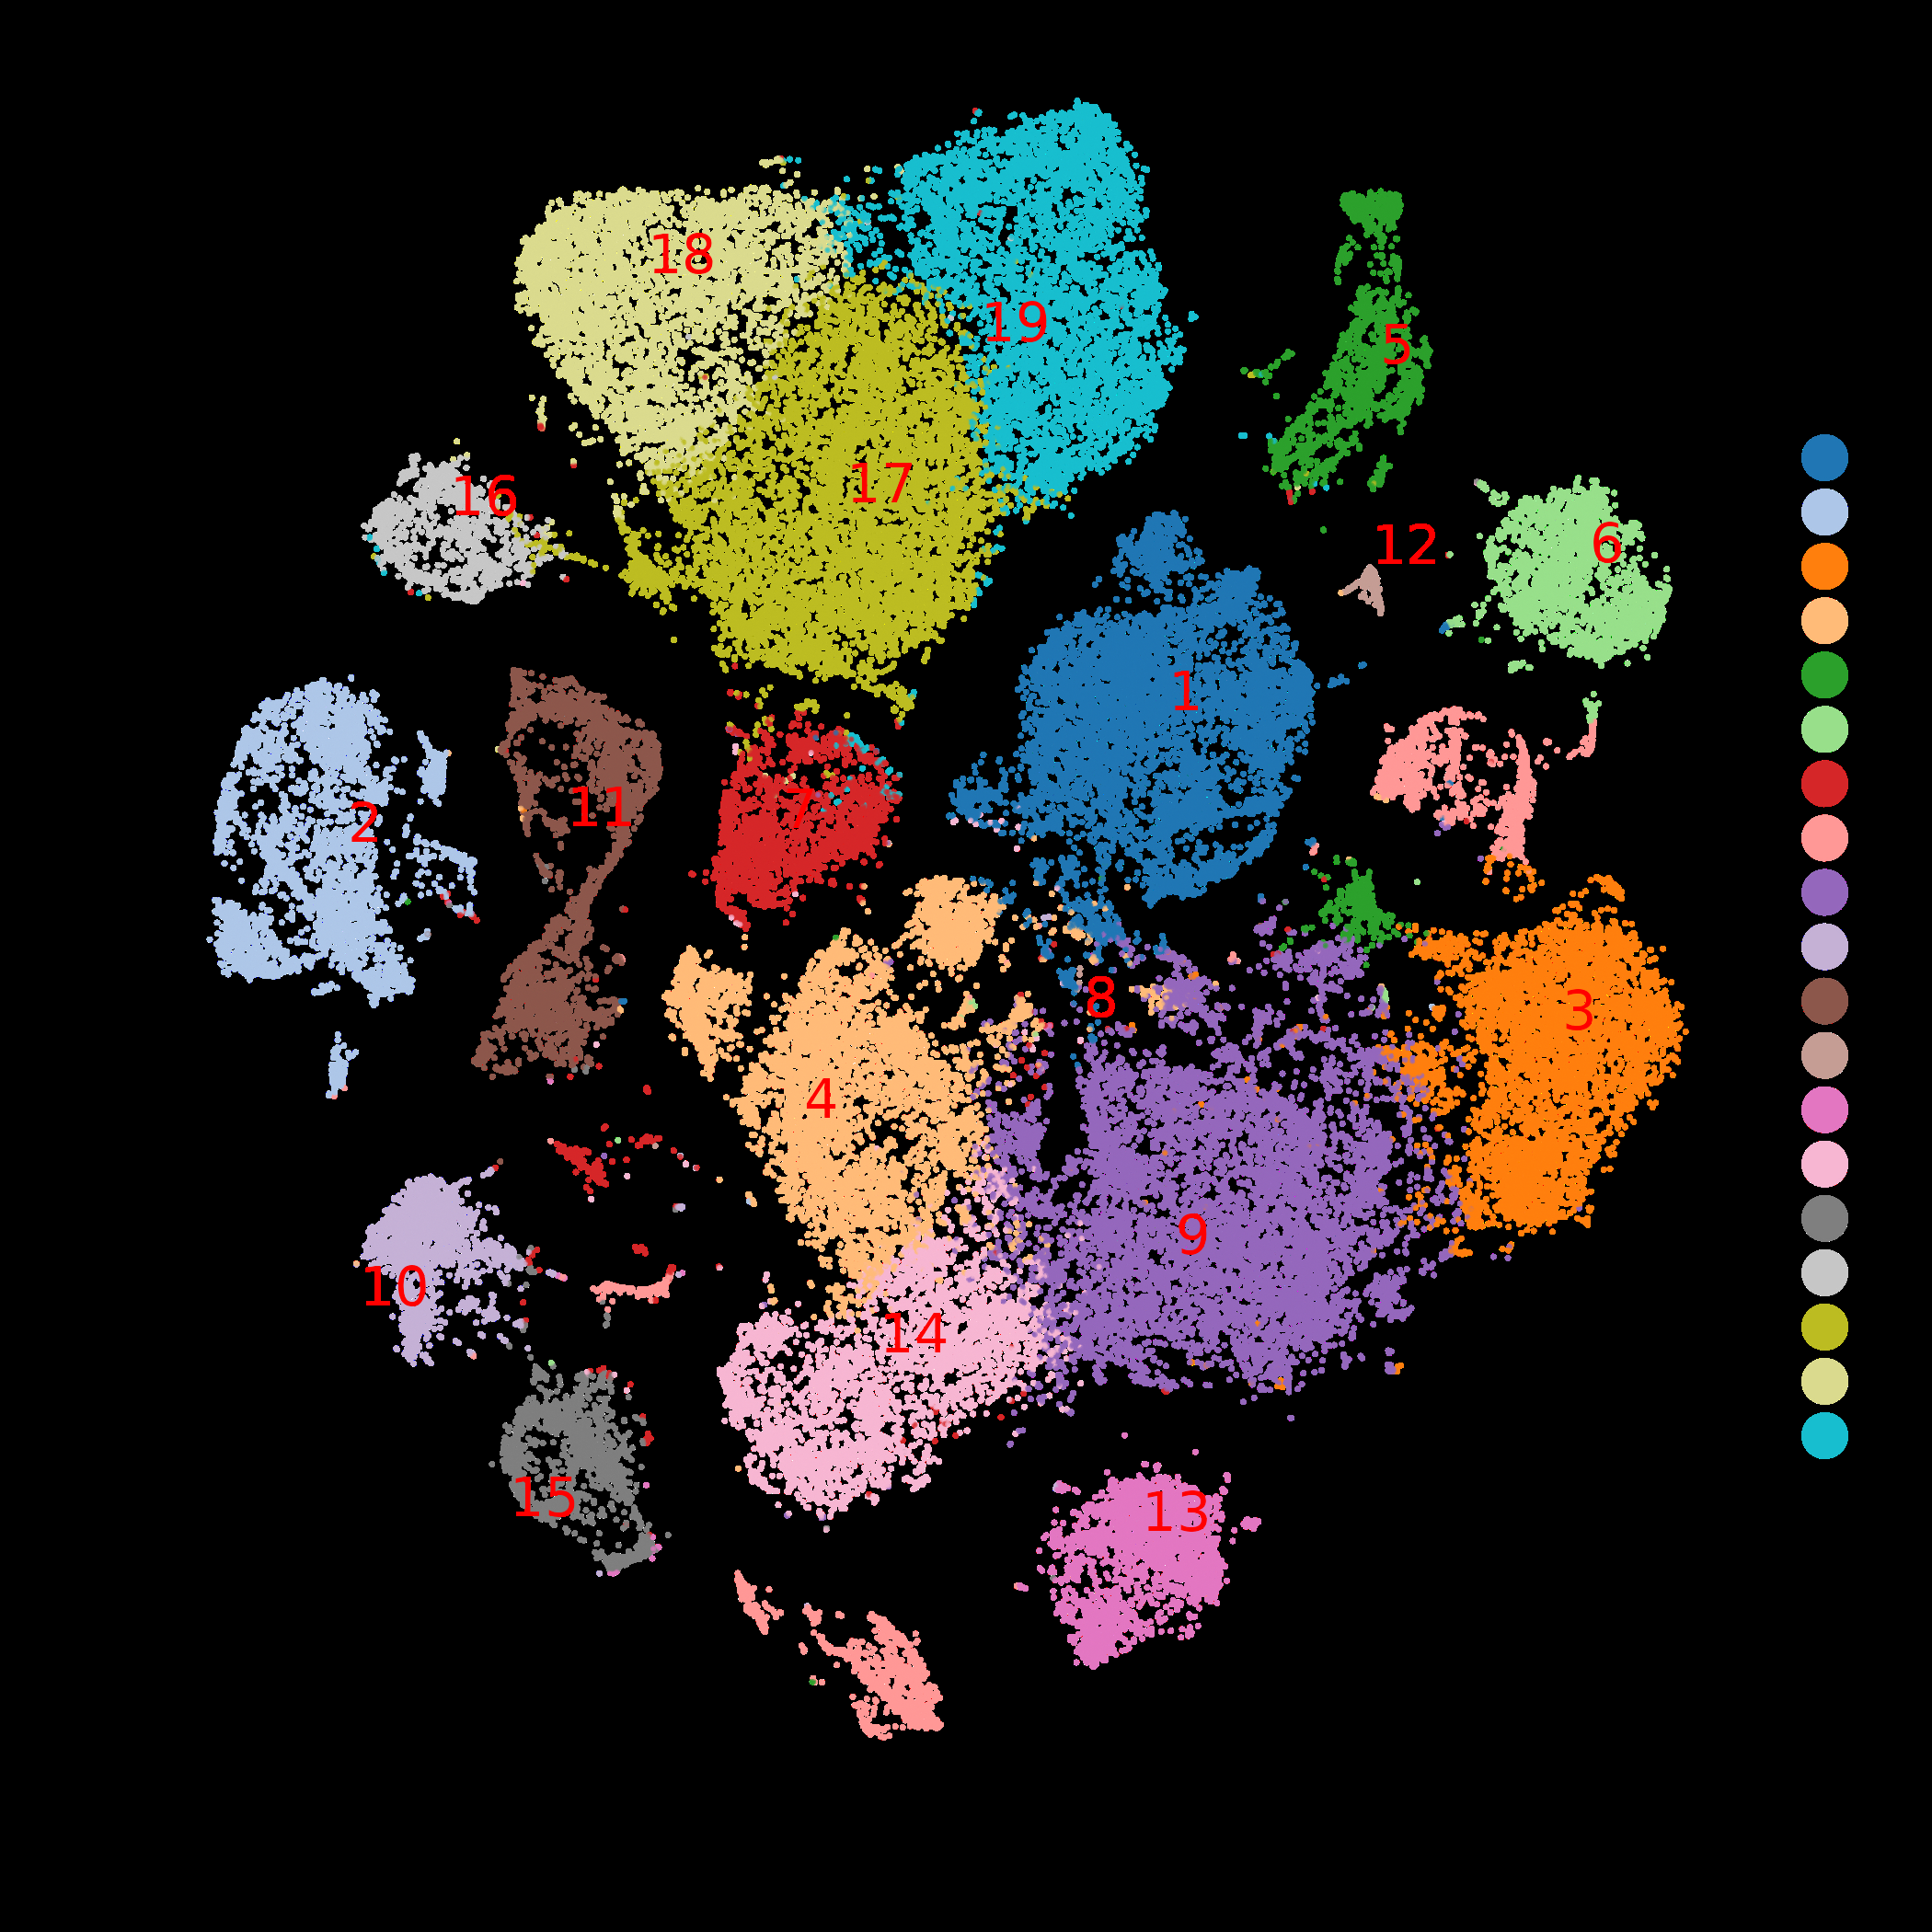
Fig.1.
Fibroblasts (migrating)
Mesonephric cells
Granulosa cells (migrating)
Granulosa cells
Oogonia/oocytes
Endothelial cells
Primordial germ cells (migrating)
Erythrocytes
Pre-granulosa cells (migrating)
Leukocytes
Hemopoietic stem cells
Mesonephric podocytes
Macrophages
Pre-granulosa cells (mitotic)
Immune cells (migrating, mitotic)
Spermatocytes (cytokinetic)
Male germ cells (migrating)
Spermatocytes (apoptotic)
Spermatocytes (GPCR-activated)

Slide 2
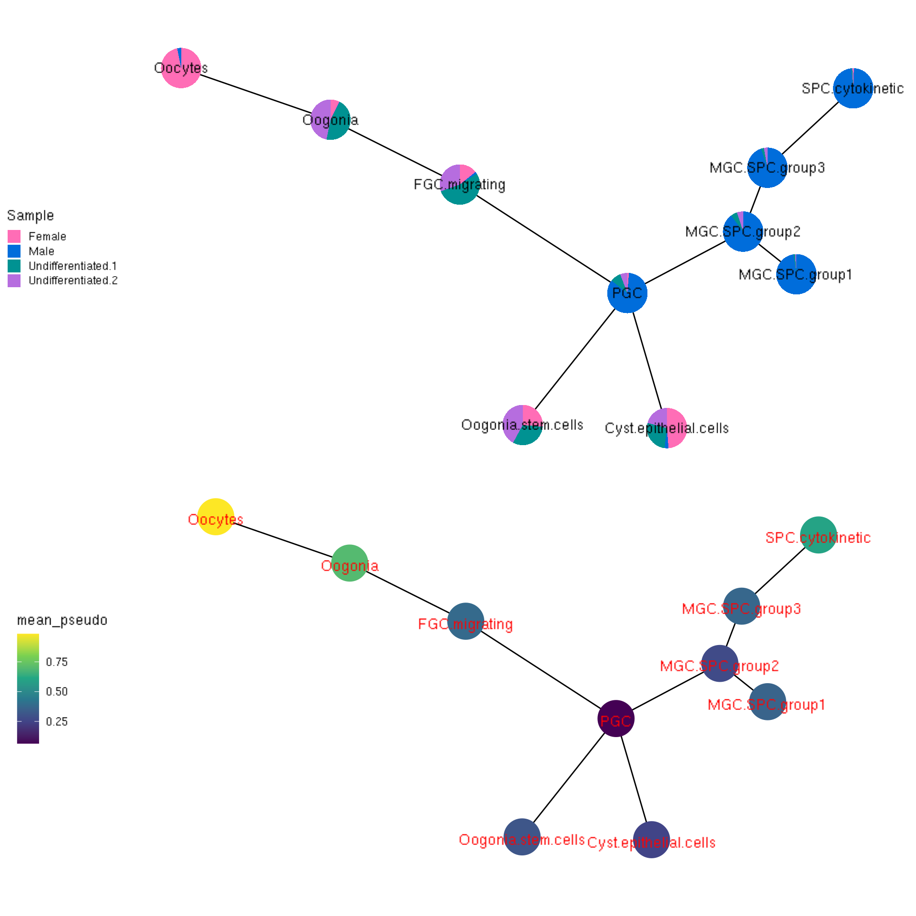
Fig.2.

Slide 3
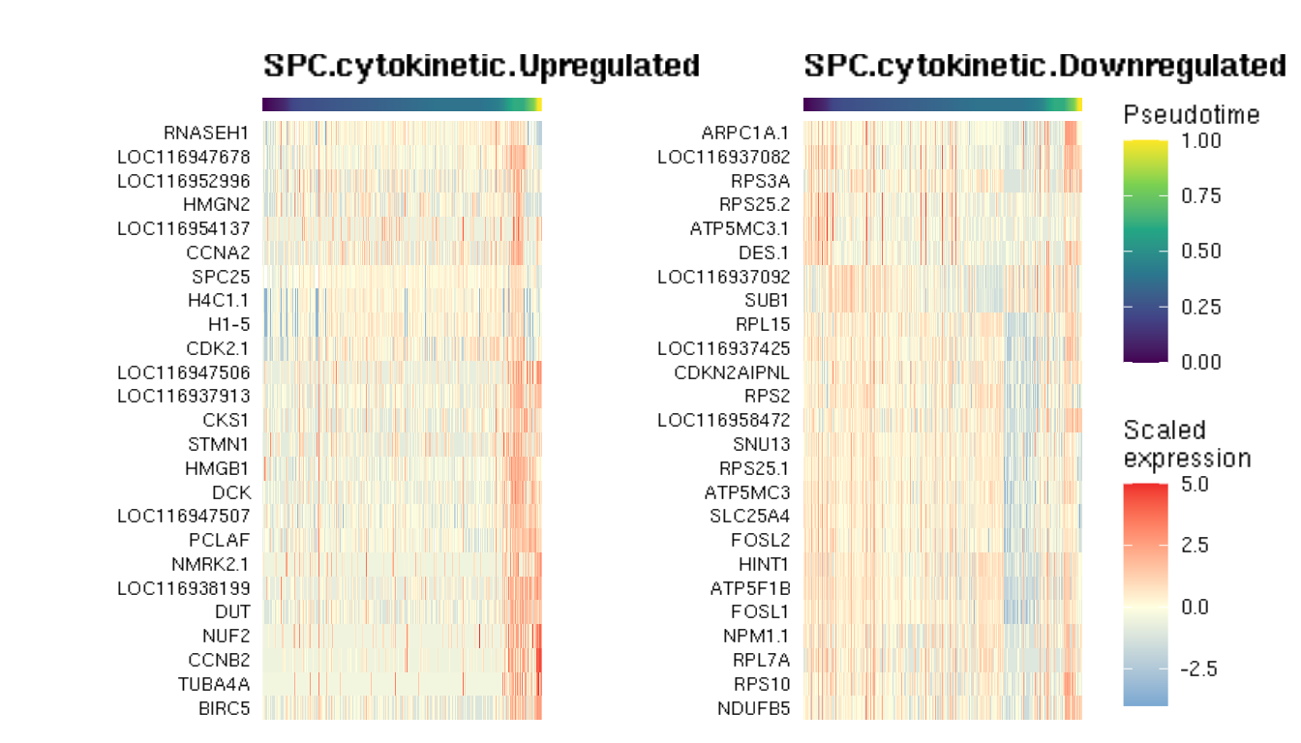
Fig.3.

Slide 4
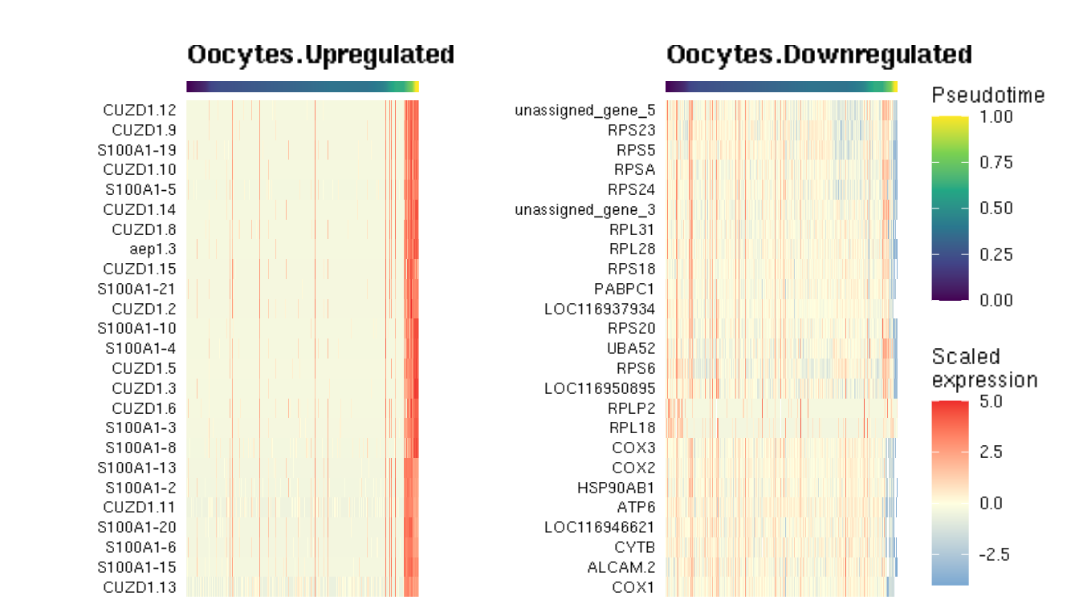
Fig.4.

Slide 5
Working hypothesis for sea lamprey germ cell development
Fig.5.
Lipopolysaccharide
↑TNIP3
Nitrogen starvation
↑GABARAPL2
Heat
↑HSPBB
Circadian & lipid/glucose metabolism
↑NR1D2
Insulin-like growth factor signaling
↑IGFBP7, IGFBPL1
Iron ion transport & oxidative stress
↑FOSL1, FOSL2, FTH1, JUN
↑HSPA8, HSP90AA1, HSP90AB1,HSPBB
↑SPARCL1, PRDX2, PTMA
Integrin-mediated signaling
PGC
Oogonia cyst
Cell migration
↑EPDR1, HSPA8, HSP90B1
↑ID2, MCL1, NPM1, RHOA, TP73
Cell migration
↑AEP1, CUZD1, FOSL1, GPR1
↑LAMB2, PTMA, S100A1, ZP4
↑WNT7B
↑PIWIL1
Cell fate commitment
↑ANP32A, BOLL, HSPA8
↑HSP90AB1, HSP90B1
↑NLRP3, PIWIL11, SYCP3, TP73
↑WNT5A, WNT5B
MGC
MGC
FGC
Cell fate commitment
↑AEP1, CUZD1
↑S100A1, WNT5B
↑ZP2, ZP3, ZP4
↑EPDR1, FEM1B
↑ NLE1
Iron ion transport
↑ADGRL3, BOLL, CBX1, FTH1
↑HSPA8, HSP90AB1, HSP90B1
↑RACK1, SYCP3, TP73
↑WNT5A, WNT5B
S-phase
spermatocyte
Oxidative stress
↑BCL2, CYP8B1
↑EPDR1, EFM1B
↑GPX, NLE1
Oogonia
Meiosis arrested
spermatocyte
Oxidative stress
↑AEP1, CCNB2, CUZD1, S100A1
↑GPX4, ZP2, ZP3, ZP4
meiotic
spermatocyte
NOTCH signaling
Oocyte
↑CCNA2, CCNB2
↑CDK2, CDK6
↑PIWIL1, PLK1
cytokinetic
spermatocyte
Apoptotic
spermatocyte
WNT signaling

