Slide 1
04 Oct 2020
Logan St. Cyr
Lucas Nieddu
Justin Figueredo

Slide 2
Management
Budget Proposal Approved by one Dr. Beaty
Research of potential sensors completed, sensors ordered
Reevaluating our next sprints to be ready for launch
Integration of Interface Control Documents, Functional Block Diagrams, and the Payload Diagrams are next priority
Met with AES 1050 class for research and potential recruiting for stretch goals

Slide 3

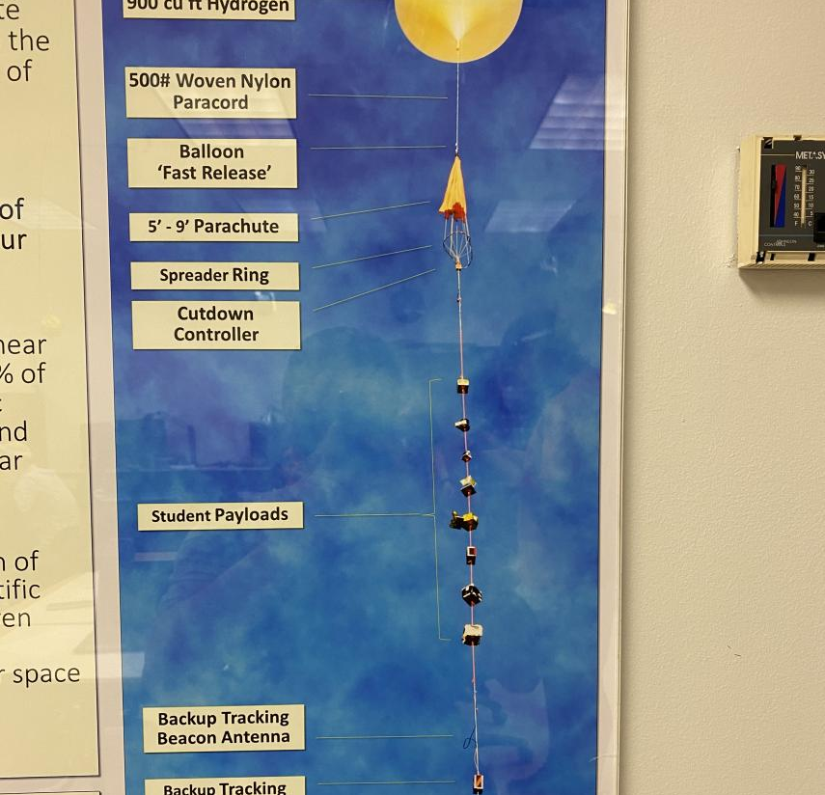
Up in the Air

Slide 4
Library integration for RFD300x MAV sdk– Justin

Slide 5
Docker compose and data management- Lucas

Slide 6

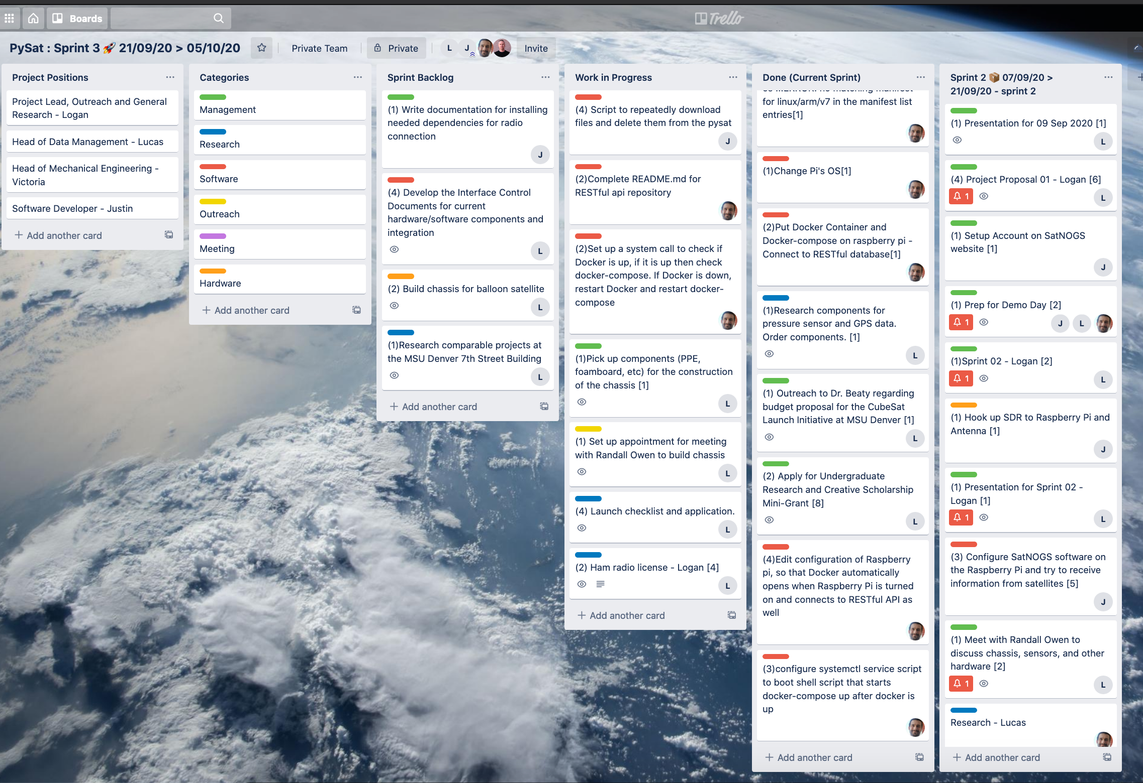
Trello Board

Slide 7
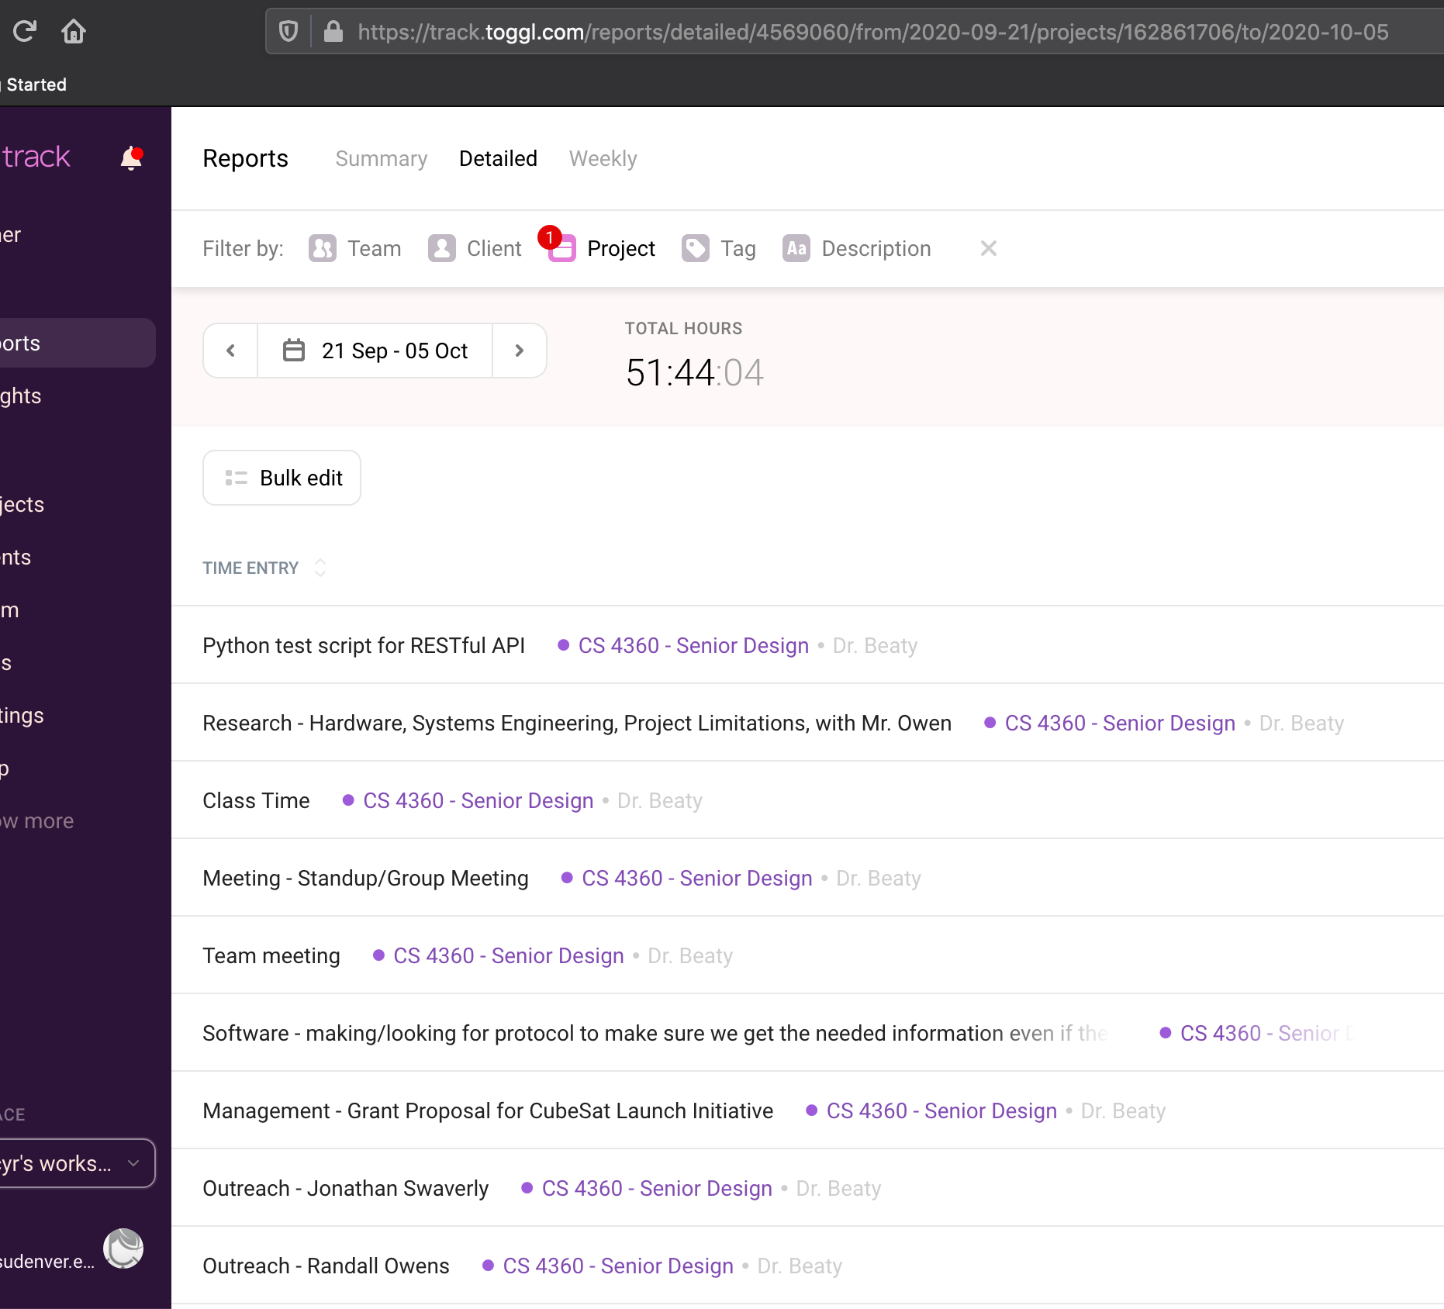
Toggl Track

Slide 8
Next Steps
Design of thermal testing for the system during flight
Complete Functional Block Diagrams for hardware components
Submit proposal for flight to EOSS prior to 21 Oct 2020 for launch approval
Design chassis without heaters to ensure the transmitter continues to function based upon the parameters of the launch

