Slide 1
CS 4360: CubeSat Presentation
Logan St. Cyr
Justin Figueredo
Victoria Crowley

Slide 2
Previous Sprint
Integrate all sensors to include GPS, altitude, pressure, and internal temperature
Battery test payload for the total launch time and test
Launch, tracking, recovery and data collection (woohoo!)
Analyze data based upon the recovered payload

Slide 3
Current Sprint
Cleanup of old stories
Major Goals
Research Antenna and tracking for CubeSat (due to failure during the flight test)
Recalculate Link Budget (increased receiver sensitivity, increased power dependent upon the FCC regulations)
Develop the Interface Control Documents for current hardware/software components and integration
Where do we go from here?
Communication with AIAA has increased to meet the goal of establishing systems that can assist in meeting the team’s stretch goals
Using a plasma cutter or laser cutter to build out the model chassis

Slide 4
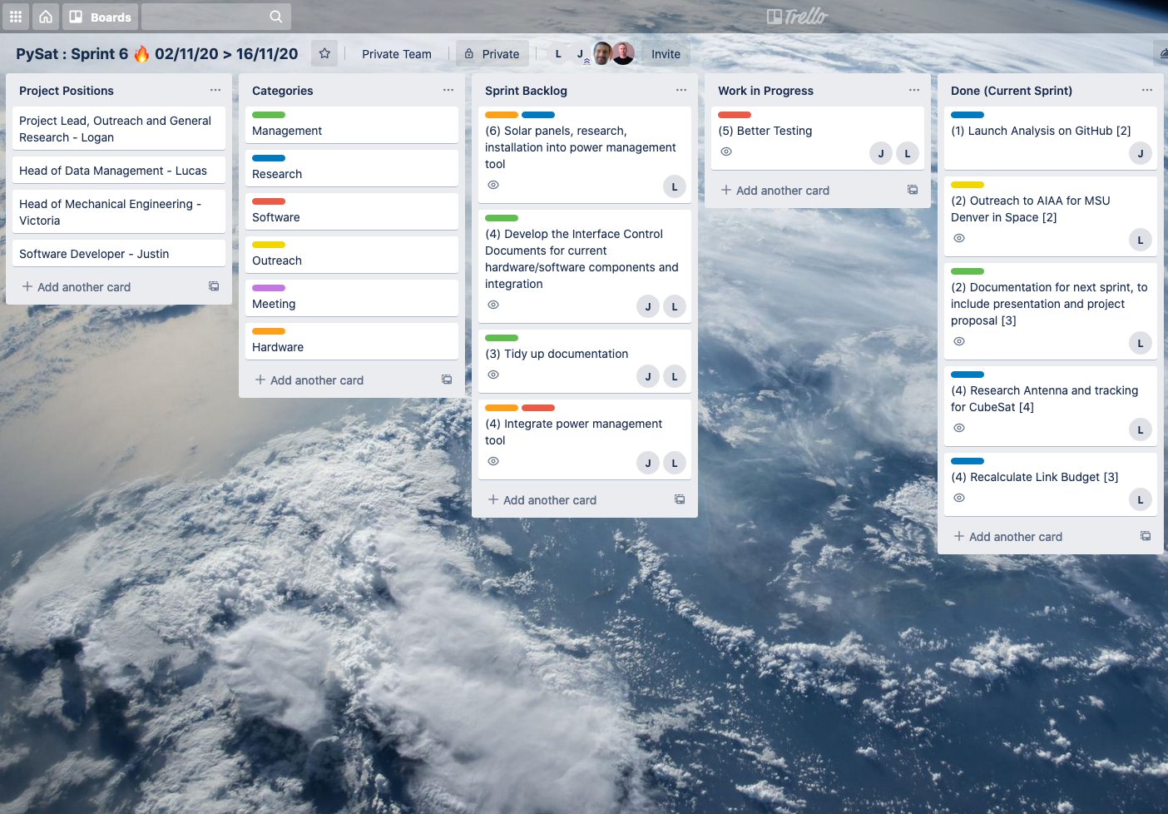
Trello Board
Moved some items from the backlog to the work in progress
Reevaluated the shortcomings of our previous flight and recalculated the link budget and the sensitivity of our antenna
Mainly covered the cleaning up of unfinished taskings

Slide 5
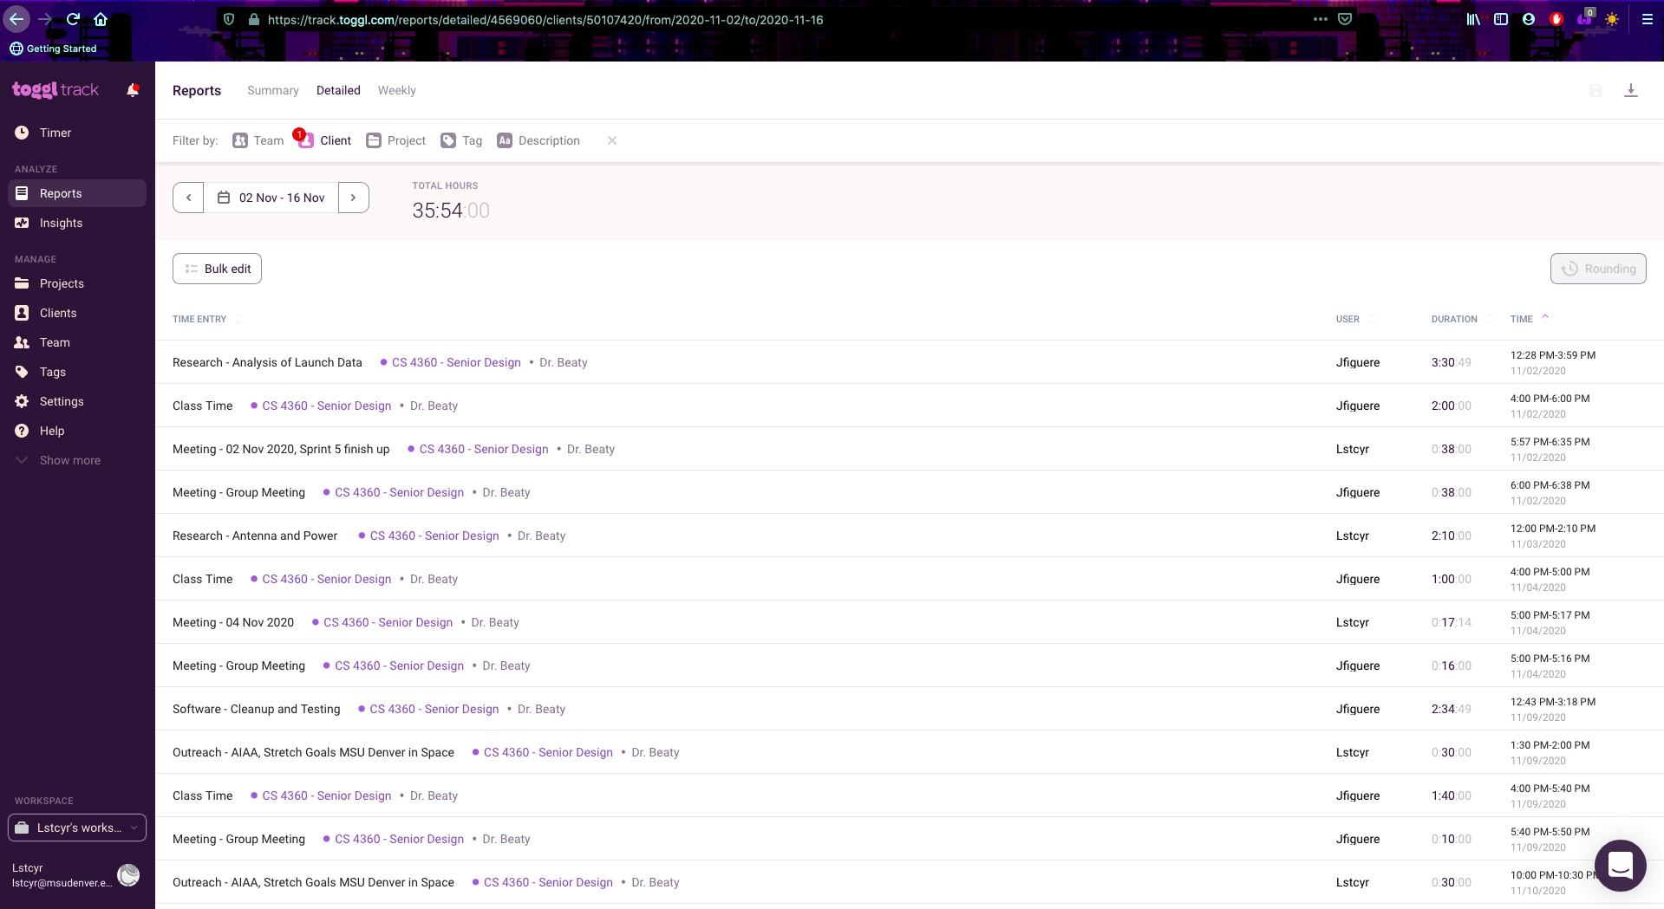
Toggl Hours
Much of our time was taken up coding together, or doing independent research to determine what our next sprint goals should be
Shorter hours for this past sprint due to a reduction in team members and health challenges at home

Slide 6

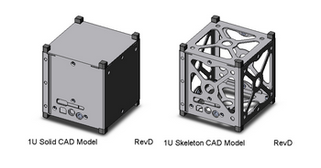
CAD Designs and Fitting of internal Components
Victoria Crowley is currently procuring the metal for us to build a simple 1U CubeSat
The exact material will be dependent upon our budgetary restrictions; however the primary purpose of this is to design and test potential payload configurations along with the planned components for the CPU, radio, and battery components

