Slide 1



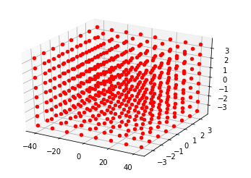
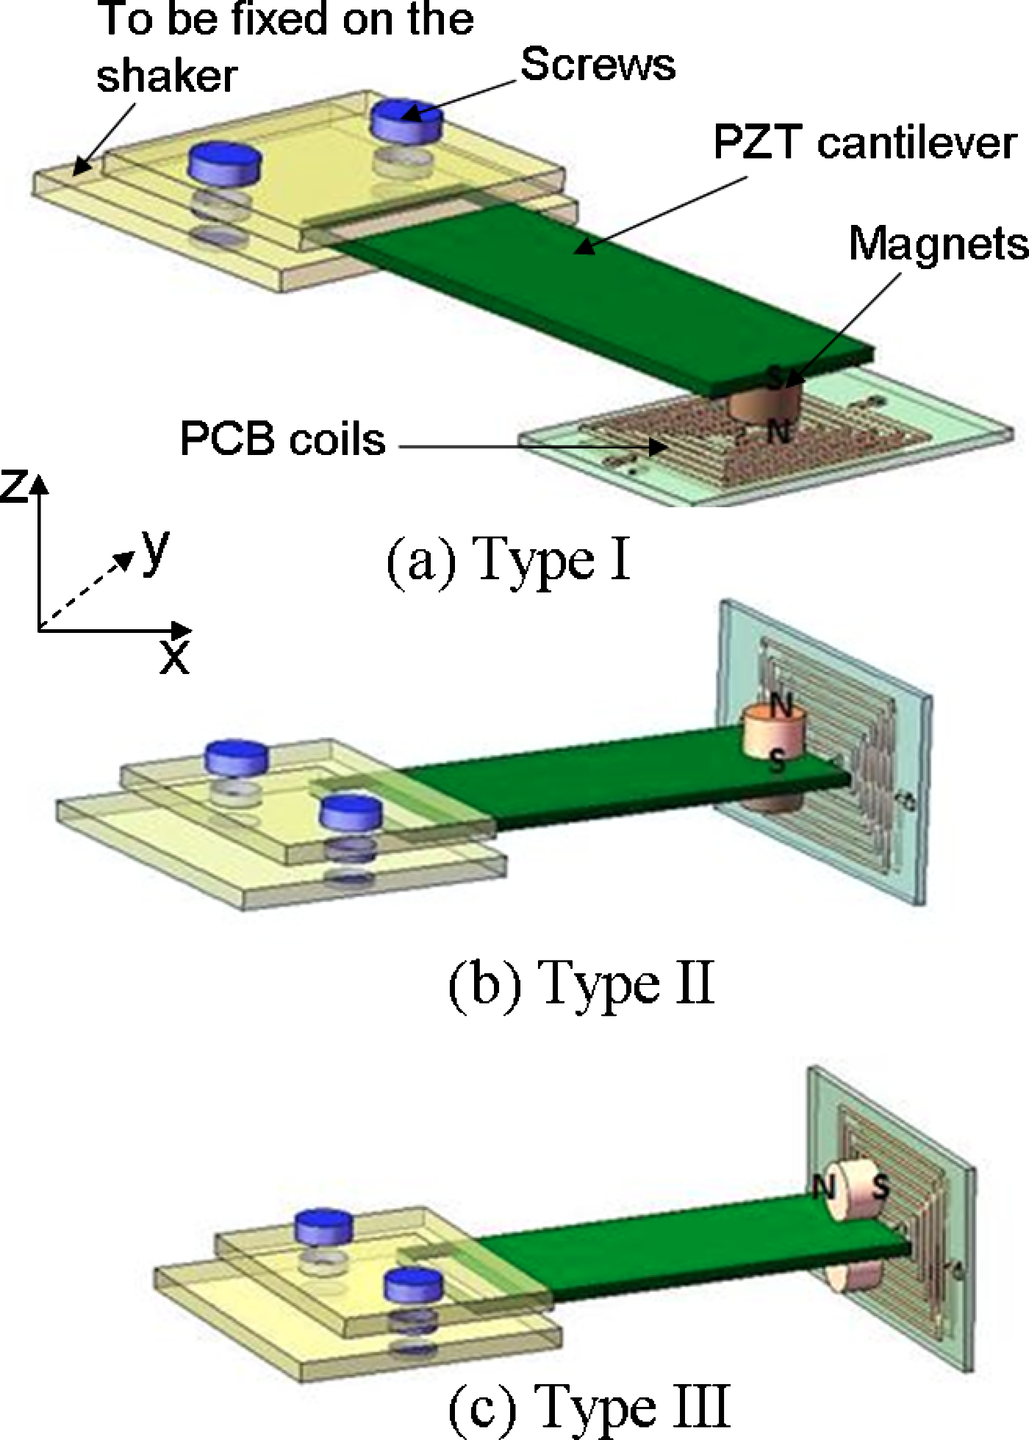
A Computational Model of the Piezoelectric Effect
Joshua Milem¹ and Anna Turnbull^{1,2}
¹Laboratory for Hybrid Quantum Systems, Department of Physics and Astronomy, Michigan State University, East Lansing, MI 48824
²Lyman Briggs College, Michigan State University, East Lansing, MI 48824
Piezoelectric Effect – What is it?
Computational and Theoretical Model of Piezoelectric Materials
Computational Model
Theoretical Model
Original figure of piezoelectric effect in picture form because the internet sucks (compression = voltage, voltage = compression)—IN PROGRESS
The Tools: Monte Carlo Simulation (hoomd)
Output of Code Initially (No E applied) – A lattice of particles representing the crystalline structure & Energy stored in lattice vs. time plot
Derivation of equations that describe piezoelectricity and what they mean
Creating a Lattice of Interacting Atoms
Motivation in SAW and LiNbO₃
Pieces of our code will be used in our description of our model all in this column
Output of Code Shortly after E field applied (several hundred counts) – Initial Lattice Deformation & Energy Plot – IN PROGROSS
SAW pic from Johannes or Justin—IN JP’S THESIS?
Uses of Piezoelectric Crystals
Applying an Electric Field and Seeing a Change
Piezoelectric Energy Harvesting Devices, sensors, etc
Output of Code a while after E field applied (a thousand counts) – Visible Lattice Deformation & Energy Plot – IN PROGRESS
Problems with the Model
References

