Slide 1
Azure Cosmos DB Workshop
Subtitle or speaker name

Slide 2



Why are we here?
Learn
Various techniques to modernize applications with Azure Cosmos DB
Challenge
Try out challenging hands-on activities
Expand
Expand our skillset with different features of Azure Cosmos DB

Slide 3
How to be successful
Work together! If everyone is hands on, things move quicker
Collaborate with other teams
Read, re-read, and then read the challenges again
Ask why not? There's always more than one way to solve the challenge

Slide 4
Agenda
09:00-09:15 Welcome
09:15-09:30 Overview
09:30-10:00 Review Challenge
10:00-11:15 Migrate Challenge
11:15-11:30 Break
11:30-12:00 Cart Challenge
12:00-13:00 Lunch
13:00-14:00 Cart Challenge
14:00-15:00 Optimize Challenge
15:00-15:15 Break
15:15-16:30 Ingest Challenge
16:30-17:30 Scale Challenge
17:30-18:00 Review
Notes:
This is the full-day agenda

Slide 5
Agenda
09:00-09:15 Welcome
09:15-09:30 Overview
09:30-09:45 Review Challenge
09:45-10:45 Migrate Challenge
10:45-11:00 Break
11:00-12:00 Ingest Challenge
12:00-12:45 Scale Challenge
Notes:
This is the half-day variant of the agenda

Slide 6
Logistics
SSID
Azure Accounts/Lab Environment
Venue
Meals

Slide 7
Microsoft Event Code of Conduct
Microsoft’s mission is to empower every person and every organization on the planet to achieve more. This includes at Microsoft Migration dry-run where we seek to create a respectful, friendly, and inclusive experience for all participants. As such, we do not tolerate harassing or disrespectful behavior, messages, images, or interactions by any event participant, in any form, at any aspect of the program including business and social activities, regardless of location.
We do not tolerate any behavior that is degrading to any gender, race, sexual orientation or disability, or any behavior that would violate Microsoft’s Anti-Harassment and Anti-Discrimination Policy, Equal Employment Opportunity Policy, or Standards of Business Conduct. In short, the entire experience at the venue must meet our culture standards.
We encourage everyone to assist in creating a welcoming and safe environment. Please report any concerns, harassing behavior, suspicious or disruptive activity to the nearest security guard or show staff. Microsoft reserves the right to refuse admittance to, or remove any person from OpenHack at any time, in its sole discretion.

Slide 8
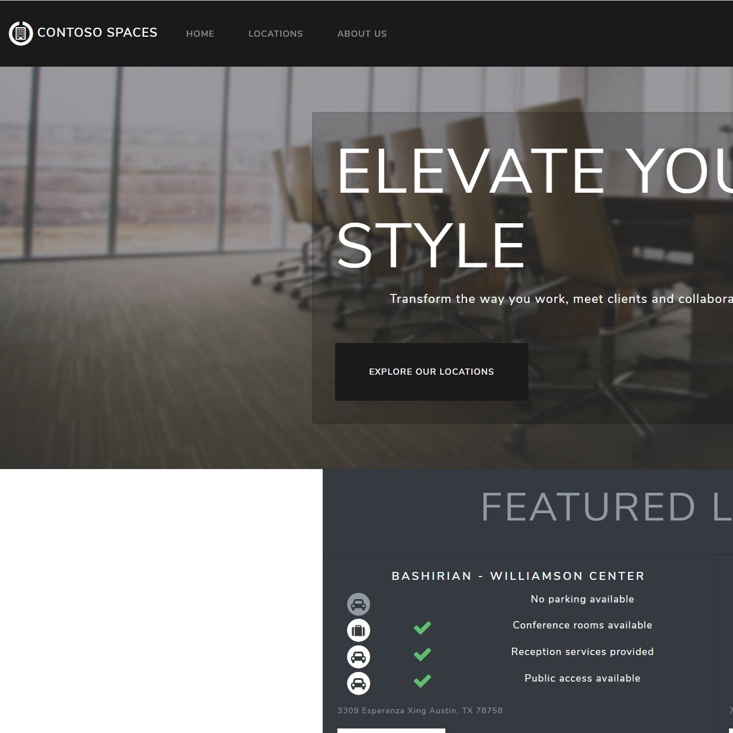
Contoso Spaces

Slide 9
Contoso Spaces
Start-up company
Rents office spaces for entrepreneurs in general Seattle area
Got to market quickly
Hired a consulting firm
Built their applications with the latest versions of .NET
Used SQL Server for their database
Migrated to Azure PaaS services last year
Azure SQL Database
Azure App Service

Slide 10









Current Solution in Azure Diagram
App Service Plan
SQL Server

Slide 11
Technology Stack
Web Applications .NET Core 3.0
API Services .NET Core 2.1
Libraries .NET Standard 2.0
Database Technology SQL Server
Source Control GitHub
Web application | Docker seesharprun/contoso.spaces.web
API application | Docker seesharprun/contoso.spaces.web

Slide 12
Technology Notes
All data access is done in the API tier
Eliminates the need to update the web application regularly
Web and API application code is available as a Docker container
Makes it easier to scale
Database is very traditional and highly normalized
Used common RDBMS practices
Source code is available on GitHub
Review workshop notes

Slide 13
Database Architecture
dbo.Rooms
Column | Type
Id | int, PK
Description | nvarchar(max)
MonthlyRate | decimal(18,2)
Seats | int
PrivateFacilities | nvarchar(max)
PhoneIncluded | nvarchar(max)
Windows | datetimeoffset(7)
Corner | bit
LocationId | int, FK
dbo.Locations
Column | Type
Id | int, PK
Name | nvarchar(max)
Longitude | float
Latitude | float
MailingAddress | nvarchar(max)
Image | nvarchar(max)
LastRenovationDate | datetimeoffset(7)
ParkingIncluded | bit
ConferenceRoomsIncluded | bit
ReceptionIncluded | bit
PublicAccess | bit
dbo.CartLocation
Column | Type
Id | int, PK
CartId | int, FK
LocationId | int, FK
dbo.Carts
Column | Type
Id | int, PK
UserId | int

