Slide 1
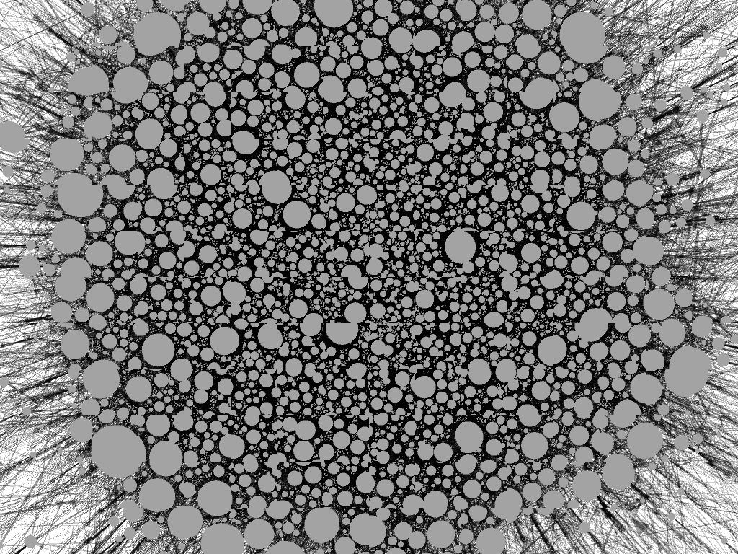
TNDY-336 Final Project
Unraveling HIV Transmission Networks: A Social Network Analysis Approach using ICPSR 22140 Data

Slide 2

Our Team
Group Multiplexity
Kaijie “Yuri” Yu
Ahmad Alasmari
Edward Segura-Tinoco
Denise Escarcega
Ghurdan Alghureid

Slide 3




Tools Utilized in Our Analysis
Python
Versatile programming language
Used for data preprocessing, cleaning, and manipulation
Stata
Powerful statistical software
Employed for data analysis and visualization
RStudio
Integrated development environment (IDE) for R
Facilitated Social Network Analysis (SNA) and complex computations
Gephi
Open-source network visualization and exploration software
Enabled the creation of insightful graphs and visualizations for HIV transmission networks
Notes:
In this project, we used three tools to analyze and visualize the HIV transmission network data.
We began by using Python for data preprocessing, cleaning, and ensuring the dataset was ready for further analysis.
Stata was then employed to perform in-depth statistical analyses and generate visualizations to help us understand trends and patterns in the data.
RStudio, an IDE for R, allowed us to conduct Social Network Analysis, providing a unique perspective on HIV transmission networks.
Finally, we used Gephi to create visually engaging and informative network graphs, further illustrating the relationships and connections within the HIV transmission network.

Slide 4
Introduction
Project inspiration:
CDC STI transmission behavior: “Sexually Transmitted Disease Surveillance"
"Fracking and Risky Sexual Behavior"
“Social Context of Sexual Relationships Among Rural African Americans,” Sexually Transmitted Diseases
Previous Work:
Modeling HIV/STI transmission by methods of infection via sexual, social, needle, drugs
Project Goal:
Identify at-risk individuals by covariate subclassification for potential intervention plans/implementations to effectively target at-need populations
Future work:
Dynamic network evolution of transmission: the

Slide 5
8-Study Data Collection
Colorado Springs Project 90, 1988-1992
N = 595 respondent individuals
Age = 15 and older
Bushwick [Brooklyn, NY] Social Factors and HIV Risk (SFHR) Study, 1991-1993
N = 804 respondents
Age = 18 and older
Atlanta Urban Networks Project, 1996-1999
N = 228 respondents
Age = 19 and older
Flagstaff Rural Network Study, 1996-1998
N = 95 respondents
Age = 18 and older
Atlanta Antiretroviral Adherence Study, 1998-2001
N = 358 respondents
Age = 22 and older
Houston Risk Networks Study, 1997-1998
N = 126 respondents
Age = 18 and older
Baltimore SHIELD (Self-Help in Eliminating Life-Threatening Diseases), 1997-1999
N = 768 respondents
Age = 18 and older
Manitoba Chlamydia Study, 1997-1998
N = 2,120
Age = 10 and older

Slide 6
Data Limitations and Outcomes
Each study is different and does NOT survey identically
Missing values and different questions
Final data for analysis:
694 nodes and <2000 edges
Covariates:
Race, sex, age, behavior, disable, unemployed, street, education
Weighted network based on the frequency of duplicate sexual interactions

Slide 7
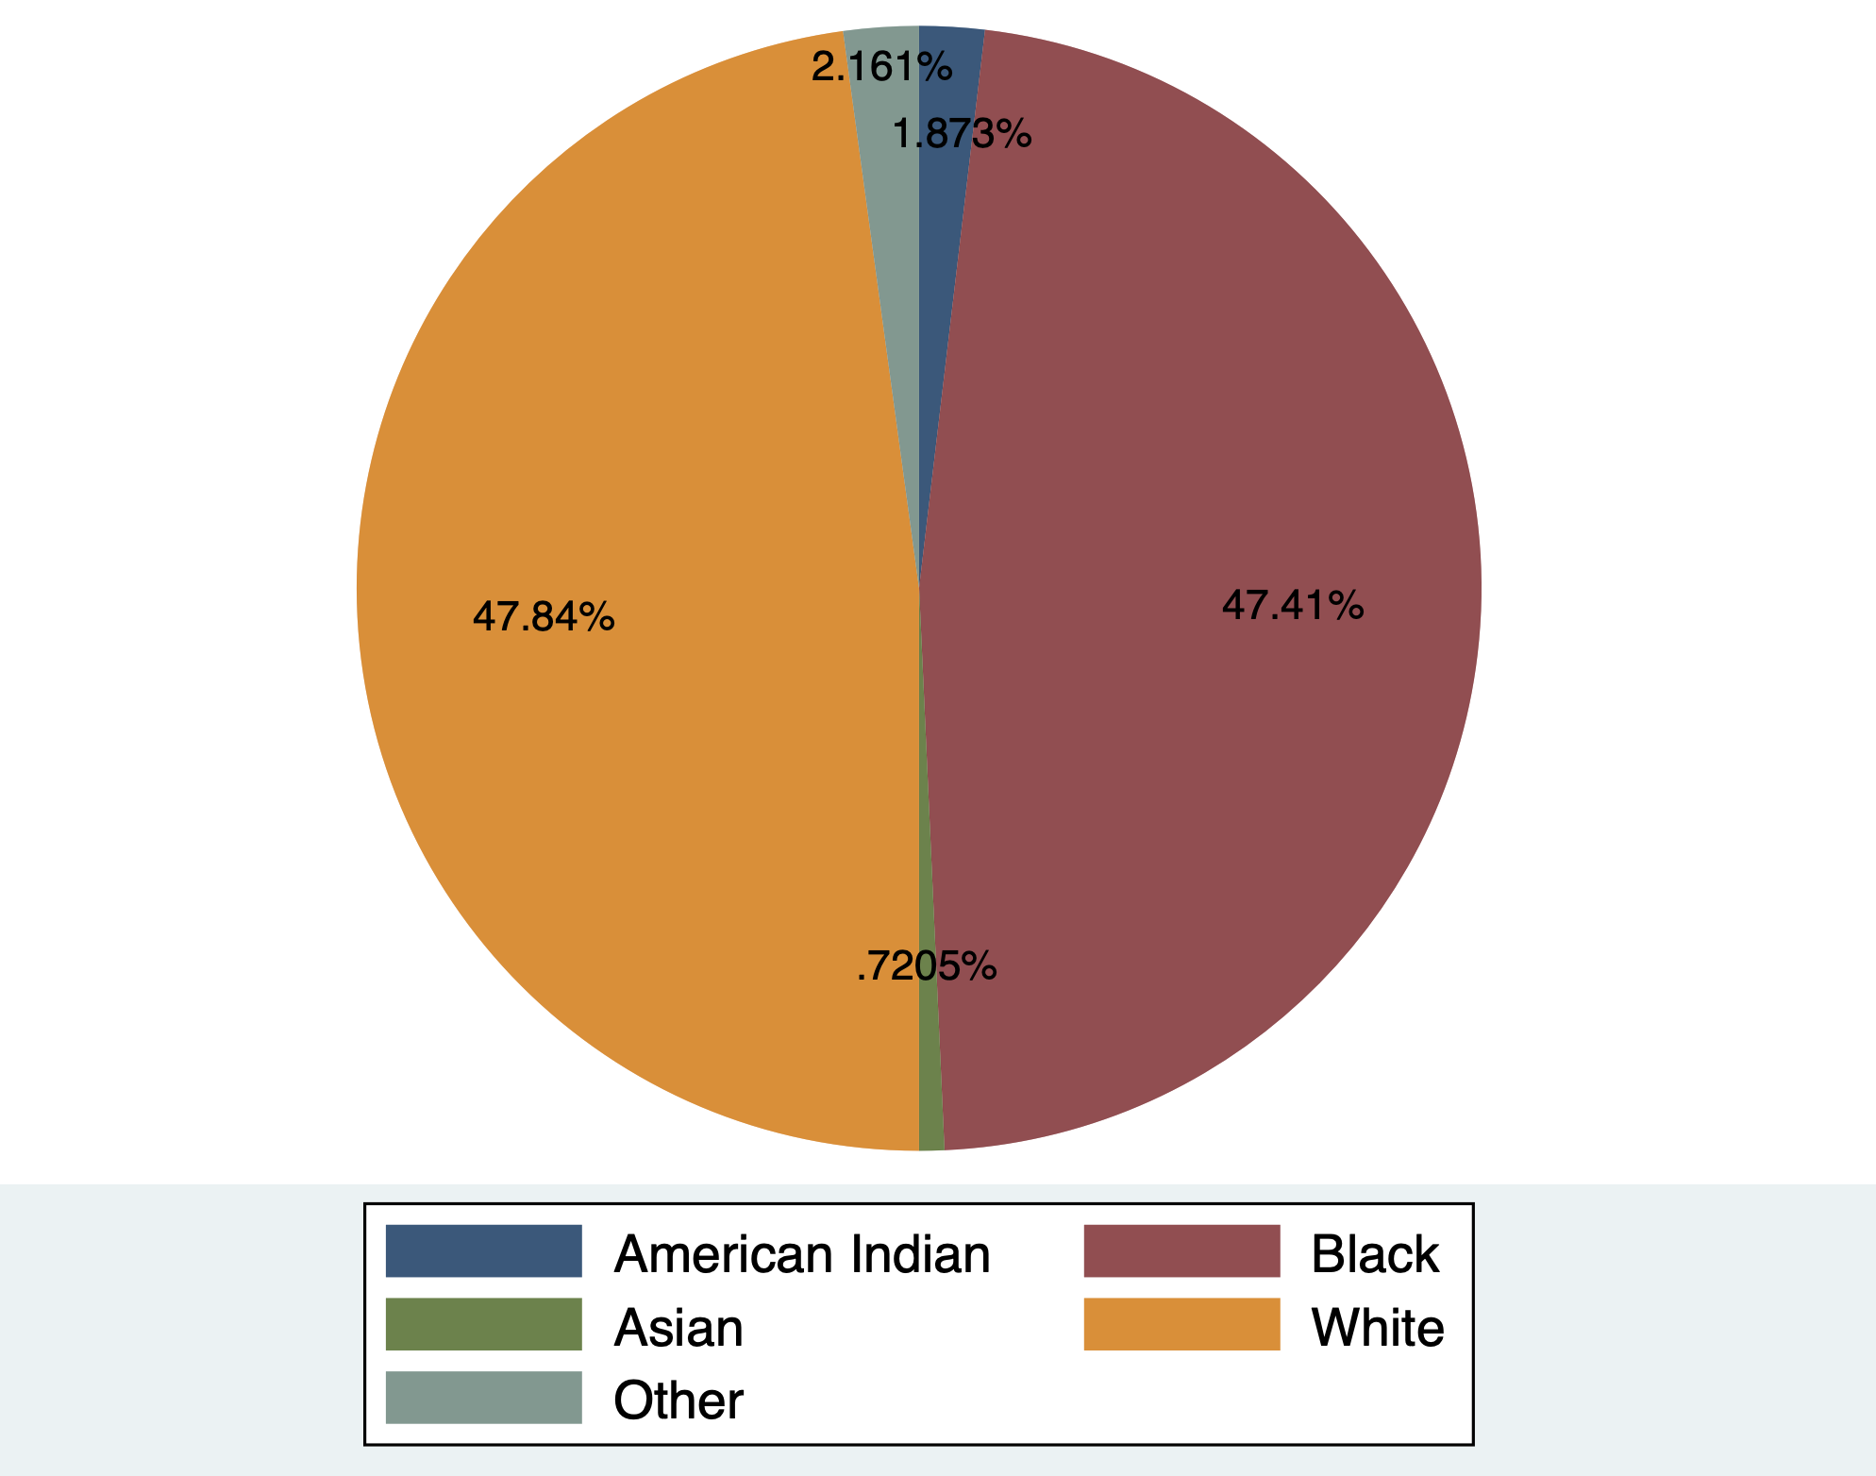
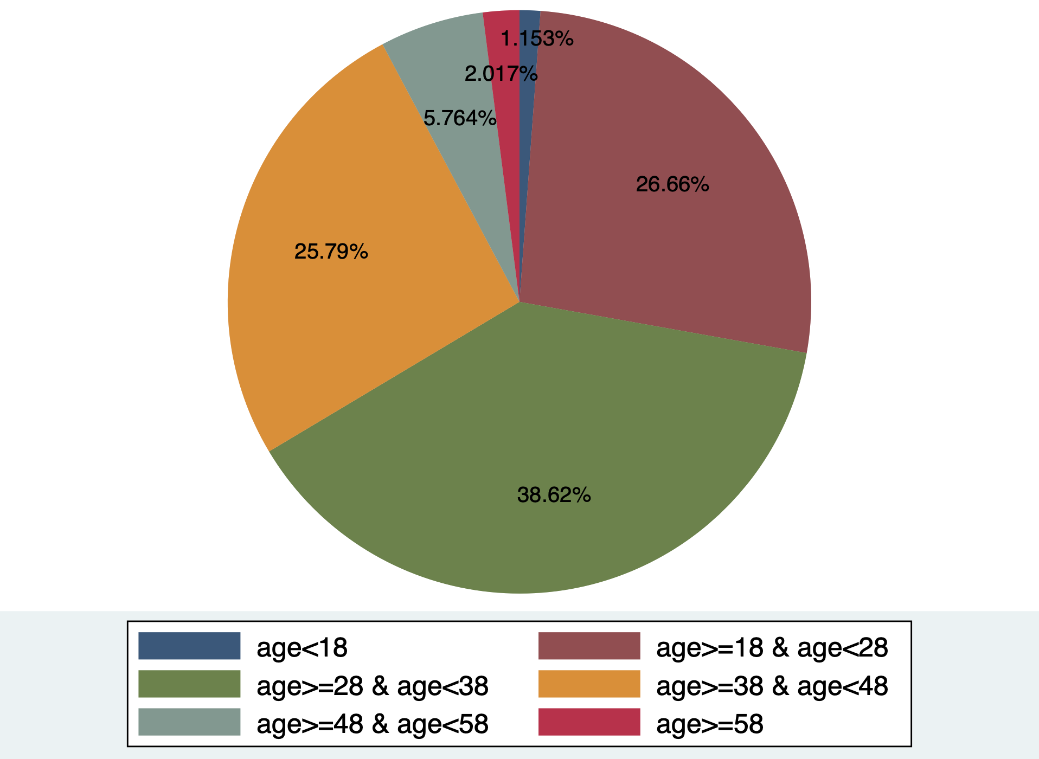
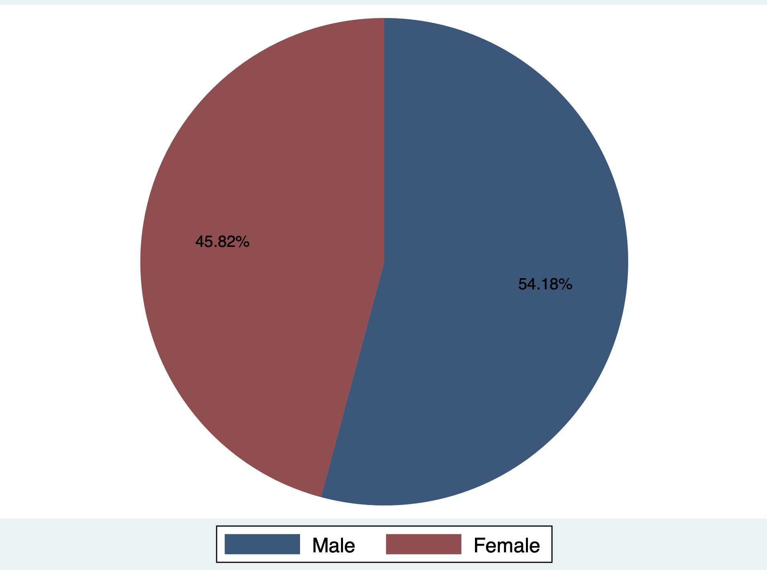
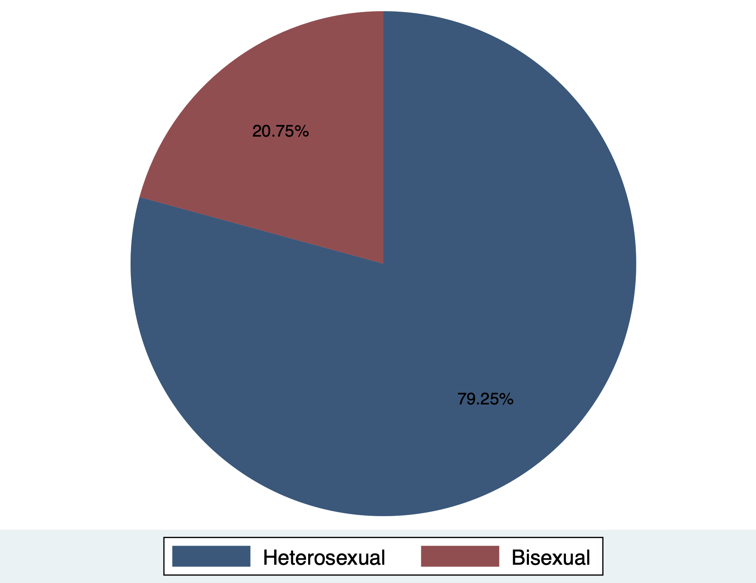

Slide 8
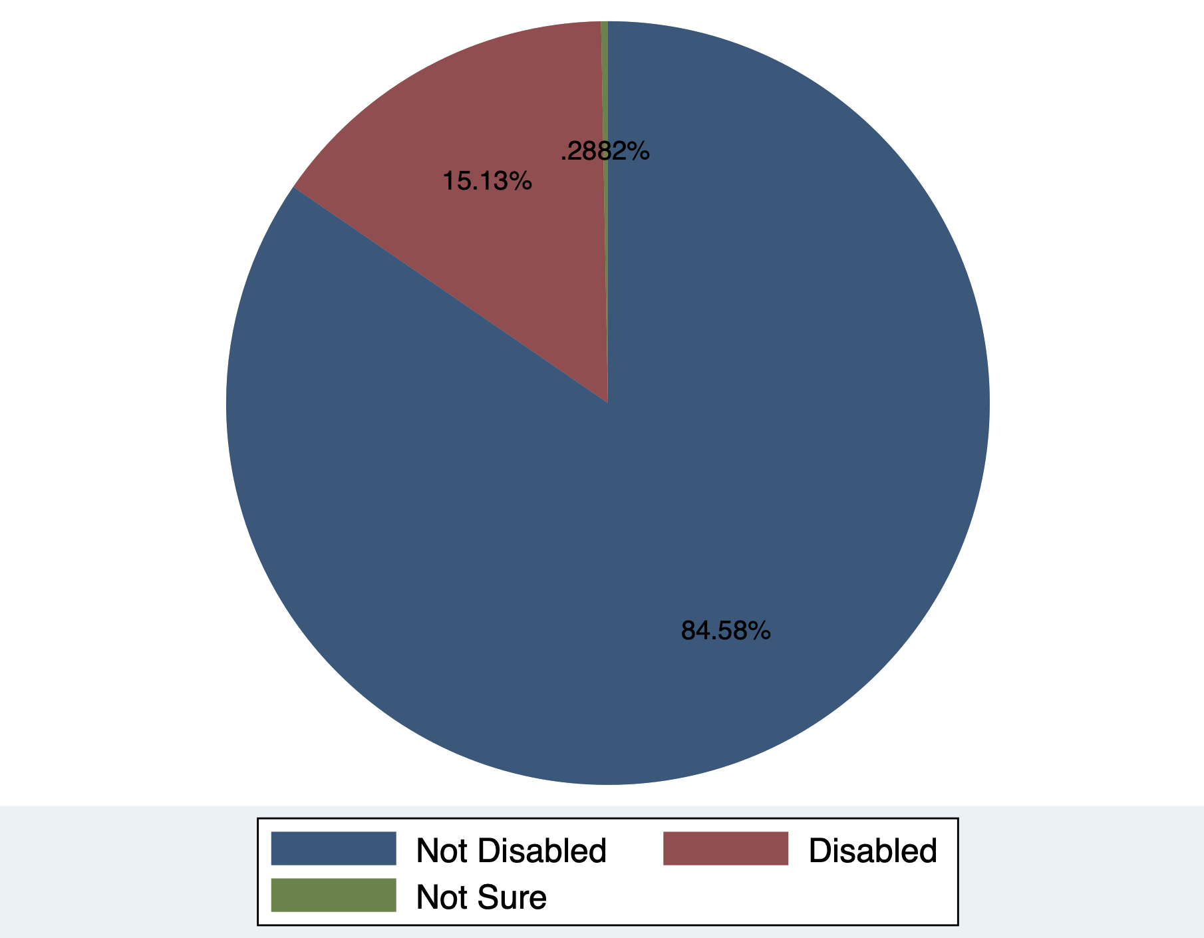
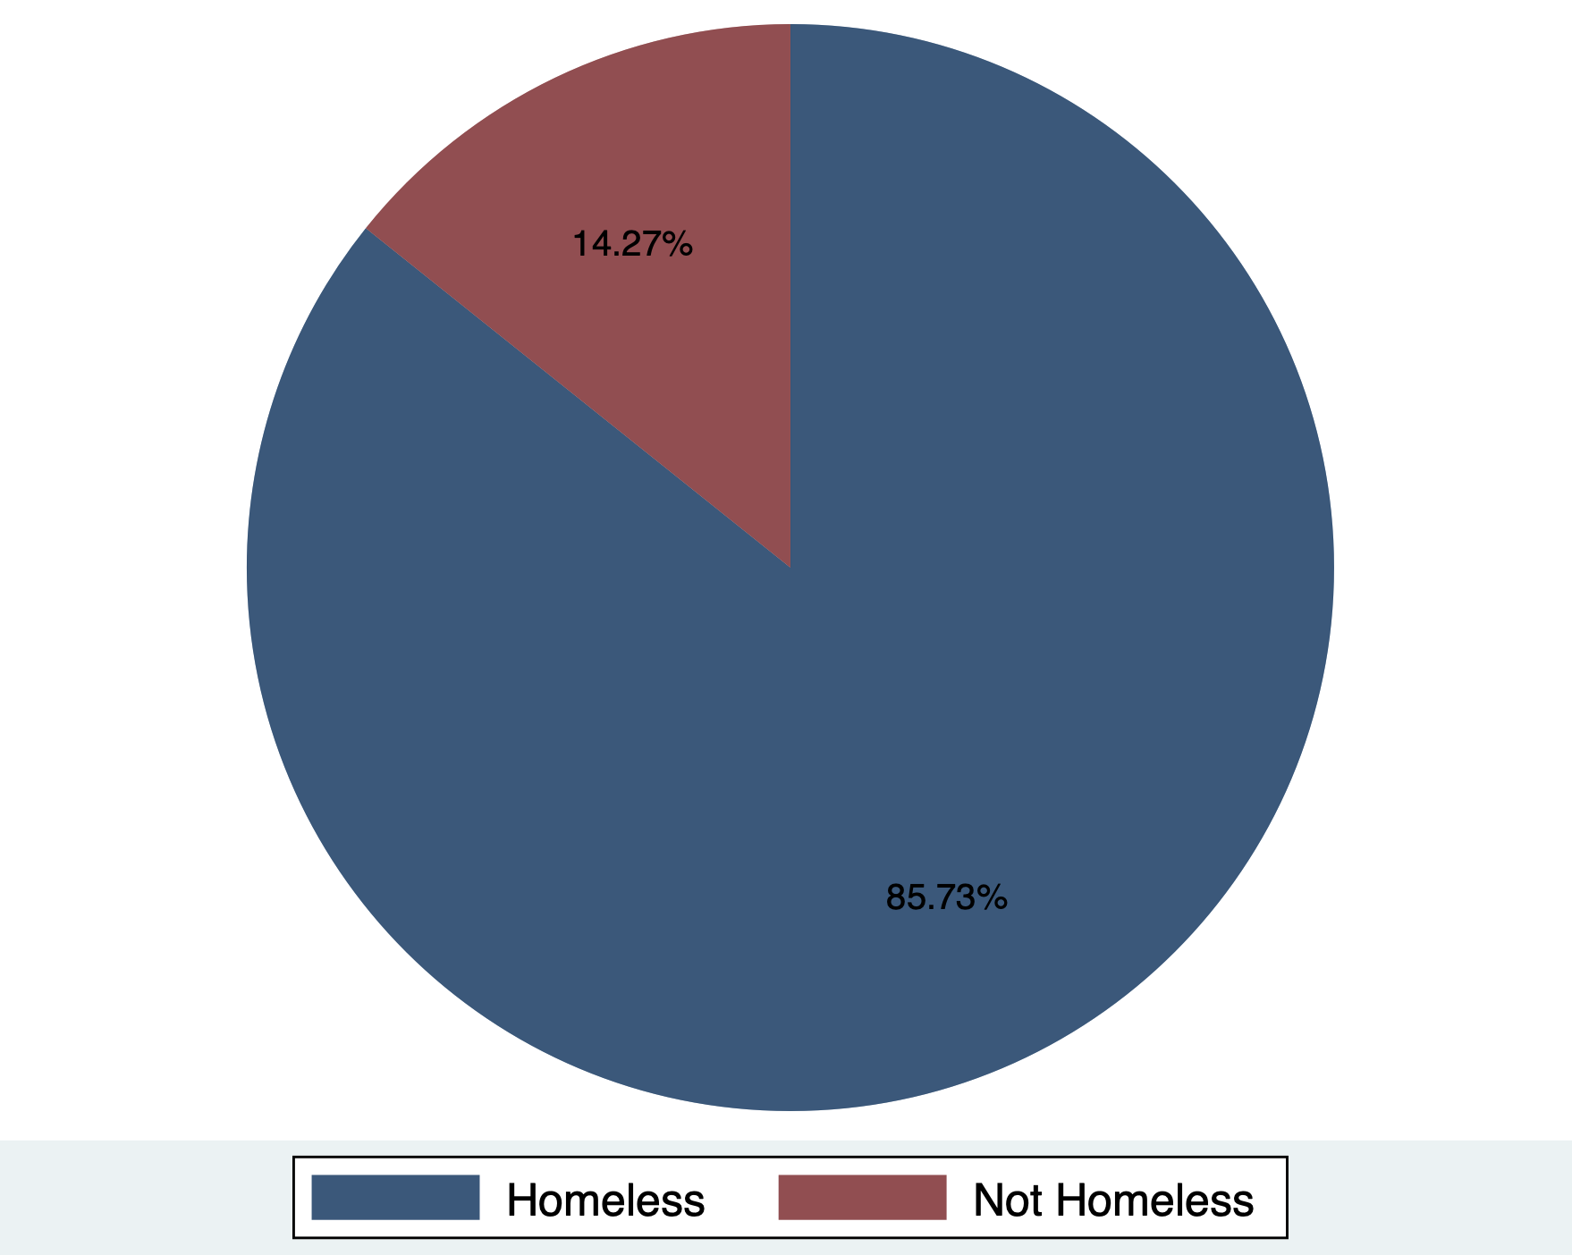
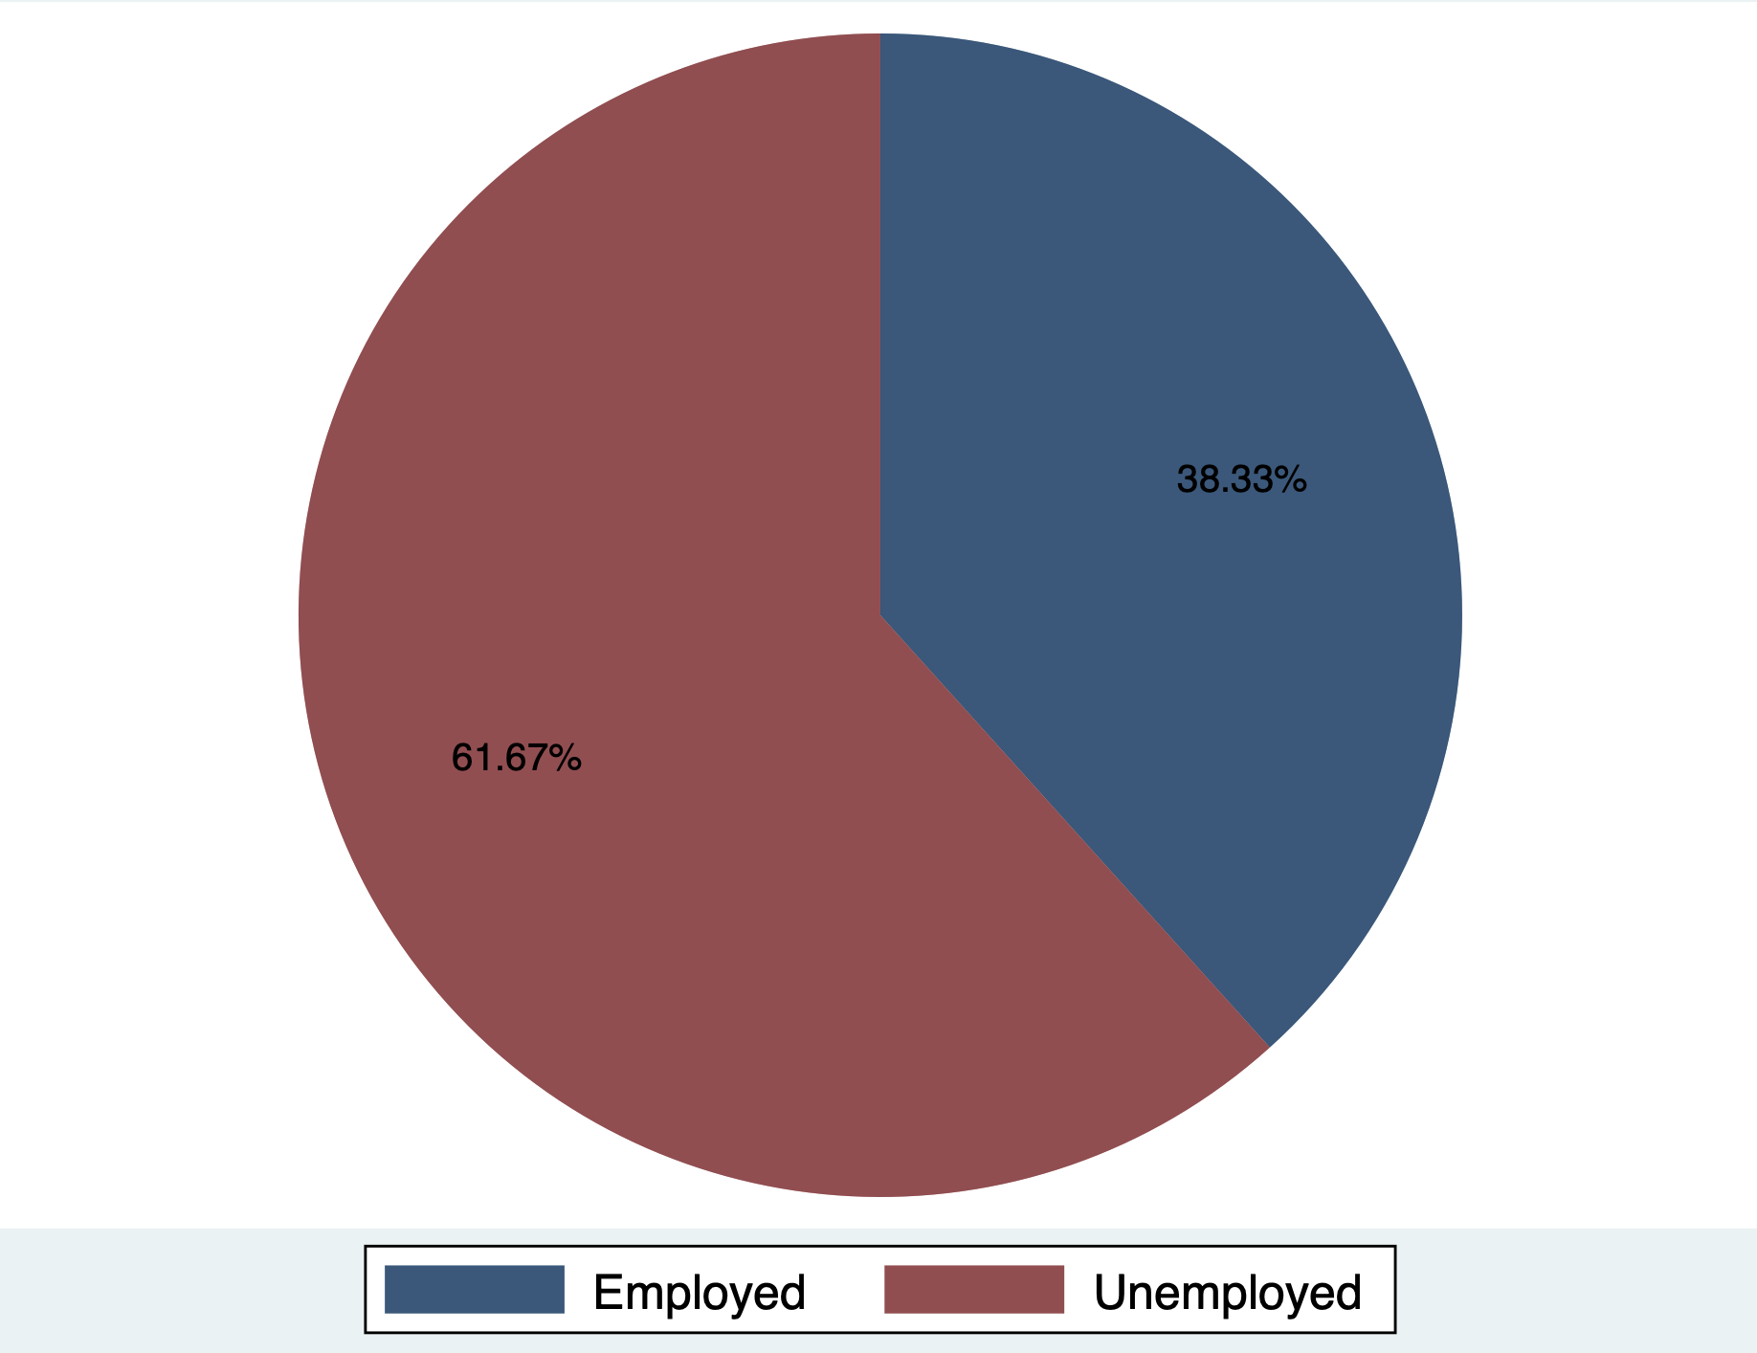
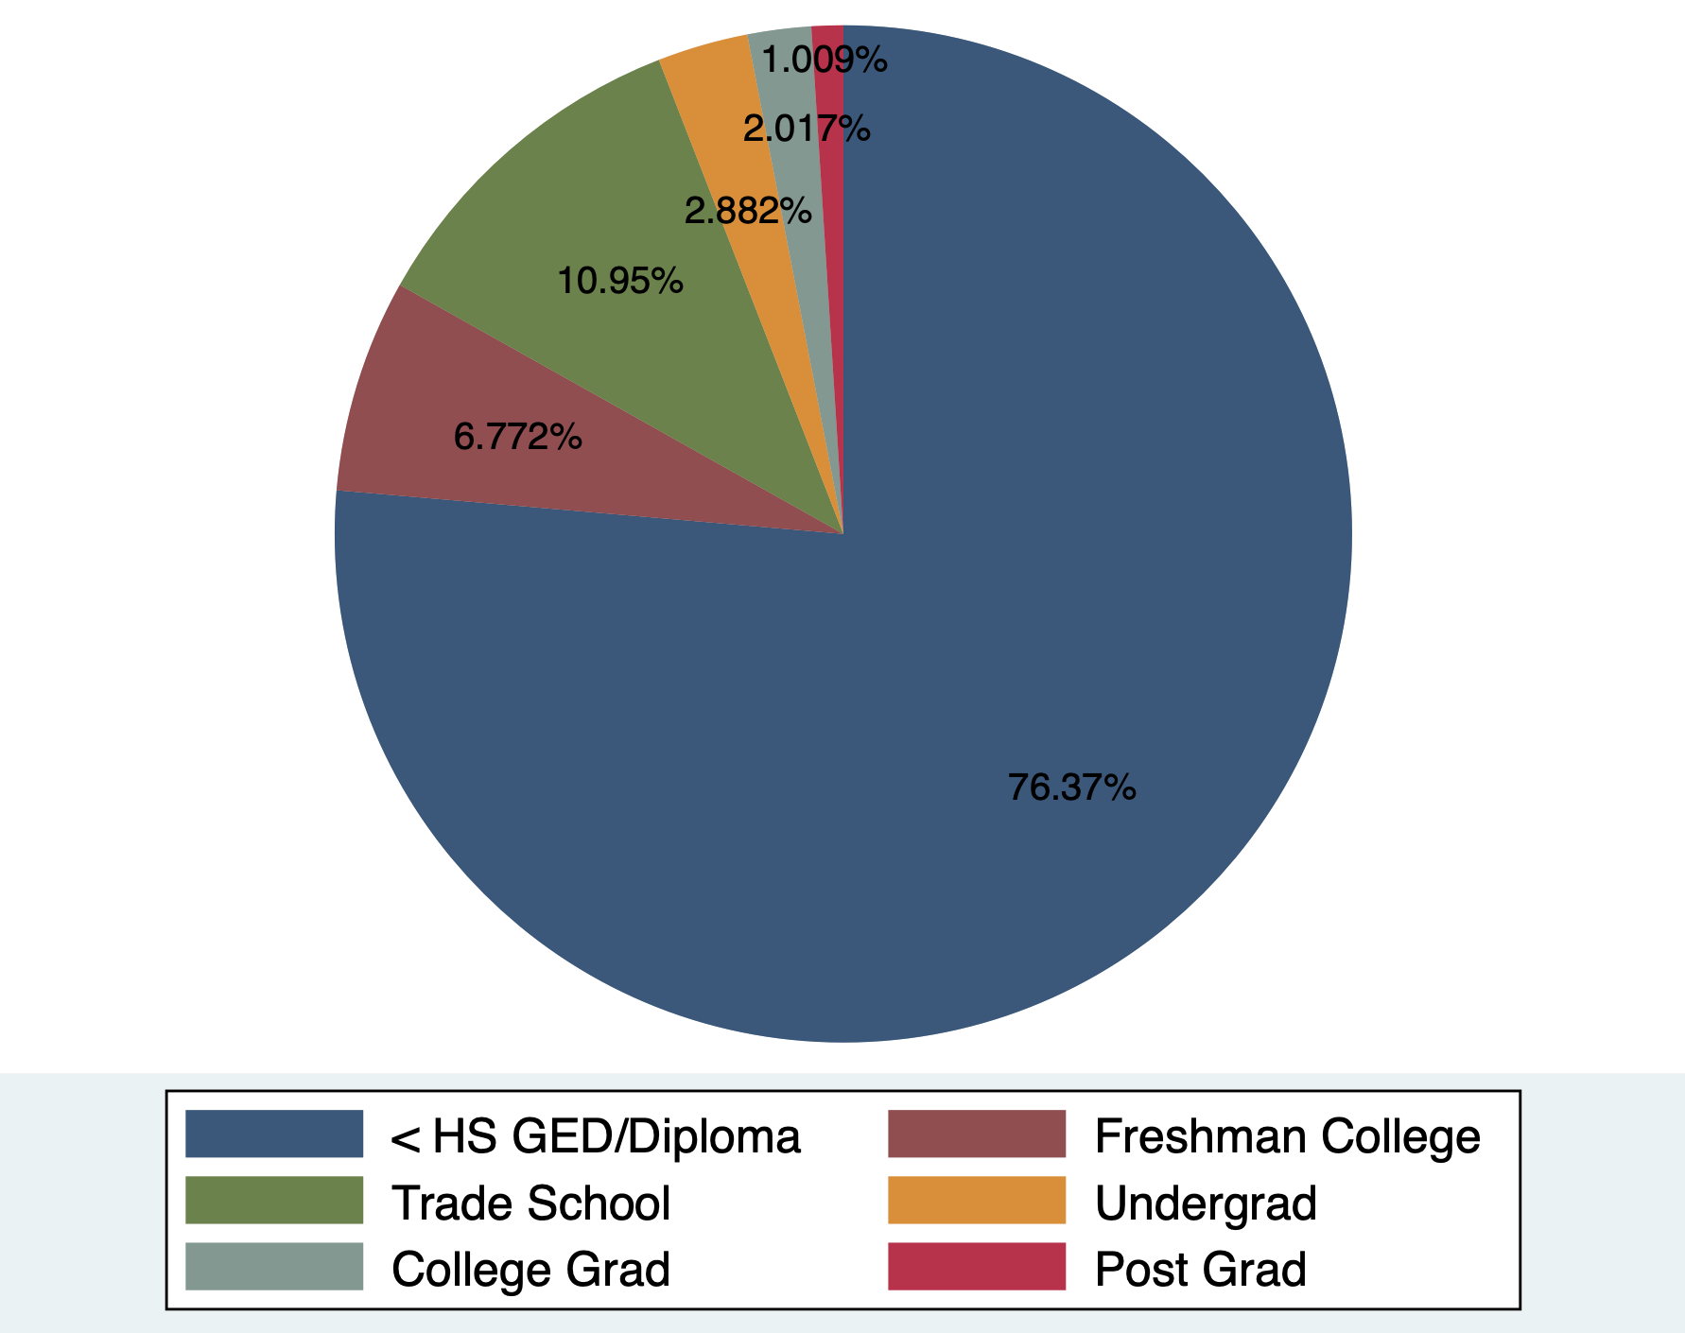

Slide 9

Visualization
Why Gephi?
Open-source network analysis & visualization software
Written in Java on the NetBeans platform
Explores & understands network relationships
Free, cross-platform, user-friendly
Rich features & active community support
Notes:
In the visualization phase of our project, we chose to use Gephi, a powerful and open-source network analysis and visualization software.
It helps us explore and understand the relationships between individuals in networks

Slide 10
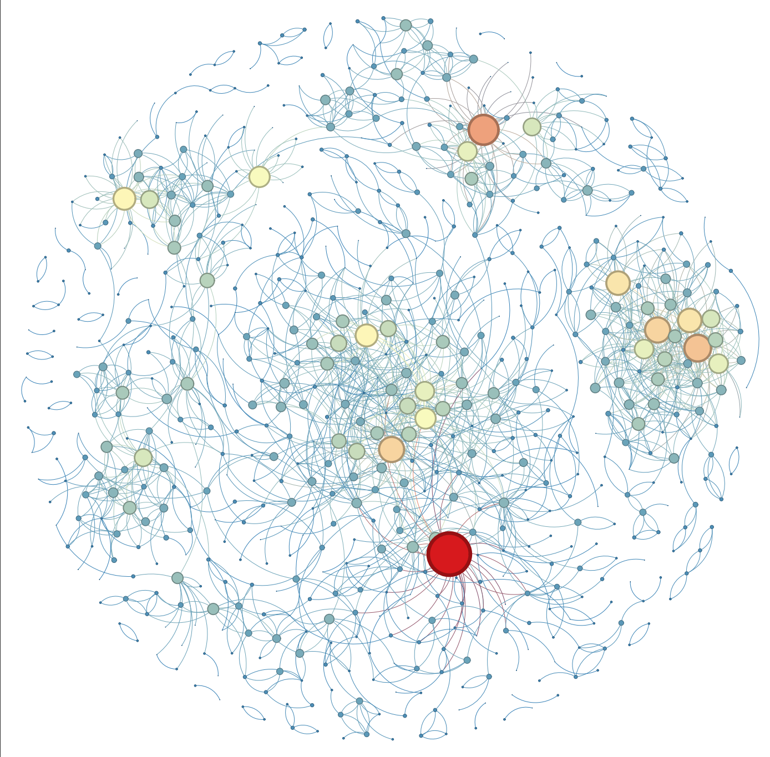
Visualization
Sees in Gephi

Slide 11

Our Research Questions
Five-number summary: Interpretation & significance in the network
Centrality measures & node attributes: Identifying central subgroups
Community detection: Subgroups with higher HIV transmission risk
Network models & node attributes: Impact on network formation & HIV transmission
Predictive models: Using network properties to assess HIV transmission risk
Key individuals & groups: Targeting interventions to reduce HIV transmission
Structural holes & brokerage positions: Roles in information & resource flow
Notes:
Our research aims to address several key questions related to the HIV transmission network. These questions will help us understand the network structure, identify high-risk subgroups, and inform potential interventions.
First, we will examine the five-number summary of the network and interpret its significance in understanding the network properties.
We will then analyze how centrality measures such as degree, betweenness, and eigenvector centrality differ across node attributes, and explore whether certain subgroups are more central in the network.
We will use community detection algorithms to identify subgroups based on node attributes and investigate if any of these subgroups have a higher risk of HIV transmission. We will also examine the defining characteristics of these subgroups.
Next, we will assess whether network models like Exponential Random Graph Models (ERGMs) can help explain the formation and structure of the HIV transmission network based on node attributes, and identify which attributes have the strongest impact.
We will explore the possibility of developing predictive models for HIV transmission risk within the network, using the relationships between node attributes and network properties.
We will attempt to identify key individuals or groups within the network who could be targeted for interventions to reduce HIV transmission, using algorithms like k-shell decomposition or methods like snowball sampling.
Finally, we will look for structural holes or brokerage positions within the network and examine how these positions relate to node attributes. Individuals occupying these positions may play a unique role in the flow of information or resources within the network, and we will use methods like Burt's constraint measure to identify these positions.

Slide 12

Research Questions Part 1
1. What is the five-number summary of the network. How can we interpret them?
2. How do centrality measures (degree, betweenness, eigenvector) differ across node attributes? Are certain subgroups more central in the network?
3. Can community detection algorithms identify subgroups within the network based on node attributes, and if there are subgroups have a higher risk of HIV transmission? What are the defining characteristics of these subgroups?
4. Can network models, such as Exponential Random Graph Models (ERGMs) helps explain the formation and structure of the HIV transmission network based on node attributes? Which attributes have the strongest impact on network formation and HIV transmission?

Slide 13
Term | Value | Interpretation of value
Size | 694 | There have 694 nodes in this network
Density | 0.0038 | The proportion of observed ties in a network to the maximum number of possible ties. 0.0038 is the interconnection of this network, which is not very high.
Components | 311 | The network split into 311 subgroups.
Diameter | 20 | It’s the longest of the shortest paths across all pairs of nodes. Diameter 20 means it takes 20 steps to connect the two nodes that are furthest in the network.
Clustering coefficient | 0.2144 | It’s the proportion of closed triangles to the total number of open and closed triangles. 0. 2144 means a moderate level of clustering in this network.

Slide 14
Impact of Significant Attributes on Network Formation and HIV Transmission
1- RACE
Coefficient: 0.577145
The strongest impact on network formation and HIV transmission.
Individuals from the same racial group are more likely to form connections.
2- Unemployment Status
Coefficient: 0.125353
This attribute might affect the HIV transmission network structure by creating clusters of individuals with similar employment statuses.
3- Living on the streets
Coefficient: 0.122385

Slide 15

Research Questions Part 2
5. Can the relationships between node attributes and network properties (e.g., centrality measures) be used to develop predictive models for HIV transmission risk within the network?
6. Can you identify any key individuals or groups of individuals (e.g., opinion leaders, influencers) within the network who could be targeted for interventions to reduce HIV transmission? We can use algorithms like k-shell decomposition or methods like snowball sampling to identify these individuals or groups.
7. Can you identify any structural holes or brokerage positions within the network, and how do these positions relate to node attributes? Individuals occupying these positions may have a unique role in the information or resource flow within the network. We can use methods like Burt's constraint measure to identify structural holes or brokerage positions.

Slide 16
Who occupies brokerage points?
Key brokerage positions are occupied by individuals with these node attributes:
Race: white or black
Sexuality: mostly heterosexual
Not disabled
Mostly unemployed
Not homeless
Mostly high school level education

Slide 17
Concluding remarks
A number of factors are key to spreading HIV. The most important of which seem to be gender, race, and sexual behavior.
Intervention policies should be tailored to specific community needs, as not all communities look or behave the same
Targeting individuals likely to occupy brokerage positions in the network could help to stop spread

Slide 18
Concluding remarks cont.
Race, unemployment status, and housing status play key roles in determining transmission networks. It is imperative that key underlying socioeconomic issues are addressed
Further information could provide better understanding and more context
The role of certain occupations such as sex worker, drug dealer, etc.
The role of ethnicity (race variable does not distinguish non-Hispanic and Hispanic in white category)

Slide 19

Thank you!

