Slide 1
Prediction of car accident severity in seattle, WA
Coursera Capstone for IBM Data Science Professional Certificate
M. Sagianis

Slide 2
Purpose
Traffic Accidents cause problems for everyone
Personal Injury / Property Damage
Congestion
Insurance headaches
With number of cars on the road increasing, but roadways staying constant, expect more congestion and accidents in future.
Ability to predict accident severity can provide multiple benefits
Efficiently allocate resources for Emergency Responders
Changes in policy that will reduce incidents in high density areas
Increase safety of people on the road

Slide 3
Data
Dataset provided by the city of Seattle, consisting of all traffic incidents from 2004 – present (roughly 220,000 incidents)
Incidents recorded with severity level as well as a host of different attributes such as location, people involved, environmental conditions, and classification of accident
For model training, unknown and missing values were removed, leading to roughly 170,000 incidents to train model
Final data attributes for model training were:
Collision Type
Collision Location Type
Weather Conditions
Road Conditions
Light Conditions

Slide 4
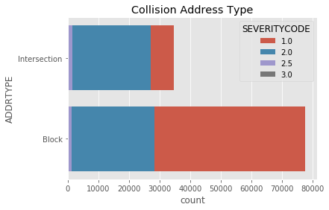
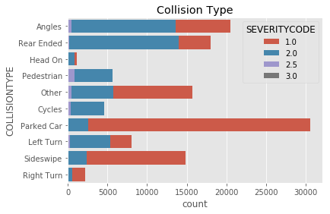
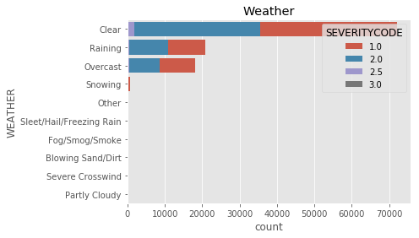
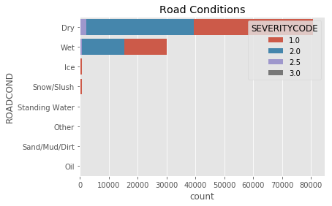
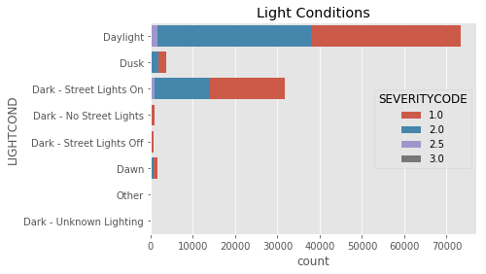
Visualization of Modeling Variables

Slide 5
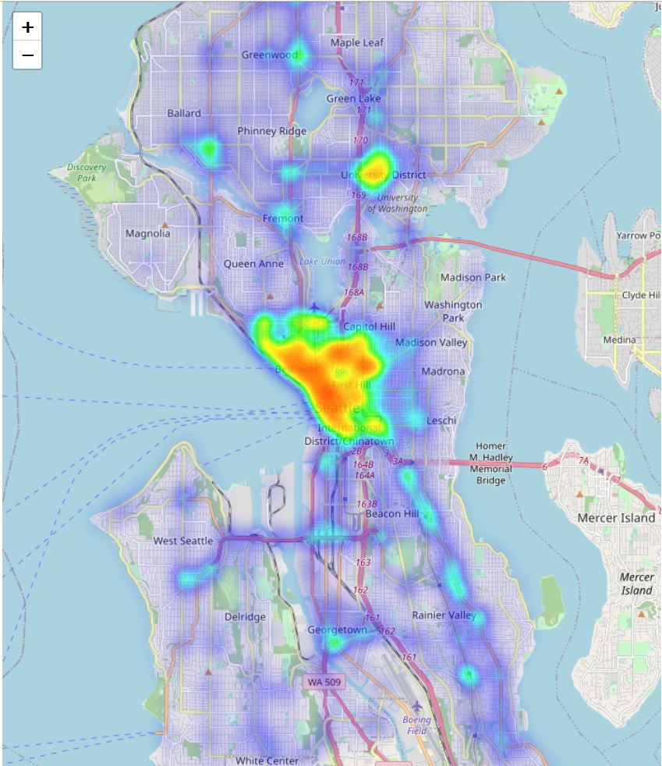
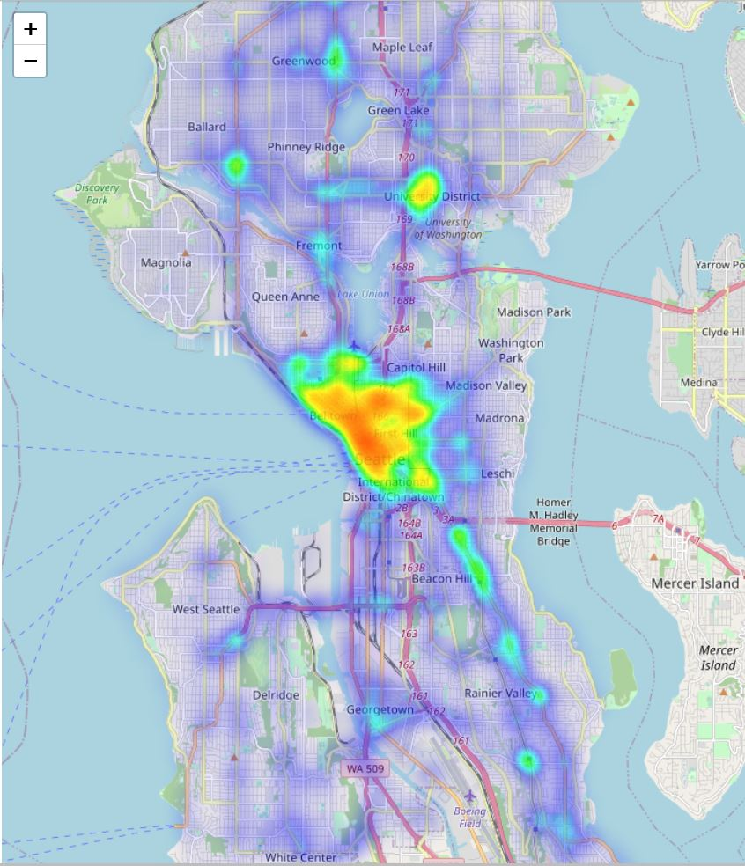
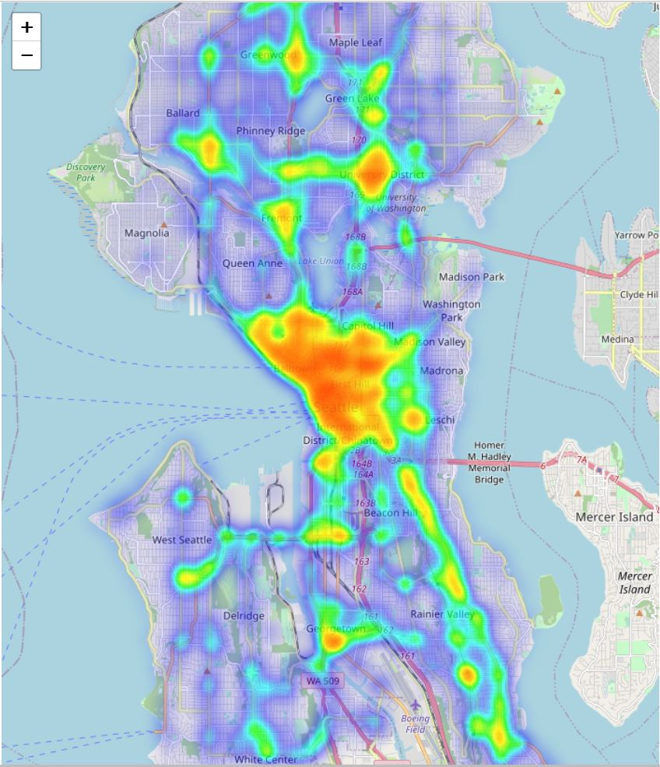
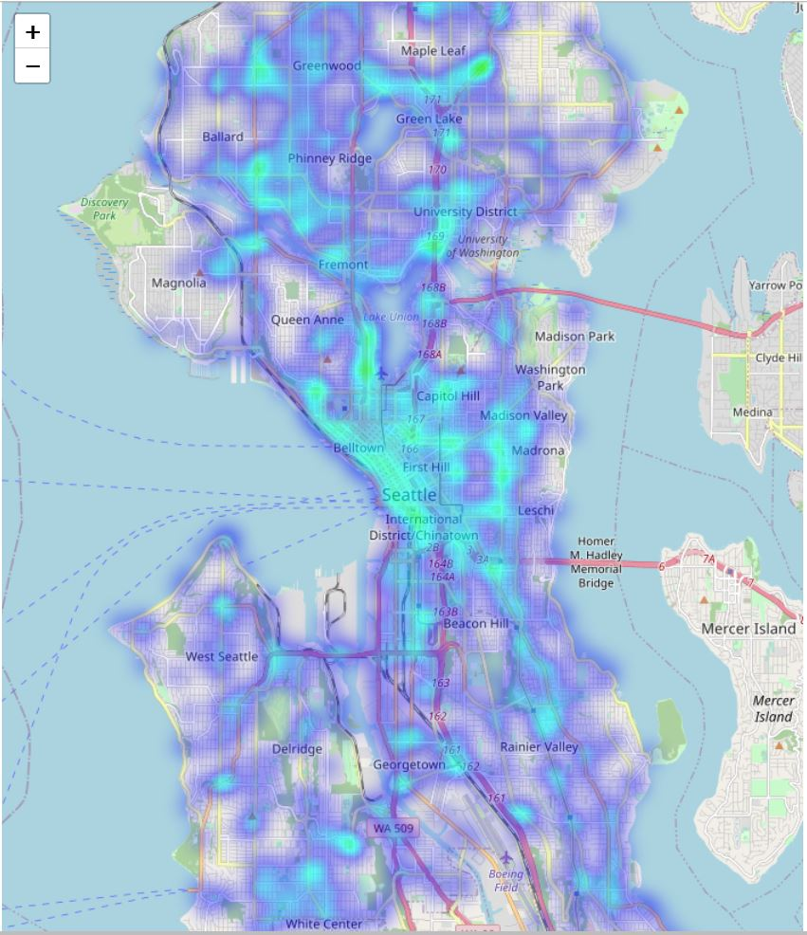
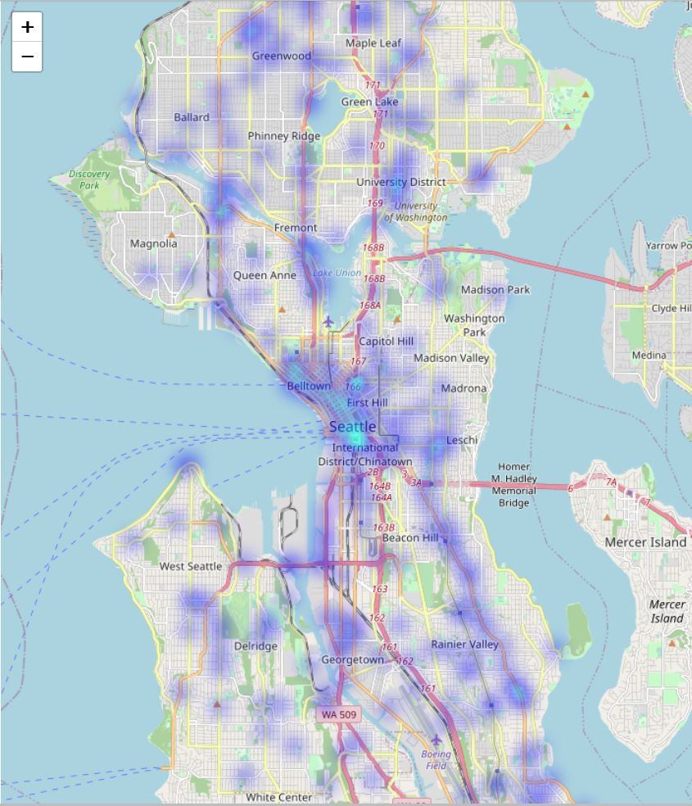
Visualization of Accident Location
Severity All (Above)
Severity = 1 (Center Top)
Severity = 2 (Right Top) Severity = 2.5 (Center Bot)
Severity = 3 (Right Bot)

Slide 6
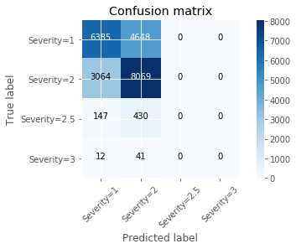
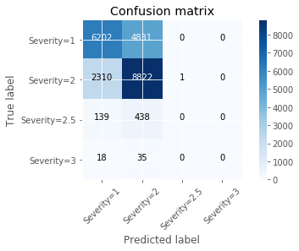
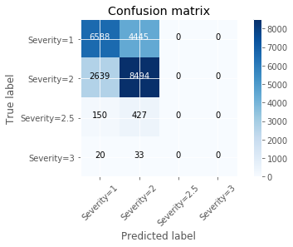

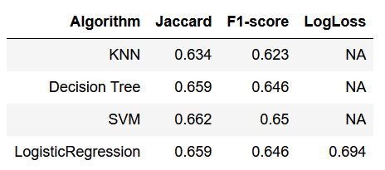
All Severity Models
K- Nearest Neighbors (Top Left)
Decision Tree (Top Right)
Support Vector Machine (Bot Left) Logistic Regression (Bot Right)
Accuracy Summary (Table)

Slide 7
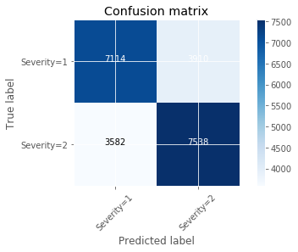
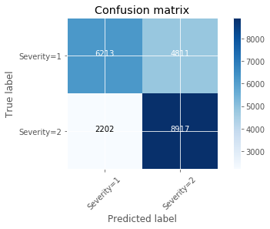
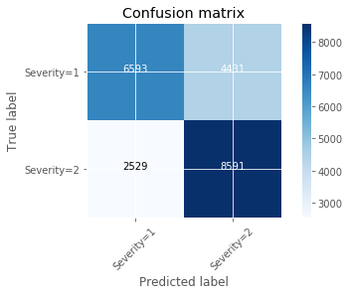

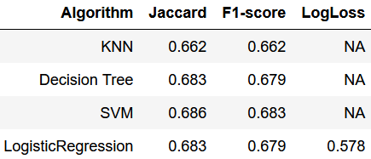
Low Severity Model
K- Nearest Neighbors (Top Left)
Decision Tree (Top Right)
Support Vector Machine (Bot Left) Logistic Regression (Bot Right)
Accuracy Summary (Table)

Slide 8
Conclusion
4 models built and trained based on supplied data
Similar accuracy values across models
Models clearly biased due to inability to accurately predict high severity cases
Likely due to low incident counts
Models retrained with data only consisting of low severity incidents
Accuracy improved, but still < 70% accuracy
Likely attribute selection can be improved; however attributes were chosen to be easily understood at 911 call of incident.

