Slide 1
Exam-Flow
An Agentic Multimodal Framework for Automated Academic Integrity Verification
Motasem Aldiab • M. Sajid Ali
IEEE Conference Symposium: Thompson Okanagan Section – Canada (TOK-CSES 2026)
Proof of Concept: Four Demonstration Scenarios
Notes:
Good morning. Today we are presenting Exam-Flow, an agentic multimodal framework for academic integrity verification in programming assessments.

Slide 2
What is an Agentic AI?
Moving from monolithic black-box language models to specialized micro-expertise.
🧠 Traditional LLM (Monolithic System)
• Architecture: A single giant black-box model attempting all functions simultaneously.
• Workflow: Single prompt ➔ generic output ("Does everything, specializes in nothing").
• Cognitive Overload: When asked to parse hours of video, screen diffs, and complex code at once, it frequently hallucinates.
• Audit Failure: Generates an opaque final response without transparent, intermediate reasoning chains.
🤖 Agentic AI (Specialized Micro-Expertise)
• Architecture: Decomposes complex multi-modal problems into specialized, coordinated roles.
• Workflow: Multiple focused agents (Agent A, Agent B, Agent C, Agent D) working in sequence.
• Targeted Responsibilities: Each agent is given a specific prompt, specific evidence inputs, and dedicated tools.
• Explainable Audit Trails: Intermediate logs are recorded step-by-step, providing verifiable evidence for instructors.
Exam-Flow | IEEE TOK-CSES 2026
02
Notes:
Before we dive into the architecture, let's define what an "agent" is. A traditional LLM is a monolithic black box. You give it a huge prompt, and it tries to do everything, often hallucinating. Agentic AI breaks this down. An agent is a software component given a highly specific task, prompt, and role.

Slide 3
Why Multi-Agent Architecture?
The Hospital Analogy: Combining specialized experts to ensure diagnostic accuracy.
🏥 The Clinical Diagnostic Team Analogy
In a hospital, you do not ask one doctor to take the X-ray, analyze blood pathology, and perform the surgery. You rely on specialized experts whose distinct findings are synthesized before making a high-stakes decision.
👁️ Visual Proctor
= The Radiologist
Watches the physical behavior.
• Tracks webcam gaze vectors, head pose, and physical presence.
• Treats routine keyboard glances as normal.
• Outputs an objective, timestamped behavioral observation log.
💻 Code Reviewer
= The Pathologist
Analyzes the technical artifact.
• Inspects screen recording and code syntax progression.
• Detects Sudden Logic events (< 3s paste).
• Evaluates logic against reference benchmarks using ChromaDB RAG.
⚖️ Integrity Auditor
= The Chief Surgeon
Reviews all evidence to synthesize findings.
• Cross-references visual logs directly against code timestamps.
• Checks whether code sudden appearance coincides with gaze diversions.
• Escalates ambiguous cases to INVESTIGATION for human oversight.
Exam-Flow | IEEE TOK-CSES 2026
03
Notes:
Why use multiple agents instead of one? Think of it like a hospital. You don't ask one doctor to do the X-ray, read the blood tests, and perform the surgery. You use specialized experts. Similarly, Exam-Flow uses a Visual Proctor for video, a Code Reviewer for syntax, and an Auditor to combine their findings.

Slide 4
The Proctoring Dilemma
Right now, we have a major dilemma in online proctoring. Current tools look at things in isolation. On one hand, webcam software watches the student's physical movements. But it's completely blind to the code they are writing. On the other hand, autograders look at the final code file, but they are completely blind to how the student behaved.
📷 Visual Proctoring (Physical Movements)
• Scope: Tracks webcam feed, facial presence, eye gaze, and posture (OpenCV / MediaPipe).
• Isolation Flaw: "Context Blind" — observes movement without understanding intent.
• False Alarm Trap: Looking at keyboard to type, thinking, or posture shift gets falsely flagged as cheating.
• Exploitation Gap: Student staring straight at camera while pasting external/AI code remains undetected.
💻 Code Analysis (Autograders & Similarity)
• Autograders: Compile and execute final code against unit tests (verifies correctness, not authorship).
• Similarity Detection: Structural token / AST matching against peers (e.g., JPlag, MOSS winnowing).
• Isolation Flaw: "Temporally Blind" — inspects only the final static file at submission.
• GenAI Vulnerability: A 100/100 correct program cannot reveal whether it took 2 hours to type or 2 seconds to paste.
Key Insight: An observation is a reason to investigate—not standalone proof of misconduct.
Exam-Flow | IEEE TOK-CSES 2026
02
Notes:
In programming exams, instructors face a dual challenge. Visual proctoring flags innocent head and eye movements as cheating, while static autograders evaluate only the final submitted file, blind to whether it was typed incrementally or pasted in one second from ChatGPT. We need forensic triangulation.

Slide 5
State of the Art: Literature Comparison Matrix
Benchmarking datasets, open science availability, and core limitations.
Paper (Author, Year) | Target Modality | Dataset Used | Temporal Awareness | Open Code/Data? | Core Limitation
Nigam et al., 2021 | Webcam (Video) | Systematic Review | Real-time / Post-hoc | N/A | High false alarms on benign behavior; blind to code.
Labayen et al., 2021 | Video + Biometrics | Proprietary Univ. Data | Continuous | ❌ No | Focuses on identity, not process-level code integrity.
Prechelt et al., 2002 (JPlag) | Source Code | Student Submissions | N/A | ✅ Code Open | Temporally blind; cannot detect GenAI or copy-paste.
Khalil & Er, 2023 | Text / Code | ChatGPT Outputs | None (Static) | ❌ No | Fails against uniquely generated LLM code.
Choi et al., 2024 (SaTML) | Source Code | CodeNet / GitHub | None (Static) | ✅ Code Open | Can identify author style, but blind to how code was written.
Lamba & Sharma, 2024 | Video + Audio + Logs | Custom Dataset | None (Static) | ❌ No | Parallel data streams; no forensic cross-referencing.
Naveen et al., 2025 (AutoOEP) | Multi-modal | Synthetic Data | None (Static) | ❌ No | Lacks real-world process-level code insertion tracking.
Ma et al., 2024 (AgentBoard) | Text / UI Actions | Agent Trajectories | Windowed logs | ✅ Code Open | Evaluates generic agent tasks, not live academic integrity.
Exam-Flow (Ours) | Video + Screen + Code | 4 Curated Scenarios | Real-time | ✅ Code + Data Open | Proof-of-concept; requires human-in-the-loop review.
Exam-Flow | IEEE TOK-CSES 2026
05
Notes:
30-SECOND SCRIPT FOR DR. MOTASEM:
"This table summarizes the state-of-the-art literature across visual proctoring, code similarity, and multi-agent frameworks. Notice the 'Dataset Used' and 'Open Code/Data?' columns: prior work largely relies on proprietary or synthetic data without open-sourcing. Visual tools like Nigam and Labayen are blind to code. Code tools like JPlag are temporally blind to the process. Exam-Flow is the only framework that unifies video, screen, and code into a continuous, explainable timeline with fully open-sourced code and benchmark data."

Slide 6
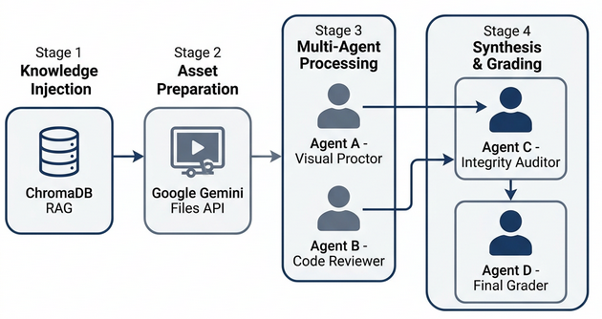
Exam-Flow Architecture
Four sequential stages from reference grounding to verified multi-agent synthesis.
Stage 1: Knowledge Injection
Grounds the AI with reference code and rubrics in ChromaDB RAG.
Stage 2: Asset Preparation
Synchronizes webcam video, screen recording, and submitted code.
Stage 3: Multi-Agent Processing
Extracts behavioral anomalies (VP) and sudden logic events (CR).
Stage 4: Synthesis & Grading
Cross-references evidence (IA) and applies the grade cap (FG).
Exam-Flow | IEEE TOK-CSES 2026
06
Notes:
SPEAKER SCRIPT FOR DR. MOTASEM:
"Here is the core architecture. We move left to right. First, we inject knowledge into the system using ChromaDB. Second, we prepare the video and code assets. Third, the multi-agent processing begins: the Visual Proctor and Code Reviewer work sequentially to extract anomalies. Finally, the Integrity Auditor and Final Grader synthesize the evidence into a single, explainable report."

Slide 7
Agent Roles & Targeted Prompts
Table I from the paper: Exact prompt instructions and requested output schemas.
Agent Role | Exact Prompt Excerpt (Table I) | Output Fields
1. Visual Proctor (VP) | “Looking at the keyboard is usually normal.” | • Verdict: CLEAR, SUSPICIOUS, CRITICAL • Anomaly log with timestamps • Behavioral reasoning
2. Code Reviewer (CR) | “Flag any 'Sudden Logic': complex code that appears in under 3 seconds rather than being typed incrementally.” | • Technical score (0–100) • Screen/submission match • Sudden logic timestamps
3. Integrity Auditor (IA) | “AUDIT STATUS: [PASS / FAIL / INVESTIGATION]” | • Audit status • Confidence score • Cross-modal discrepancies
4. Final Grader (FG) | “STATUS: [Certified / Flagged / Failed]” | • Final grade (grade cap enforced) • Pre-audit technical score • Unified evidence timeline
Exam-Flow | IEEE TOK-CSES 2026
07
Notes:
Table I displays the prompt instructions governing each agent. Instead of black-box scoring, each agent receives explicit operational guidance: the Visual Proctor is told that looking at the keyboard is normal; the Code Reviewer flags sudden logic appearing in under 3 seconds; the Auditor cross-references both streams; and the Final Grader caps grades if integrity is violated.

Slide 8
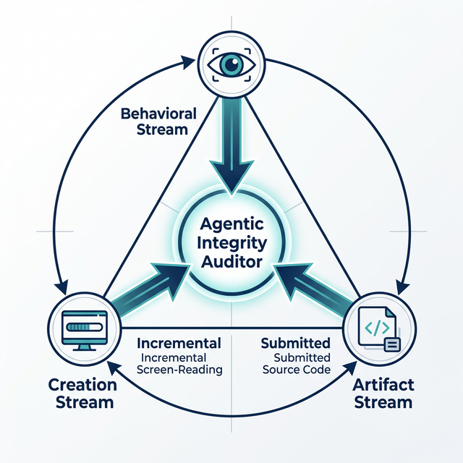
Cross-Modal Evidence Triangulation
How the Integrity Auditor cross-references behavior, development, and submission.
How Triangulation Works (3 Steps)
1. Visual Proctor (Behavior)
Watches the student's webcam video feed. Tracks gaze direction, head pose, and presence. Normal keyboard glances are classified as benign.
2. Code Reviewer (Development)
Watches the on-screen code development in real-time. Detects instantaneous block insertions (< 3 seconds) and checks logic against reference benchmarks.
3. Integrity Auditor (Synthesis)
Correlates the two timelines. If a 15-line algorithm appears in 0.8s while the student looks off-screen, it triggers a cross-modal flag for instructor review.
Exam-Flow | IEEE TOK-CSES 2026
08
Notes:
Here is how triangulation works in simple terms. Three evidence sources—student behavior from webcam, code progression from screen, and the final submitted file—are fed into the Integrity Auditor. 1. The Visual Proctor watches the student. 2. The Code Reviewer watches the screen. 3. The Integrity Auditor compares them. If a student looks away at the exact second a sudden code block appears, it flags a breach. If they typed incrementally with normal gaze, it passes.

Slide 9
System Backend: Memory & Context
How Exam-Flow prevents AI hallucination and saves time.
📚 ChromaDB (The AI's Reference Library)
What is it?
A Vector Database used for RAG (Retrieval-Augmented Generation). A smart search engine for the AI.
Why do we need it?
Without it, the AI guesses. RAG forces the AI to look up the instructor’s actual rubric and ideal solutions before grading.
How we use it:
• Upload "Ideal Solutions" & "Marking Rubric" into ChromaDB.
• Convert text to math vectors using Google's gemini-embedding-001.
• Code Reviewer queries: "Find closest reference solution" to ground the AI in reality.
⚡ Smart Caching Layer (Short-Term Memory)
What is it?
A memory system that saves final results so we don't have to ask the AI again.
Why do we need it?
LLMs are slow and cost money. A fresh multi-agent analysis takes ~60 seconds. A cache hit takes < 1 second.
Types of Caching (Context):
Most enterprise applications use external distributed tools like Redis or Memcached.
How we used it:
Built a lightweight internal Python cache (stored in RAG manager) saving final reports under unique Case IDs for instant reloading without API calls.
Exam-Flow | IEEE TOK-CSES 2026
09
Notes:
Here is our system backend: memory and context. ChromaDB serves as the AI's reference library using RAG. Without it, LLMs hallucinate; with it, the Code Reviewer queries actual instructor rubrics and ideal solutions using gemini-embedding-001. The Smart Caching layer is our short-term memory. While enterprise systems use Redis or Memcached, we implemented a lightweight internal Python cache that stores finalized reports by Case ID, slashing retrieval latency from 60 seconds to under 1 second.

Slide 10
The Testbed: Four Proof-of-Concept Scenarios
Four distinct cases designed to test normal behavior, instant code injection, cross-modal mismatches, and AI hallucinations.
Case | The Scenario (What Happened) | Ground Truth | System Verdict | Why This Case Matters
T1 | Honest Coding: Incremental typing of Bubble Sort over several minutes. | PASS | PASS (Score: 100/100) | Proves the system does not trigger false alarms on normal, honest behavior.
T2 | Sudden Logic: A complete Binary Search algorithm is pasted into an empty editor in under 1 second. | FAIL | FAIL (Flagged at 00:19) | Proves the Code Reviewer successfully catches instant code injection.
T3 | The Mismatch: Student types recursive Java on screen, but submits a Python file with a while loop. | FAIL | FAIL (Grade capped: 10/100) | Proves the Auditor catches discrepancies between the video and final file.
T4 | The Evasion: Student uses AI assistance and glances away. AI incorrectly reports "face not visible." | FAIL | INVESTIGATION (Grade capped: 20/100) | Proves that AI makes mistakes. The system flagged it for Human Review rather than a hard auto-fail.
Study Scope: Four curated demonstration packages recorded by the developer. Evaluation unit: trial package.
Exam-Flow | IEEE TOK-CSES 2026
10
Notes:
Here is our experimental testbed of four demonstration cases. T1 verifies our honest baseline: normal typing produces a clean PASS. T2 tests sudden logic: pasting an entire algorithm in 1 second triggers an instant FAIL. T3 catches cross-modal mismatch: Java on screen versus Python submitted. T4 is our evasion scenario with AI assistance and external notes. Crucially, the system escalated to INVESTIGATION rather than an automated punishment, acknowledging AI vision ambiguity.

Slide 11
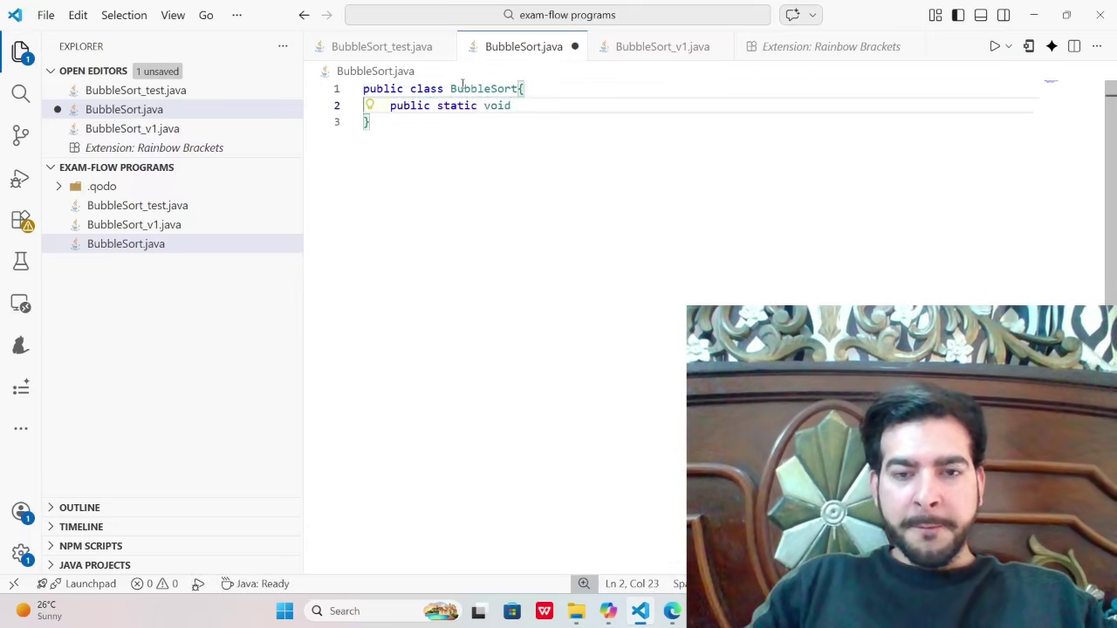
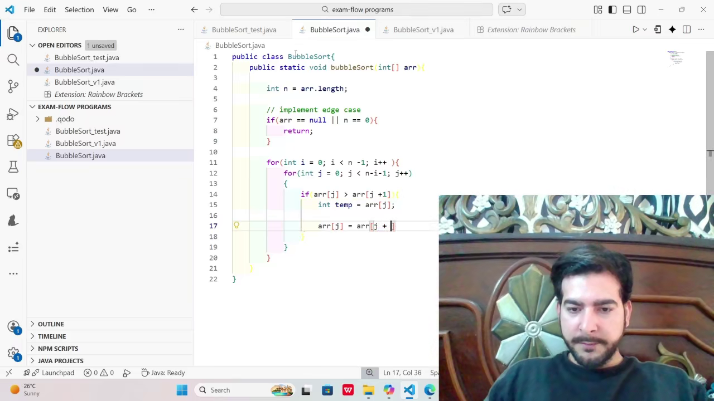
Trial 1: Honest Baseline (T1)
Bubble Sort: Incremental code progression without anomalies.
00:15 — Early method initialization & class setup
01:17 — Incremental loop construction & swap logic
AI Assessment Outcome: Verdict: PASS | AI Technical Score: 100/100 (Clean development timeline)
Exam-Flow | IEEE TOK-CSES 2026
11
Notes:
In Trial 1, the student implements Bubble Sort. The sampled frames show natural, incremental typing from 15 seconds to 1 minute 17 seconds. The Visual Proctor reported no anomalous gaze diversions, the Code Reviewer noted regular typing pace, and the Integrity Auditor issued a clean PASS with a 100/100 technical grade.

Slide 12
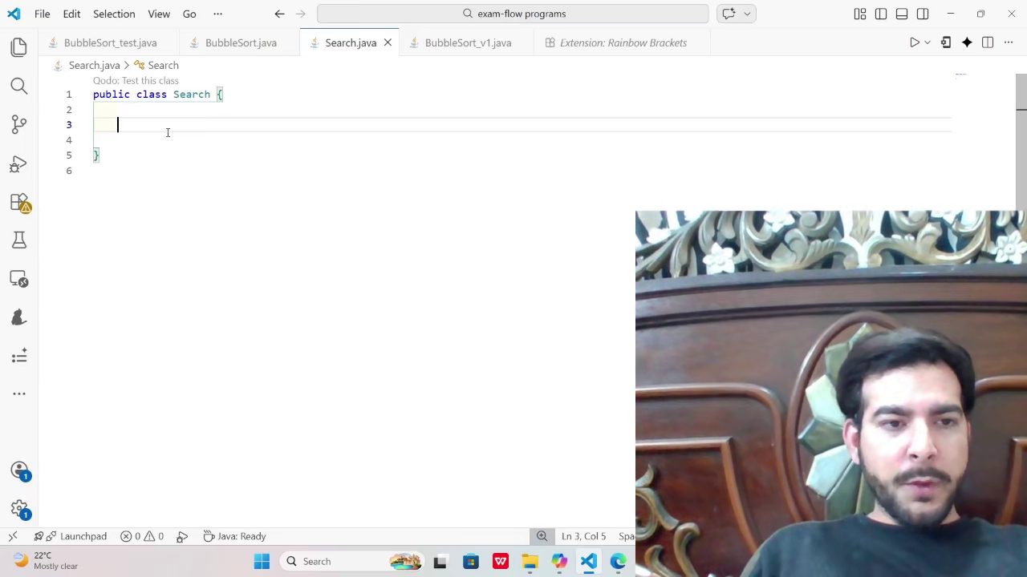
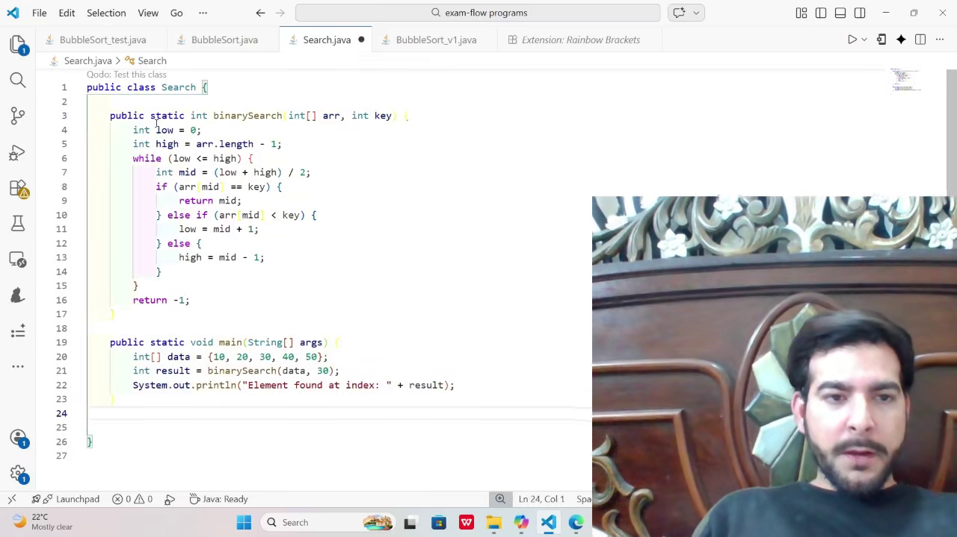
Trial 2: Sudden Code Appearance (T2)
Binary Search: A complex code block appears instantaneously in under 1 second.
00:19 — Editor class empty (no incremental typing)
00:20 — Complete Binary Search implementation injected
AI Assessment Outcome: Sudden Logic Event Flagged | Verdict: FAIL (Instant paste bypasses typing process)
Exam-Flow | IEEE TOK-CSES 2026
12
Notes:
In Trial 2, a complete Binary Search method is pasted between 19 and 20 seconds. The code is syntactically perfect and gets 100% on unit tests, which would pass a traditional autograder. However, Exam-Flow's Code Reviewer flags the sudden logic event, and the Auditor issues an overall FAIL verdict.

Slide 13
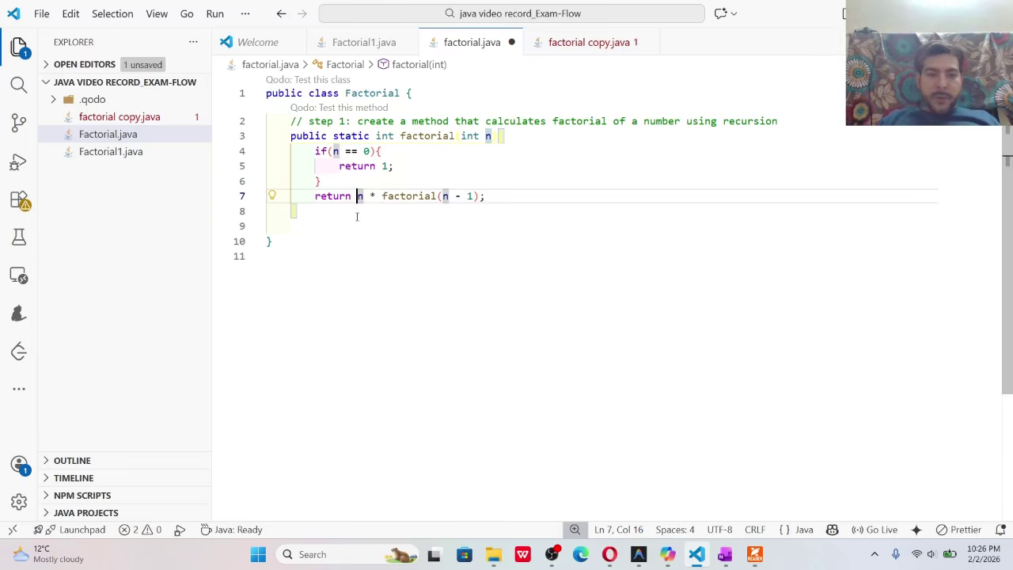
Trial 3: Recording / File Discrepancy (T3)
Factorial: Discrepancy between on-screen development and submitted artifact.
Cross-Modal Mismatch Detected
• On-Screen Development (Video): Java recursive implementation (calls factorial recursively).
• Submitted Artifact (.py File): Python iterative implementation using a while loop.
• Autograder Blind Spot: Video proctor sees a student working; code autograder runs Python tests.
• Exam-Flow Forensic Result: Synthesizes both streams, exposes language and paradigm clash, and flags FAIL (10/100).
AI Assessment Outcome: Paradigm / Language Mismatch | Verdict: FAIL (Score: 10/100)
Exam-Flow | IEEE TOK-CSES 2026
13
Notes:
In Trial 3, the student types recursive Java code on screen, but submits an iterative Python script. Unimodal proctoring cannot catch this because the video looks like authentic typing, and the Python file passes test cases. Exam-Flow cross-references the video against the file, detects the paradigm mismatch, and fails the submission.

Slide 14
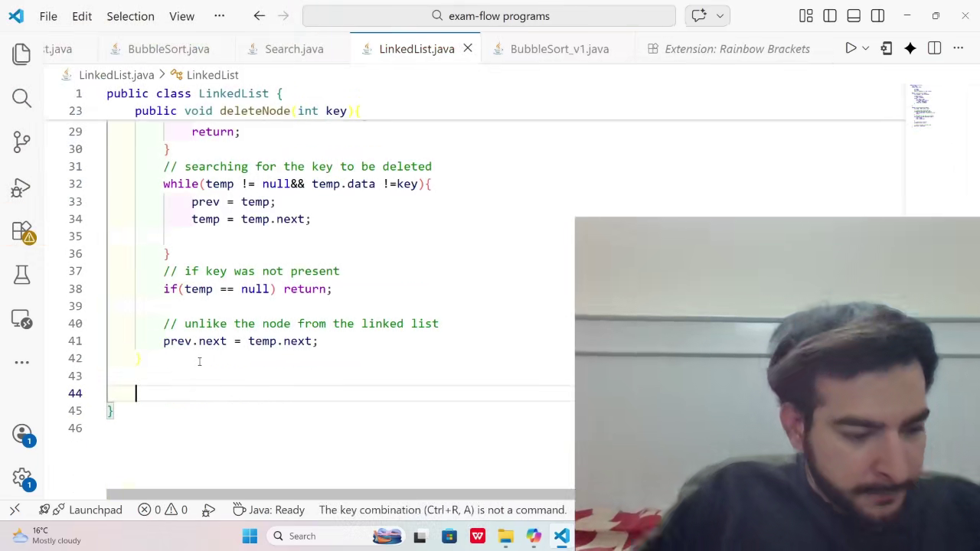
Trial 4: External Reference & Gaze Correlation (T4)
Singly Linked List: Multi-agent audit flags AI assistance; gaze timing exposes oversight need.
Forensic Findings in T4 Report
• Experiment Purpose: Simulates AI-assisted code generation (Qodo extension) combined with external reference notes.
• Primary Code Breach: Sudden Logic events at 00:07, 00:28, 00:35, 00:38 (instant data structure insertions).
• Visual Proctor Limitation: Model reported “face not visible” at 03:24, but video shows candidate face clearly visible (gaze averted to notes, not occluded).
• Audit Escalation: Status assigned INVESTIGATION; grade capped at 20/100 (raw technical score: 85–95/100).
Audit Status: INVESTIGATION | Grade Capped at 20/100 | Visual/Temporal Ambiguity Needs Human Review
Exam-Flow | IEEE TOK-CSES 2026
14
Notes:
Trial 4 is our most insightful test case. The candidate used external notes and AI code completion to implement a Linked List. The system successfully caught the instantaneous logic insertions. However, the visual model reported "face not visible" at 3:24 when the candidate was merely averting gaze to notes. This discrepancy perfectly proves our paper's thesis: AI vision models can misinterpret gaze as occlusion, making human-in-the-loop review mandatory.

Slide 15
Why Humans Must Stay in the Loop
AI is an investigator, not a judge.
1. AI Hallucinations
The Problem: The AI mistakes a student glancing at their keyboard as "face not visible."
The Risk: False accusations destroy student trust and violate due process.
2. Timing Mismatches
The Problem: Video timestamps and code timestamps do not perfectly align without a common clock.
The Risk: The system might flag two unrelated events (e.g., a glance at 00:20 and code at 00:41) as a coordinated cheat.
3. The "Auto-Fail" Trap
The Problem: The prototype automatically capped grades at 20/100 upon any audit flag.
The Fix: AI should never punish a student. It must only flag the evidence for a human instructor to review.
Takeaway: AI generates the evidence. Human instructors make the final decision.
Exam-Flow | IEEE TOK-CSES 2026
15
Notes:
This slide drives home our core educational philosophy: AI is an investigator, not a judge. First, AI hallucinations can mistake a keyboard glance for an absent face. Second, timing mismatches between video and editor logs can create false correlations. Third, automated grade penalties risk punishing innocent students. Our conclusion is absolute: AI compiles the evidence, but human instructors must make the final disciplinary decision.

Slide 16
Scope & Honest Limitations
A proof-of-concept demonstrating architectural feasibility, not statistical superiority.
What This Study Demonstrated
✅ End-to-End Pipeline: Successfully linked webcam video, screen diffs, and final code into one workflow.
✅ Instant Code Detection: Caught multi-line algorithm insertions in under 3 seconds (Sudden Logic).
✅ Cross-Modal Catches: Identified when the video language (Java) did not match the submitted file (Python).
✅ Fast Evidence Retrieval: Proved the caching layer delivers reports to instructors instantly.
What This Study Did NOT Claim
❌ No Large-Scale Cohort: Tested on 4 developer-recorded scenarios, not a university-wide student population.
❌ No Statistical F1 Scores: We make no claims of precision or recall on a population level.
❌ No Hardcoded Magic: The 3-second "Sudden Logic" rule is an empirical prompt, not a proven universal threshold.
❌ No Ignored Privacy: We acknowledge that uploading video to external LLM APIs requires strict institutional compliance.
The Bottom Line: This framework proves the architecture works. Moving to real-world deployment requires larger datasets and human-in-the-loop policy.
Exam-Flow | IEEE TOK-CSES 2026
16
Notes:
Here are our honest scope and limitations. We demonstrated a functional end-to-end architecture, rapid code insertion detection, language mismatch resolution, and sub-second caching. However, we explicitly do NOT claim university-wide F1 scores or population statistical significance from 4 developer trials. The 3-second rule is an empirical prompt instruction, and privacy compliance remains paramount.

Slide 17
Summary & Future Directions
Bridging behavioral evidence and code progression for transparent assessment.
Core Contributions
Bridged the Gap: Combined webcam behavior with process-level code tracking to eliminate blind spots.
Explainable Evidence: Replaced opaque "cheating scores" with timestamped, human-readable audit trails.
Human-Centric Design: Positioned AI as an investigator, keeping instructors as the final judges to protect due process.
Future Work
Scale: Run large-scale trials with real student cohorts (beyond the 4-scenario proof of concept).
Precision: Implement hardware-level clock synchronization for perfect timestamp alignment.
Privacy: Transition to on-premises, privacy-preserving local models to avoid external API uploads.
Code Repository: github.com/MSajidAli-byte/Exam-Flow | Archived Data: doi.org/10.5281/zenodo.23465605
Thank You! Questions & Discussion
Exam-Flow | IEEE TOK-CSES 2026
17

Slide 18
Presenter Reference: Q&A Defense Sheet
Key factual anchors from the revised paper for live audience questions.
If asked about F1 / Statistical Superiority: “We removed automated F1 and classification rate claims because our evaluation extraction script was text-search based and we evaluated four curated demonstration packages. We strictly position Exam-Flow as an architectural proof-of-concept.”
If asked about Embeddings & RAG Models: “Our reference retrieval layer in ChromaDB uses Google’s gemini-embedding-001 with cosine distance, not CodeBERT. The manuscript and codebase explicitly reflect this configuration.”
If asked about the 3-Second Sudden Logic Rule: “The 3-second threshold is an empirical prompt instruction designed to catch multi-line block insertions, not a proven mathematical optimum. Validating sensitivity across typing speeds is future work.”
If asked about Reproducibility & Open Science: “The complete pipeline, prompt templates, evaluation scripts, and demonstration assets are publicly archived on Zenodo (DOI: 10.5281/zenodo.23465605) and GitHub under an open license.”
If asked why Human-in-the-Loop is Mandatory: “As shown in Trial 4, vision models can misinterpret gaze aversion as facial occlusion. AI must serve as an explanatory investigative aid, while certified human instructors retain sole disciplinary authority.”
Exam-Flow | IEEE TOK-CSES 2026
18
Notes:
This is a presenter reference sheet for Dr. Motasem during the Q&A session. It provides clear, factual talking points on F1 removal, gemini-embedding-001, the 3-second sudden logic rule, Zenodo reproducibility, and human-in-the-loop governance.

