Slide 1
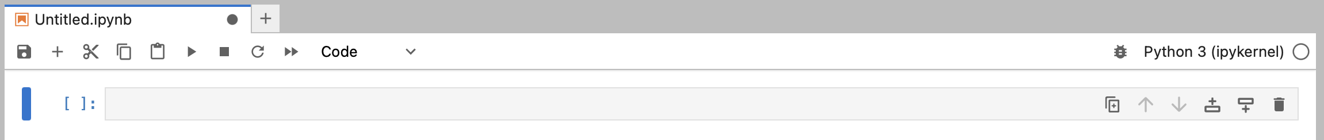
Jupyter notebook
Installation and setup
1. Install anaconda https://www.anaconda.com/docs/getting-started/anaconda/install#macos-linux-installation
2. Create an environment with required packages conda create -n DSML4geo scipy matplotlib numpy
3.Activate environment conda activate DSML4geo
4. Install jupyterlab either using command line conda install -c conda-forge jupyterlab or anaconda GUI (next page
Opening a notebook and getting started
Make sure your environment is activated conda activate DSML4geo
Navigate into the directory where your class materials are
In the command line, type jupyter lab (or type jupyter-notebook name_of_notebook.ipynb
A new browser tab should open. Note that this doesn’t require an internet connection.
Either open an existing notebook using the file manager at the left or create a new notebook using the launcher panel.
You can have more than one notebook open at once; they open as tabs at the top.
Writing some code
Jupyter notebooks (.ipynb) can contain both python code and text. The text can be formatted using markdown. Each box is called a cell.
To select a cell, click the left hand side, to the left of the square brackets. The active cell will have a blue bar.
Add or remove cells using the plus and scissors. Alternatively type x to delete and a or b to add cells above and below respectively.
To run a cell, press the play sign (▸). Or when you are clicked into the cell to edit it, press shift and enter to run and move to the next cell, or command and enter to stay in the active cell. When a code cell runs, a number will appear in the square brackets. This shows the order the cells have been run in.
You need to run the cells in order, otherwise you will get errors. If anything goes wrong, just restart the kernel (i.e. to remove the outcomes of all calculations from memory, but not to delete any code/text you have written). Use the ⟳ arrow.
To make a cell markdown, click to the left of the [ ] and type m. To get back to code, use y. Otherwise, use the drop down (code/text/raw).
Markdown Headings: Use # for a title, ## for a section, and ### for a sub-section; Lists: Use * or - for bullet points.

Slide 2
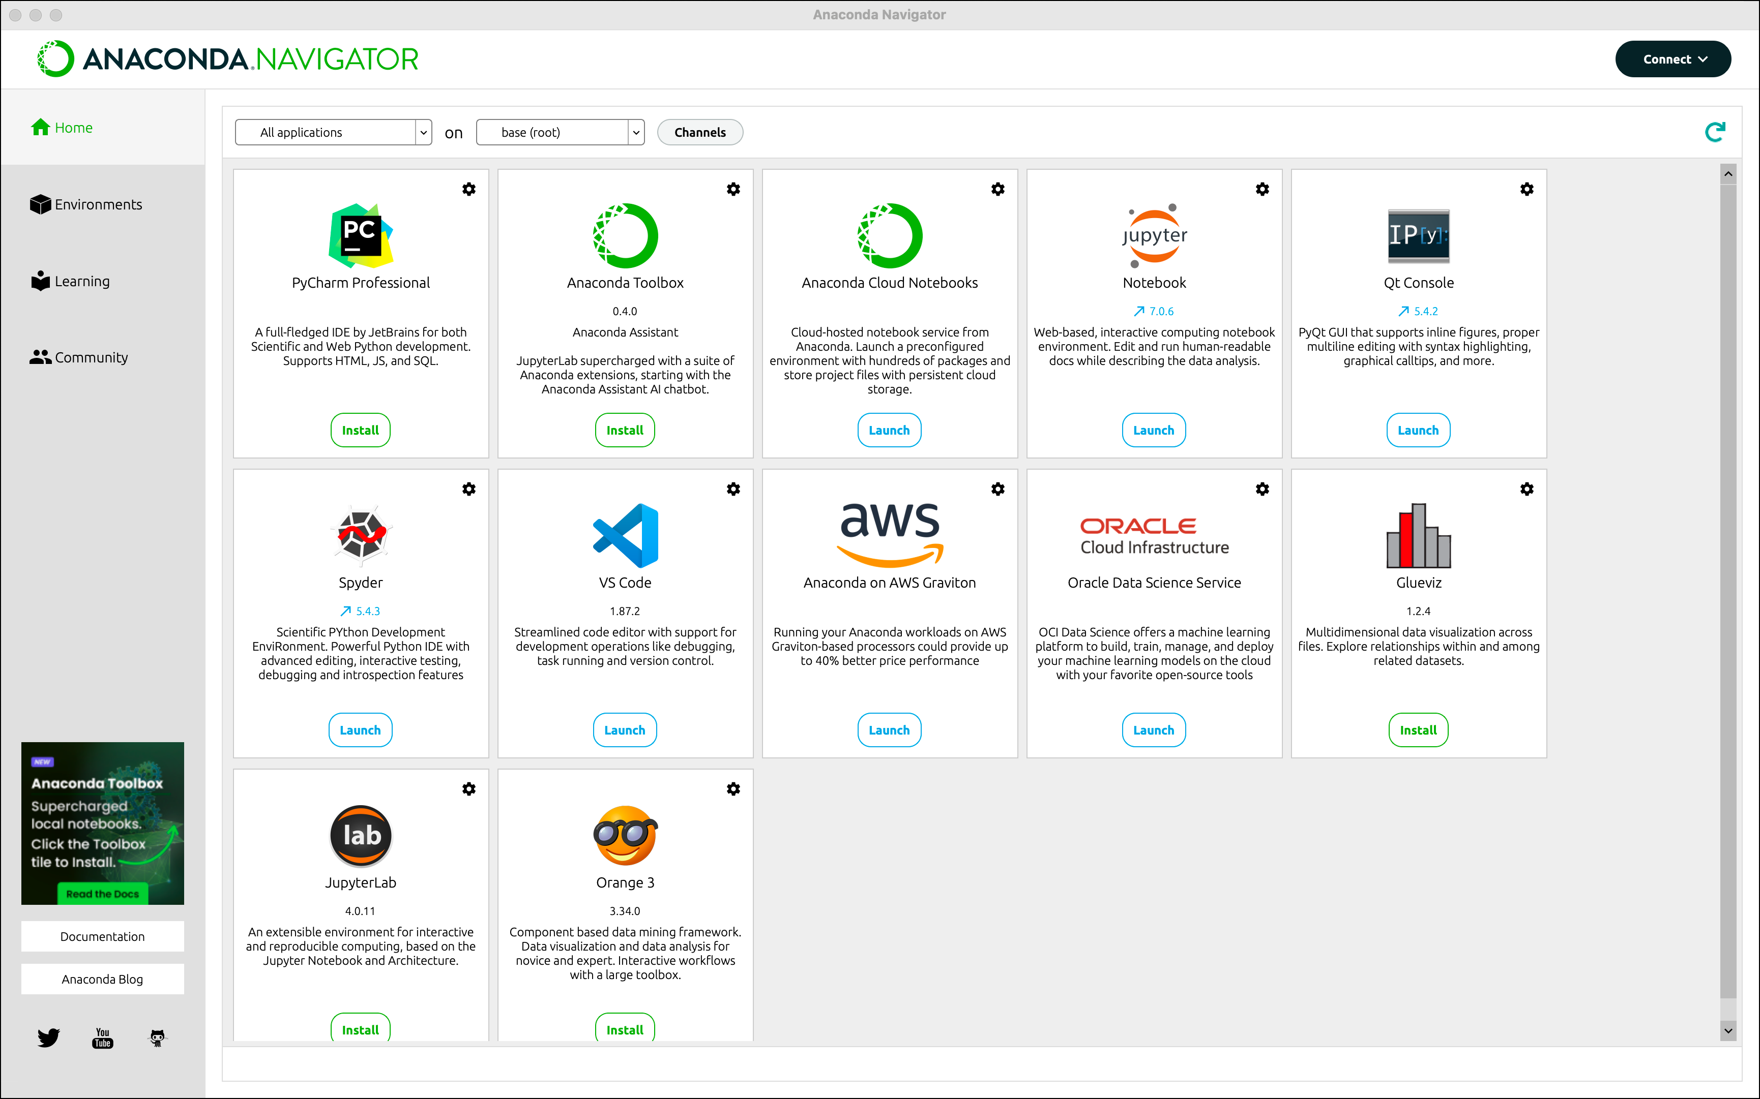
Jupyterlab

Slide 3
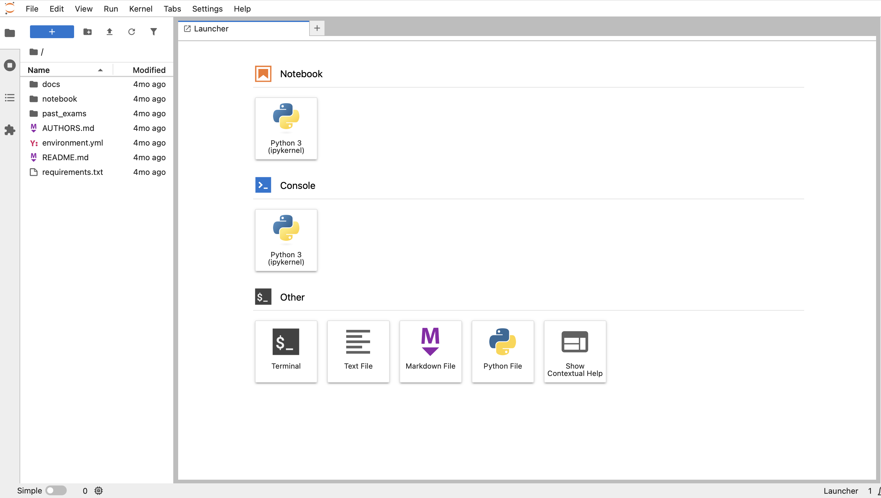
Jupyterlab

