Slide 1

Data Science and Machine Learning for Geoscientists
Lecture 3: Exploratory data analysis with plotting and visualisation
Samaneh Abolpour Mofrad
Sabolpou@ic.ac.uk
22 October 2026
Imperial College London

Slide 2
Today’s lecture
Contents
Recap of last week exercises
Exploratory data analysis
Visualisation
    Matplotlib
    Seaborn

Slide 3
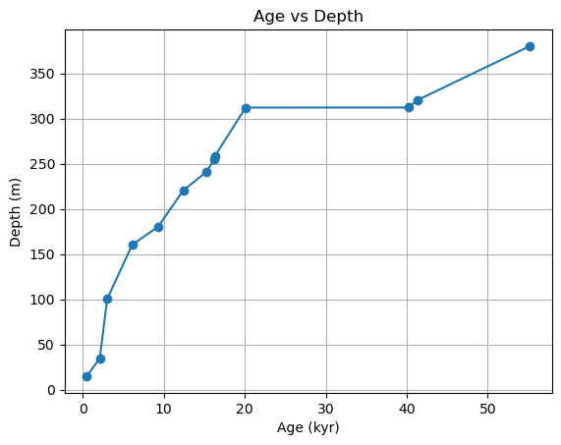

Exercise 1 recap
What does the dataset describe?
The array has shape (2,13): row 0 is age in Myr and row 1 is depth in metres.
Marker | Age (Myr) | Depth (m)
1 | 0.5 | 15.0
2 | 2.1 | 35.0
3 | 3.0 | 100.3
4 | 6.1 | 160.3
Frist four markers
$$×$$
Myr
Notes:
You have two objectives in this exercise:
1. To produce a matrix that shows the sedimentation rate between each marker in **cm/kyr**. Note that the units are different than the units you were given above, so you will need to account for that.
2. I also want to know what the average sedimentation for this site is.

Slide 4
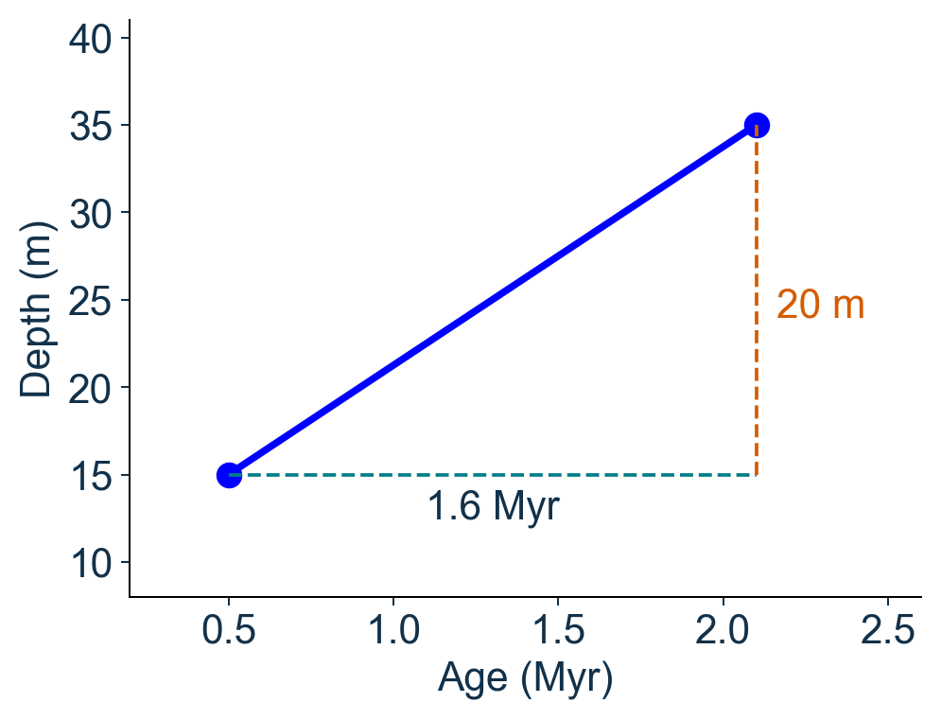
Recap
Sedimentation rate between two markers
Rate = change in depth / change in age
Depth change: 35 − 15 = 20 m
Age change: 2.1 − 0.5 = 1.6 Myr
Rate= 20 / 1.6 = 12.5 m/Myr
Rate= 12.5 × 100 / 1000 = 1.25 cm/kyr

Slide 5
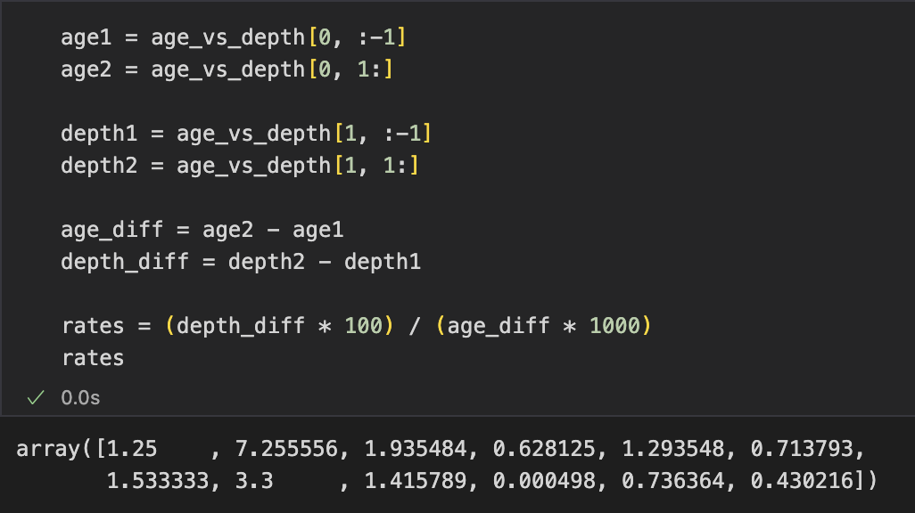
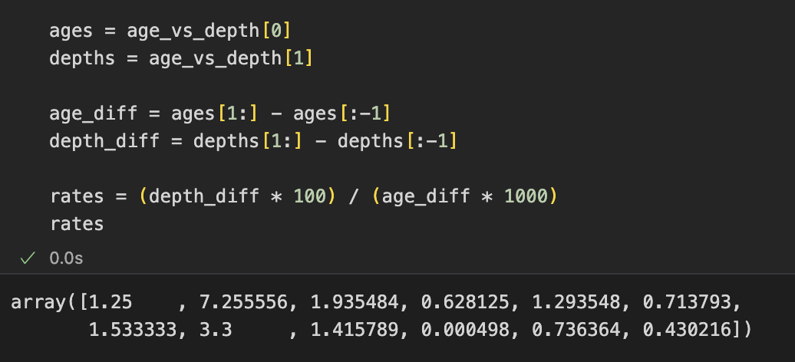
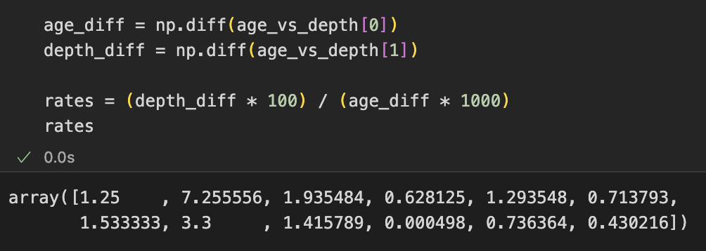
Exercise 1 recap
Calculating all intervals with NumPy

Slide 6
Exercise 1 recap
Two different meanings of “average”
Arithmetic mean: each interval receives equal weight
rates = (depth_diff * 100) / (age_diff * 1000)
rates.mean()
1.7077 cm/kyr
Total thickness / total time
Overall rate: total depth change divided by total elapsed time
overall_rate = (depth_diff.sum() * 100) / (age_diff.sum() * 1000)
OR
overall_rate = (depths[-1] - depths[0]) / (ages[-1] - ages[0]) * 0.1
0.6675 cm/kyr

Slide 7
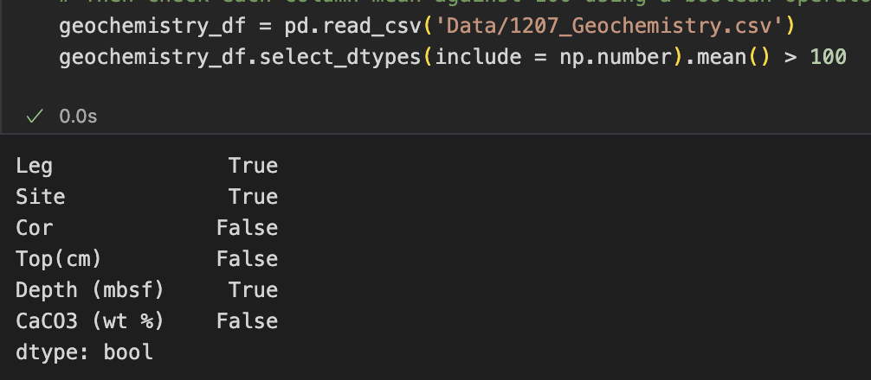
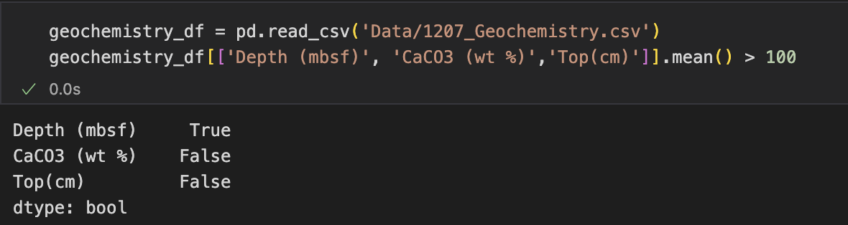
Exercise 3 recap
Write a one-line program that outputs a series of Boolean values (True or False) that indicates whether the mean of each numeric column is bigger than 100.
All numeric columns
Selected measurement columns

Slide 8
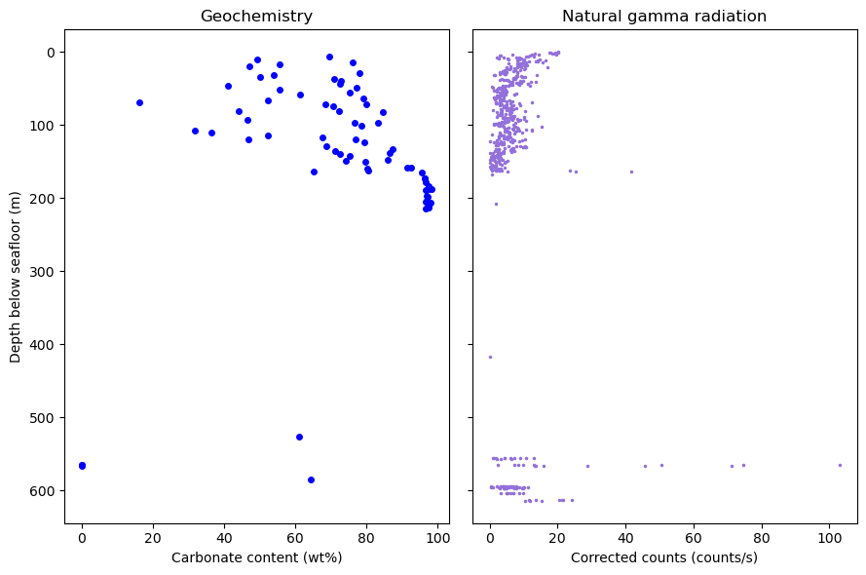
Exercise 4 recap
Two measurements from ODP Site 1207
What is the average carbonate content of samples from ODP Site 1207 where the gamma ray count is >30?
Geochemistry
Carbonate content: CaCO3 (wt %)
Natural gamma radiation
Corr. Counts: corrected counts per second
Shared coordinate: Depth (mbsf)
mbsf = metres below seafloor.

Slide 9
Exercise 4 recap
Matching observations using rounded depth
One geochemistry sample
Three gamma measurements
Depth (m) | Rounded | CaCO3 (wt%)
6.95 | 7 | 69.630
Depth (m) | Rounded | Counts (cps)
6.60 | 7 | 11.18
6.90 | 7 | 10.75
7.20 | 7 | 7.78
A shared key can create several matches for one sample.
How many merged rows will this example produce?

Slide 10
Exercise 4 recap
The merged table: three matches for one sample
Depth (mbsf) | CaCO3 (wt %) | Corr. Counts
7 | 69.630 | 11.18
7 | 69.630 | 10.75
7 | 69.630 | 7.78
Rounded depth is the shared key.
The same carbonate measurement appears in all three rows.

Slide 11
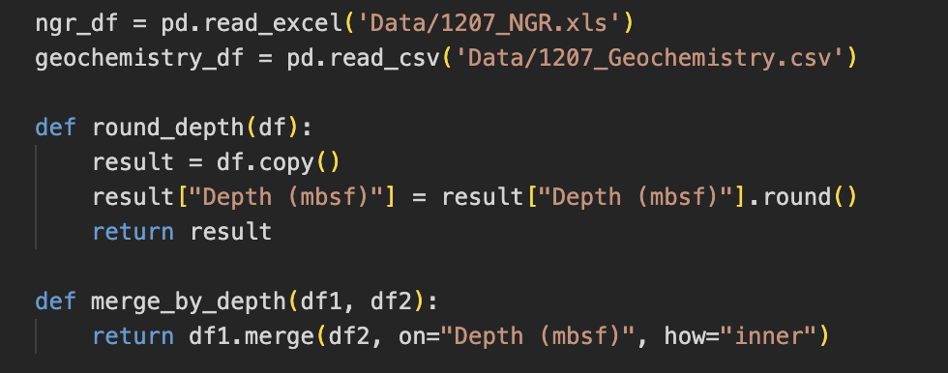
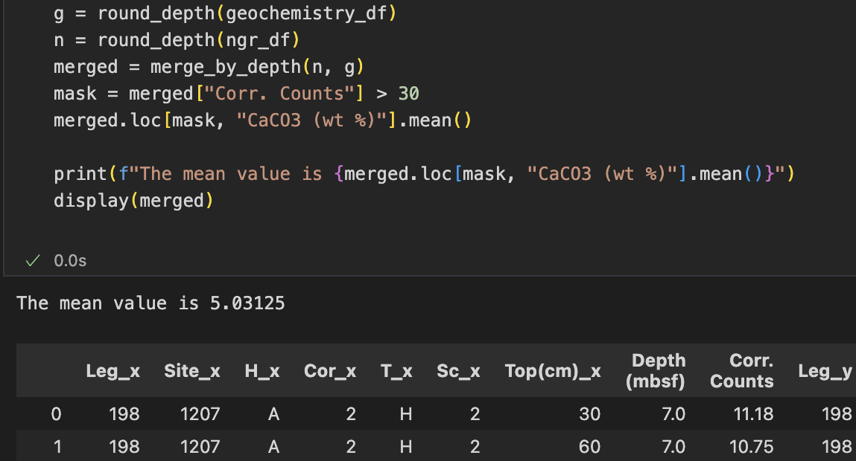
Exercise 4 recap
Copy, round, merge and filter
Mean across the selected rows: 5.03125 wt%
Notes:
Some samples appear more than once after merging, so this mean gives more weight to samples with more matching gamma measurements.

Slide 12
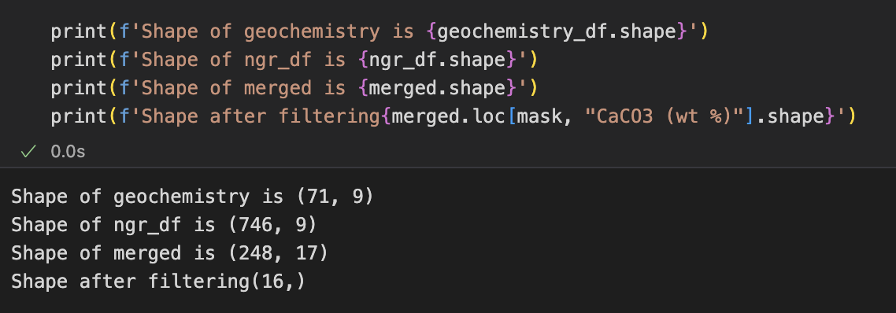
Exercise 4 recap
Dataset / selection | Rows | Columns
Geochemistry (geochemistry_df) | 71 | 9
Natural gamma radiation (ngr_df) | 746 | 9
After merging (merged) | 248 | 17
After filtering Corr. Counts > 30 | 16 | 17

Slide 13
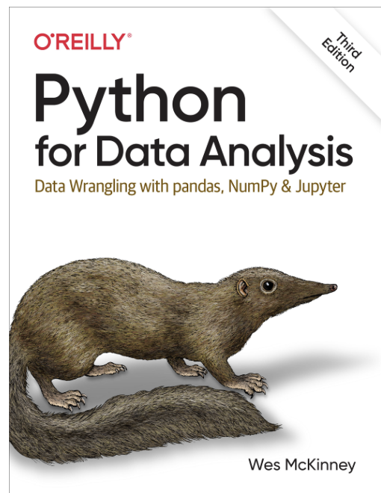
Exploratory data analysis
A scientific question before a plot
EDA is an investigative process to summarize, and visualize data sets to discover patterns, spot anomalies, test assumptions, and check relationships before building models.
Chapter 7 and 9
Question | A useful starting plot
How are values distributed? | Histogram or density plot
How do two measurements vary together? | Scatter plot
Where do events occur? | Map or coordinate plot
How do groups differ? | Box plot or grouped distribution

Slide 14
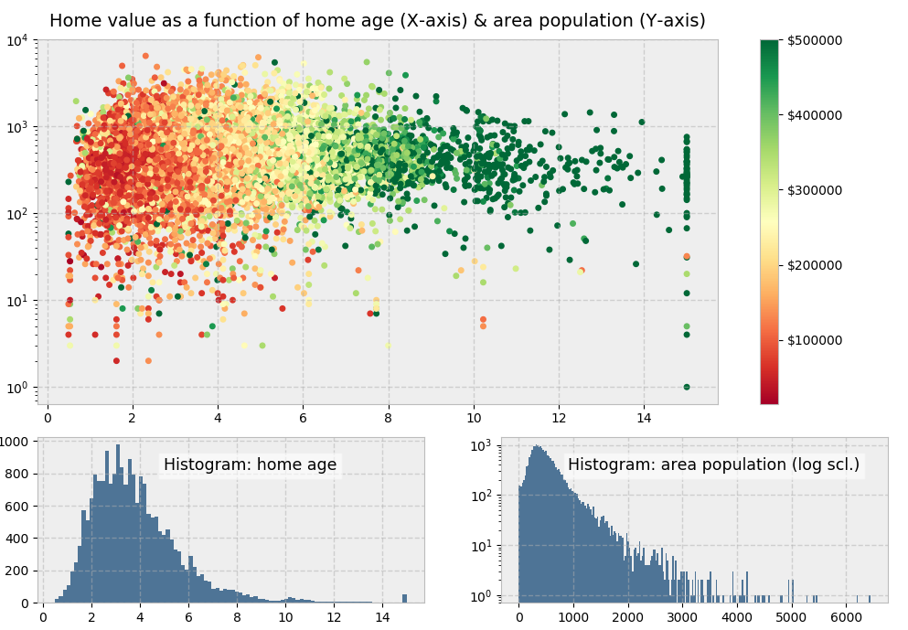

Matplotlib
Visualisation in Python
Library for creating static, animated, and interactive visualizations in Python
Allows you to plot graphs and other visuals
Extremely fine control over the plot

Slide 15
Exploratory data analysis
The California event catalogue
One row is an event, but not every event is an earthquake
313,342 catalogue entries, 293,145 labelled “earthquake”
raw = pd.read_csv(
"Datasets/combined_eq_"
"california_clean.csv"
)
is_quake = raw["type"].eq(
"earthquake"
)
eq = raw.loc[is_quake].copy()
raw.type.nunique()
# 15
Column | Meaning
type | Earthquake, explosion, …
mag | Magnitude estimate
depth | Event depth in kilometres
longitude / latitude | Event location in degrees
sig | Significance score
First inspection: raw.head(), raw.info(), raw["type"].value_counts()
15

Slide 16
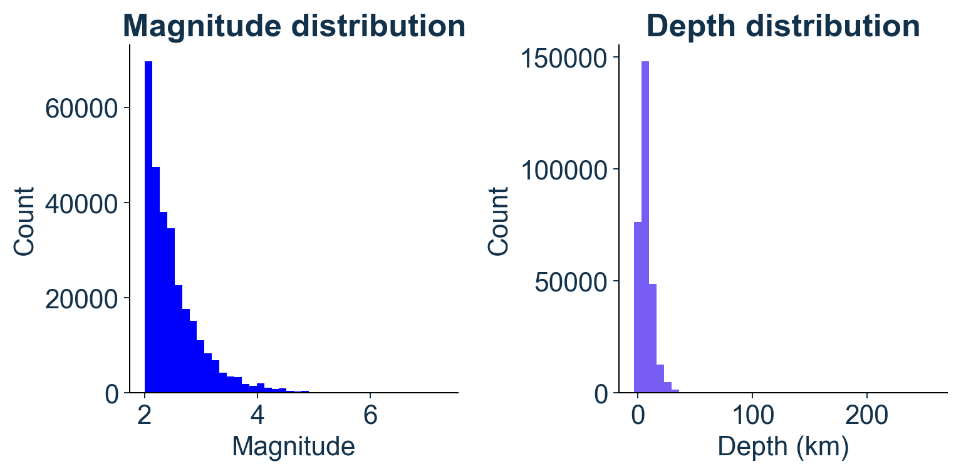
Matplotlib
The Figure holds the Axes
import matplotlib.pyplot as plt
fig, ax = plt.subplots() # One plotting area
fig, axes = plt.subplots(1, 2, figsize=(10, 4))
axes[0] is the left plotting area; axes[1] is the right one.
A Figure is the whole output canvas.
An Axes is an individual plotting area with its data and axes.
A single figure can have several Axes.

Slide 17
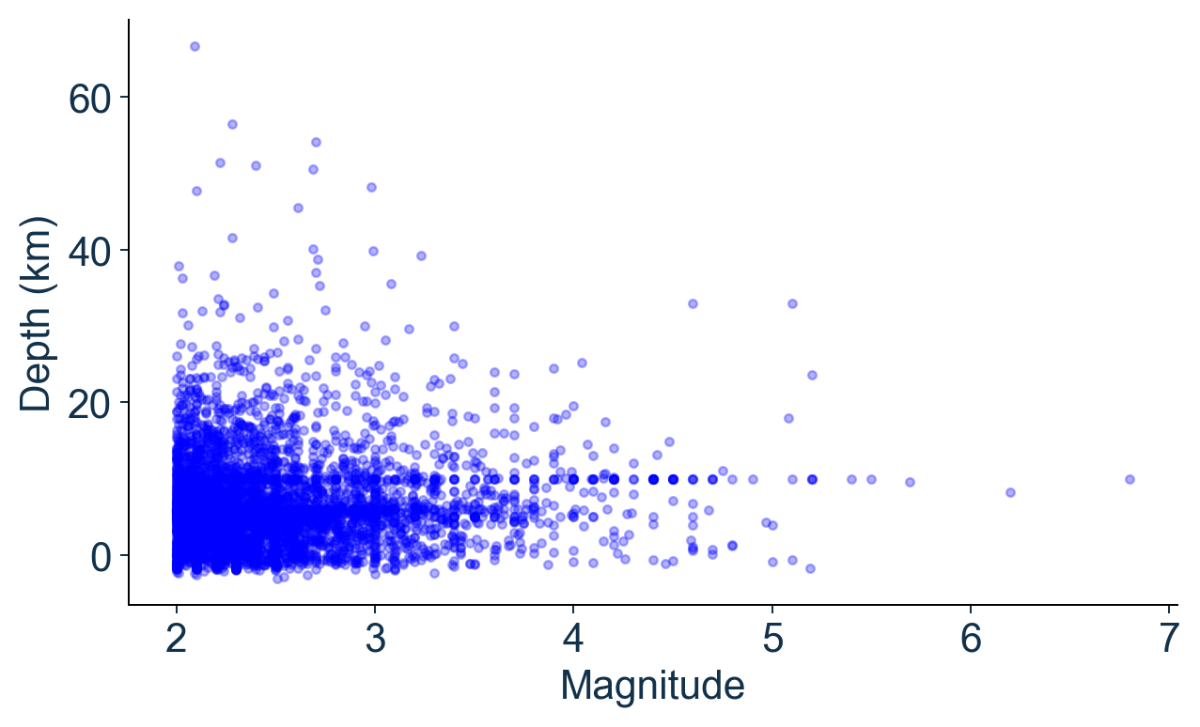
Scatter plots
How do two measurements vary together?
sample = eq.sample(
n=5000, random_state=7)
plt.scatter(
sample["mag"],
sample["depth"],
s=10, alpha=0.25)
One dot represents one event. What patterns can you see?

Slide 18
Scatter plots
How do two measurements vary together?
Most dots cluster around magnitude 2-3 and depths of roughly 0-20 km. Small, shallow earthquakes dominate this sample.
Larger-magnitude events are less common. There are fewer dots toward the right of the plot.
There is no obvious straight-line relationship between magnitude and depth. Earthquakes of similar magnitude occur at different depths.

Slide 19
Plot directly from pandas
Choose the plot type for your question
A Series plots one column. A DataFrame can compare columns.
eq.mag.plot() Also works
Code | Plot type | What it shows
eq["mag"].plot() | Line | Values against index
eq["mag"].plot.hist(bins=30) | Histogram | Magnitude distribution
eq.plot.scatter(x="mag", y="depth") | Scatter | Magnitude versus depth

Slide 20
pandas and Matplotlib
Two ways to draw the same scatter plot
Matplotlib
fig, ax = plt.subplots()
ax.scatter(
sample["mag"],
sample["depth"],
s=10, alpha=0.3
)
Pandas
ax = sample.plot.scatter(
x="mag",
y="depth",
s=10, alpha=0.3
)
In both examples, ax is a Matplotlib plotting area:
ax.set_xlabel("Magnitude")
ax.set_ylabel("Depth (km)")
Data Science and Machine Learning for Geoscientists
20

Slide 21
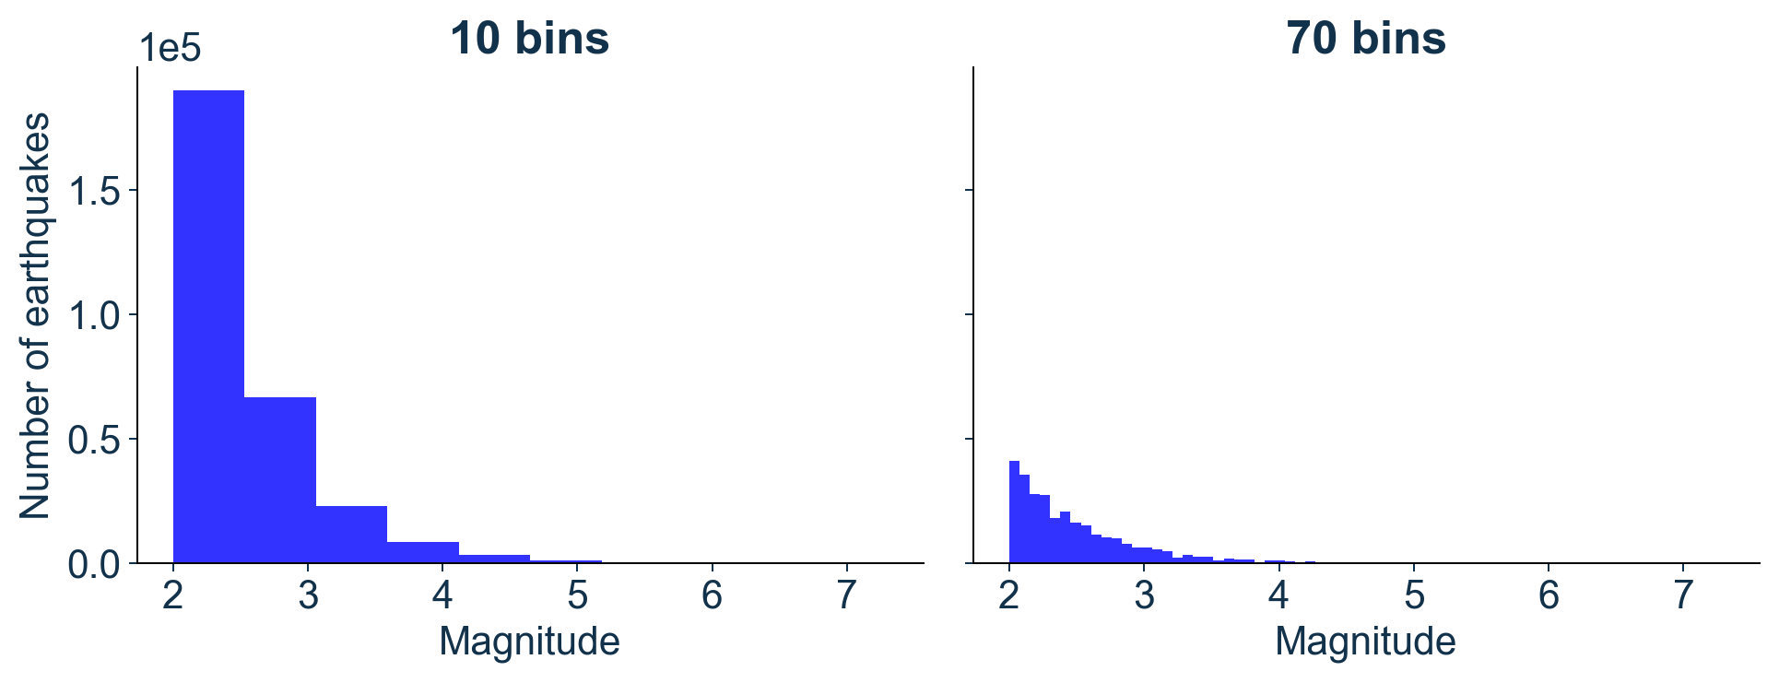
Histograms
The same measurements, different bin choices
ax.hist(eq["mag"].dropna(), bins=30)
What changes when you change the number of bins?
Both panels show all 293145 natural-earthquake rows, using non-missing magnitudes.
A histogram groups numerical observations into intervals and counts how many fall in each.
Ten bins simplify the shape;
70 bins reveal finer variation but may emphasise noise.
A high bin count is not inherently better.

Slide 22
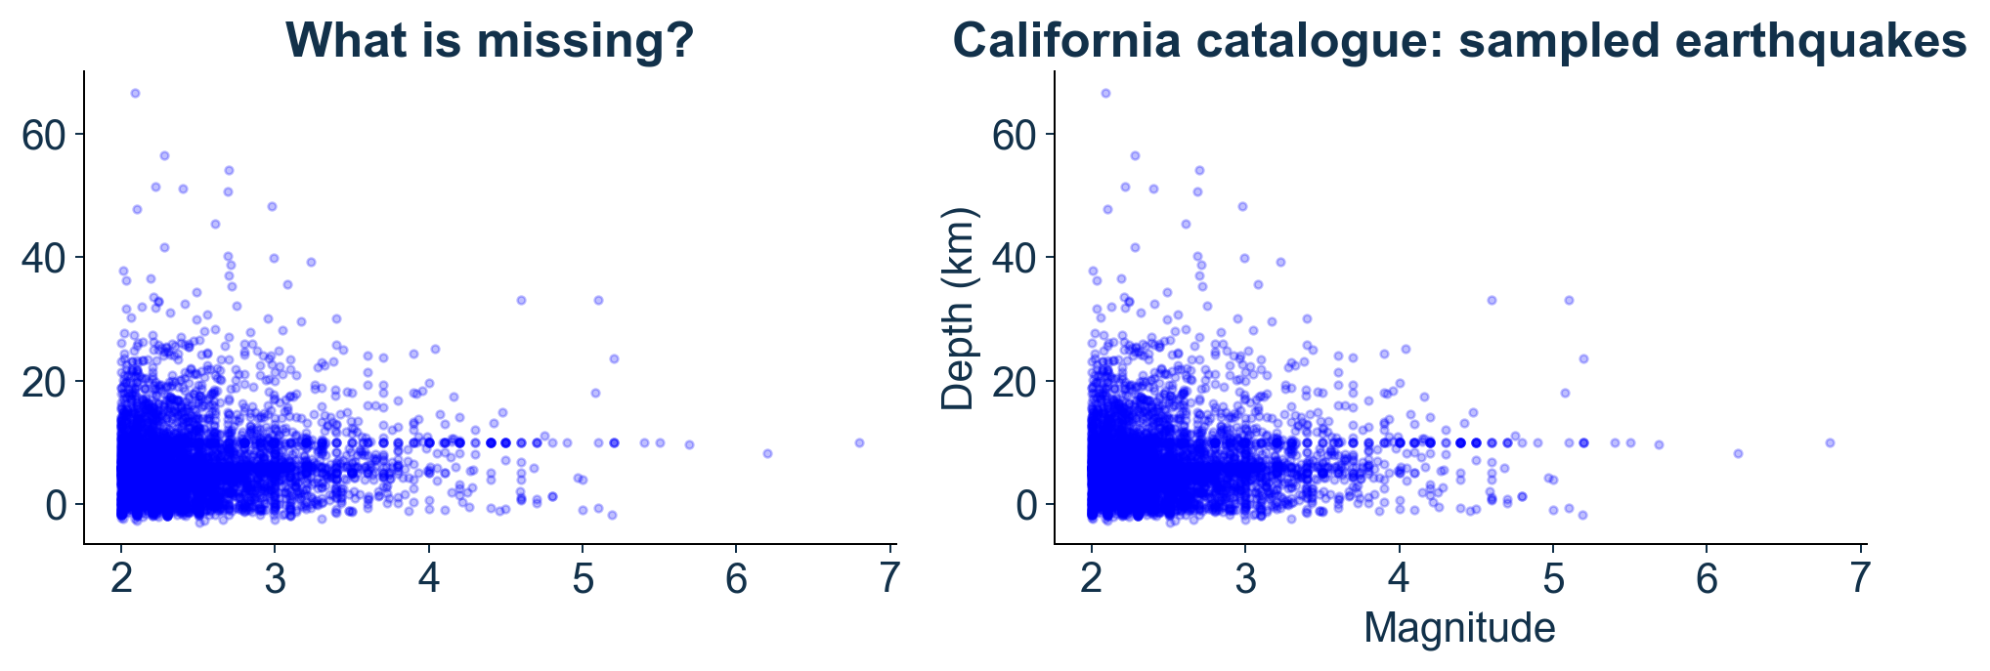
Clear figures
Labels make the interpretation possible
ax.set(xlabel="Magnitude", ylabel="Depth (km)")
Data Science and Machine Learning for Geoscientists
22

Slide 23
Subplots and export
Several views of the same dataset
fig, axes = plt.subplots(1, 2, figsize=(10, 4))
axes[0].hist(eq["mag"].dropna(), bins=30)
axes[0].set(xlabel="Magnitude", ylabel="Count")
axes[1].hist(eq["depth"].dropna(), bins=30)
axes[1].set(xlabel="Depth (km)", ylabel="Count")
fig.tight_layout() #automatically adjusts subplot parameters
fig.savefig("earthquake_distributions.png", dpi=300)
Data Science and Machine Learning for Geoscientists
23

Slide 24
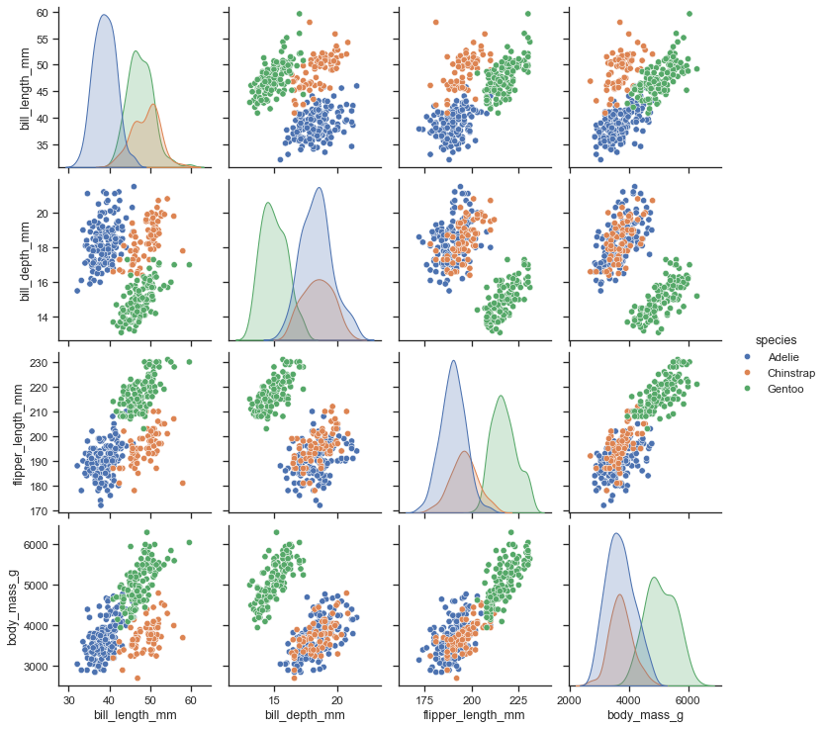

Seaborn
Statistical data visualisation
Seaborn is a statistical visualisation library built on Matplotlib. It works conveniently with pandas DataFrames.
Relatively easy to get started; can make nice plots with a few lines of code
You can combine both libraries to get to the best of both worlds

Slide 25
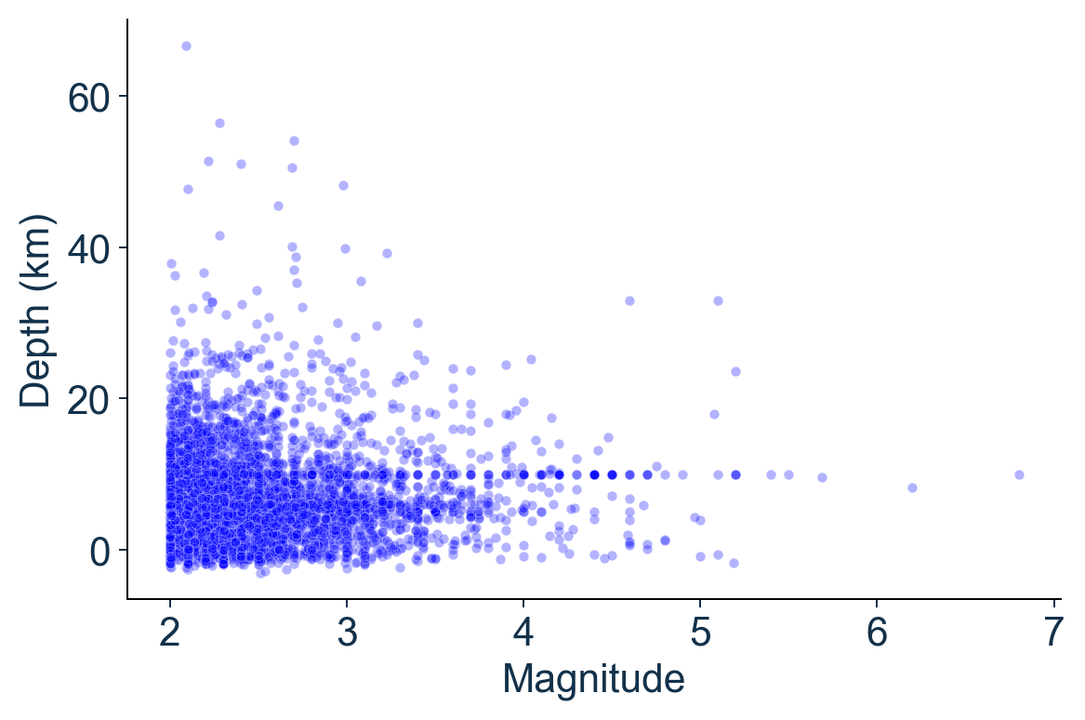
Seaborn
Statistical plotting with DataFrames
import seaborn as sns
ax = sns.scatterplot(
data=sample,
x="mag", y="depth",
alpha=0.3
)
ax.set(
xlabel="Magnitude",
ylabel="Depth (km)"
)
Seaborn is built on Matplotlib, so they work together.
Use Seaborn to create the plot, then Matplotlib to customise it.
Data Science and Machine Learning for Geoscientists
25

Slide 26
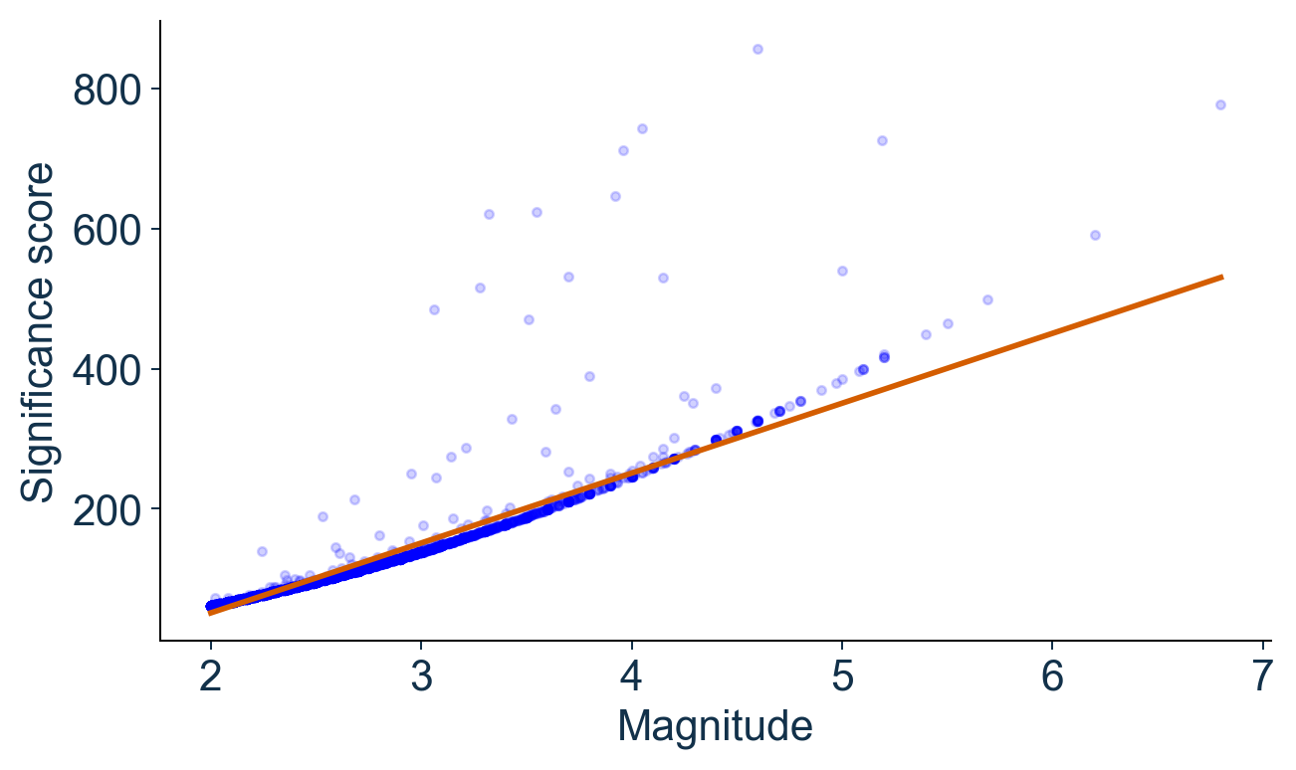
Seaborn
Relationships between variables
Magnitude and significance
regplot adds a fitted regression line; scatterplot does not.
The line is descriptive, not a validated predictive model.
A strong association needs a meaningful explanation.
The significance score already uses magnitude in its calculation.
sns.regplot(data=sample, x="mag", y="sig")
Seaborn regression documentation
Data Science and Machine Learning for Geoscientists
26

Slide 27
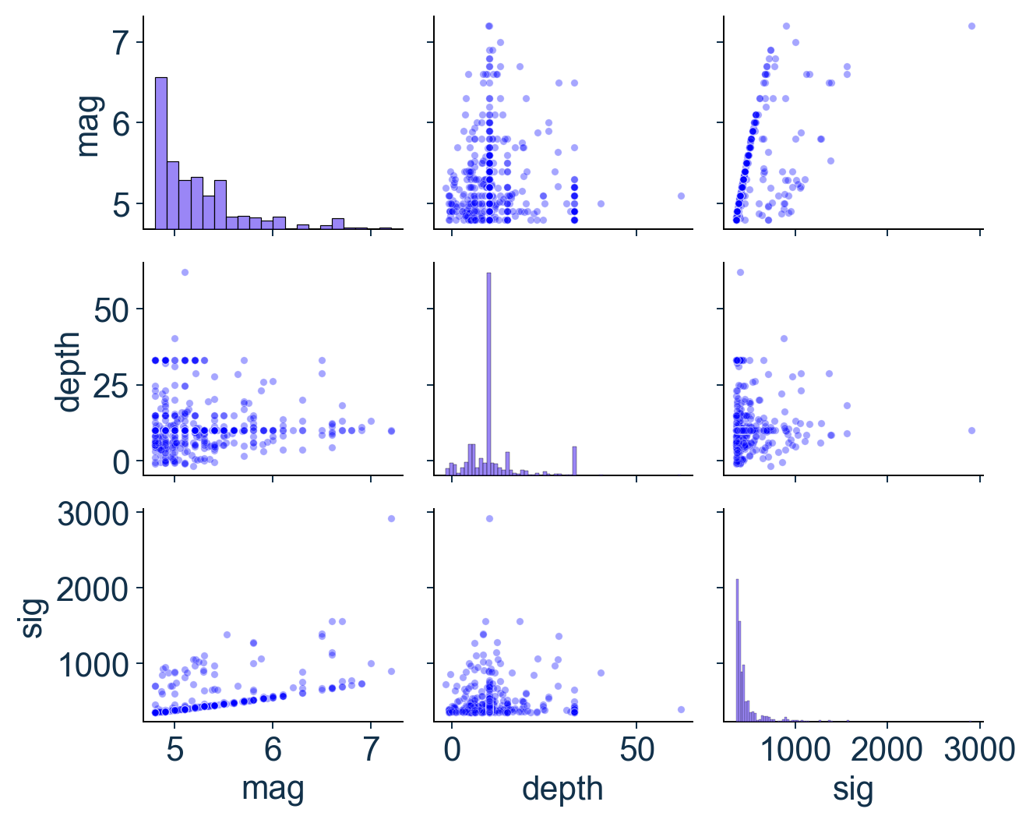
Seaborn
Pairplots
Diagonal:
One variable’s distribution
Off-diagonal
Relationships between
two variables
sns.pairplot(data=subset, diag_kind="hist")
Example: 500 earthquakes with magnitude ≥ 4.8, using magnitude, depth and significance.
Data Science and Machine Learning for Geoscientists
27

Slide 28
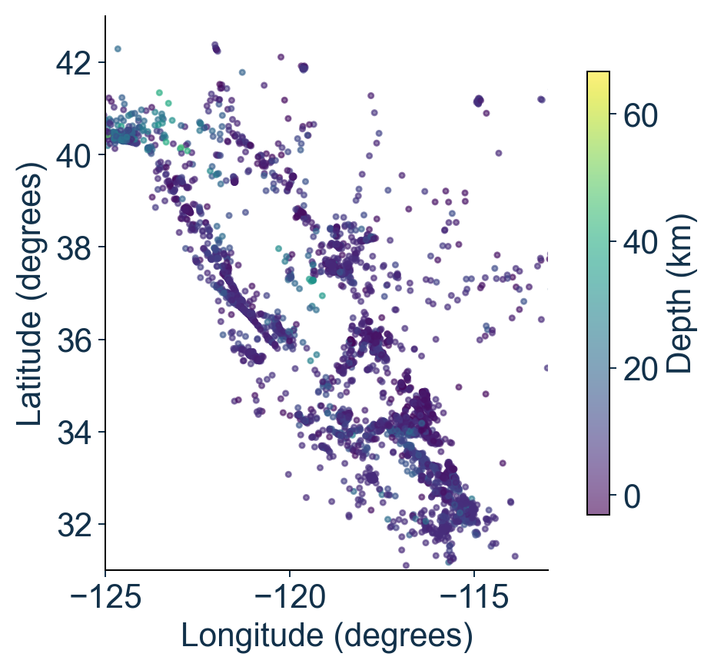
Earthquake locations
Colour represents event depth
Matplotlib:
plt.scatter(sample["longitude"], sample["latitude"], c=sample["depth"], cmap="viridis", s=7, alpha=0.6)
Seaborn alternative:
sns.scatterplot(data=sample, x="longitude", y="latitude", hue="depth", palette="viridis", s=7, alpha=0.6)

Slide 29
More visualisation tools
Interactive plots and explanatory animations
Library | Useful for
Matplotlib | Creating and customising scientific figures
Seaborn | Exploring statistical patterns in tables
Plotly | Interactive plots: zoom, hover and explore
Manim | Animations that explain concepts step by step
I will add an optional notebook with short examples to help you try Plotly and Manim and become familiar with them.

Slide 30
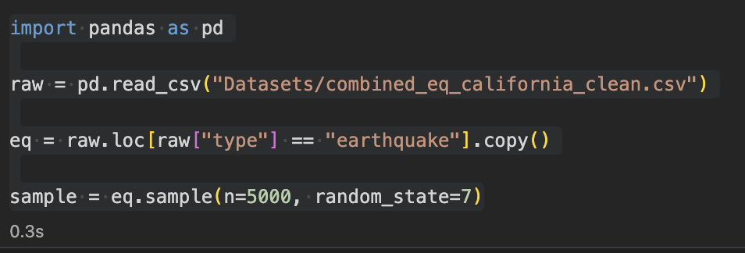
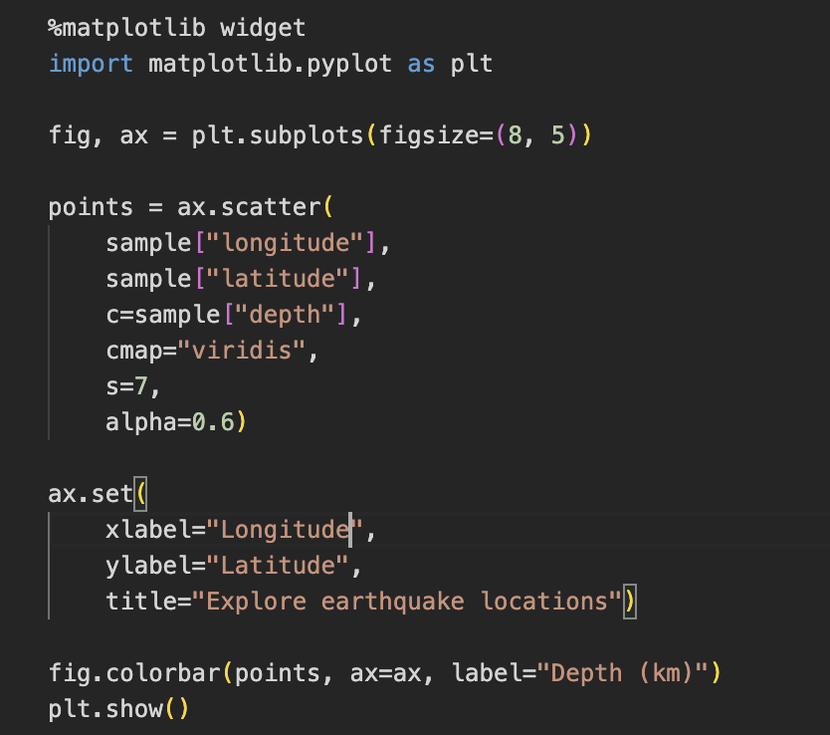
Interactive plots with Matplotlib
Install in terminal:
pip install ipympl
For conda environment:
conda install -c conda-forge ipympl
Restart the kernel
Add this line before importing matplotlib
%matplotlib widget
import matplotlib.pyplot as plt

Slide 31
