Slide 1

Data Science and Machine Learning for Geoscientists
Data Science and Machine Learning for Geoscientists
Lecture 4: Data preprocessing with scikit-learn
Lecture 4: Data Preprocessing
Samaneh Abolpour Mofrad
Sabolpou@ic.ac.uk
Samaneh Abolpour Mofrad
Sabolpou@ic.ac.uk
29 October 2026
Imperial College London
Imperial College London

Slide 2
Today’s lecture
Data preparation for machine learning
Recap from last week
Data preparation for machine learning
    Identify duplicates and handling missing measurements
    Explain fit(), transform() and the role of a test set.
    Get familiar with scikit-learn
    Use imputers and scalers in a scikit-learn Pipeline.

Slide 3
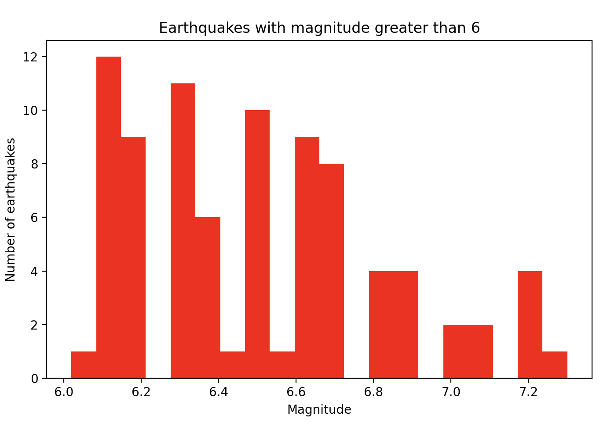

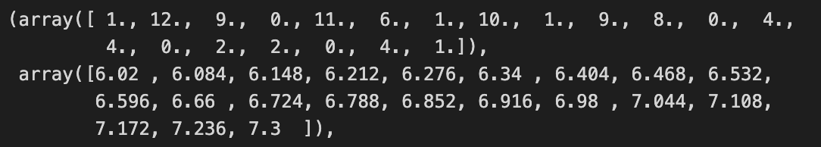
Lecture 3 recap
Exercise 3: a histogram of larger earthquakes
Plot a histogram showing the frequency of earthquakes with a magnitude greater than 6. Use red for the color of the bins. Limit your plot to 20 bins.
How many earthquakes are between 6 and 6.2?
count from the displayed bins:
1+12+9 = 22

Slide 4
Lecture 3 recap
Fixed interval needs an explicit counting rule
Question: how many events have magnitude between 6 and 6.2?
mask = (caliquakes_df["mag"] > 6.0) & (caliquakes_df["mag"] <= 6.2)
count = mask.sum()
print(count)
# 13
# 22

Slide 5
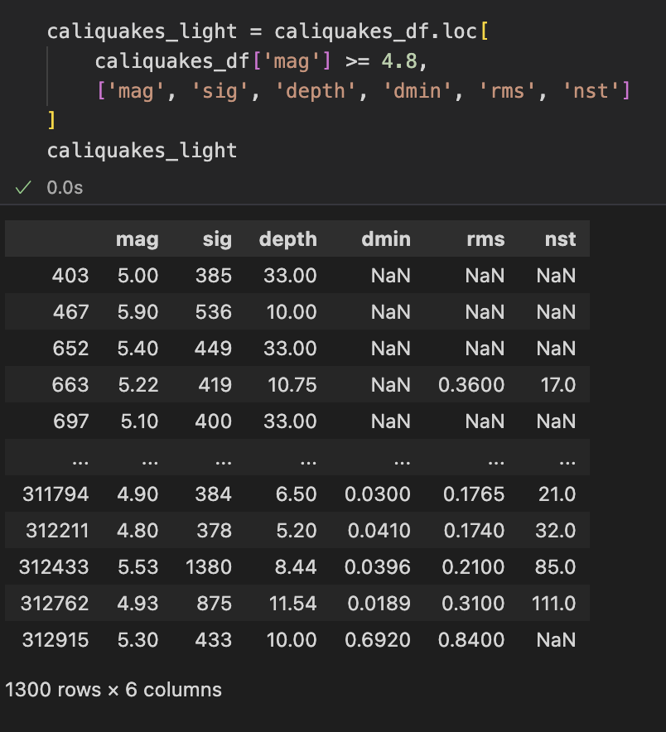
Lecture 3 recap
Exercises 4: correlation
Create a new dataframe that is a subset of caliquakes_df and keeps only data with a magnitude >= 4.8 and only contains these series: mag, sig, depth, dmin, rms, nst
df.loc[rows, columns]

Slide 6
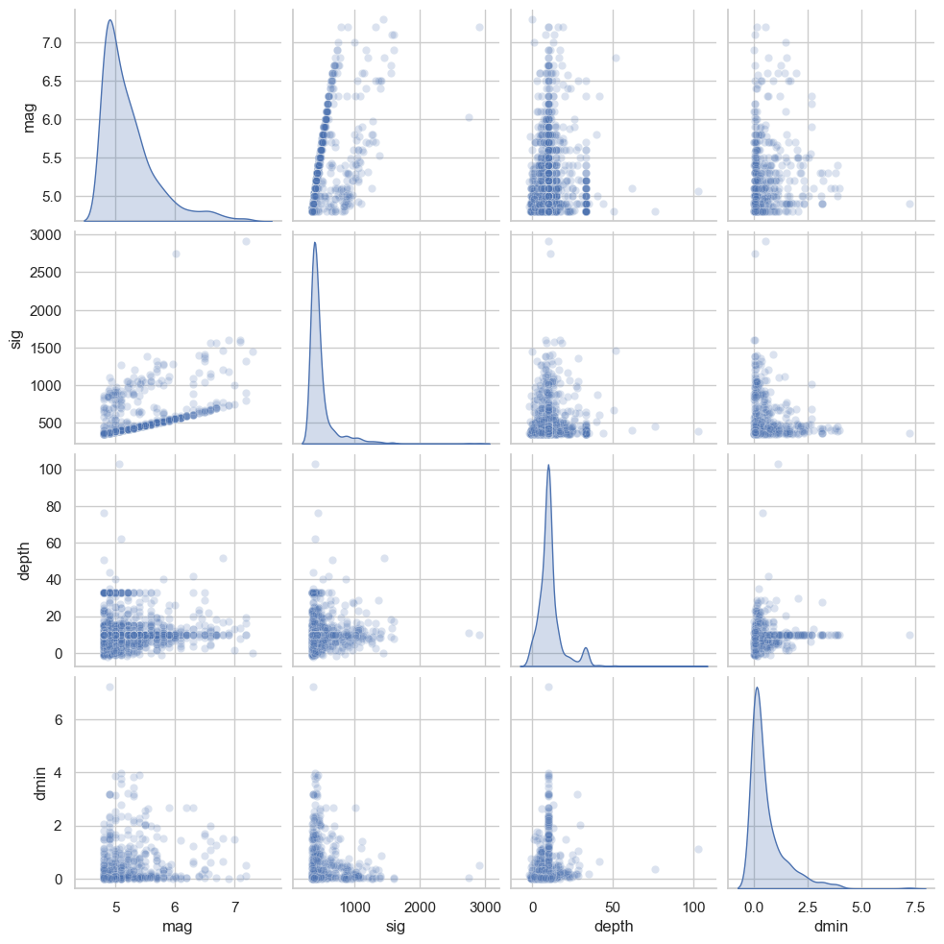
How to read a pairplot
Diagonal panels: show the distribution of each individual variable.
Other panels: show relationships between two variables. Each point represents an earthquake.
Look for center, spread, trends and clusters when comparing variables.
A kernel density estimate (kde) estimates the distribution of one variable by smoothing observations
sns.pairplot(df[['mag', 'sig’, 'depth’, 'dmin’]],
diag_kind='kde');
StatQuest: Pearson’s correlation

Slide 7
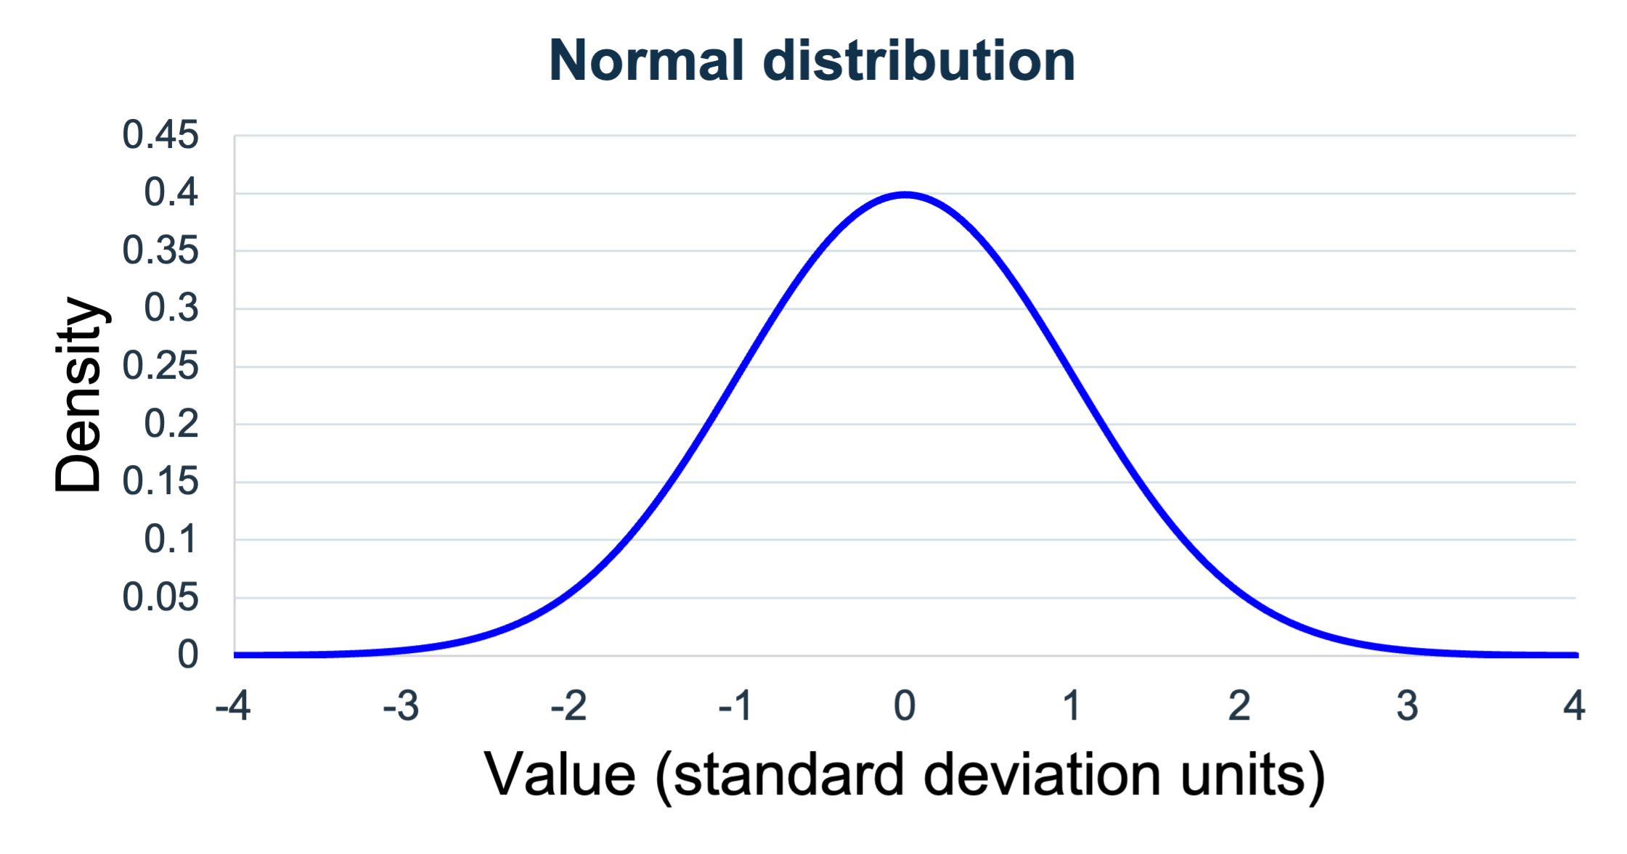
The normal distribution
A symmetric bell-shaped distribution
In this standard normal example, the mean is 0 and the standard deviation is 1.
Most values lie near the centre, fewer lie towards the extremes.
Mean = median
The y-axis is density; probability corresponds to an area over an interval, not the curve height at one point.
Symmetry alone is not proof of normality. A normal distribution has a specific bell shape with a single peak.
Watch StatQuest: The Normal Distribution

Slide 8
Mean and median
A small porosity example
Mean: Sum of all values divided by the number of values.
Median: is the exact middle value when the data points are ordered from smallest to largest. For an even set, the median is the average of the two middle numbers.
Illustrative porosity values (vol%) | Summary
40, 45, 50, 55, 80 | Mean = 54 vol%
Sorted middle value: 50 | Median = 50 vol%
The mean uses every value. The median locates the middle.
StatQuest: Mean, variance and standard deviation

Slide 9
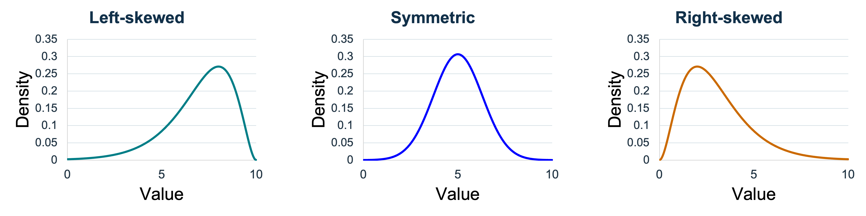
Skewness
The tail gives the direction
Longer tail towards smaller values
Mean < median < mode
The two sides mirror one another
Mean = median = mode = 5
Longer tail towards larger values
Mode < median < mean
Notes:
A skewed distribution is asymmetric. A longer tail toward high values is right (positive) skew; a longer tail toward low values is left (negative) skew

Slide 10
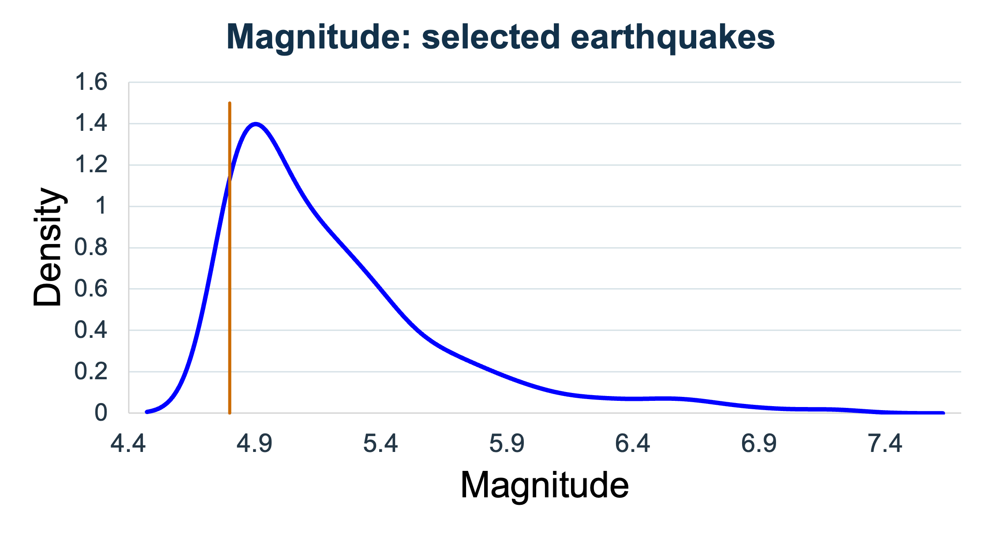
Earthquake distributions
Interpreting the diagonal panels
Many selected earthquakes lie near the lower threshold and relatively few have large magnitudes.
The longer tail to high values is right skewness.
The median gives a useful central comparison because large values influence the mean.
Orange line: selection threshold = 4.8
KDE can extend below the selection threshold because of smoothing; that does not mean the selected dataset contains observations below 4.8.
Mode < median < mean

Slide 11
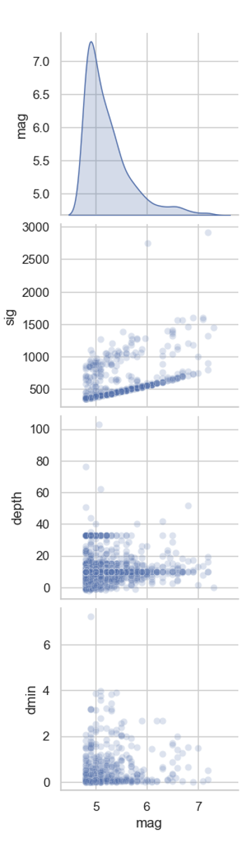
Relationships between earthquake measurements
Pair | What to explain
Magnitude and significance | Larger earthquakes generally have higher significance scores, but earthquakes of the same magnitude can have different scores.
Magnitude and depth | Most earthquakes in this subset occur at shallow depths. There is no clear upward or downward trend: larger earthquakes are not consistently deeper or shallower.
Magnitude and dmin | Most earthquakes have small distances to the nearest recording station. There is no clear overall trend between magnitude and this distance.

Slide 12

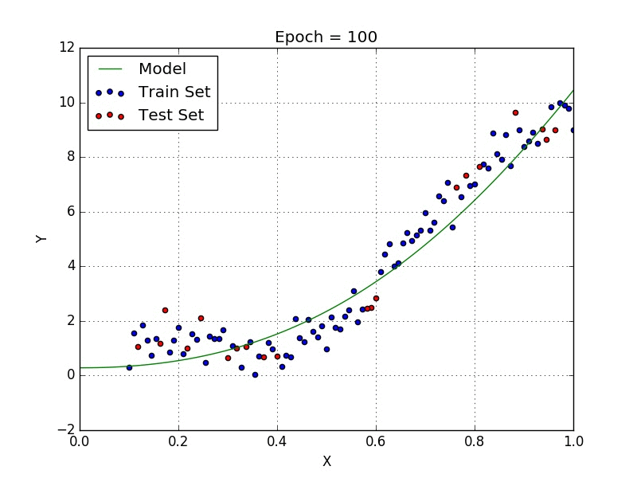
Introducing scikit-learn
Our next tool for preparing data
Scikit-learn is a Python library for data preprocessing and machine learning.
Today, we will use it to:
    Split data into training and test sets.
    Fill missing measurements using values learned from training data.
    Scale numerical variables.
    Combine preparation steps into a reusable pipeline.
Later, we will use it to build and evaluate predictive models.
Notes:
Plots help us understand our data. Now we need to turn that understanding into a consistent preparation process.

Slide 13
How our Python tools work together
Library | Role in workflow
Pandas | Load, inspect and clean data tables
NumPy | Work with numerical arrays
Matplotlib / Seaborn | Visualise distributions and relationships
scikit-learn | Fit and apply reusable preprocessing steps
We will use these tools together to prepare sediment-core measurements.

Slide 14
The core dataset
Data collected along drilled sediment cores
Column | Interpretation
label | Sample identifier
Depth CSF-A (m) | Core depth in metres
Porosity (vol%) | Pore volume percentage
NGR total counts (cps) | Natural gamma count rate
Reflectance L*, a*, b* | Lightness and colour coordinates
Each row represents a sample with associated measurements.
cps: counts per second

Slide 15
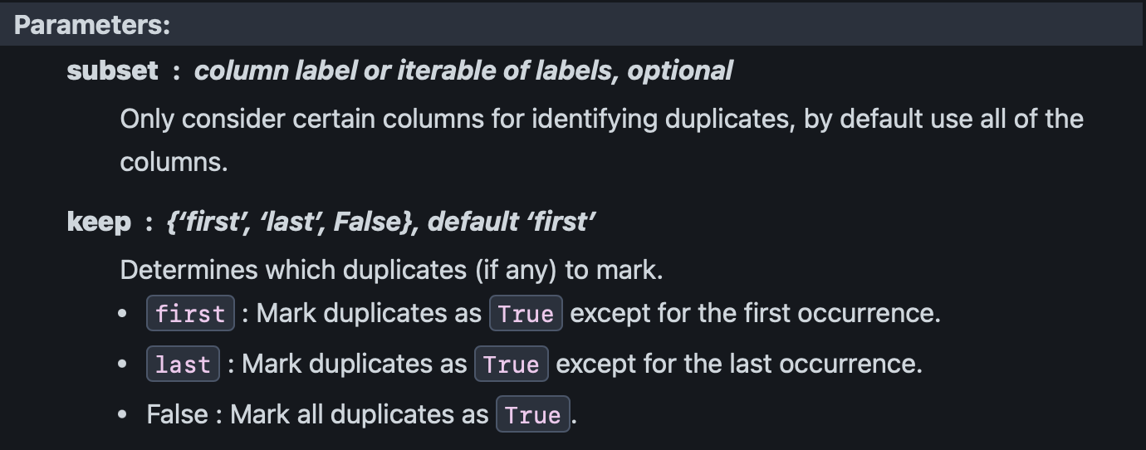
Duplicates
Repeated records can distort summaries and evaluation
The pandas .duplicated() method, by default, checks whether a row has the same values in every column as an earlier row. The output is True or False.
data.duplicated().sum()
data = data.drop_duplicates().copy()
data.duplicated(subset=None, keep='first’)
data.duplicated(subset=['label’, 'Depth CSF-A (m)’]).sum()
McKinney, 3rd ed., §§7.1–7.2

Slide 16
Missing, invalid or unusual?
Different cases require different decisions
Check whether measurements fall within physically meaningful ranges. For example:
Observation | What to do first
Porosity = −10.2 vol% | Check the record against physical limits Negative porosity is physically invalid.
NGR = −9999 cps | Check whether this is a missing-value code Metadata should confirm this in a real project.
Reflectance a* < 0 | Check the meaning and valid range of this variable Negative a* and b* values can be legitimate
An unusually high, plausible value | Inspect context before deciding to remove it
McKinney, 3rd ed., §§7.1–7.2

Slide 17
Cleaning data
Make invalid-value decisions explicit
clean = data.loc[data["Porosity (vol%)"] >= 0].copy()
clean["NGR total counts (cps)"] = (
clean["NGR total counts (cps)"].replace(-9999, np.nan)
)
It removes the single negative porosity row
We treat NGR -9999 as missing values and replaces them with NaN.
We apply these fixed cleaning rules before splitting the data into training and test sets.
McKinney,7.1–7.2

Slide 18
Preparing data for prediction
Why do we split before filling the gaps?
We have removed duplicate records and handled invalid values. Some measurements are still missing.
Our goal is to predict marine sediment porosity:
Inputs, X: natural gamma-ray and reflectance measurements.
Target, y: measured porosity.
To assess predictions fairly, we must keep some observations separate from those used for learning.
Before calculating replacement values for missing data, we split the data. We then learn those values from the training set only.

Slide 19
Training, validation and test sets
Separate fitting, model selection and final evaluation
Subset | Purpose
Training | What relationships can the model learn? Fit preprocessing parameters and model parameters
Validation / development | Which model or settings should we choose? Compare alternatives and select the workflow
Test | How well does our model predict unseen observations? Estimate performance after fixing the workflow
Today we demonstrate training and test sets; validation becomes important when we compare models or settings.

Slide 20
Data leakage
When evaluation data influence learning
Data leakage happens when information that should be unavailable during learning influences the model or its preparation. This can make performance appear better than it will be on new data.
Can we apply the training mean to fill missing values in the test set?
Fit the imputer on training data
Apply those fitted transformations to validation and test set
Example | What to do
Calculating a replacement mean from the whole dataset | Calculate it using training data only
Fitting a scaler before splitting | Fit on training data, then transform both sets
Repeatedly changing the model based on test results | Use validation for those decisions

Slide 21
Train-test split
A reproducible split
from sklearn.model_selection import train_test_split
train_set, test_set = train_test_split(
clean, train_size=0.7, random_state=30
)
num_cols = train_set.select_dtypes(include="number").columns
train_ = train_set[num_cols].copy()
test_ = test_set[num_cols].copy()
The train/test size is a choice depends on the dataset size,
Having enough observations for both learning and reliable evaluation, and the intended prediction task.
scikit-learn: train_test_split

Slide 22
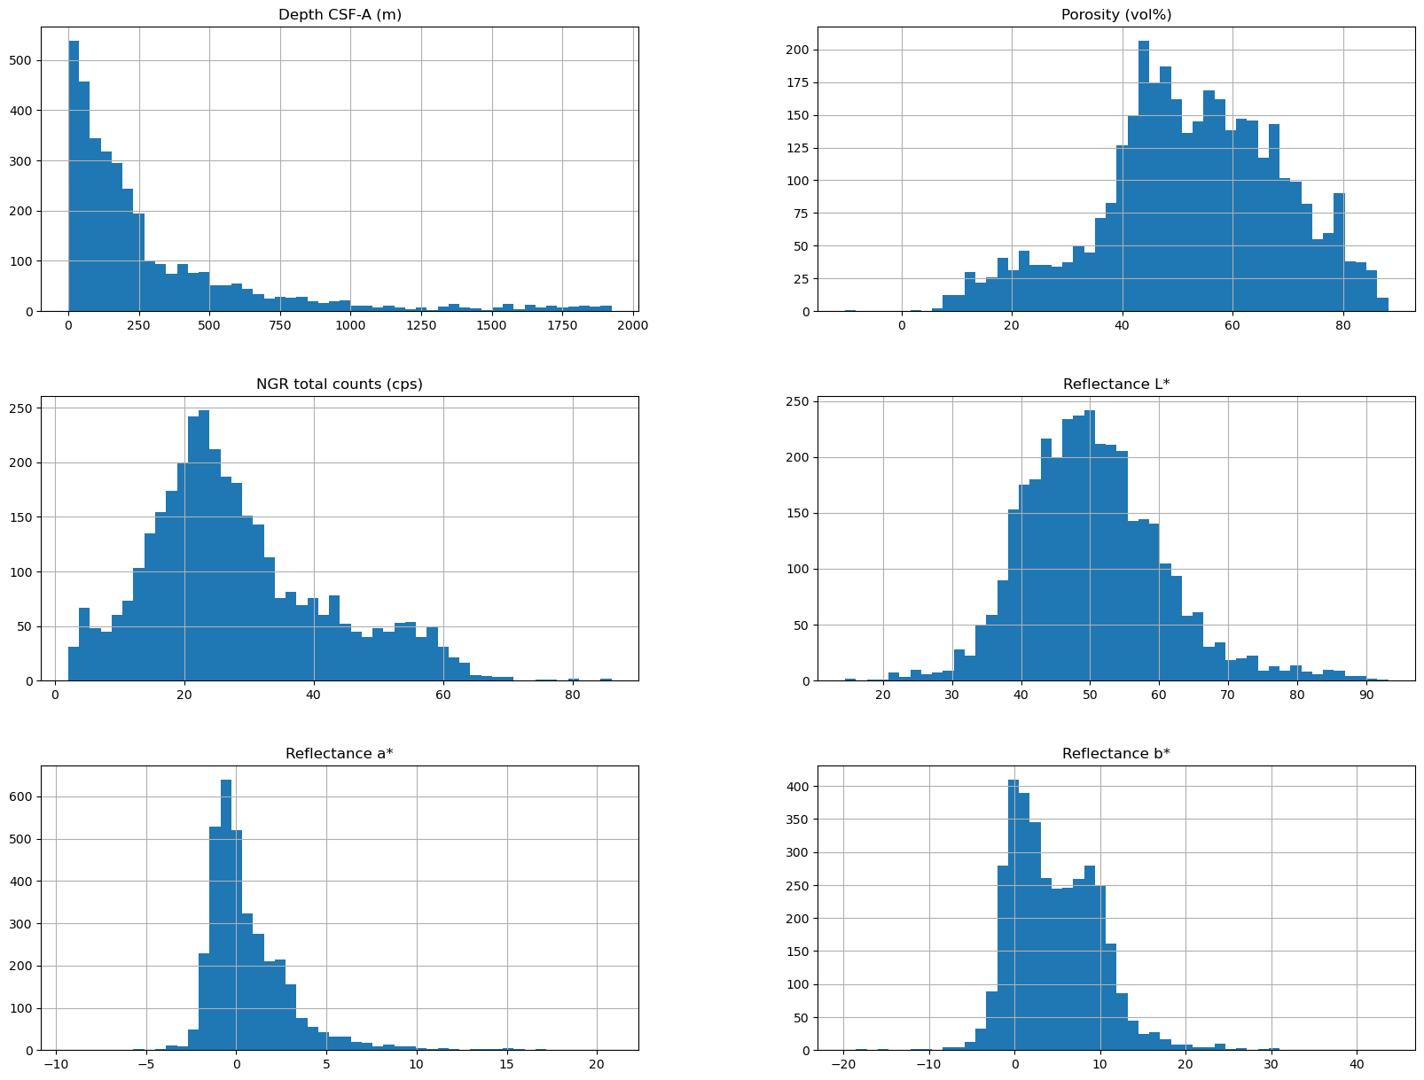
Exploring training data
import matplotlib.pyplot as plt
train_set.hist(bins=50, figsize=(20,15));
Each histogram shows one variable. The horizontal axis shows its values, and the vertical axis counts the samples in each interval.
Where are most observations?
Which way do the tails extend?
Are there possible multiple peaks?

Slide 23
Exploring training data
Depth
Most samples come from shallow depths. The long tail towards greater depths makes the distribution right-skewed.

Slide 24
Exploring training data
Porosity
Most observations are around 40–80 vol%, with a longer tail towards lower values. Negative porosity is physically invalid; in our cleaning example, we remove the affected row.

Slide 25
Exploring training data
NGR
The main peak is around 20–25 cps. The longer tail towards higher values indicates right skewness.
The −9999 value is not visible in this figure

Slide 26
Exploring training data
Reflectance L
The central part is approximately bell-shaped, but the longer right-hand tail suggests some right skewness.

Slide 27
Exploring training data
Reflectance a
A strong peak near zero and a long right-hand tail indicate right skewness.

Slide 28
Exploring training data
Reflectance b
Two apparent peaks, near 0 and 8, suggest possible bimodality.
Histogram appearance depends on bin width. Narrow bins show more detail but can create small, irregular peaks.
Wide bins smooth the appearance but can merge nearby peaks.
Try several bin widths: do the two main peaks remain visible?

Slide 29
Missing measurements
Count them before choosing a treatment
Training variable | Missing values
Depth CSF-A (m) | 0
Porosity (vol%) | 0
NGR total counts (cps) | 7
Reflectance L* | 9
Reflectance a* | 5
Reflectance b* | 0
X_train.isna().sum()
NaN represents missing data;
zero is not automatically missing.
McKinney, 7.1–7.2

Slide 30
Options for missing values
The choice depends on the variable and the question
Method | Main idea | Main limitation
Remove rows or columns | Exclude incomplete observations or variables | Loses information and may introduce bias
Mean, median or most frequent value | Use a summary of the observed training values | Reduces variability and can distort relationships
Forward fill | Use the previous observed value | Assumes the value remains applicable across the gap
Rolling mean or median | Use observations within a local window | May smooth genuine changes; depends on window size
Interpolation | Estimate between observed points using their time or depth positions | Can be misleading across large gaps or abrupt changes
scikit-learn: SimpleImputer

Slide 31
Options for missing values
The choice depends on the variable and the question
Method | Main idea | Main limitation
Remove rows or columns | Exclude incomplete observations or variables | Loses information and may introduce bias
Mean, median or most frequent value | Use a summary of the observed training values | Reduces variability and can distort relationships
Forward fill | Use the previous observed value | Assumes the value remains applicable across the gap
Rolling mean or median | Use observations within a local window | May smooth genuine changes; depends on window size
Interpolation | Estimate between observed points using their time or depth positions | Can be misleading across large gaps or abrupt changes
Forward fill, rolling statistics and interpolation require meaningful time/depth order and appropriate grouping.
scikit-learn: SimpleImputer

Slide 32
Options for missing values
Using .fillna()
filled_df = train_set.copy()
Filled_df.fillna(0)
filled_df.isnull().sum()
mean = train_set["Reflectance L*"].mean()
filled_df["Reflectance L*"] = (
filled_df["Reflectance L*"].fillna(mean)
)
Training: 40, 50, 60, missing Learned mean: 50
Test values: 80, nan.
Which value fills the gap?

Slide 33
From manual filling to an imputer
SimpleImputer
SimpleImputer learns and stores one replacement value per column, according to the strategy you choose. For example, mean, median or most frequent value. scikit-learn documentation
fit() stores the replacement values; it does not itself fill the gaps.
An imputer is a transformer: an object that changes the data.
Method | Meaning for a mean imputer
fit() | Calculate and store the mean of each column from the training data
transform() | Fill missing values using those stored means
fit_transform() | Fit and then transform the same dataset

Slide 34
SimpleImputer
One fitted object, two datasets
from sklearn.impute import SimpleImputer
imputer = SimpleImputer(strategy="mean")
imputer.fit(train)
train_filled = imputer.transform(train)
test_filled = imputer.transform(test)
Should we call fit() again on the test set?
No. That would calculate new replacement values from the test data.
We use transform() to apply what we already learned from the training set.
scikit-learn: SimpleImputer

Slide 35
Why do we scale numerical features?
Different units can give variables unequal influence
Some machine-learning methods compare samples using numerical distances. A variable with larger numerical differences can dominate that distance, even when it is not more informative.
Feature difference | Numeric difference | Squared difference
Depth: 100 m | 100 | 10,000
Porosity: 5 percentage points | 5 | 25
What happens if we express depth in kilometres?
The same depth difference becomes 0.1 km, and its squared becomes 0.01.
Nothing about the samples has changed, but their calculated distance changes dramatically.
We do not want our choice of units to determine which variable dominates.

Slide 36
StandardScaler
Centre and scale using training statistics
z = (x − training mean) / training standard deviation
from sklearn.preprocessing import StandardScaler
scaler = StandardScaler()
train_scaled = scaler.fit_transform(train_filled)
test_scaled = scaler.transform(test_filled)
The training columns become approximately mean 0 and standard deviation 1;
The test columns do not necessarily have those exact summaries.
A negative standardized value means below the training mean, not physically negative porosity.
scikit-learn: StandardScaler

Slide 37
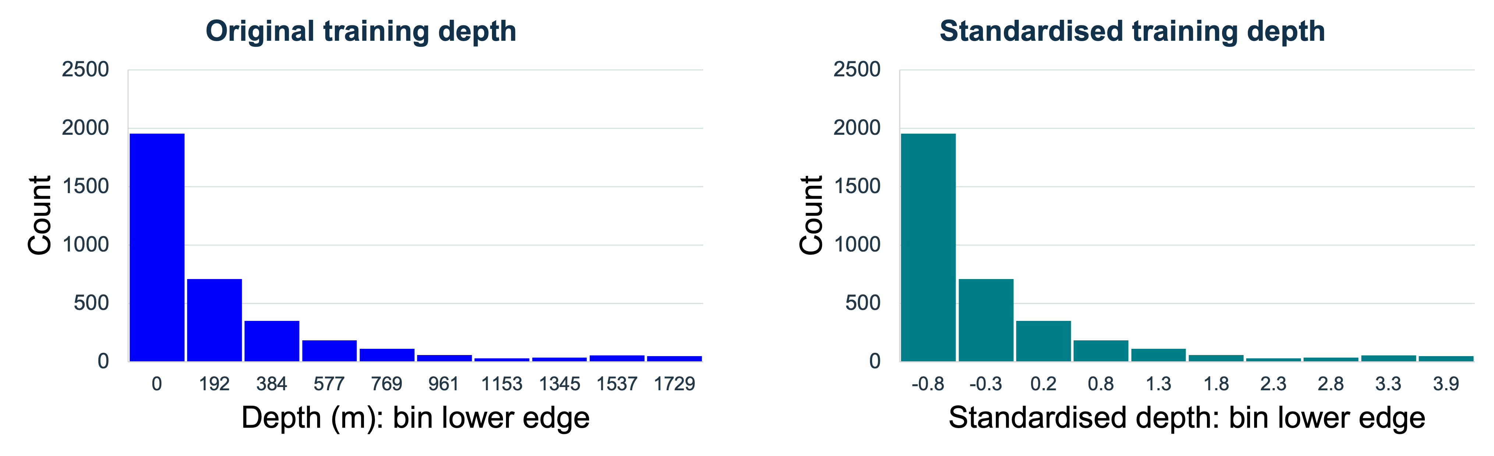
Scaling and distribution shape
Standardisation preserves skewness
Scaling puts numerical features on comparable scales.
It is useful for methods sensitive to distances or feature scales.

Slide 38
MinMaxScaler
Another scaling method
scaled value = (x − training minimum) / training range
Illustrative value | Role | Scaled value
20 | Training minimum | 0.0
40 | Training observation | 0.5
60 | Training maximum | 1.0
80 | New observation | ?
(80-20)/(60-20) =1.5
Can a test value fall outside 0 to 1 after this transformation?
scikit-learn: MinMaxScaler

Slide 39
A preprocessing Pipeline
Ordered operations in one reusable object
from sklearn.pipeline import Pipeline
my_pipeline = Pipeline([
("imputer", SimpleImputer(strategy="mean")),
("std_scaler", StandardScaler())
])
train_ready = my_pipeline.fit_transform(X_train)
test_ready = my_pipeline.transform(X_test)
What data reach the scaler: the original data or imputed data?
scikit-learn: Pipeline

Slide 40
Optional StatQuest videos
Histograms, Clearly Explained
Recap: bins and distributions
Boxplots are Awesome!!!
Quartiles and unusual observations
Mean, variance and standard deviation
Numerical summaries and scaling
Pearson’s Correlation, Clearly Explained
Association between measurements

