Slide 1


Slide 2

Micro Volunteer Management System

Slide 3
Group Members Introduction
Muhammad Sameet Ul Hassan
(mc210201178)

Slide 4

INTRODUCTION OF PROJECT
In this project, we will build a web-based application named as “Micro-Volunteer management System (mVMS)”. Web application the Micro-Volunteer management System (mVMS) is about to facilitate non-profit organization and charity to find skilled persons as volunteers besides donations. This application remove crucial part of that is different volunteers will have different skill sets and different charities require volunteers according to their needs as projects. Using this applicationsorganizations will find skilled volunteer according to their needs.

Slide 5
To develop this project we are going to propose a design. In design Document we provide different types of proposes solutions for front end and as well as for back end too, which includes the following information:
Entity relationship diagram
Database diagram
Class diagram
Sequence diagram
Architecture design
GUI design
Test cases

Slide 6
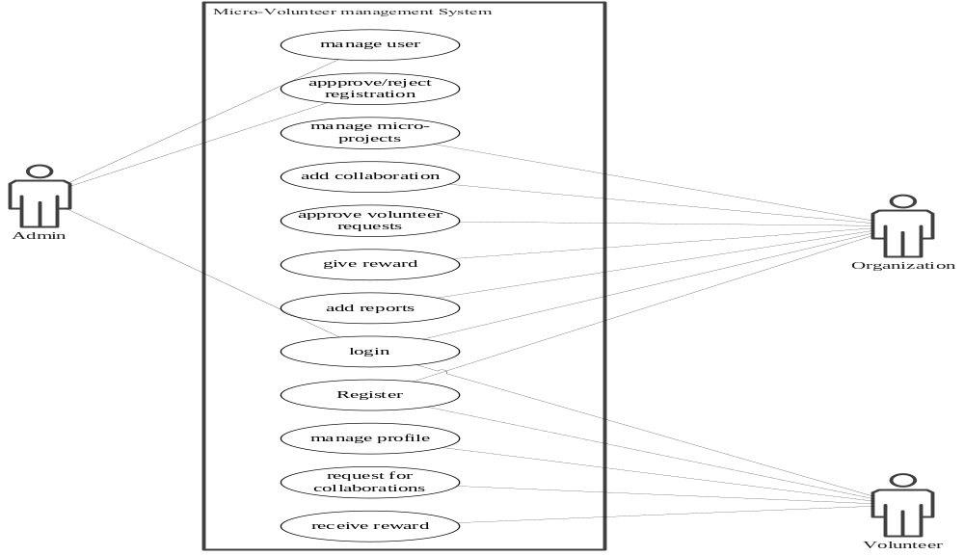
Use Case Diagram

Slide 7
Business Rules Catalog
Write down here some core business rules/functional requirements of your project.

Slide 8
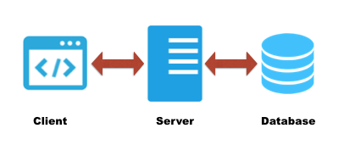
Architectural Design

Slide 9
Team Structure
Muhammad Sameet Ul Hassan
Developer, Designer, Content Writer

Slide 10
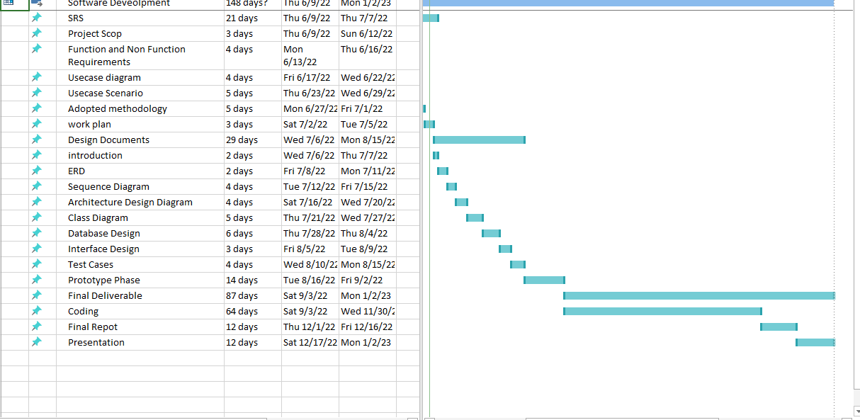
Project Schedule

Slide 11
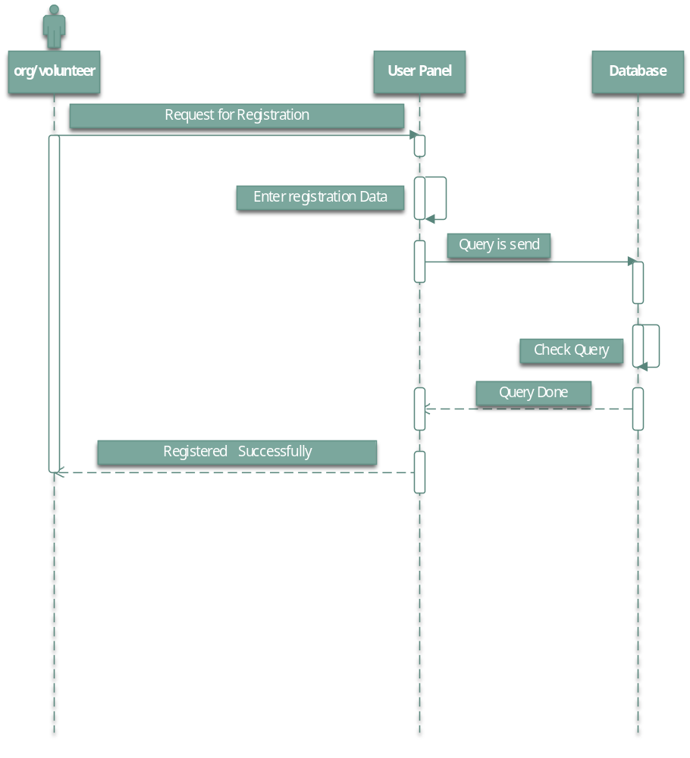
Sequence Diagrams

Slide 12
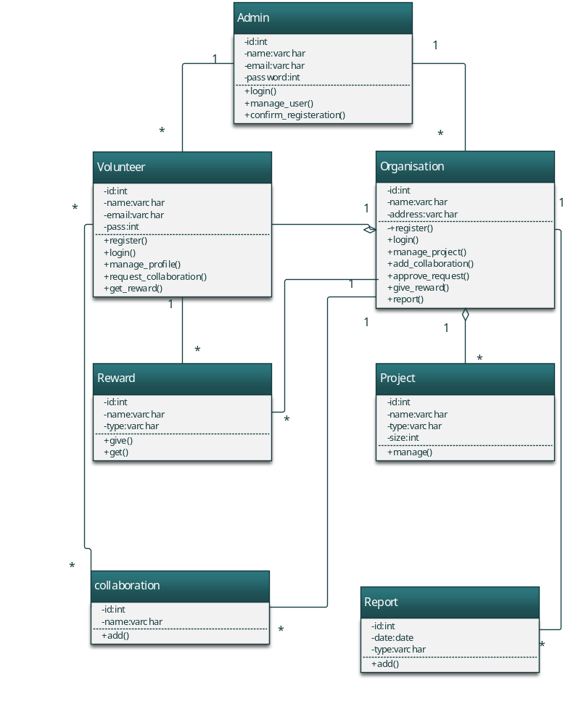
Logical Model/Class Diagram

Slide 13
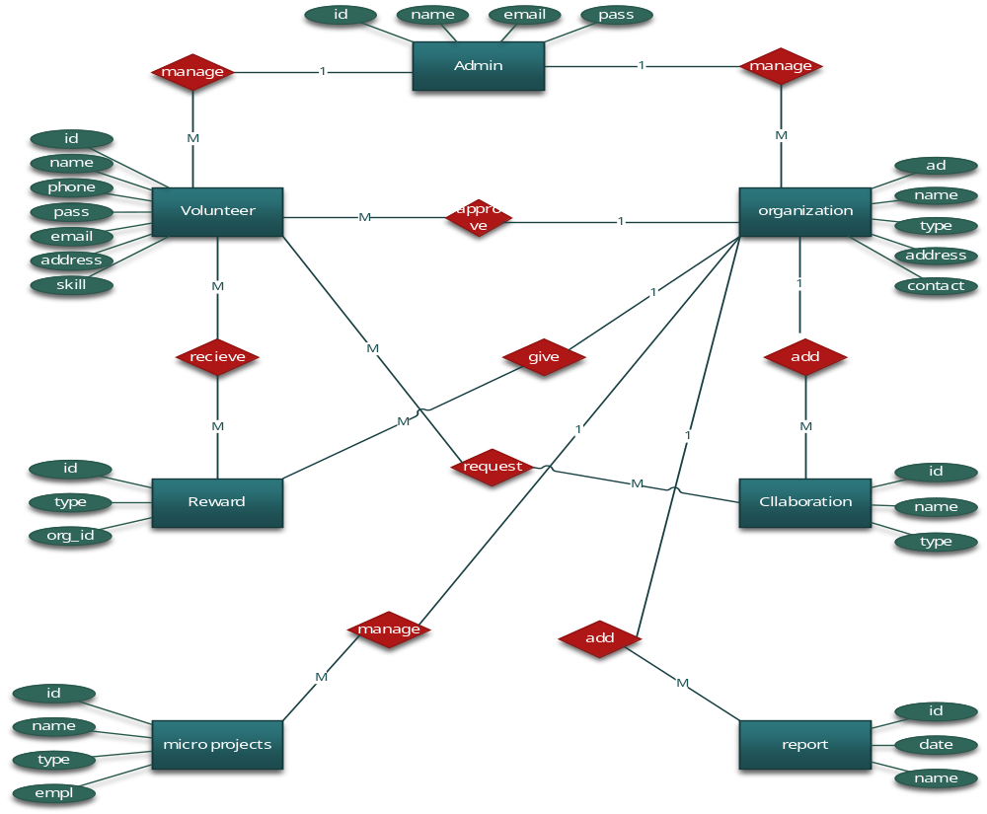
Entity-Relationship Diagram

Slide 14
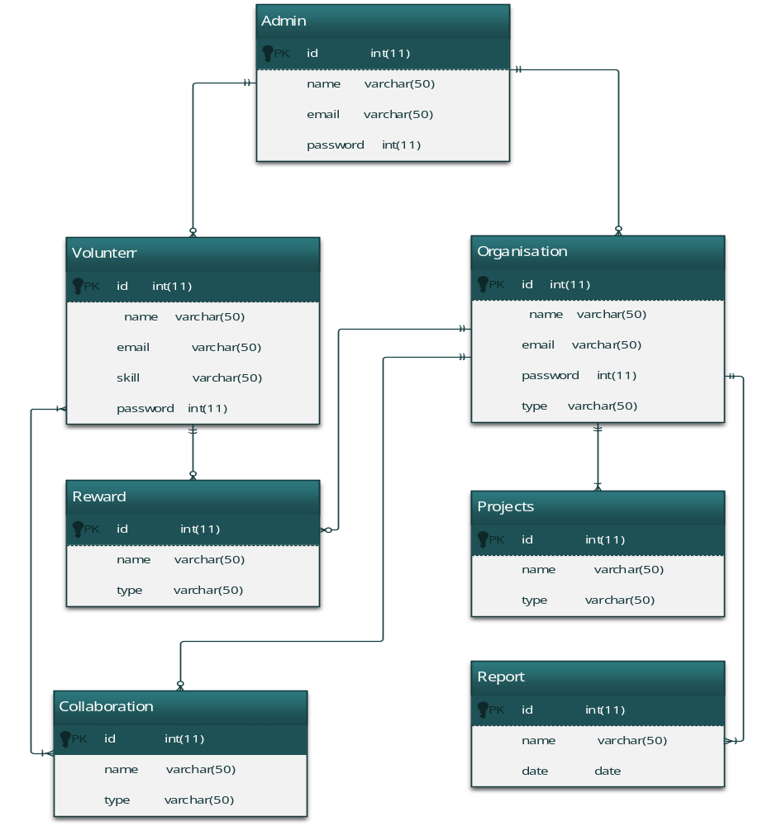
Database Diagram

Slide 15
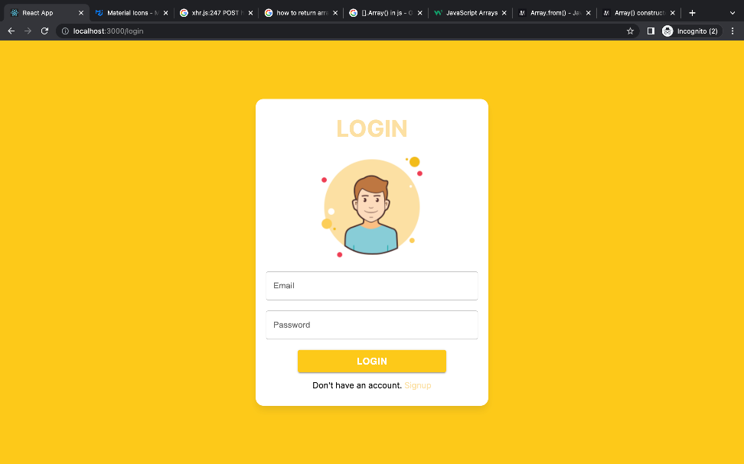
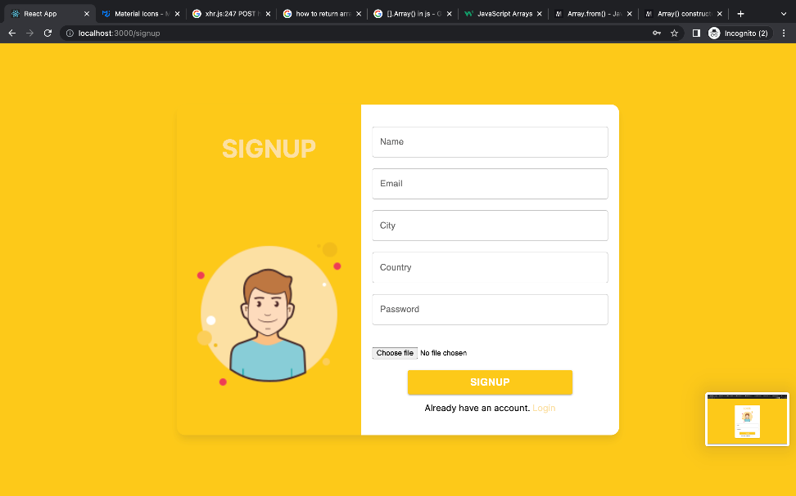
User Interfaces

Slide 16
Tools
Mongodb
ExpressJs
NodeJs
ReactJS

