Slide 1
Who Matters Most in a Citation Network?
• Citation network analysis of the bibliometrics literature
• Introduction to Network Science
• [YOUR NAME] | ID: [STUDENT ID]
• October 28, 2026

Slide 2
Research questions
• Main question: which papers are most influential in the bibliometrics literature, and how are they connected?
• Q1. Which papers receive the most incoming citations (in-degree)?
• Q2. Which papers act as bridges between parts of the network (betweenness)?
• Q3. Does PageRank re-order the in-degree ranking?
• Q4. What communities exist, and do rankings change over time?

Slide 3
Data and methods
• Source: OpenAlex API, retrieved 2026-10-20; no login needed.
• Sample: top-cited journal articles whose title matches “bibliometric”, “citation analysis”, “co-citation”, “bibliographic coupling”, “scientometrics” (up to 100 per query), merged, de-duplicated by title, top 150 kept.
• Edge A → B means A cites B. Only citations between sampled papers are kept.
• Cleaning: 4 self-loops removed; 1 edge points to a later-published paper (metadata artefact, kept and flagged).
• Result: N = 150 papers, E = 424 citations; 133 papers lie in the largest weak component.
• Tools: Python (NetworkX, pandas, SciPy, Matplotlib). Communities: Louvain on the undirected graph (seed 42).
• Clustering is computed on the undirected graph; path length only on the largest weak component (also undirected).

Slide 4
Network metrics
Metric | Value
Papers (N) | 150
Citations (E) | 424
Mean in-degree (E/N) | 2.83
Mean total degree (2E/N) | 5.65
Density E/[N(N−1)] | 0.0190
Papers with no links | 15
Weak components | 17
Average clustering (undirected) | 0.212
Avg. path length, largest component | 2.92
Diameter, largest component | 7
Louvain modularity (24 groups) | 0.421
• 33% of papers are never cited inside the sample.
• Maximum in-degree is 41 against a mean of 2.83: citations are highly concentrated.
• The network is sparse: density is under 2%.

Slide 5
Most-cited papers inside the network (in-degree)
Rank | Paper | Year | In-degree
1 | Co‐citation in the scientific literature: A new measure of the relationship b… | 1973 | 41
2 | Software survey: VOSviewer, a computer program for bibliometric mapping | 2009 | 31
3 | Bibliographic coupling between scientific papers | 1963 | 18
4 | Visualizing a discipline: An author co‐citation analysis of information scien… | 1998 | 15
5 | Citation Analysis as a Tool in Journal Evaluation | 1972 | 12
6 | Changes in the intellectual structure of strategic management research: a bib… | 2004 | 11
7 | Toward a definition of “bibliometrics” | 1987 | 10
8 | The intellectual structure of the strategic management field: an author co‐ci… | 2007 | 10
9 | The Literature of Bibliometrics, Scientometrics, and Informetrics | 2001 | 8
10 | Bibliometric Methods in Management and Organization | 2014 | 8
In-degree counts citations from the other 149 sampled papers only. Rank correlation with global OpenAlex citation counts: Spearman ρ = 0.35.

Slide 6
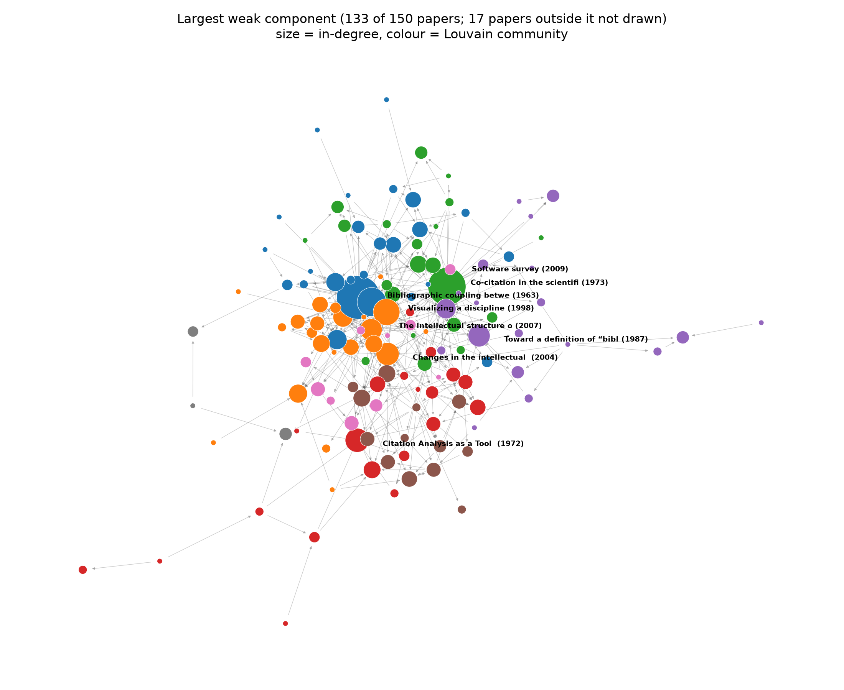
The citation network

Slide 7
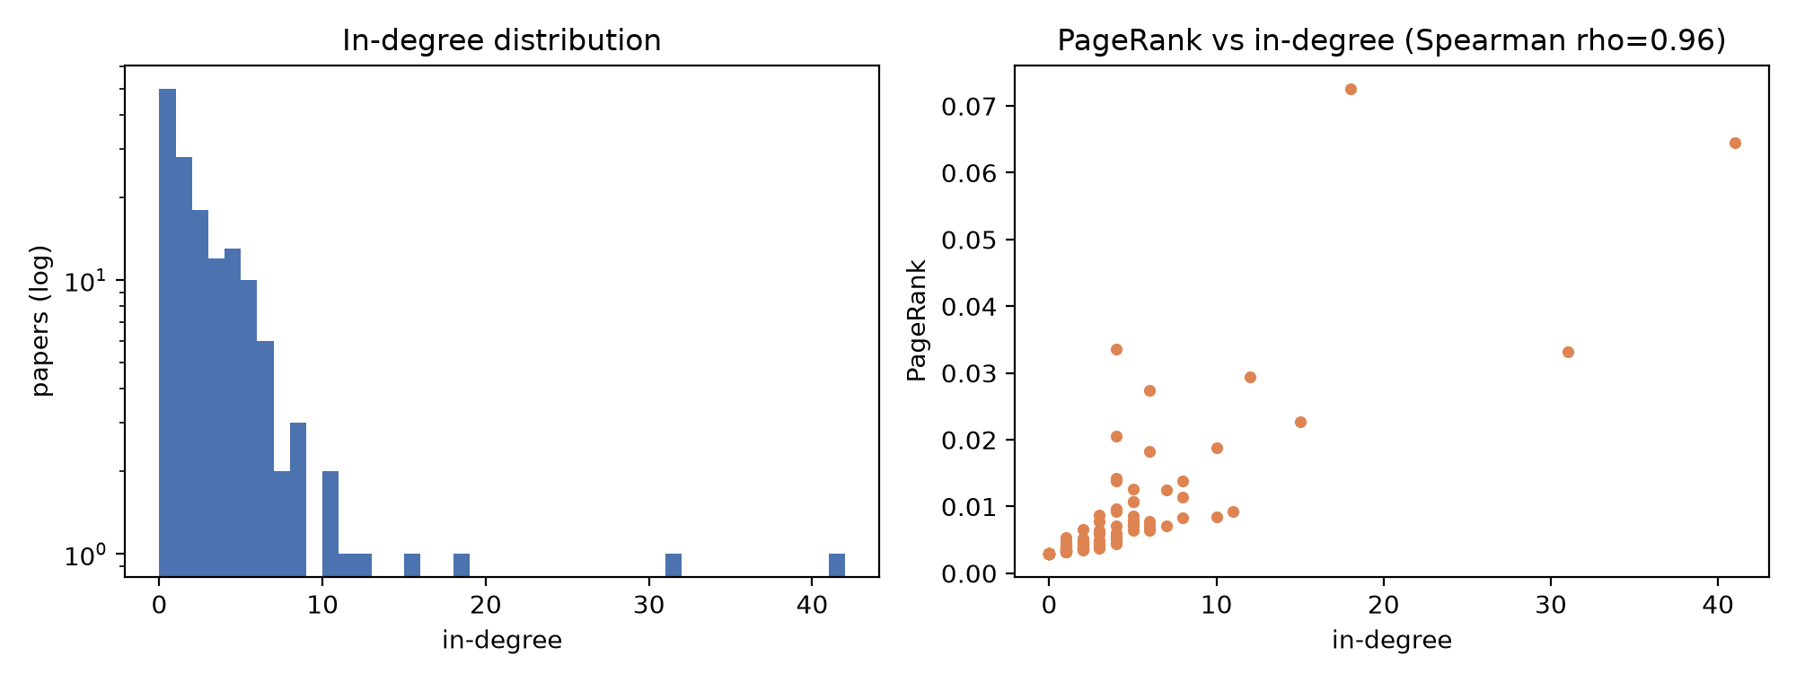
In-degree versus PageRank
PR | Top PageRank papers | Year
1 | Bibliographic coupling between scientif… | 1963
2 | Co‐citation in the scientific literatur… | 1973
3 | From the science of science to Scientom… | 2009
4 | Software survey: VOSviewer, a computer … | 2009
5 | Citation Analysis as a Tool in Journal … | 1972
6 | Scholarly communication and bibliometri… | 2002
7 | Visualizing a discipline: An author co‐… | 1998
8 | The use of bibliometric data for the me… | 1985
9 | Toward a definition of “bibliometrics” | 1987
10 | New bibliometric tools for the assessme… | 1995
• Spearman ρ (in-degree, PageRank) = 0.96: the two rankings broadly agree.
• But only 6 of the top 10 are shared; PageRank rewards being cited by well-cited papers.
• Older papers collect more in-sample citations (Spearman ρ year vs in-degree = -0.61).

Slide 8
Bridge papers (betweenness centrality)
Rank | Paper | Year | Betweenness
1 | How to conduct a bibliometric analysis: An overview and guidelines | 2021 | 0.0109
2 | Bibliometric Methods in Management and Organization | 2014 | 0.0071
3 | Scholarly communication and bibliometrics | 2002 | 0.0071
4 | The intellectual structure of the strategic management field: an author co‐cita… | 2007 | 0.0052
5 | Changes in the intellectual structure of strategic management research: a bibli… | 2004 | 0.0045
6 | Visualizing a discipline: An author co‐citation analysis of information science… | 1998 | 0.0044
7 | Bibliometric Methods: Pitfalls and Possibilities | 2005 | 0.0042
8 | Forty-five years of Journal of Business Research: A bibliometric analysis | 2019 | 0.0038
9 | A bibliometric analysis of operations research and management science | 2016 | 0.0036
10 | The evolution of the intellectual structure of operations management—1980–2006:… | 2008 | 0.0031
Directed betweenness. Top bridges are mostly review/method papers that cite across fields; foundational papers are cited a lot but sit at path endpoints, so they score low.

Slide 9
Communities (Louvain)
Group | Papers | Median year | Most-cited paper in group (in-sample)
0 | 25 | 2015 | Co‐citation in the scientific literature: A n (1973)
1 | 22 | 2007 | Visualizing a discipline: An author co‐citati (1998)
2 | 21 | 2016 | Software survey: VOSviewer, a computer progra (2009)
3 | 20 | 2014 | Citation Analysis as a Tool in Journal Evalua (1972)
4 | 19 | 2018 | Toward a definition of “bibliometrics” (1987)
5 | 13 | 2006 | Bibliometric Methods: Pitfalls and Possibilit (2005)
6 | 10 | 2015 | The Structural Influence of Marketing Journal (2003)
7 | 3 | 2015 | Bibliometrics: The Leiden Manifesto for resea (2015)
Modularity 0.421 with 8 groups of 3+ papers; remaining groups are single papers with no in-sample links. Group labels are computed only on structure, not on topic.

Slide 10
Rankings through time (network up to 2010 vs full)
Paper (year) | Rank ≤2010 | Rank full | In-deg ≤2010 | In-deg full
Co‐citation in the scientific literature: A n (1973) | 1 | 1 | 14 | 41
Citation Analysis as a Tool in Journal Evalua (1972) | 2 | 5 | 7 | 12
Visualizing a discipline: An author co‐citati (1998) | 2 | 4 | 7 | 15
Bibliographic coupling between scientific pap (1963) | 4 | 3 | 5 | 18
Scholarly communication and bibliometrics (2002) | 4 | 14 | 5 | 6
Mapping of science by combined co-citation an (1991) | 6 | 9 | 4 | 8
Is citation analysis a legitimate evaluation (1979) | 6 | 12 | 4 | 7
Problems of citation analysis (1996) | 6 | 30 | 4 | 4
New bibliometric tools for the assessment of (1995) | 6 | 14 | 4 | 6
The Intellectual Development of Management In (1986) | 10 | 20 | 3 | 5
Early network: 61 papers, 93 citations. Ties share a rank. The 1973 co-citation paper stays first; several early papers fall in the full ranking as later papers cite other work.

Slide 11
Limitations
• Database: OpenAlex coverage and reference lists differ from Web of Science or Scopus.
• Sampling: title keyword search ranked by global citations; applied bibliometric studies (e.g. in management) dominate the recent half and some topics are missed.
• Closed sample: only citations among the 150 papers count, so in-degree is not total citations.
• Citation age: older papers had longer to be cited; self-citations are not removed.
• Single run: Louvain is stochastic (seed fixed) and the cutoff year is a choice.
• Citation counts measure attention, not quality.

Slide 12
Conclusions
• Most-cited inside the network: “Co‐citation in the scientific literature: A new measure of the relati…” (1973), in-degree 41.
• Influence depends on the measure: in-degree, PageRank and betweenness pick out different papers (foundational, well-connected, and bridging).
• Structure: sparse (density 0.019) but 133 of 150 papers are connected; modularity 0.42 indicates moderate community structure.
• Citation counts alone do not measure quality, but network position shows the structural role each paper plays.

Slide 13
References and data
• OpenAlex API (https://openalex.org); Priem, Piwowar & Orr (2022), OpenAlex: a fully-open index of scholarly works.
• Hagberg, Schult & Swart (2008). Exploring network structure, dynamics, and function using NetworkX.
• Blondel et al. (2008). Fast unfolding of communities in large networks. J. Stat. Mech.
• Page, Brin, Motwani & Winograd (1999). The PageRank citation ranking.
• Reproducibility: data/processed/{nodes,edges}.csv and metadata.json; src/analyze.py regenerates every figure and number.

