Slide 1
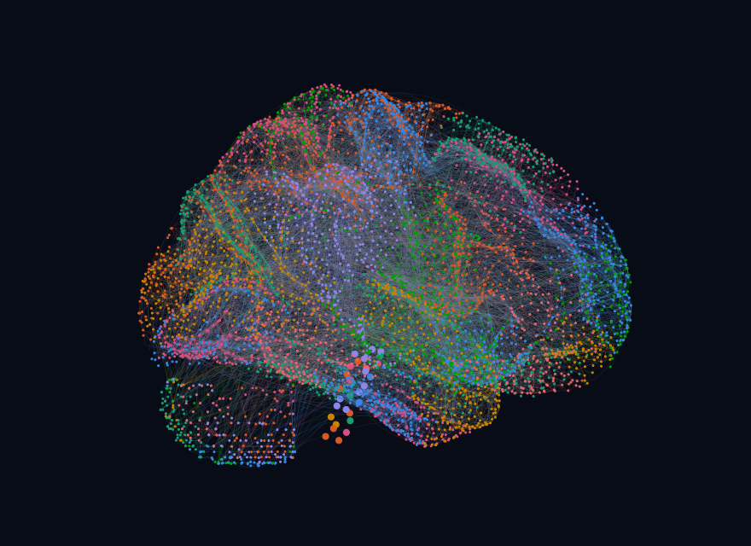
INTRODUCTION TO NETWORK SCIENCE · FINAL PROJECT
HSK-ShiFu
A network analysis of the Chinese taught in the HSK Standard Course, Levels 1–3
5,379
32,076
8
nodes
links
communities
M Samiul Hasnat
22661068, Computer Science of Technology
28 October 2026
3D layout of the network, coloured by community
Notes:
(≈20 s) Good morning. My project treats the three HSK Standard Course textbooks as one network and asks what network science can tell us about how Chinese is taught. The picture is the real network: 5,379 nodes and 32,076 links, laid out in 3D and coloured by its eight communities.

Slide 2
Is a textbook a complex network?
01 · INTRODUCTION
Why we care
Four questions
A textbook is a network: every sentence reuses characters and words from earlier lessons.
Its shape decides what a learner must meet first, how often ideas return, and what breaks when something is missed.
Natural language is already known to be small-world and heavy-tailed. Is a designed curriculum the same?
Ferrer i Cancho & Solé, 2001
Q1
Is the HSK 1–3 network scale-free and small-world?
Degree distribution · clustering · path length
Q2
Which units hold the curriculum together?
Centrality · k-core
Q3
Do its communities follow lessons or HSK levels?
Modularity · normalised mutual information
Q4
How robust is it when units are missing?
Random failure vs targeted attack
Notes:
(≈45 s) Why study a textbook as a network? Every sentence reuses characters and words from earlier lessons, so the books are a web of reuse. Its shape decides what a learner has to meet first, how often things come back, and what falls apart when a learner misses something. Ferrer i Cancho and Solé showed in 2001 that word networks of natural language are small-world and heavy-tailed. My question is whether a designed curriculum looks the same. I ask four things: is it scale-free and small-world, which units are the hubs, do its communities follow lessons or HSK levels, and how robust it is when units are missing.

Slide 3
5,379 teaching units, 32,076 relations
02 · DATA
Nodes: units of the books
Links: relations in the books
Where links come from
78% stated in the text
18% string matching
3% language model
The graph
Undirected and simple
1 component, 100% of nodes
⟨k⟩ = 11.9 · density 0.0022
36,419 link records, merged into 32,076 simple links
Collected from
3 scanned HSK textbooks
Page transcripts
graphify knowledge graph
Typed, merged network
Notes:
(≈50 s) The dataset is my own. I took the three HSK Standard Course textbooks, Levels 1 to 3, transcribed every page, built a knowledge graph with graphify, and then typed and merged its nodes. A node is a teaching unit: 2,850 sentences, 932 characters, 651 words, 311 grammar points, plus pronunciation notes, radicals, culture notes, the 50 lessons and the 3 books. A link is a relation the books state or imply: a sentence contains a character or word, a lesson introduces a word, a sentence illustrates a grammar point. 78% of the 36,419 link records are read straight from the text, 18% come from string matching and 3% from a language model. I treat the graph as undirected and simple, which merges duplicates into 32,076 links. It is a single connected component with mean degree 11.9 and density 0.0022, so it is very sparse.

Slide 4
The indicators, and how each was tested
03 · METHODS
Question | Indicators | Baseline or test
Scale-free? | Degree distribution P(k), ⟨k²⟩/⟨k⟩, discrete power-law fit (Clauset et al.) | Likelihood ratio vs exponential, lognormal and truncated power law
Small world? | Average clustering C, average shortest path L, diameter | σ and ω vs 3 Erdős–Rényi and 3 degree-preserving rewired graphs
Which hubs? | Degree, betweenness (300 sampled sources), closeness, eigenvector, Katz, PageRank, k-core | Spearman rank agreement between all seven
Communities? | Louvain modularity Q, strong/weak test (Radicchi), participation coefficient | NMI against lesson and against HSK level
Robust? | Giant-component size as nodes are removed; Molloy–Reed criterion | Random failure vs degree, betweenness and adaptive attacks
Python · NetworkX 3.7 · powerlaw 2.0 · NumPy / SciPy · every random step seeded (42) · full analysis runs in 37 s
Notes:
(≈45 s) Each question maps to indicators from the course, and each one is tested against a baseline, not just reported. For the degree distribution I fit a discrete power law with the Clauset–Shalizi–Newman method and compare it with exponential and lognormal fits by likelihood ratio. For small-worldness I compute clustering and path length and compare them with three Erdős–Rényi graphs and three degree-preserving rewired graphs, giving σ and ω. For hubs I compute seven centralities and check how well they agree with Spearman correlation. Communities come from Louvain; I test whether they are strong or weak in Radicchi’s sense and compare them with lessons and HSK levels using NMI. For robustness I remove nodes at random and by attack, and compare with the Molloy–Reed criterion. Everything is in Python with NetworkX and powerlaw, seeded so it is reproducible.

Slide 5
A few function words are the hubs
04 · RESULTS · DEGREE DISTRIBUTION
Observed distribution
Power-law fit, k ≥ 8
α = 2.75
± 0.03 · fit to the 53% of nodes with k ≥ 8 · KS 0.041
745
72.6
links on 我; the mean is 11.9
⟨k²⟩/⟨k⟩: hubs dominate
Top hubs: 我 745 · 你 680 · 的 645 · 了 632
vs exponential: power law wins, p < 0.001
vs lognormal: no clear winner, p = 0.32
Notes:
(≈55 s) First result: the degree distribution. This is the complementary cumulative distribution on log–log axes: the share of nodes with at least k links. The mean degree is 11.9, but the biggest hub, the character 我, has 745 links, and ⟨k²⟩/⟨k⟩ is 72.6, so the second moment is dominated by hubs. The top four are 我, 你, 的 and 了: pronouns and grammatical particles that appear in almost every sentence. Above k = 8 a discrete power law fits with exponent 2.75, within the 2 to 3 range typical of real networks. It clearly beats an exponential, but a likelihood-ratio test cannot separate it from a lognormal, so I call the network heavy-tailed and scale-free-like, not strictly scale-free.

Slide 6
Any two units are about 3.5 steps apart
04 · RESULTS · SMALL WORLD
Average clustering C
σ = 85.8
Small world vs Erdős–Rényi: C is 79× random while L stays 0.92× random
Average shortest path L
σ = 2.65
Still above 1 against rewiring that keeps every node’s degree
ω = 0.84
Each baseline is the mean of 3 graphs with the same 5,379 nodes and 32,076 links. Diameter: 8 for the HSK network, 6 for random graphs.
Random-like by ω: clustering is far below a lattice’s 0.68
Notes:
(≈50 s) Second: is it a small world? Average clustering is 0.164, about 79 times the clustering of Erdős–Rényi graphs of the same size, and still about 3 times that of degree-preserving rewired graphs. Yet the average shortest path is only 3.45 steps, slightly shorter than random, with diameter 8. So any two units, say a character in Lesson 1 and a grammar point in Book 3, are about three and a half links apart. The small-world coefficient σ is 85.8 against random graphs and 2.65 against rewired ones, both above 1. The stricter ω is 0.84, close to the random end, because its clustering is far below a ring lattice’s 0.68. My reading: short paths come from the hubs, and clustering is high compared with random, but not lattice-like.

Slide 7
The same hubs win on every measure
04 · RESULTS · CENTRALITY
Top 8 nodes by degree
Rank agreement with degree (Spearman ρ)
# | Node | Meaning | Degree | Betweenness
1 | 我 wǒ | I, me | 745 | #2
2 | 你 nǐ | you | 680 | #3
3 | 的 de | attributive particle | 645 | #1
4 | 了 le | particle of change | 632 | #4
5 | 是 shì | to be | 417 | #5
6 | 不 bù | no, not | 376 | #6
7 | 什么 shénme | what (word) | 330 | #7
8 | 去 qù | to go | 301 | below #10
k = 9
The innermost core holds 1,398 nodes (26%): all 50 lessons, 931 sentences, 192 characters, 171 words and 45 grammar points.
Betweenness sampled from 300 source nodes.
Notes:
(≈45 s) Third: who are the hubs? The top of the degree ranking is 我, 你, 的, 了, 是, 不 and 什么. The same four, 我, 你, 的 and 了, are also the top four by betweenness, closeness, eigenvector and PageRank, so the measures agree. Degree and PageRank correlate at 0.97 and degree and k-core at 0.94; even the weakest agreement, with eigenvector centrality, is 0.73. On average lessons have about 100 links, characters 18, words 15 and sentences 9.5. The k-core decomposition goes down to a core of k = 9 that holds 1,398 nodes, about a quarter of the network, including every lesson. The curriculum is held together by a small set of grammatical characters.

Slide 8
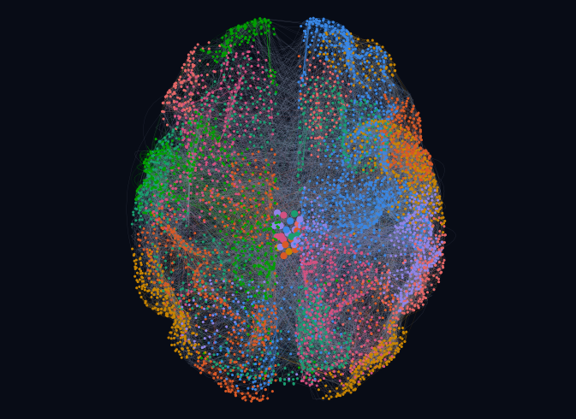
Communities follow lessons, not levels
04 · RESULTS · COMMUNITIES
Major community and its hubs
Nodes
HSK 1
HSK 2
HSK 3
Pointing and wanting 个 这 那
911
Negation and goodness 不 好 很
793
Having and wanting more 了 有 多
787
Linking and contrast 就 吧 没
743
Asking and going 什么 去 一
723
Comparing and degree 得
557
Core pronouns and “is” 我 你 的 是
442
Q = 0.38
Q = 0.36
Place and ongoing action 在 呢
423
32 communities
merged into 8
Weak, not strong: none of the 8 passes the strong test and 2 pass the weak test; the tightest keeps 36% of its links inside.
Lessons, not levels: only one community is mostly HSK 1 (70%); the other seven mix all three levels.
0.39
0.10
NMI with lesson
NMI with level
Notes:
(≈55 s) Fourth: communities. Louvain finds 32 fine communities with modularity 0.38, which I merge into the 8 major communities you see coloured in the 3D layout. Their names are provisional, taken from each one’s busiest members. The bars show each community’s mix of HSK levels. Only the core pronouns community, 我, 你, 的 and 是, is mostly Level 1; every other community mixes all three levels. NMI confirms it: the communities share 0.39 of their information with lessons but only 0.10 with HSK level. One caveat: lesson links were part of the Louvain weights, so some of the lesson agreement is built in. The communities are also loose: none is strong in Radicchi’s sense, two are weak, and the tightest keeps only 36% of its links inside. Hubs like 我 and 的 have participation coefficients near 0.87, so they connect every community.

Slide 9
Robust to failure, fragile to attack
04 · RESULTS · ROBUSTNESS
Random failure (mean of 5 runs)
78%
Attack by betweenness
62%
Attack by degree
44%
Degree, recomputed every step
2%
Shares still connected after removing 20% of nodes
Removed until the giant is below 50%
Random failure
not within 30%
Betweenness attack
28%
Degree attack
18%
Adaptive degree attack
14%
κ = 72.6
Molloy–Reed: κ ≫ 2, so random failure must remove 98.6% to break it
Notes:
(≈50 s) Fifth: robustness. I remove nodes and track how much of the network stays in the giant component. Removing 20% of nodes at random still leaves 78% connected. Removing the 20% with the highest betweenness leaves 62%, and the 20% with the highest degree only 44%. If degree is recomputed after every removal, the adaptive attack, the network collapses to 2%. The giant component drops below half after 18% of nodes under a degree attack and 14% under the adaptive one, but never within 30% under random failure. This matches the Molloy–Reed prediction: κ = ⟨k²⟩/⟨k⟩ is 72.6, far above 2, so random failure would need to remove about 98.6% of nodes. It is the classic robust-yet-fragile pattern Albert, Jeong and Barabási described for scale-free networks.

Slide 10
What the structure means for learning
05 · DISCUSSION
Theoretical
Practical: learn the hubs first
Designed text behaves like natural language
Heavy tail, small world and loose modules, like the word networks of natural language (Ferrer i Cancho & Solé).
Hubs come from reuse
Each lesson links back to the same few function words, as preferential attachment predicts; growth over lessons is still to be tested.
Robust yet fragile
As Albert et al. found for the Internet: random gaps cost little, missing hubs cost most of the network.
100 hubs → 79% of uses, 50% of sentences
200 hubs → 91% of uses, 81% of sentences
Organised by topic, not difficulty
Communities match lessons (NMI 0.39) far more than HSK levels (0.10).
Order study by degree: drill hub characters first, then their neighbours.
Treat a weak hub as an attack: re-teach it before moving on.
Notes:
(≈55 s) What does this mean? Theoretically, a designed curriculum shows the same signatures as natural language networks: a heavy tail, a small world and loose modules. The hubs come from reuse, since every lesson links back to the same function words, which is what preferential attachment predicts, although I have not yet tested growth lesson by lesson. The network is robust yet fragile, exactly as Albert and colleagues found for the Internet. And it is organised by topic rather than by difficulty level. Practically, the chart ranks characters by degree. Learning just the top 100 hub characters, 11% of the 932, covers 79% of all character uses in the book sentences and makes half of the sentences fully readable; the top 200 reach 91% and 81%. So study should be ordered by degree, and a tutor should treat a weak hub like a targeted attack and re-teach it before moving on. This coverage figure is computed from the same network data, counting distinct characters per sentence.

Slide 11
Four questions, four answers
06 · CONCLUSION
Q1 · Structure
Q2 · Hubs
Heavy-tailed and small-world by σ
Four function words top every centrality
Tail α = 2.75; C is 79× random with L = 3.45. But ω = 0.84, and a lognormal fits the tail as well.
我, 你, 的 and 了; Spearman ρ of 0.73–0.97 with degree; the k = 9 core holds 26% of nodes.
Q3 · Communities
Q4 · Robustness
Loose modules that track lessons, not levels
Robust to random gaps, fragile to hub loss
Q = 0.36 for 8 communities, none strong; NMI 0.39 with lesson vs 0.10 with HSK level.
With 20% of nodes removed: 78% stays connected at random, 44% under degree attack, 2% under adaptive attack.
Limits: 18% of links come from string matching and 3% from a language model; grammar points are under-linked; lesson links in the Louvain weights inflate lesson NMI; one static snapshot. Next: weighted and directed links, lesson-by-lesson growth to test preferential attachment, and HSK 4–6.
Notes:
(≈40 s) To conclude, the four answers. One: the HSK network is heavy-tailed and small-world by σ, although ω and the lognormal comparison say we should not call it strictly scale-free. Two: four grammatical characters, 我, 你, 的 and 了, are the hubs on every centrality measure. Three: the communities are loose and follow lessons and topics rather than HSK levels. Four: it is robust to random gaps but fragile when hubs are missing. The main limits are that some links come from string matching or a language model, grammar is under-linked, and lesson agreement is partly built into the community weights. Next I would add weights and direction and test growth lesson by lesson.

