Slide 1
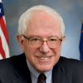
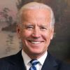

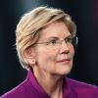

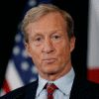
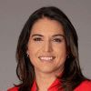
Bernie Sanders leads the Nevada primaries
This is a demo of the clone-shapes command in PPTXHandler.
This slide shows an e-commerce site’s performance in 2020.
The values are updated from data.
These slide smoothly transition, morphing shapes from one slide to the next.
Bernie Sanders
46.8%
Joe Biden
20.2%
Pete Buttigieg
14.3%
Elizabeth Warren
9.7%
Amy Klobuchar
4.2%
Tom Steyer
4.7%
Tulsi Gabbard
0.1%

