Slide 1
PyData Impact Scholars Meeting @ 5th May 2023
~Meetups, Networking and Data Science
~Sanket Verma
Notes:
Normal explanation

Slide 2


About Me
~ Takes care of the community & OSS @ Zarr
~ Chair @ PyData Delhi and Global ‘20 & ‘21
~ Worked with forensics, startups, organisations
~ Sometimes I play the Violin
/msankeys963
Notes:
Tell about yourself.

Slide 3
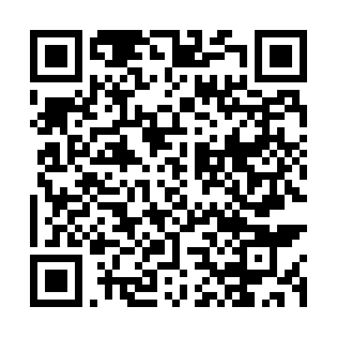
Repository 👇🏻

Slide 4
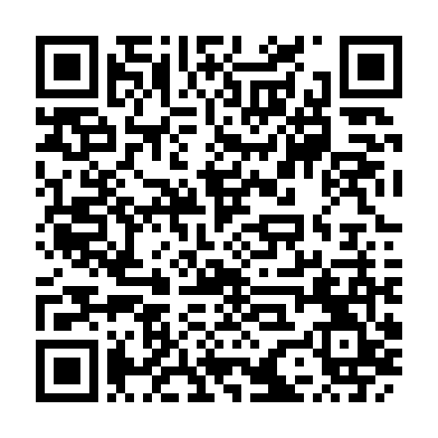
Slides 👇🏻

Slide 5


What I’m gonna talk about?
What is PyData and NumFOCUS?
Why start a meetup chapter?
What if it’s growing slowly?
How can you benefit professionally?
Networking 101

Slide 6
What I’m gonna show you?
What is Data Science & ML?
Data Science Pipeline
Hands-On
What we’ve done so far!
Scope

Slide 7
Important Links! ;)
~numfocus.org
~pydata.org
~meetup.com/pro/pydata
/pydata

Slide 8
What is Data Science & ML? 🤔
Data science is an interdisciplinary field that uses scientific methods, processes, algorithms and systems to extract knowledge and insights from structured and unstructured data!

Slide 9
What is Data Science & ML? 🤔
Machine learning, on the other hand, refers to a group of techniques used by data scientists that allow computers to learn from data. These techniques produce results that perform well without programming explicit rules.

Slide 10
What does a general machine learning pipeline looks like? 🧐

Slide 11
Pipeline… 😀
~ Identify the problem
~ Data Collection
~ Data Pre-processing
~ Data Visualisation and Feature Engineering
~ Modelling and Prediction
~ Performance of the models

Slide 12

Enter Python! 🐍
~ Created by Guido van Rossum in 1991
~ Object Oriented Language
~ Maintained by PSF
~ Has over ~100 current core contributors

Slide 13
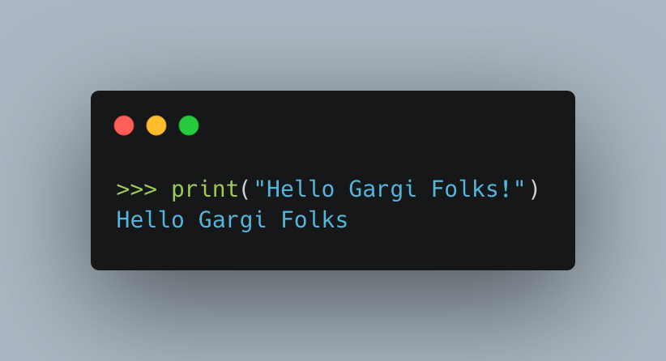
Print Statements! 🖨

Slide 14
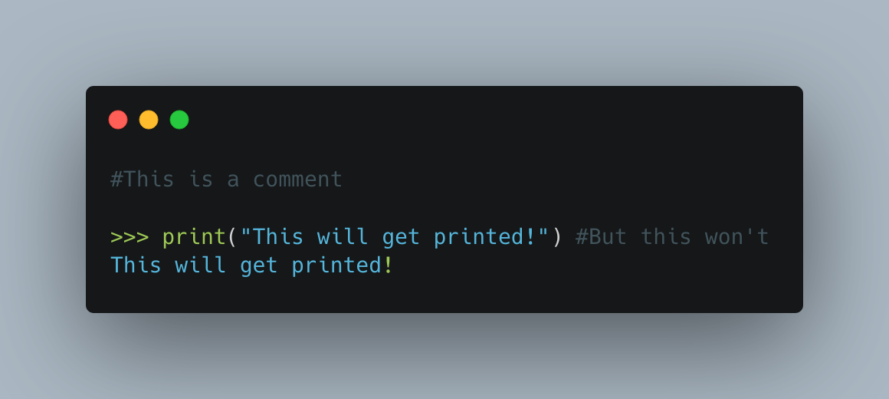
Comments! ＃﹟＃

Slide 15
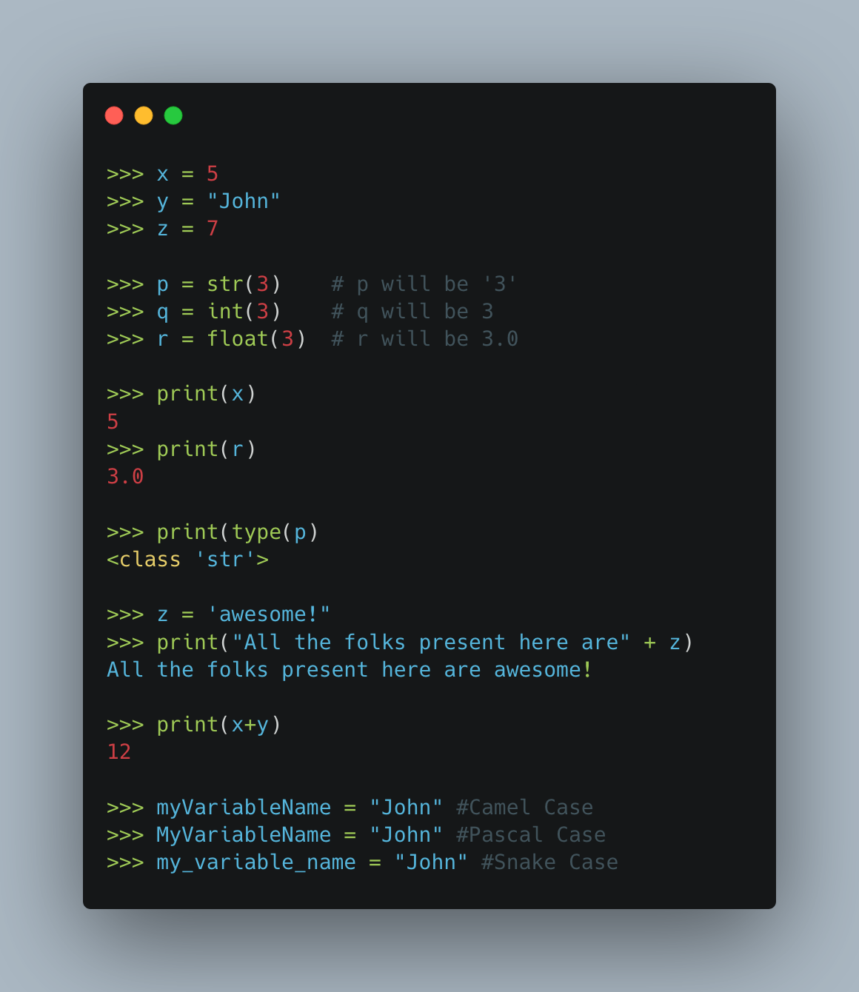
Variables! ⓧⓠⓩ

Slide 16
Data Types! 👨🏻‍💻
~ Text: str
~ Numeric Types: int, float, complex
~ Sequence: list, tuple, range
~ Set Types: set, frozenset

Slide 17
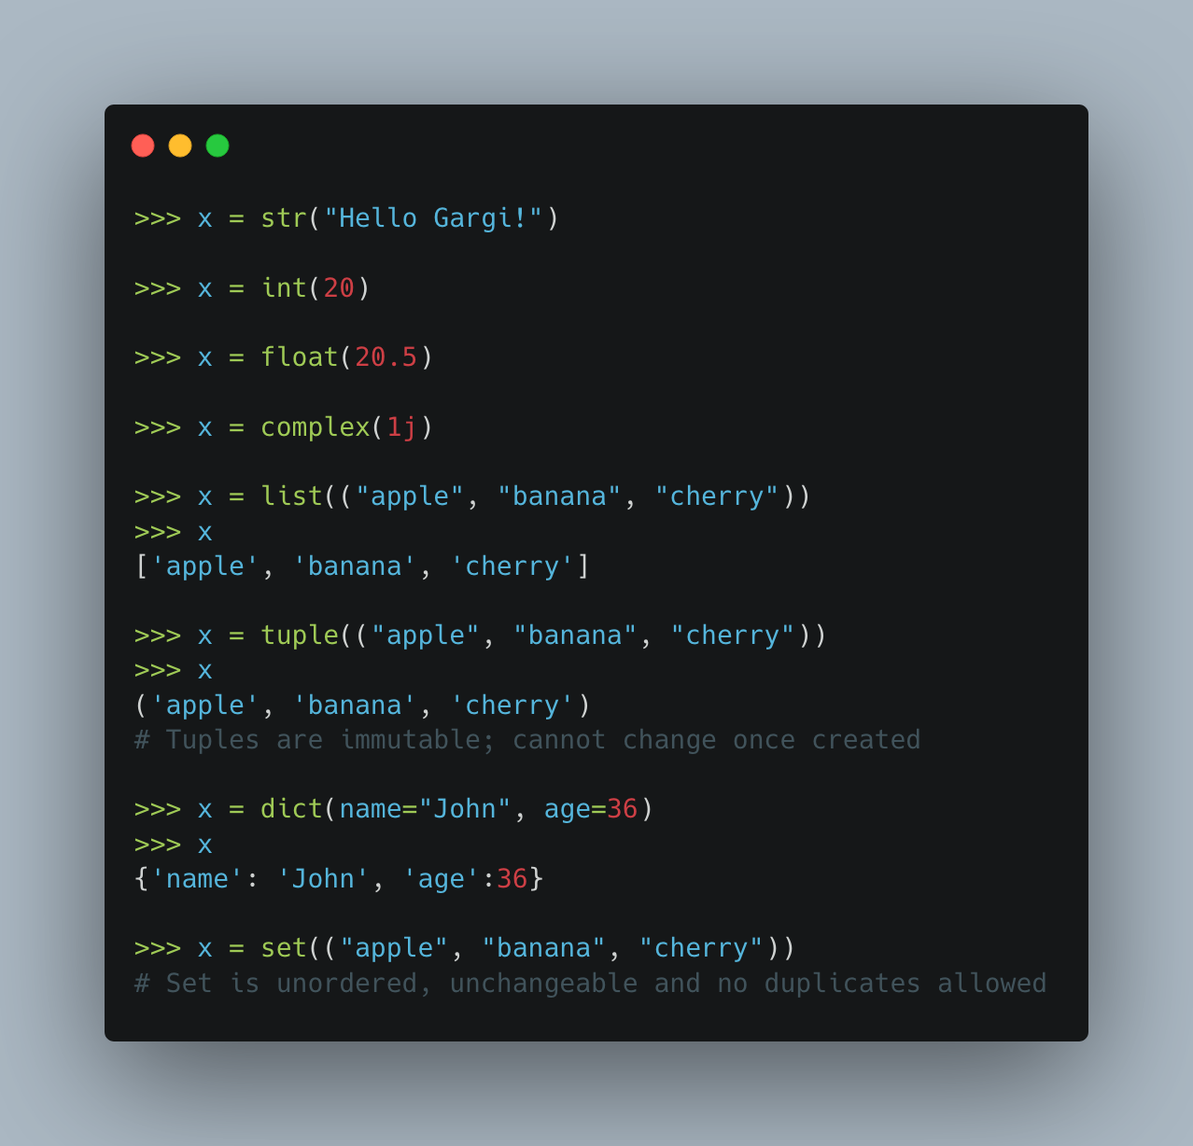

Slide 18
Conditions and Loops! 🔁
~ Conditions: If … else
~ Loops: While & for loops

Slide 19
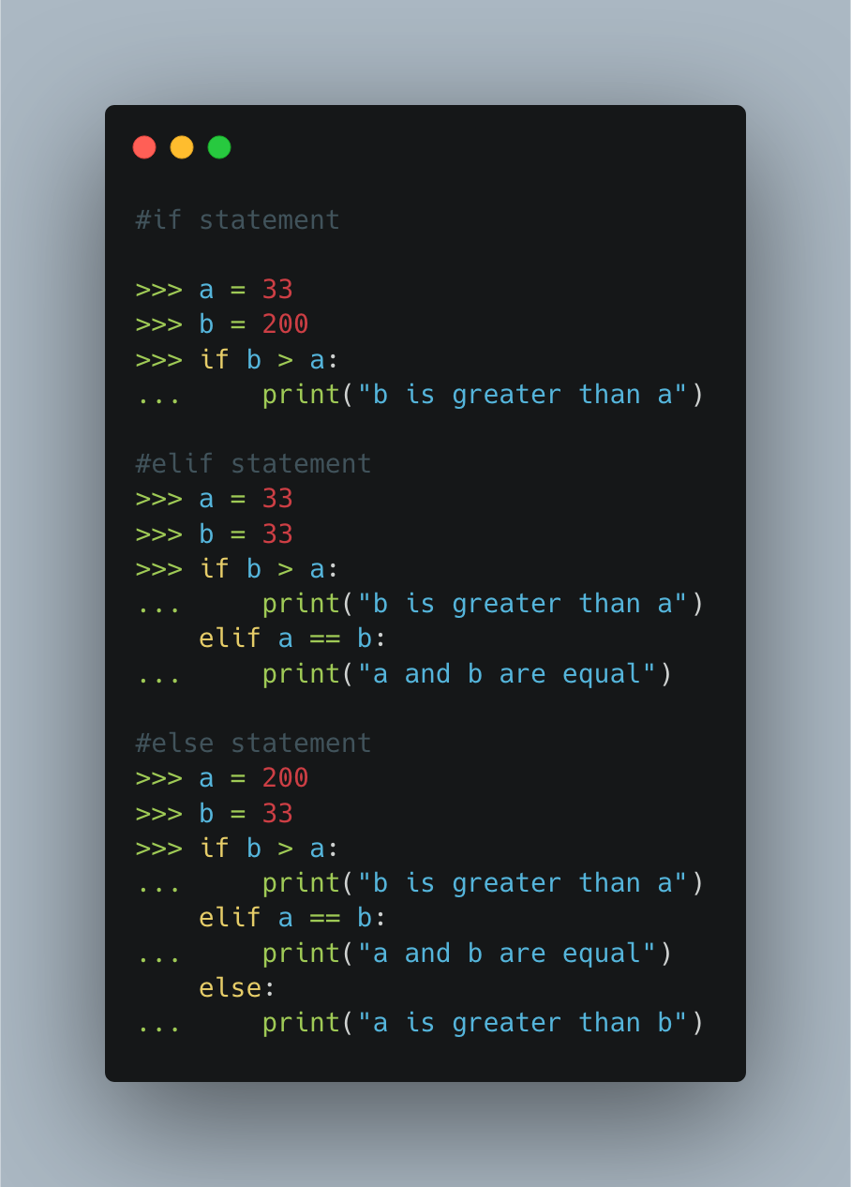

Slide 20
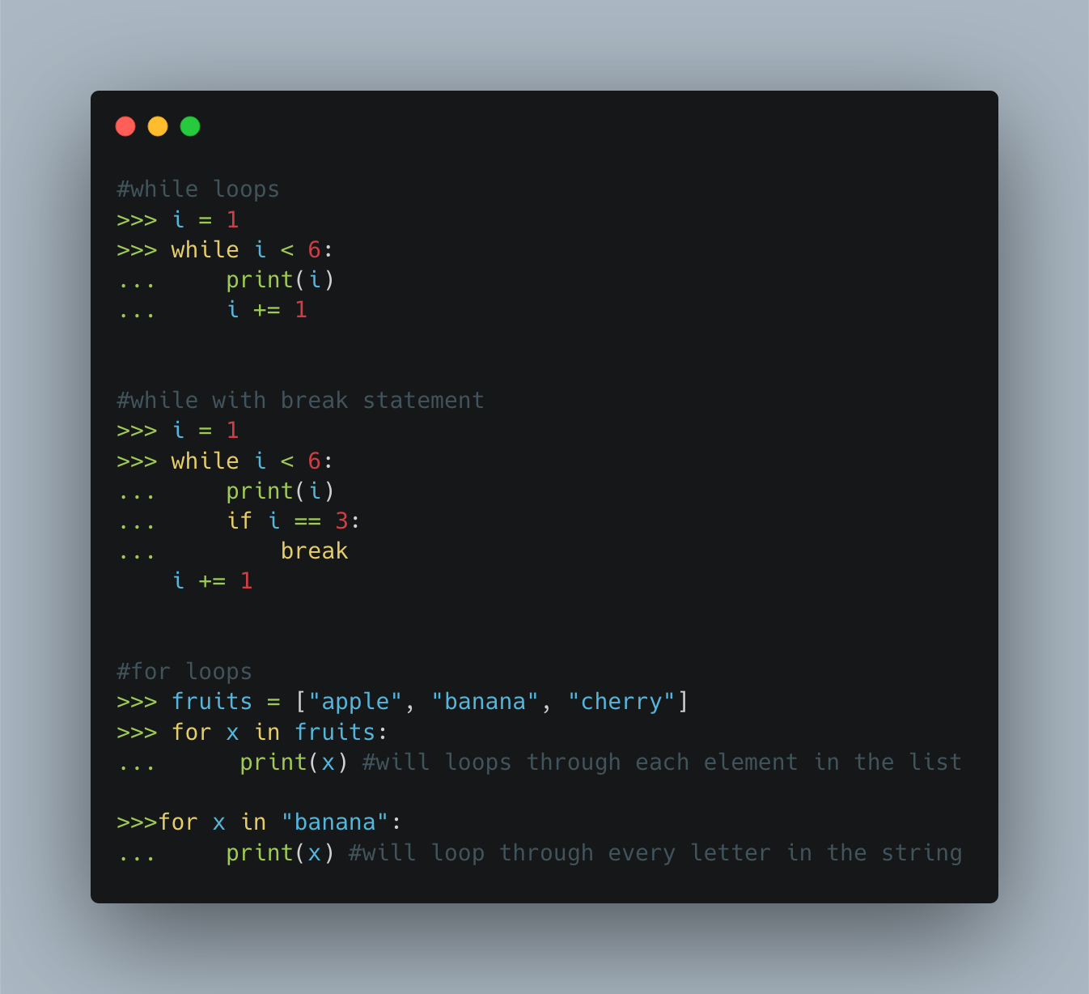

Slide 21
Functions! 🧠
~ block of code which only runs when it is called
~ defined using ‘def’ keyword
~ can pass data, known as parameters, into a function
~ function can return data as a result

Slide 22
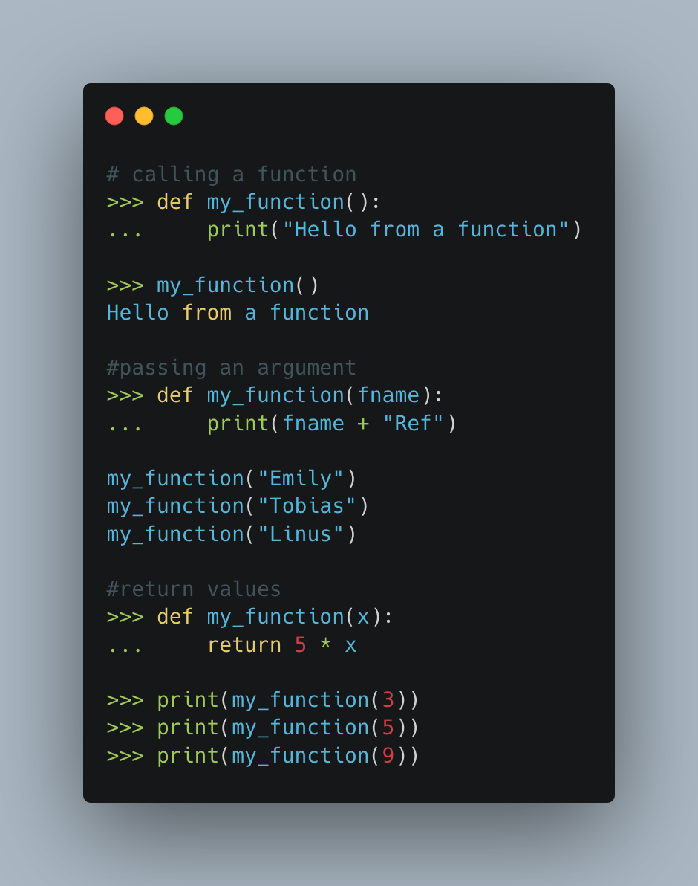

Slide 23
Now, let’s get our hands dirty! 👨🏻‍💻

Slide 24
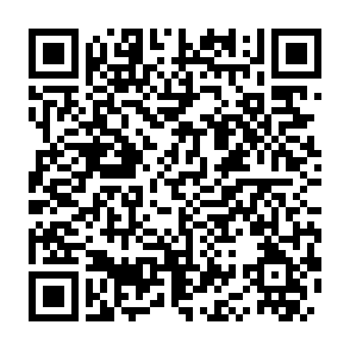
Let’s see some code! 🧑🏻‍💻

Slide 25
Conclusion!
What we’ve learned so far? 🥺

Slide 26
Was it good!?
Did you like it?
🤔

Slide 27
Scope 👀
~ play around with datasets and make your own predictions
~ deep dive into real world problems and solve them! 😄
~ use python to create cool stuff
~ machine Learning is used in almost every product we see!

Slide 28
Thank you! 🙌🏻

