Slide 1
RNAseq Data Analysis and Clinical Applications, Part II
MSIB32500 Advanced Bioinformatics Fall 2017
Riyue Bao, Ph.D.
Research Assistant Professor (Bioinformatics)
Center for Research Informatics & Department of Pediatrics
The University of Chicago

Slide 2
Outline
Part I (11/18/2017)
Introduction to RNAseq technology and clinical applications
Hands on: From raw data to gene expression quantification
Part II (11/25/2017)
Differential gene expression analysis and data visualization
Hands on: Identification of genes and pathways significantly changed under condition
Homework assignment
Thanksgiving week – Gleacher center physically closed. Class will be on WebEx.
Part III (12/02/2017)
How to associate gene expression data with clinical outcome
Hands on: Use gene expression data to discover tumor subtypes and survival analysis

Slide 3
Class materials
GitHub
https://github.com/MScBiomedicalInformatics/MSIB32500
This lecture note contains the same contents as the notebook. In addition, the notebook also contains hands-on materials
lecture9.pdf
Handson9.Rmd
Rstudio (or R console) on personal computers (hands on practice)

Slide 4
Objective
(Recap from last class) Rmarkdown HTML fixed; Alignment visualization; Reference databases
Detect genes differentially expressed between conditions
Identify pathways / network enriched in genes of interest
Generate high-quality figures for publication (PCA, heatmap, sample/gene cluster, GO/pathways, etc.)
Become familiar with running commands in R / Rstudio

Slide 5
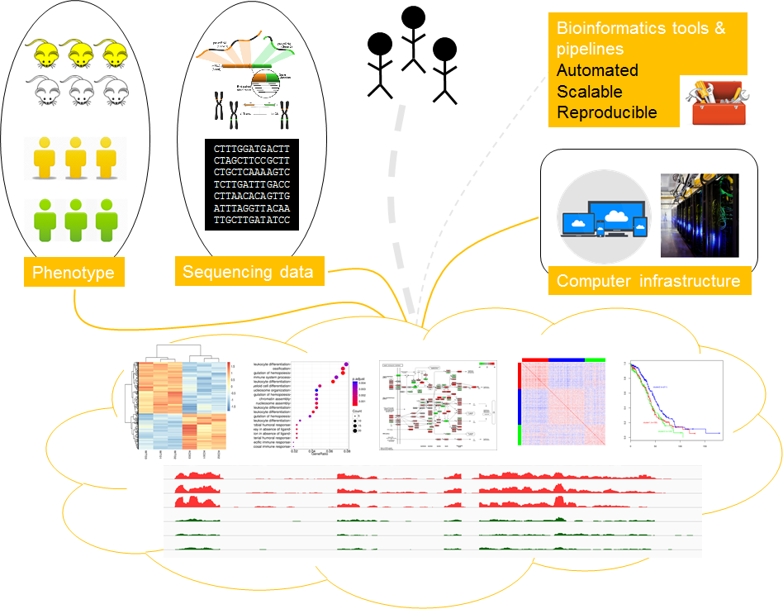

Slide 6
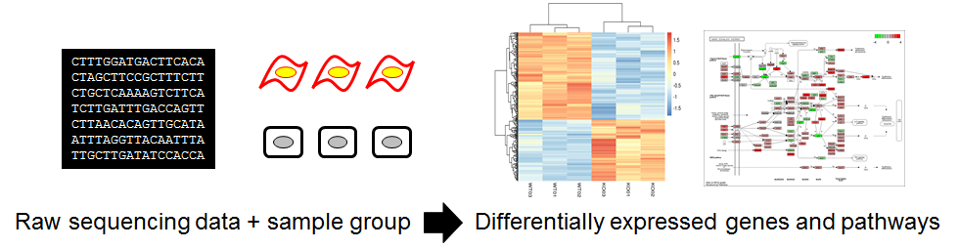
How to perform RNAseq analysis
The good-practice analysis protocol takes 8 major steps.
01-04: From raw sequencing to transcript quantification
05-08: DEG and pathway analysis (11/25, part II)

Slide 7
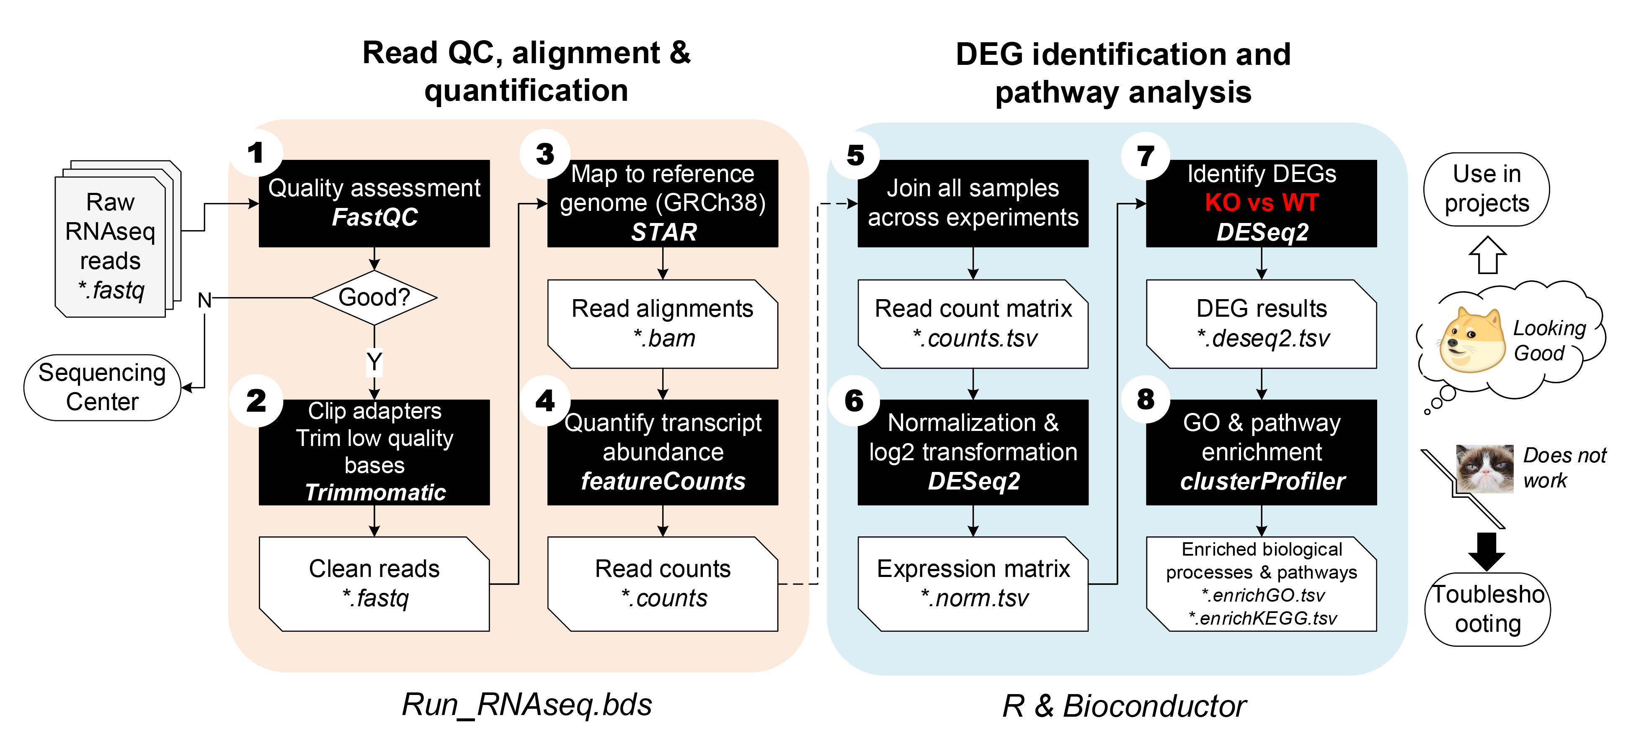
How to perform RNAseq analysis

Slide 8
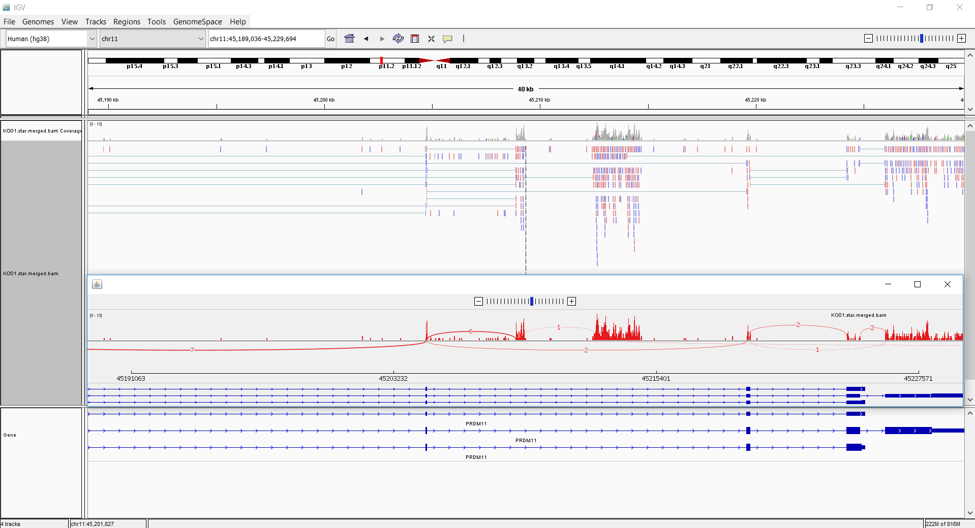
IGV (Integrative Genome Viewer)
http://software.broadinstitute.org/software/igv/home
Load existing genomes, or generate custom genomes
Visualize standard file formats
BAM
BED
GTF
… and more!

Slide 9
Reference databases
Gene annotation database: GENCODE
https://www.gencodegenes.org/
Ensembl database
https://www.ensembl.org/index.html
UCSC Genome Browser
https://genome.ucsc.edu/
NCBI databases
https://www.ncbi.nlm.nih.gov/guide/genomes-maps/

Slide 10
How to perform RNAseq analysis

Slide 11
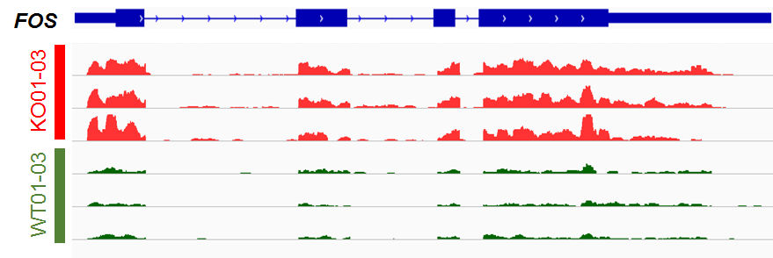
05-08: Identify differentially expressed genes and pathways: DESeq2, clusterProfiler
After steps 01-04, we have generated read alignment and counts for every annotated gene on the genome
The next step is to utilize the read counts data to detect DEGs
For example, if we visualize FOS gene across 6 samples in genome browser
FOS = Fos proto-oncogene, AP-1 transcription factor subunit

Slide 12
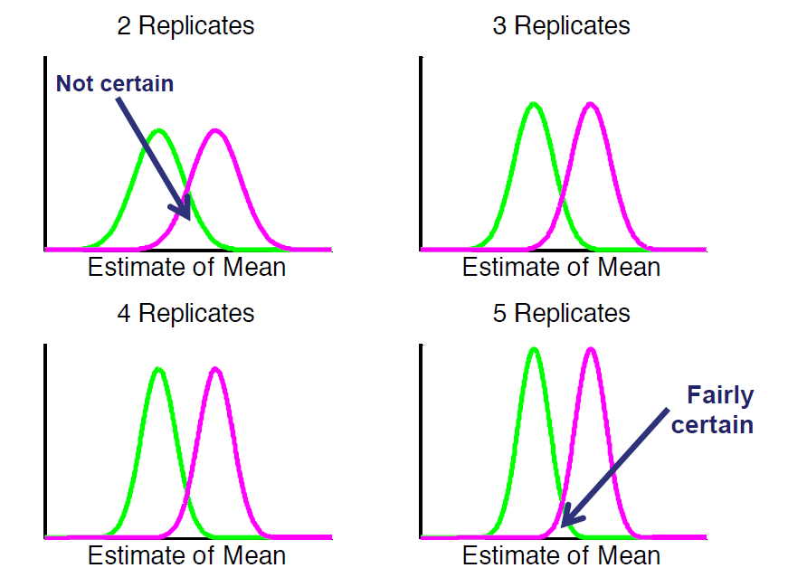
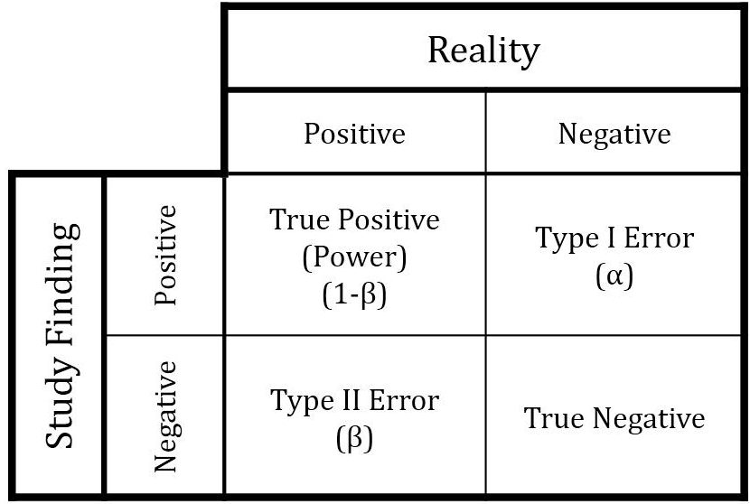
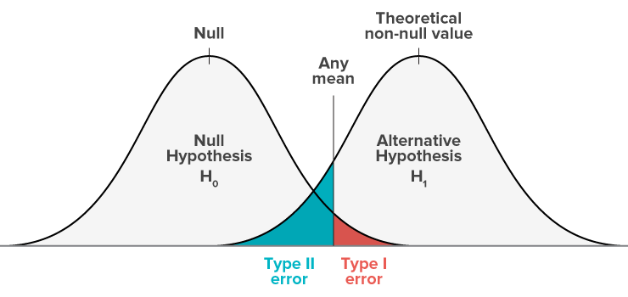
DEG detection
Sensitivity:
TP/(TP+FN)
Specificity:
TN/(FP+TN)
FP
FN
More biological replicates per group lead to higher discovery power, sensitivity and specificity.

Slide 13
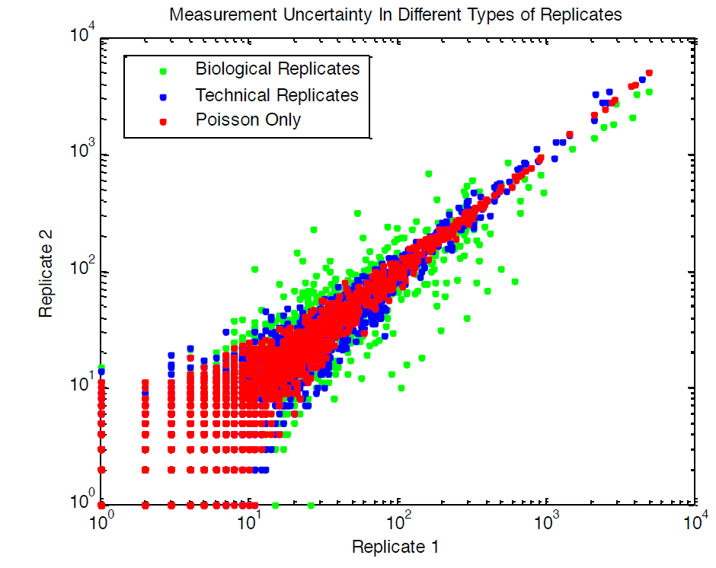
DEG detection
High correlation is expected between biological replicates.
If one sample is an outlier, it can be identified if multiple replicates are included in an experiment.
http://www.broadinstitute.org

Slide 14
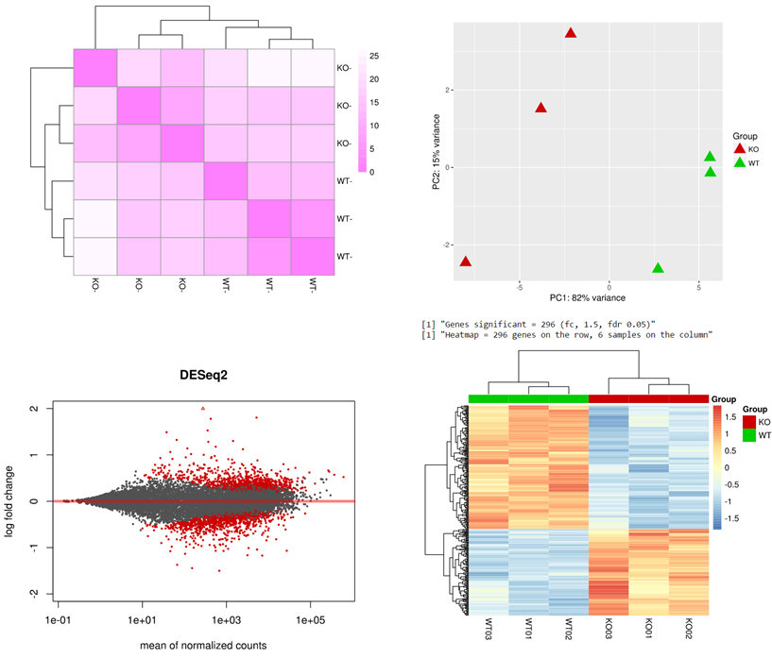
How to identify an outlier?
PCA plot (visualization)
Unsupervised sample clustering based on all genes or top variable genes (e.g. 1500)

Slide 15
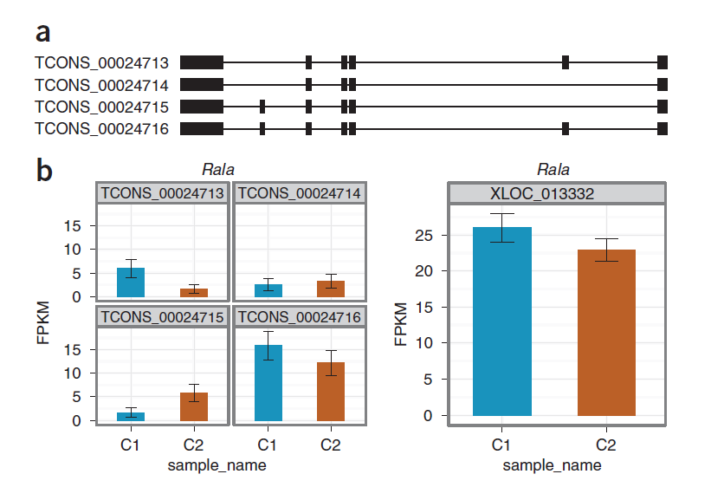
Transcript vs gene level quantification
1
3
Isoform 1 *
Isoform 3 *
Isoforms 1 – 4 Gene
Difference in gene-level expression is not significant due to variability of isoforms

Slide 16
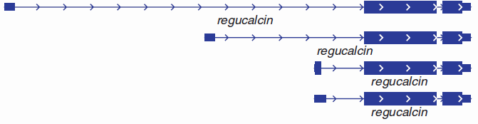
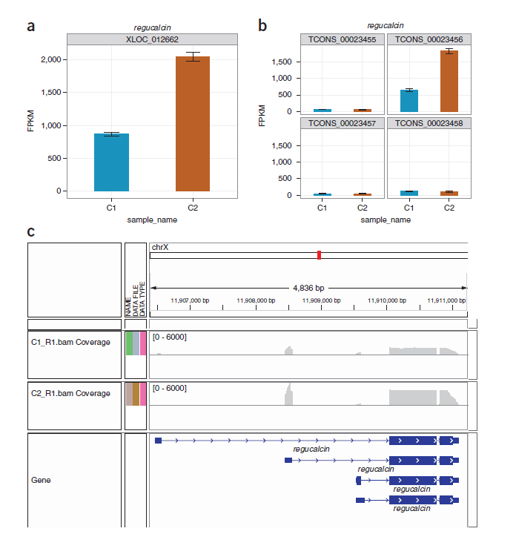
Transcript vs gene level quantification
2
Isoform 2 *
Isoforms 1 – 4 Gene
Difference in gene-level expression is significant, which is largely due to a great increase in the expression of isoform 2

Slide 17
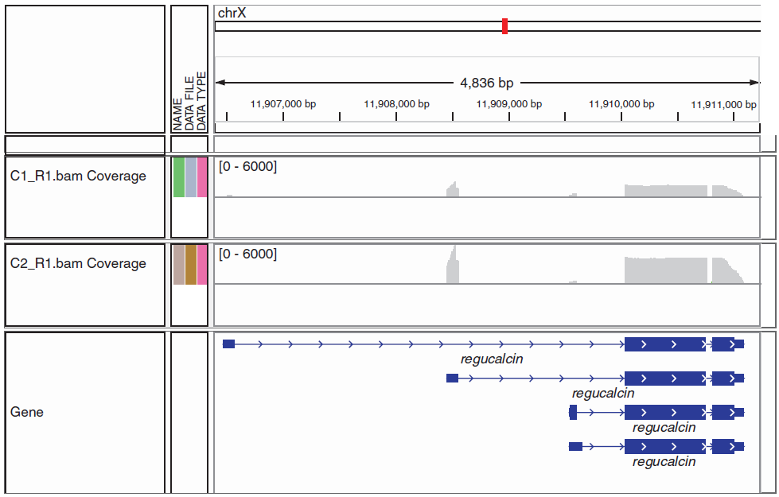
Difference in gene-level expression is significant, which is largely due to a great increase in the expression of isoform 2

Slide 18
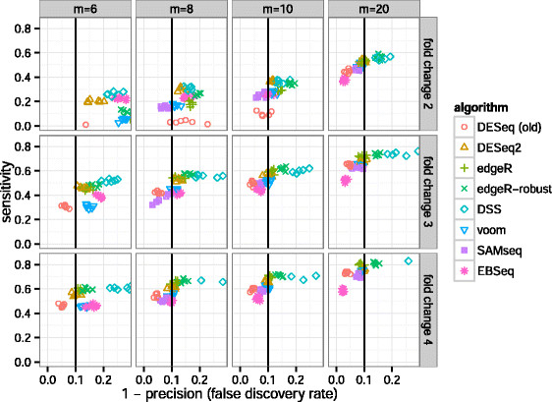
Comparison of different DEG identification methods
Sensitivity and precision of algorithms across combinations of sample size and effect size.
DESeq2 and edgeR often had the highest sensitivity of those algorithms that controlled the FDR, i.e., those algorithms which fall on or to the left of the vertical black line.
m: total sample size; split into two even-sized groups for comparison

Slide 19
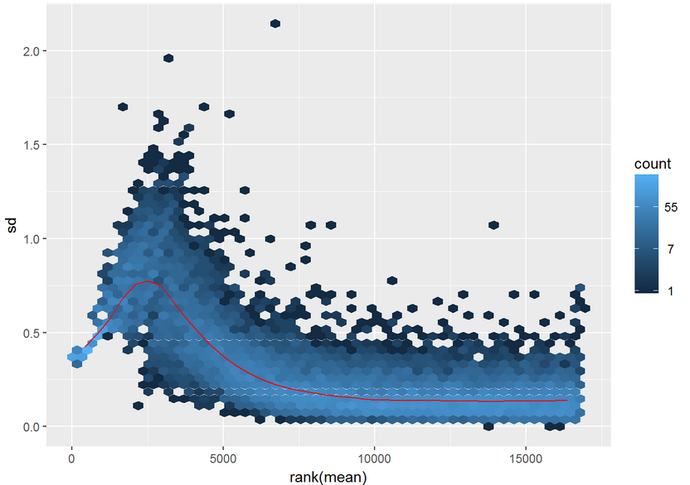
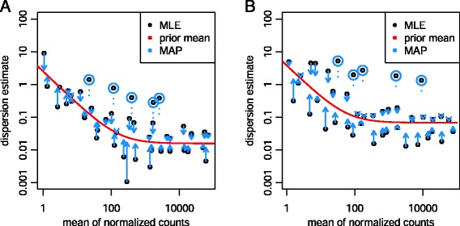
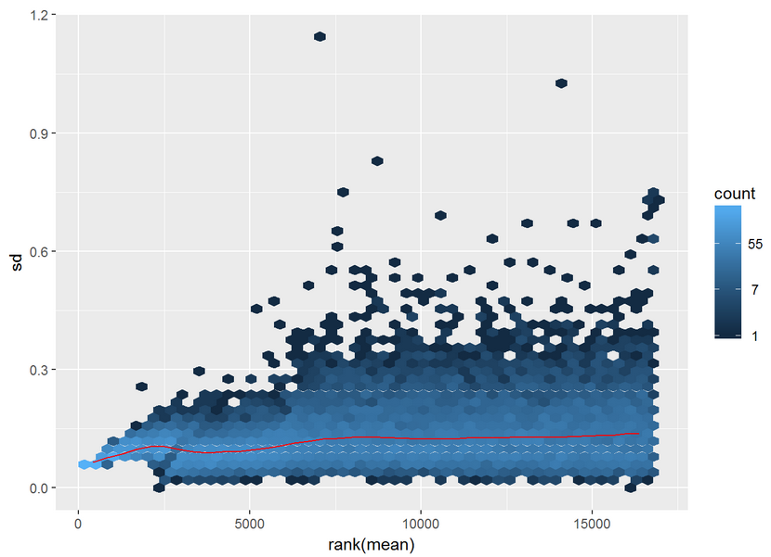
DESeq2
Love et al., Genome Biology 2014
Count matrix data
Assume data follow negative binomial distribution (sometimes also called a gamma-Poisson distribution) with mean (μ) and dispersion (α) parameters
Within-group variability, i.e., the variability between replicates, is modeled by the dispersion parameter alpha, which describes the variance of counts
Empirical Bayes shrinkage for dispersion estimation
Before
After
MAP, maximum a posteriori; MLE, maximum-likelihood estimate

Slide 20
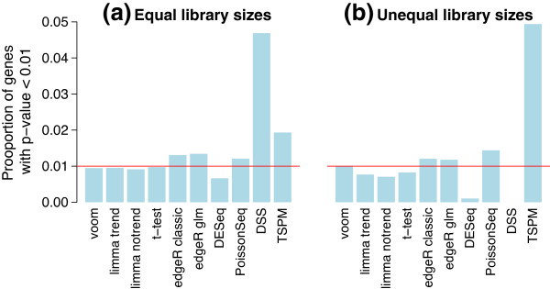
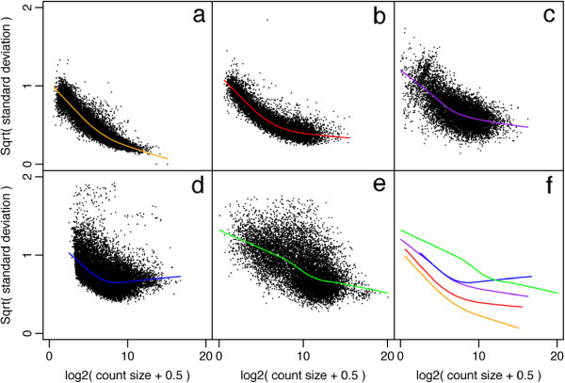
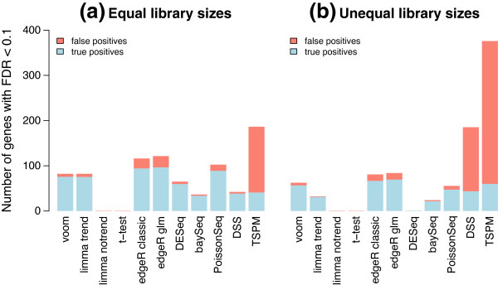
Limma voom (weighted algorithm)
Type I error rates in the absence of true differential expression
To model the mean-variance relationship than to specify the exact probabilistic distribution of the counts (e.g. NB or Poisson)
Provide accurate Type I (alpha) and Type II error (beta) control compared to other methods, especially when sample size is small
Voom with sample quality weights
Law et al., Genome Biology 2014
Power to detect true differential expression

Slide 21
More databases!
Gene annotation database: GENCODE
https://www.gencodegenes.org/
Gene Ontology (GO) database: Gene Ontology Consortium
http://www.geneontology.org/
Pathway database: KEGG
http://www.genome.jp/kegg/
Predefined gene sets: MSigDB
http://software.broadinstitute.org/gsea/msigdb/

Slide 23
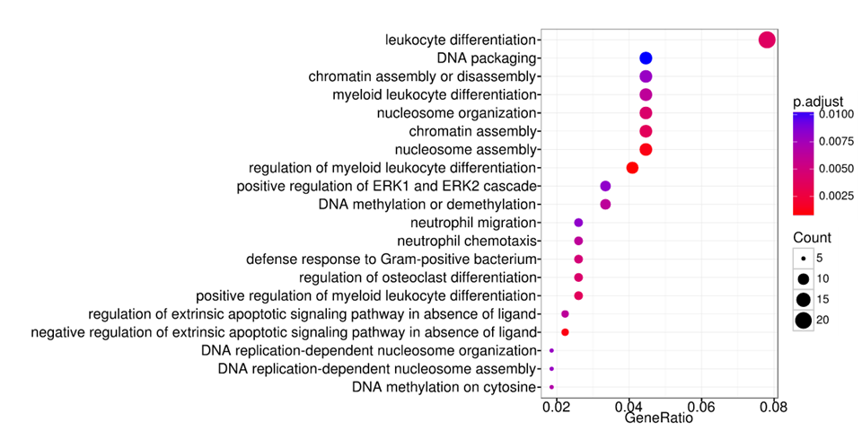

Slide 24
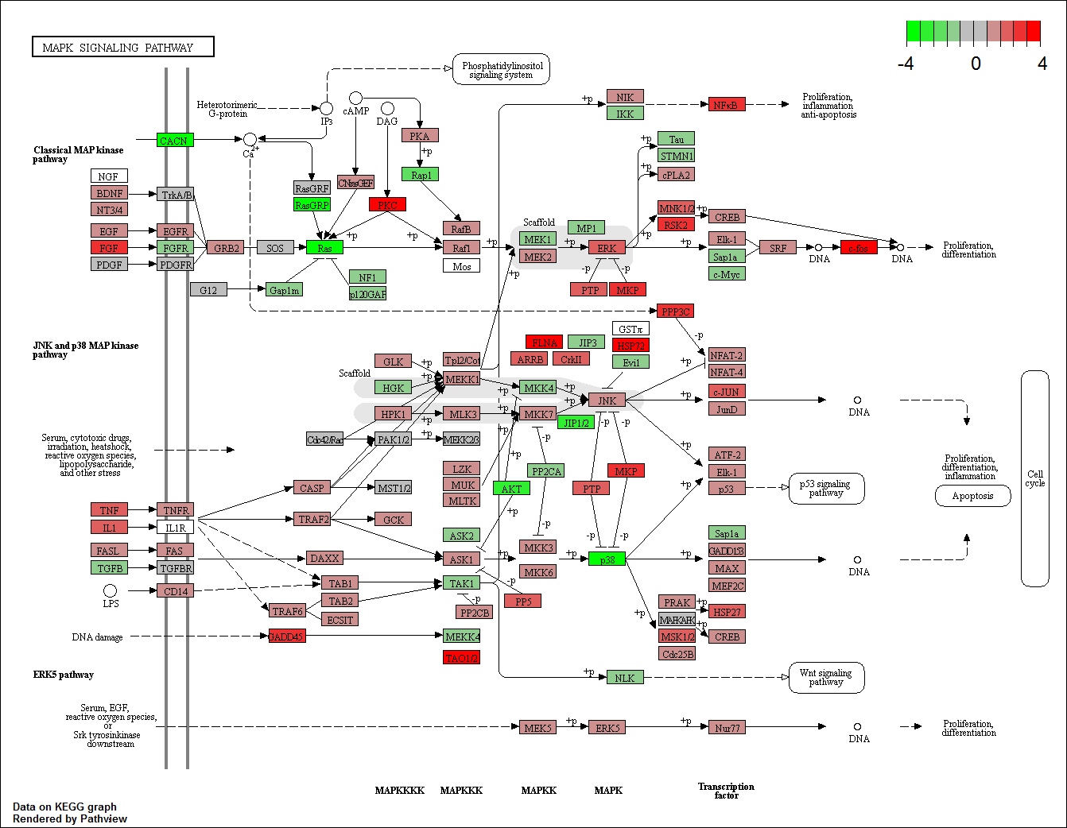

Slide 25
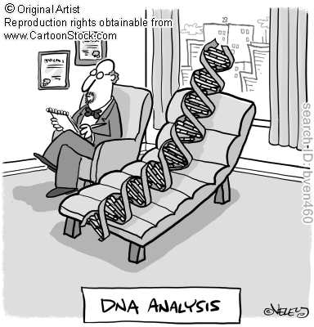

Thank you!
Questions

Slide 26
Hands-on practice START
Open your handson.Rmd on the Github or download to local computer
https://github.com/MScBiomedicalInformatics/MSIB32500/raw/master/lectures/handson8.html
Dataset: two groups (PRDM11 KO vs WT, human U2932 cells), 6 samples
Single-end reads, unstranded libraries
Fog. et al. 2015. Loss of PRDM11 promotes MYC-driven lymphomagenesis. Blood 125(8):1272-81
PRDM11 = PR/SET domain 11

Slide 27


