Slide 1
Data Science Project (EMATM0047)
Project: Student Dropout Predictor.
GitHub: https://github.com/MScProjs/MScProject2025-Ali-Suhail
Ali Suhail: dy24009@bristol.ac.uk
Student ID: 2606649

Slide 2
Problem Description
The main objective is to predict student dropout in higher education through machine learning (ML), with the aim of enabling early interventions and improving student retention.
This will be formulated as a binary classification task, where the model predicts whether a student is likely to dropout or continue (including failures), ideally making this prediction by the midpoint of the module or earlier.
Four ML models were chosen for the student dropout prediction task: Logistic Regression (LR), Support Vector Machine (SVM) RBF Kernel, Multilayer Perceptron (MLP) and Random Forest (RF).

Slide 3
Methodology & Motivation

Slide 4
Methodology
Dataset Analysis: Understand the OULA dataset (assessments, VLE, demographics) structure and key features.
Preprocessing & Feature Engineering: Merge tables into one dataset, segment into four phases (early, midpoint, late and full), clean and prepare data.
Processing: Handle missing values, remove duplicates, impute data, create train/test splits, scale and encode features.
Exploratory Data Analysis: Detailed feature insights.
Modelling: Initialise, tune, execute, and evaluate ML models; pipeline setup and hyperparameter tuning.
Results: Hypothesis testing outcomes and model evaluation.

Slide 5
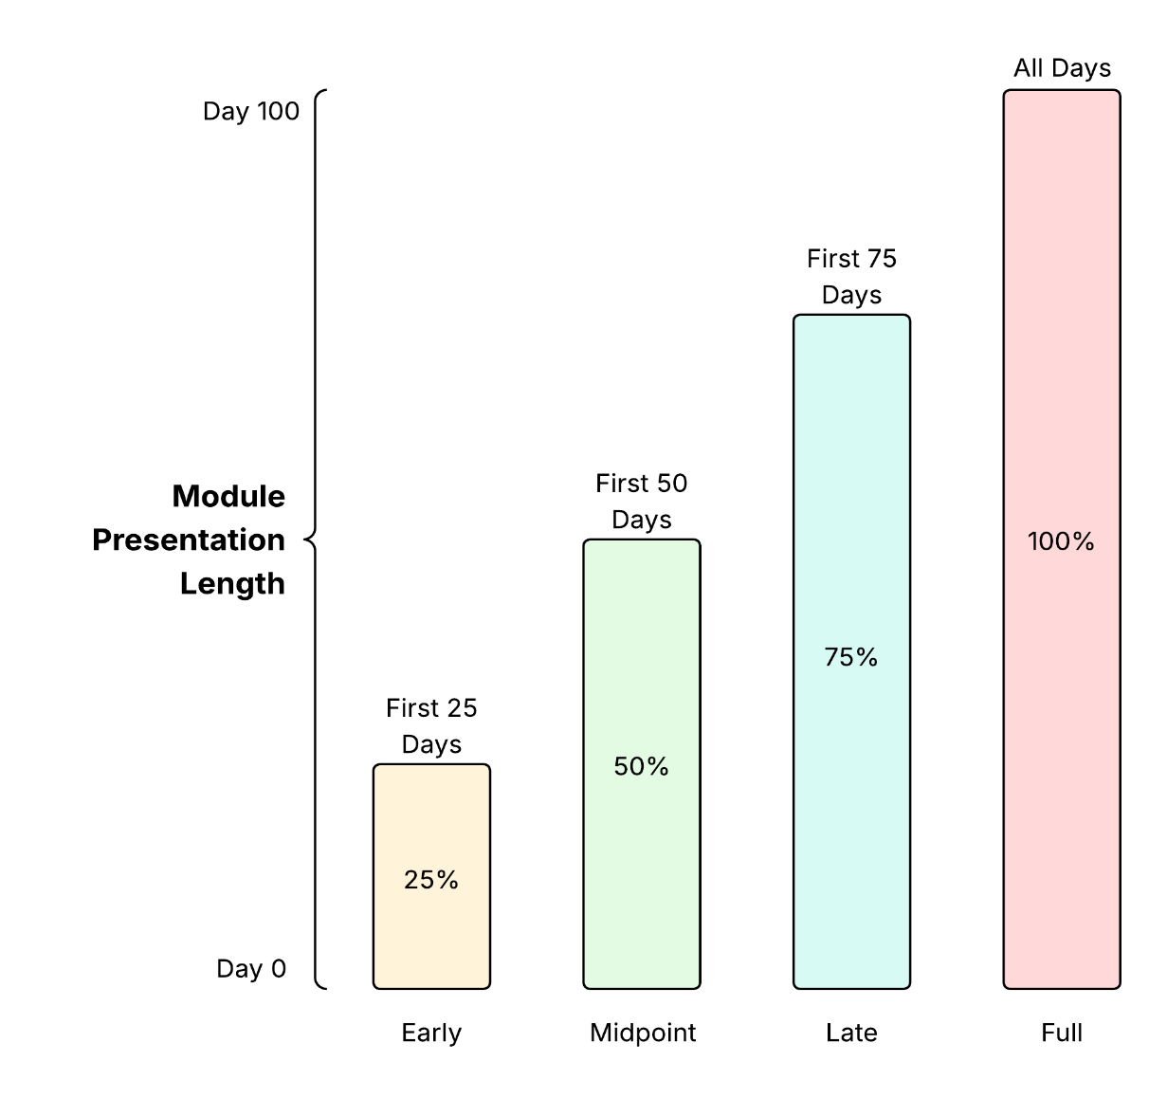
Methodology
Created 4 aggregated features: weighted score, late rate, fail rate, days active and a combined weight-score metric to simplify time-series data for ML.
Temporal segmentation proved to be an effective strategy for enabling earlier interventions. Both [1] and [2] used time-based partitioning successfully, allowing predictions at different points in a module's progression. This makes it possible for institutions to provide timely support before students fall too far behind.
Unlike prior studies focusing on pass/fail, this work targets continue/dropout classification for a new perspective.

Slide 6
Methodology
Dataset has a 20/80 dropout to non-dropout ratio, so class weights were set to 'balanced' to improve minority class detection.
GridSearch with 5-fold cross-validation was used for hyperparameter tuning to ensure stable and accurate results.
F1 macro was the main evaluation metric due to its emphasis on minority classes, with additional analysis on accuracy, F1, precision, and recall per class, focusing on dropout precision and recall.

Slide 7
Motivation
Student dropout is a major concern in higher education, affecting both students’ academic progress and institutional stability [4].
In the UK, data from the Student Loans Company shows that students who took loans but did not complete their degrees rose from 32,491 in 2018–19 to 41,630 in 2022–23, a 28% increase [3].
Factors such as mental health challenges, financial strain, academic pressure, social isolation, and limited institutional support contribute to early withdrawal [3], highlighting the need for systems that identify vulnerable students and provide personalised support.
Early identification of at-risk students enables timely, targeted interventions to improve retention and success.

Slide 8
Results & Findings

Slide 9
Hypothesis Tests and Results
Four hypothesis tests were carried out on the OULA dataset, with the key descriptions and findings outlined below:
Engagement: Very small p-value (~8.82 × 10⁻¹⁴⁰) confirms low early engagement is strongly linked to higher dropout risk.
Assessment Performance: Mann–Whitney U test (U = 22,891,409, p < 0.001) shows dropouts score significantly lower, supporting the link between weak early performance and dropout.
Demographics: Chi-Square tests found dropout differences by education, region, IMD band, and disability, but not age.
Re-enrolment: Mann–Whitney U test (U = 40,818,054, p = 1.10 × 10⁻⁷) shows multiple previous attempts increase dropout risk.

Slide 10
Model Macro F1 Scores Across Phases
Model | Early | Midpoint | Late | Full
Logistic Regression | 56% | 64% | 67% | 69%
Support Vector Machine | 65% | 67% | 69% | 71%
Multiplayer Perceptron | 43% | 47% | 49% | 57%
Random Forest | 48% | 59% | 68% | 67%
For Early and Midpoint phases, SVM achieved the best macro F1 scores (65% Early, 67% Midpoint), followed by LR (56–64%).
RF ranked third with 48–59%, while MLP had the lowest performance (43–47%).

Slide 11
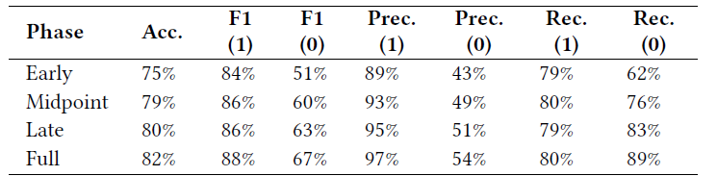
Model Evaluation Metrics – Logistic Regression
Accuracy in the Early and Midpoint phases ranges between 75–79%.
For the non-dropout class, F1, precision and recall consistently stay above 80%, with precision peaking at 93% by Midpoint, showing that LR is effective at identifying non-dropouts.
In contrast, the dropout class performs much worse: F1 lags at 51–60%, precision remains low at 43–49%, while recall is relatively stronger at 62–76%, but still falls short compared to the non-dropout class.

Slide 12
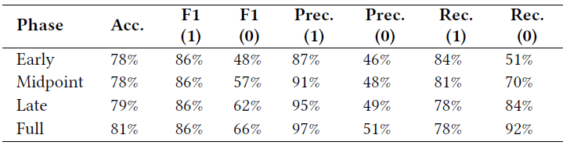
Model Evaluation Metrics – SVM (RBF)
Accuracy in both the Early and Midpoint phases remains at 78%, with no improvement despite the larger amount of student data available at Midpoint.
For non-dropout class, F1, precision, and recall all stay above 84%, indicating that SVM, like LR, is effective at identifying non-dropouts with comparable performance.
The dropout class continues to underperform: F1 falls between 48–57%, precision stays low at 46–48%, and recall ranges from 51–70%. Overall, its performance is slightly weaker than LR on the non-dropout class.

Slide 13
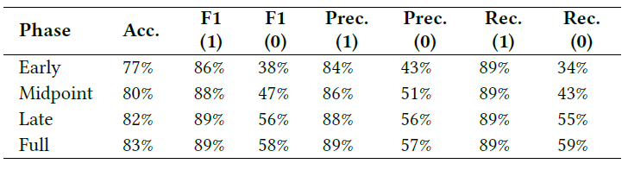
Model Evaluation Metrics – MLP Classifier
Accuracy in the Early and Midpoint phases falls within 77–80%.
For the non-dropout class, F1, precision, and recall remain consistently above 84%, with MLP performing best at predicting this class compared to other models tested.
However, for the dropout class, MLP performs the worst overall, with F1 between 38–47%, precision at 43–51%, and the lowest recall at 34–43%, showing that it struggles the most in detecting dropouts.

Slide 14
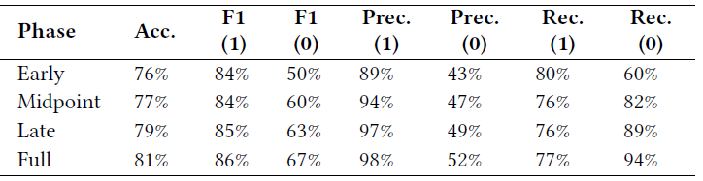
Model Evaluation Metrics – Random Forest
Accuracy in the Early and Midpoint phases stays around 76–77%.
For the non-dropout class, F1, precision, and recall remain above 80%, though recall drops to 76% in the Midpoint and Late phases.
For the dropout class, RF performs on par with LR, achieving F1 scores of 50–60%, precision of 43–47%, and recall between 60–82%. At Midpoint, RF outperforms LR in recall, scoring 82% compared to LR’s 76%.

Slide 15
Model Evaluation Metrics – Ranking (Dropout class)
Logistic Regression: F1: 51-60, Precision: 43-49%, Recall: 62-76%
Random Forest: F1: 50-60, Precision: 43-47%, Recall: 60-82%
SVM RBF: F1: 48-57, Precision: 46-48%, Recall: 51-70%
MLP Classifier: F1: 38-47, Precision: 43-51%, Recall: 34-43%

Slide 16
Model Evaluation Metrics – SHAP
A SHAP (SHapley Additive exPlanations) analysis was conducted on the Early and Midpoint phases for each model. The top 4 most influential features in each model are summarised as follows:
Logistic Regression: Weighted score, fail rate, GGG code module and studied credits.
SVM RBF: Fail rate, weighted score, studied credits and date registration.
MLP Classifier: Weighted score, late rate, fail rate and days active.
Random Forest: Weighted score, fail rate, late rate and GGG code module.
Common across models are the weighted score, fail/late rates, studied credits and days active. Demographic features (age band, gender, disability, etc.) have a low influence in all models.

Slide 17
Project Limitations

Slide 18
Limitations
The OULA dataset has significant gaps, lacking key information such as exam data, seminar participation, attendance, financial data (scholarships, bursary support, loans), behavioural records (suspensions), and health-related leaves.
The dataset is imbalanced, with an 80–20 non-dropout and dropout ratio, alongside further imbalances across features like module code, presentation, region, age band, and education level.
Modelling posed challenges for SVMs and MLPs due to the high computational cost of hyperparameter tuning and SHAP analysis, which restricted the search space and increased processing times.

Slide 19
Future Works

Slide 20
Further Work
Broaden coverage by incorporating data from multiple institutions and online learning platforms to strengthen generalisability.
For class imbalance, use techniques such as SMOTE (synthetic oversampling) or class-weight adjustments to address imbalances in dropout rates and underrepresented demographic/module categories.
Develop an application that leverages the best-performing ML model, refined through further tuning and enhanced OULA data, to predict student outcomes in real-time.

Slide 21
Reference
[1] H. Waheed, S.-U. Hassan, Naif Radi Aljohani, J. Hardman, Salem Alelyani, and R. Nawaz, “Predicting academic performance of students from VLE big data using deep learning models,” Computers in Human Behavior, vol. 104, pp. 106189–106189, Nov. 2019, doi: https://doi.org/10.1016/j.chb.2019.106189.
[2] M. Adnan et al., “Predicting at-Risk Students at Different Percentages of Course Length for Early Intervention Using Machine Learning Models,” IEEE Access, vol. 9, pp. 7519–7539, 2021, doi: https://doi.org/10.1109/access.2021.3049446.
[3] J. Bryson, “University dropout rates reach new high, figures suggest,” BBC News, Sep. 28, 2023. https://www.bbc.co.uk/news/education-66940041.
[4] G. Crosling, M. Heagney, and L. Thomas, “Improving student retention in higher education: Improving teaching and learning,” Australian Universities’ Review, vol. 51, no. 2, pp. 9–18, 2009. [Online]. Available: https://files.eric.ed.gov/fulltext/EJ864028.pdf.

Slide 22
Q&A

