Slide 1
RELATIVE REPRESENTATION EVALUATIONS AND COMPARISONS OF AUTOENCODERS AND VISUAL TRANSFORMERS
A further look into the paper "Relative representations enable zero-shot latent space communication." by Moschella, Luca, et al.
Michele SCOMINA

Slide 2
Models, like Autoencoders and Transformers, transform high dimensional data into a meaningful representation they can use to solve tasks. These learned representations depend on the initial state and hyperparameters of the given model.
Is there a meaningful way of comparing different learned representations?
If there is, to what extent and to what architectures can this representation be used for?

Slide 3
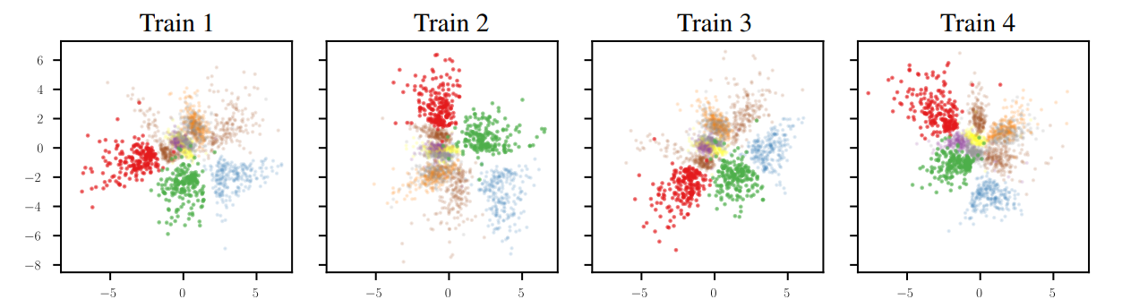
AUTOENCODERS
Autoencoders’ representations of a particular dataset reconstruction are intrinsically similar.
They are extrinsically the same after an isometric correction.

Slide 4
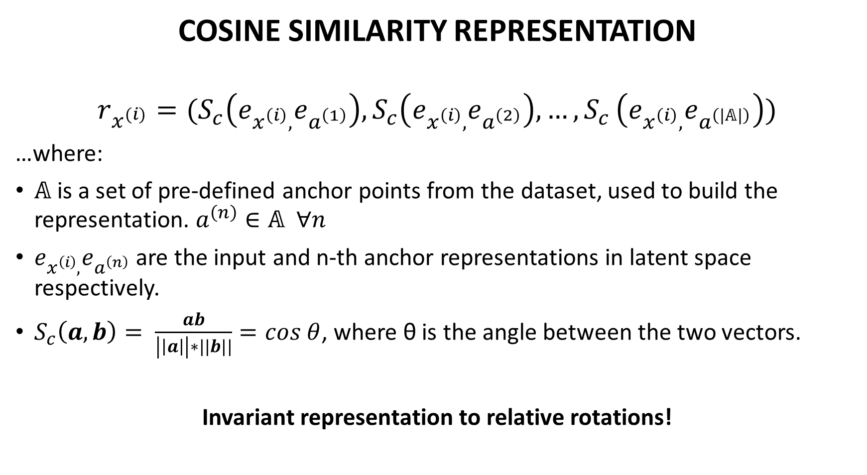
COSINE SIMILARITY REPRESENTATION
$$r_{x^{(i)}}=(S_{c}\left(e_{x^{\left(i\right)},}e_{a^{\left(1\right)}}\right),S_{c}\left(e_{x^{\left(i\right)},}e_{a^{\left(2\right)}}\right),…{,S}_{c}\left(e_{x^{\left(i\right)},}e_{a^{\left(|𝔸|\right)}}\right))$$
…where:
𝔸 is a set of pre-defined anchor points from the dataset, used to build the representation. $a^{\left(n\right)}∈\text{𝔸} ∀n$
$e_{x^{\left(i\right)},}e_{a^{\left(n\right)}}$ are the input and n-th anchor representations in latent space respectively.
$S_{c}\left(a, b\right)= \frac{ab}{\left|\left|a\right|\right|∗||b||}=cos θ$, where θ is the angle between the two vectors.
Invariant representation to relative rotations!

Slide 5

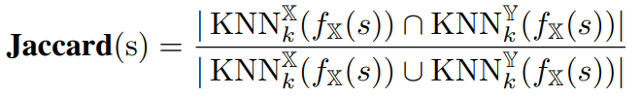


EVALUATION METRICS
The following metrics have been used to compare the representations:
Cosine Similarity Index:
Jaccard Index:
Where 𝕏, 𝕐 are source and target space respectively, and ,
are the encoding functions.

Slide 6
ARCHITECTURES AND DATASETS
The type of models used in this project are the following:
Convolutional Autoencoder (with variable bottleneck size)
Visual Transformer
The architectures are then trained on one of 4 datasets as reconstruction models:
MNIST
kMNIST
FashionMNIST
CIFAR-10

Slide 7
HYPERPARAMETERS
Optimizer: Adam
Loss function: Mean Square Error (MSE)
Number of anchors: 30 per class
Number of k-neighbours for Jaccard index: 10
Regularization: Dropout (0.5), Batch Normalization, Early Stopping

Slide 8
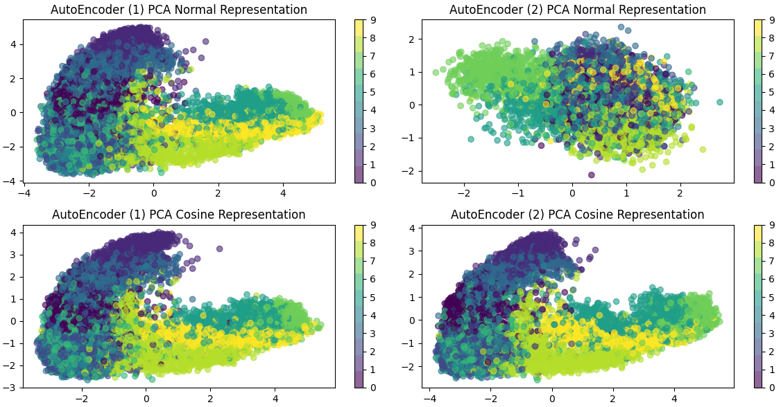
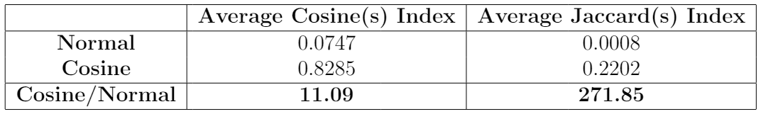
RESULTS
2 Autoencoders – Bottleneck of size 48 - FashionMNIST

Slide 9
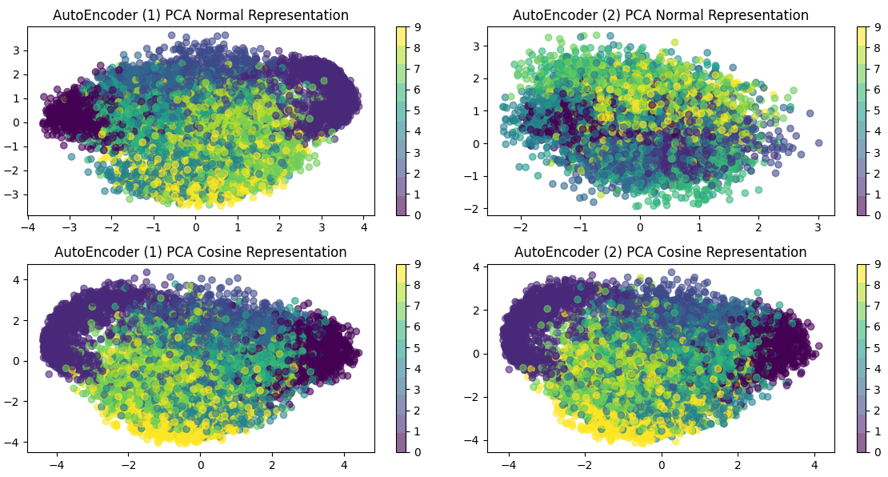
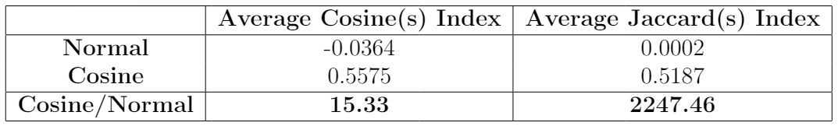
RESULTS
2 Autoencoders – Bottleneck of size 24 - MNIST

Slide 10
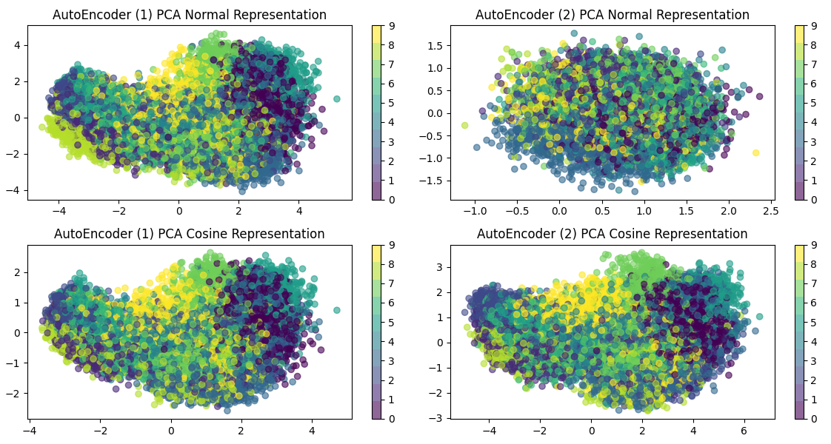

RESULTS
2 Autoencoders – Bottleneck of sizes 48,24 – kMNIST
Different scales in Cosine representation when the bottlenecks have different dimensionalities!

Slide 11
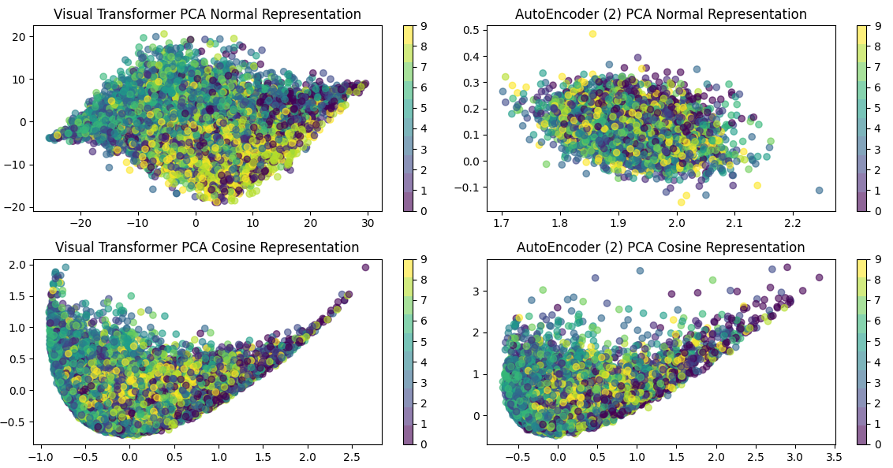
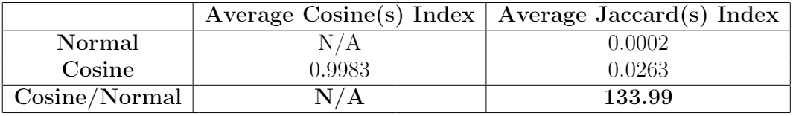
RESULTS
Visual Transformer and Autoencoder – Bottleneck of size 72 – CIFAR10

Slide 12
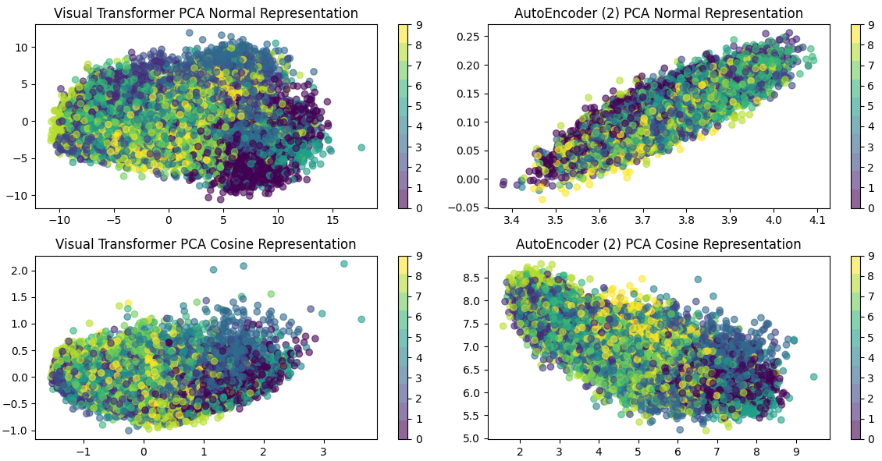
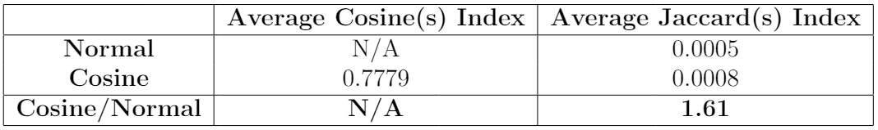
RESULTS
Visual Transformer and Autoencoder – Bottleneck of size 48 – kMNIST

Slide 13
CONCLUSIONS
Autoencoders’ latent spaces are comparable through a rotationally invariant representation.
Autoencoders of different latent space dimensionalities scale with respect to the number of dimensions.
Transformers and Autoencoders do share inconsistent similarities, further research is required in order to have a definitive answer regarding the possibility of alternative representations that might fit the models better.

