Slide 1

Solving the maximum edge disjoint path problem using a modified Lagrangian particle swarm optimization hybrid by Jake Weiner, Andreas T. Ernst, Xiaodong Li, Yuan Sun, Kalyanmoy Deb
Michele Scomina

Slide 2
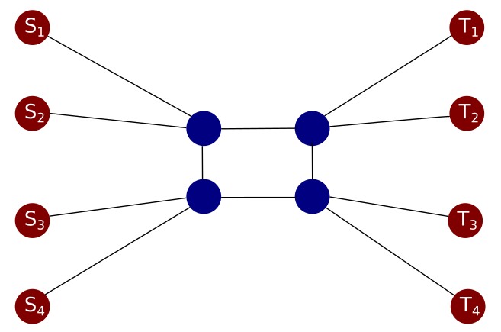
Maximum Edge Disjoint Path (MEDP)
Maximum Edge Disjoint Path:
- Set of source-terminal node pairs has to be connected on a graph.
- Edges can only be used by at most one source-destination pair.
Objective: Connect the most amount of node pairs.
Applications: Optical and energy-efficient networks
(Raghavan & Upfal – 1994)
(Gerez – 1998)

Slide 3
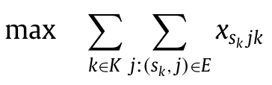
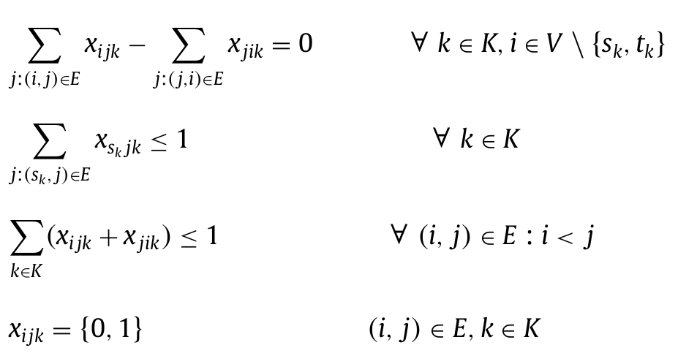
Integer Problem formulation
Vars:
x = edge use for each commodity pair
Node flow:
Parameters:
k = source-terminal pair number
i,j = node number
sk = source node of pair k
Source flow:
Capacity constraint:
Assumptions:
- All edges have a cost of 0, therefore all paths are
equally good as long as they satisfy the constraints

Slide 4
Multi-start Simple Greedy Algorithm (MSGA)
MSGA:
- One of the first approaches (Kleinberg – 1996, Blesa & Blum – 2007)
- Tries to connect the commodity pairs using Dijkstra in random orders,
then removes the edges used from the graph if a path was found.
Advantages:
- Very easy to implement.
- Very fast.
- Works very well in small and well-connected graphs.
Disadvantages:
- Poor solutions on large or poorly connected graphs.
- Does not provide an upper bound solution.
- Does not explore the entire solution space.
Sbest = 0
while n < max_iter:
reset Graph
shuffle pairs
Scurrent = 0
for pair in pairs:
path = dijkstra(Graph, pair)
if path exists:
Scurrent += 1
remove(Graph, path)
if Scurrent > Sbest:
Sbest = Scurrent

Slide 5
LaPSO
LaPSO (2021):
- Short for Lagrangian Relaxation and Particle Swarm Optimisation.
- Consists in relaxing the capacity constraints and reformulating the problem as a minimization problem.
- The MEDP turns in a series of shortest path problems with variable weights.
- If solutions are infeasible, apply a repair heuristic.
- Given the solutions and infractions, update the Lagrangian through PSO framework.
- If solution hasn’t improved, max time or iterations have been reached, return the best solution found.
Relax MEDP
constraints
Solve shortest path
problem on LR
Repair heuristic
Update Lagrangian
NO
Stopping
criterion
YES
Return best solution
and bounds

Slide 6
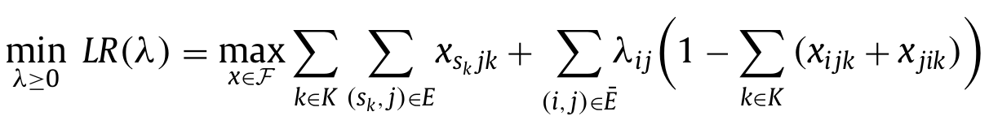
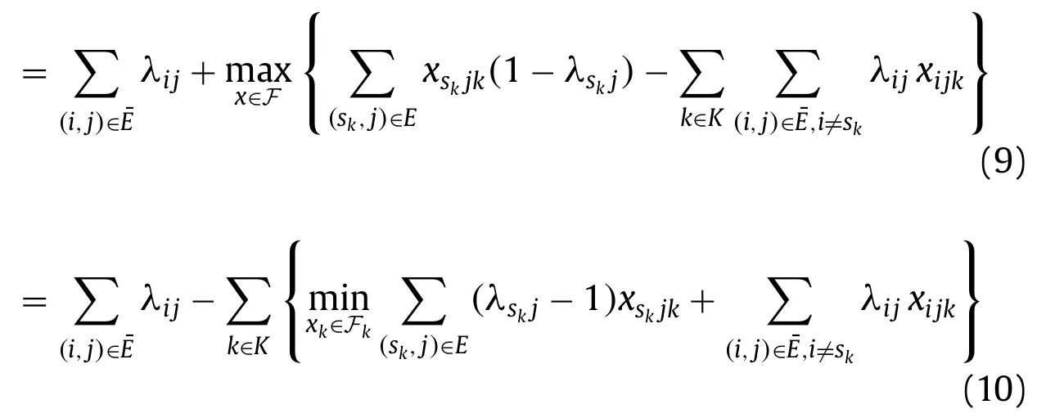

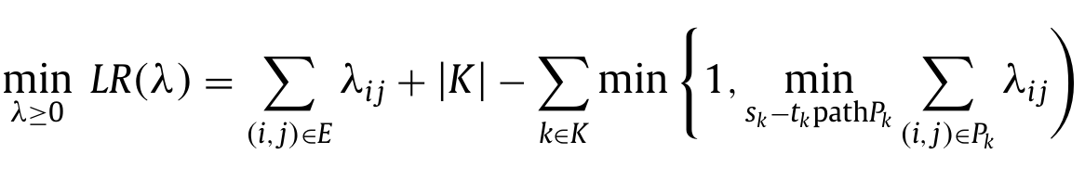
Lagrangian Relaxation
Relaxing the capacity constraint:
Parameters:
F set of feasible solutions to
all constraints except capacity

Slide 7
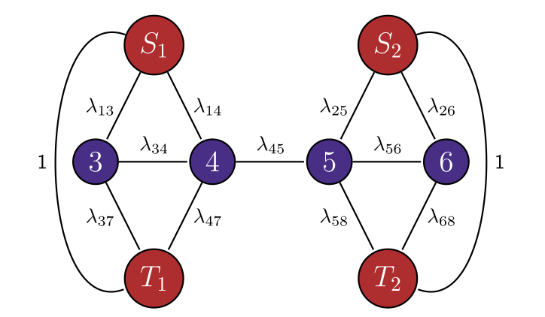
Graph representation
Graph representation of the relaxed
Lagrangian minimization problem:

Slide 8
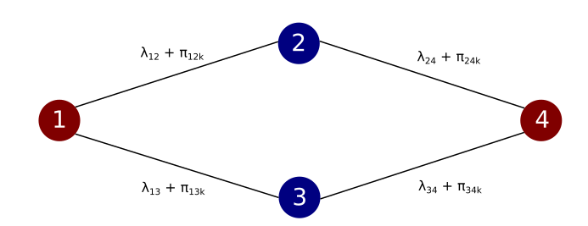
Perturbations
New problem:
If the edge weights are all the same for all commodities, then they will most likely all be connected
through the same lowest cost edges, leading to poor diversity and high violation count.
Solution: Perturbations
By adding small perturbations to the graph’s edges,
commodity pairs will diversify their paths, leading to
overall better results. These perturbations are learned
through the PSO framework to penalize edges already
used by other commodity pairs.

Slide 9
Repair heuristics
Since the MEDP problem has been relaxed, generated solutions may (and very often are) infeasible.
Solution: Repair heuristic
A repair heuristic is applied to the relaxed solution in order to make it feasible.
It takes the infeasible paths and tries to reroute them onto unused edges using Dijkstra.
There are three possible repair heuristics:
- Rand: Randomly picks an infeasible path and tries to reroute it.
- LVA (Largest Violation Arbitrary): Picks the path with the largest amount of violations and tries to reroute it.
- LVP (Largest Violation Perturbation): Picks the path with the largest amount of violations and tries to
reroute it using the perturbation values as edge weights.

Slide 10
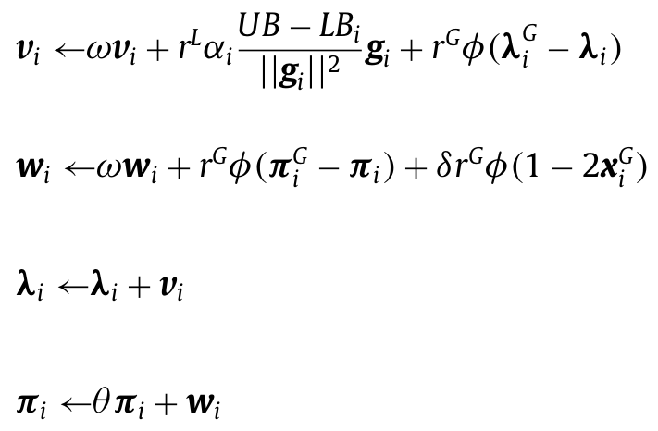
Particle Swarm Optimization
Parameters:
vi,wi = Particle speeds
ω = Velocity factor
r^{L},r^{G} = random uniform variables – [0,1]
gi = subgradient vector
UB, LBi = Upper and lower bounds
αi = Subgradient factor
ɸ = Global factor
δ = Perturbation factor
θ = Perturbation decay

Slide 11
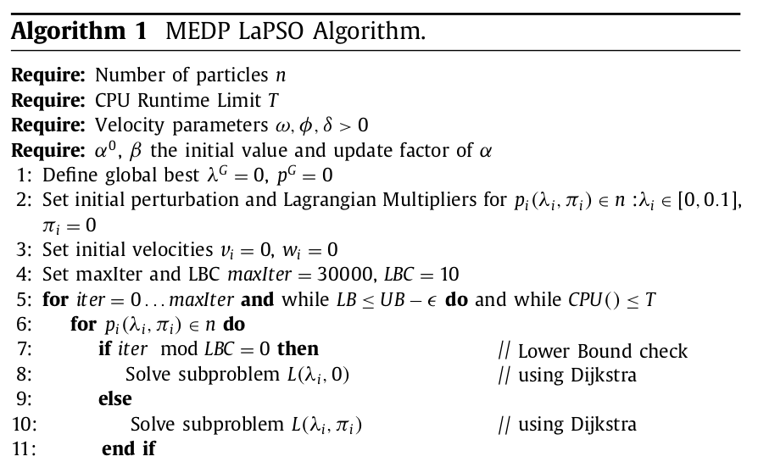
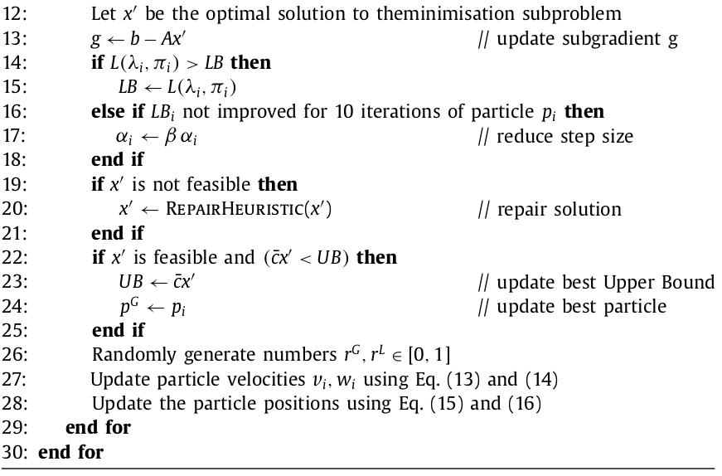
Pseudocode

Slide 12
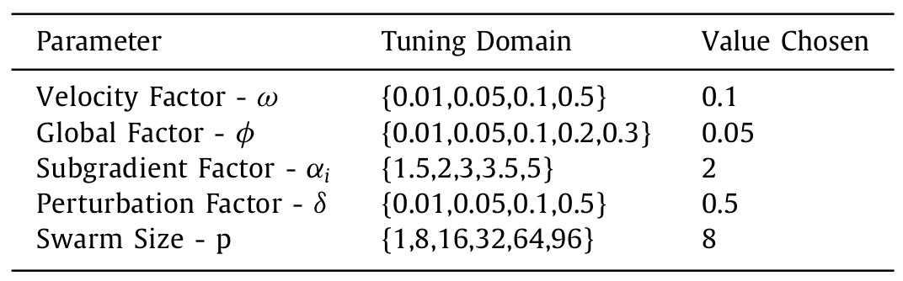
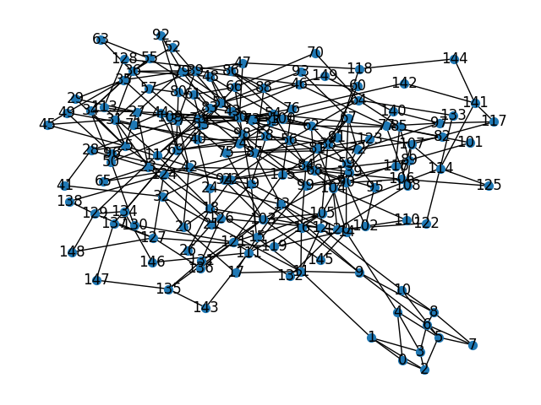
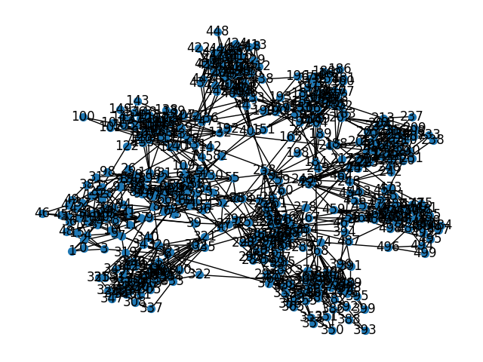
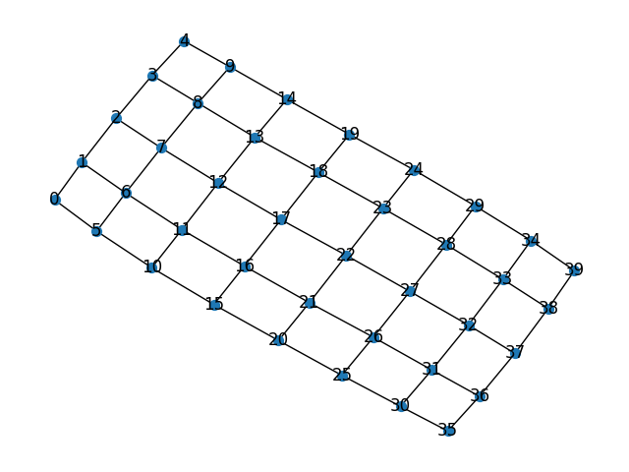
Experimental setup
Parameter choices (PSO):
Graph choices:
OrdinaryN:
CollatedC,N:
Maximum iterations: 1000
Maximum time: 20 minutes
3 runs per graph combination
66% nodes used for pairs
GridW,h:
Computational:
- Python codebase, with RustworkX for fast graph operations
- Ryzen 7 7800X3D 8-cores – 32 GBs of RAM
- MIP solver: Gurobi

Slide 13
Results
CASE: | Gurobi - Avg | MSGA - Avg | LaPSO - Avg | Gurobi - Gap | MSGA - Gap | LaPSO - Gap | Gurobi - Time | MSGA - Time | LaPSO - Time
Collated5,25 | 35.6666 | 35.6666 | 35.6666 | 0.0000 | 0.2866 | 0.1160 | 27.3711 | 0.2577 | 32.9486
Collated6,30 | 49.6666 | 49.3333 | 49.6666 | 0.0000 | 0.2850 | 0.1240 | 92.3655 | 0.5105 | 42.1783
Collated8,30 | 55.0000 | 55.0000 | 55.0000 | 0.0000 | 0.2361 | 0.1628 | 697.9784 | 0.5555 | 70.2271
Collated10,30 | 75.3333 | 72.6666 | 75.3333 | 0.0492 | 0.1925 | 0.0848 | 1024.0420 | 1.2402 | 125.1619
Collated10,50 | 124.3333 | 117.6666 | 124.3333 | 0.1907 | 0.4260 | 0.1077 | 1203.2094 | 2.3249 | 267.2233
Grid8,6 | 11.3333 | 11.3333 | 11.3333 | 0.0000 | 0.2444 | 0.1288 | 3.7978 | 0.0748 | 30.0885
Grid10,8 | 17.6666 | 16.0000 | 17.6666 | 0.0000 | 0.3846 | 0.1180 | 331.8981 | 0.1690 | 67.3477
Grid15,12 | 32.3333 | 26.0000 | 28.6666 | 0.1101 | 0.5593 | 0.2252 | 1200.2497 | 0.3349 | 92.4551
Grid25,15 | 54.0000 | 39.3333 | 47.0000 | 0.3799 | 0.6802 | 0.2703 | 1201.1051 | 0.8911 | 201.6951
Regular50 | 16.0000 | 16.0000 | 15.6666 | 0.0000 | 0.0000 | 0.0208 | 0.3434 | 0.0870 | 4.0694
Regular100 | 31.3333 | 28.3333 | 28.0000 | 0.0000 | 0.1414 | 0.1515 | 255.6080 | 0.2212 | 31.5226
Regular150 | 43.0000 | 38.0000 | 36.6666 | 0.0720 | 0.2245 | 0.2517 | 1200.2062 | 0.3314 | 23.6007
Regular250 | 65.6666 | 57.6666 | 55.0000 | 0.1244 | 0.2967 | 0.3293 | 1200.5760 | 0.9000 | 70.6878

Slide 14
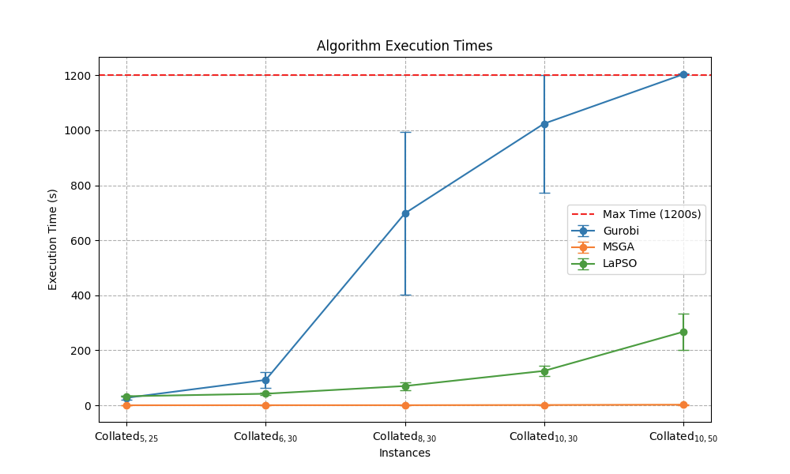
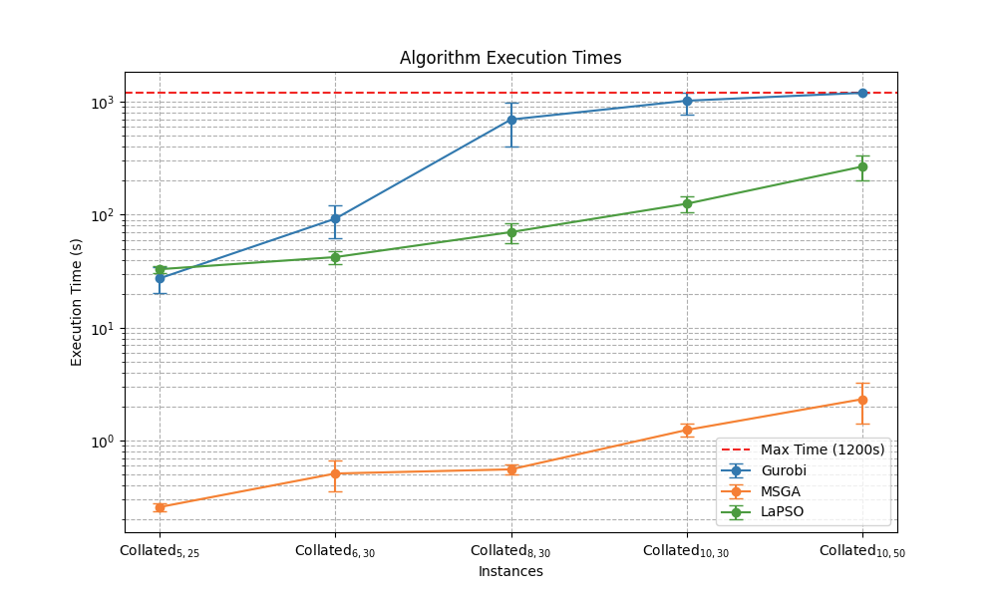
Graph plots (Collated)

Slide 15
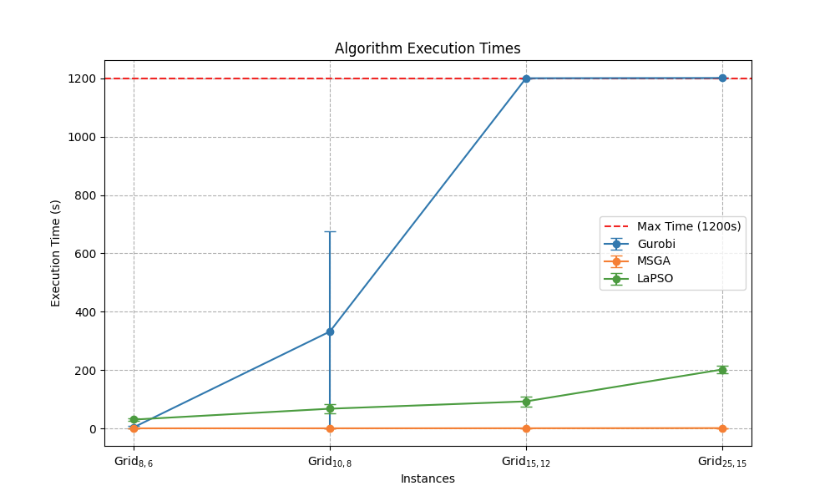
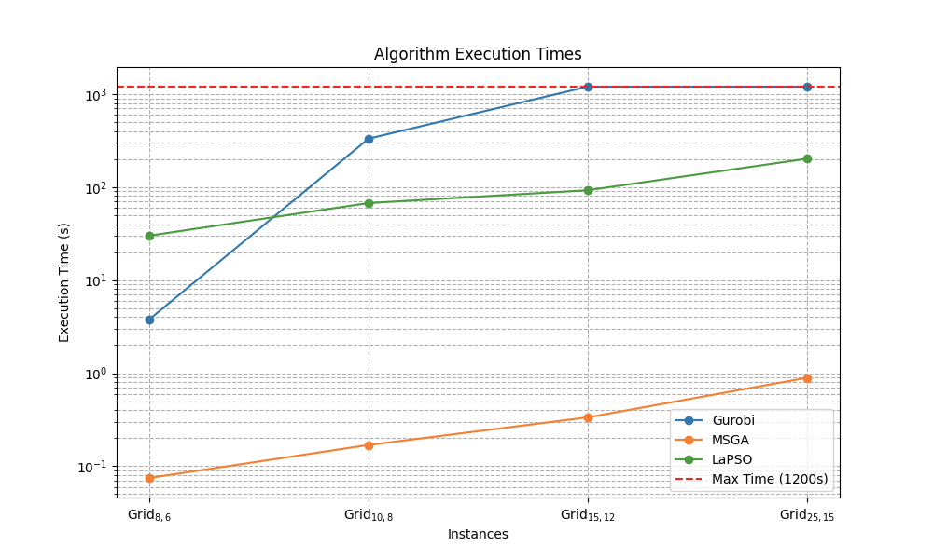
Graph plots (Grid)

Slide 16
Conclusions
LaPSO vs:
Gurobi:
- Faster computation
- Better scalability
- Better gap estimation for larger instances
MSGA:
- Better gap estimation
- Better solutions
- Comparable time complexity

Slide 17
Thank you for your attention.

