Slide 2
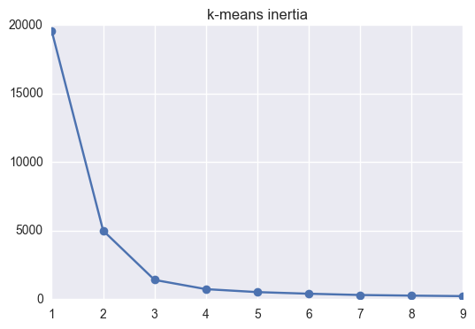
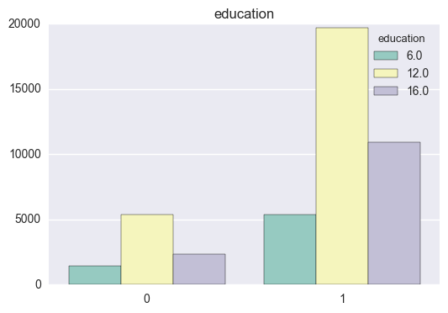
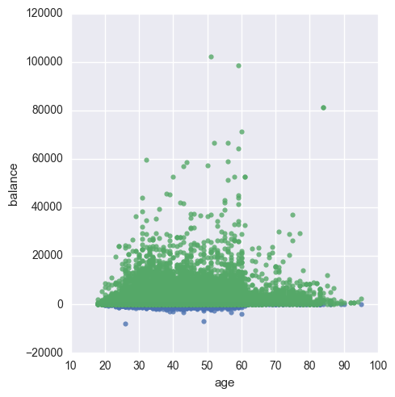
Market segmentation
2 groups of customers
Separated by balance and education
3 groups of customers
Separated by balance and education
Choose 2 segments
Segment size | 9225 | 35986
Success rate | 7% | 13%
Segment size | 3368 | 6656 | 35187
Success rate | 6% | 8% | 13%

Slide 3
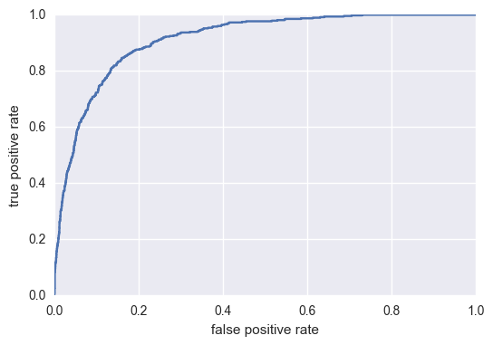
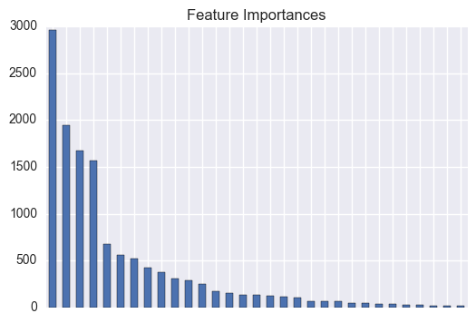
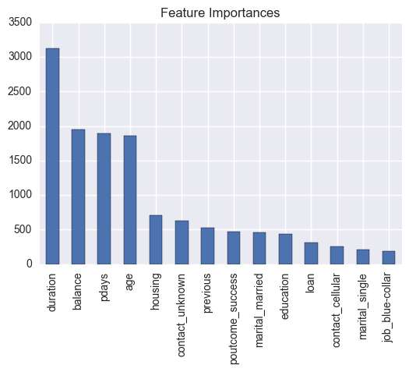
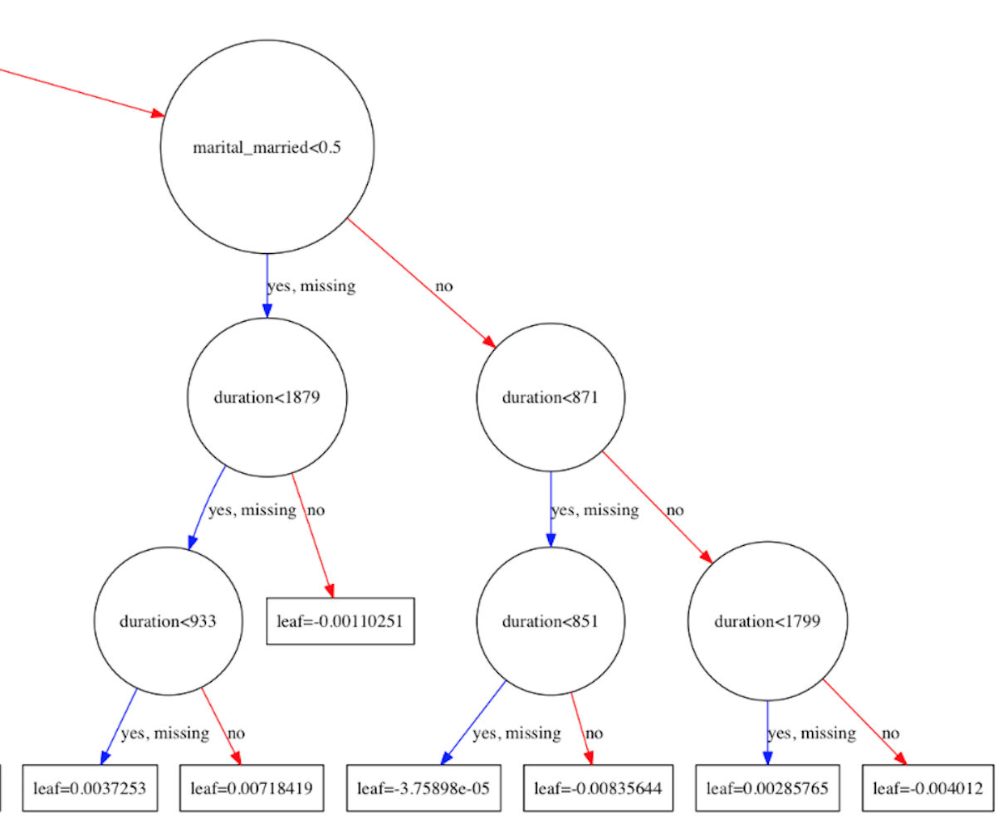
Xgboost
Parameter tuning
*max tree depths
*subsample size
*regularization
* learning rate
* number of trees
Feature selection
* model usability and reusability
* F-score
AUC: .913

Slide 4
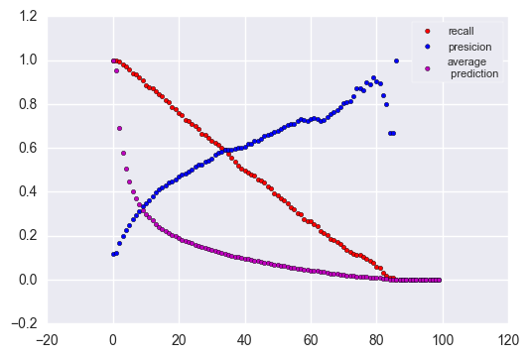
Choosing the threshold
Cost of the campaign
Do we contact customers interested in the product?
Do we annoy customers who are not interested in it?
Accuracy | 0.89
Recall | 0.7
Precision | 0.51
AUC | 0.91
Average predicted | 0.16

