Slide 1
Cloud Incident Monitoring and Response Platform
Mahendra Shabade
B9IS109 — Full Stack Web Development | Assessment 1
7-slide deck | Updated 2 July 2026
github.com/MShabade/cloud-incident-monitoring-system
Mahendra Shabade | B9IS109 | Cloud Incident Monitoring Platform
1 / 7
Notes:
Introduce yourself, module, and project. Mention this is a full-stack incident register for cloud ops teams.

Slide 2
Problem & Objectives
Why this project and what it must deliver
Problem: Alerts from AWS, Azure, and GCP still need one shared response register (PagerDuty, 2024).
Solution: Full-stack web app — login, CRUD, dashboard, audit timeline, cloud deploy.
Objectives
REST client–server architecture (Fielding, 2000)
MongoDB document store for nested timelines (MongoDB Inc., 2025)
JWT auth + RBAC (Guest / User / Administrator)
Real-time updates via Socket.IO + AWS EC2 deployment
Mahendra Shabade | B9IS109 | Cloud Incident Monitoring Platform
2 / 7
Notes:
Explain the business problem first, then map each objective to a report section.

Slide 3
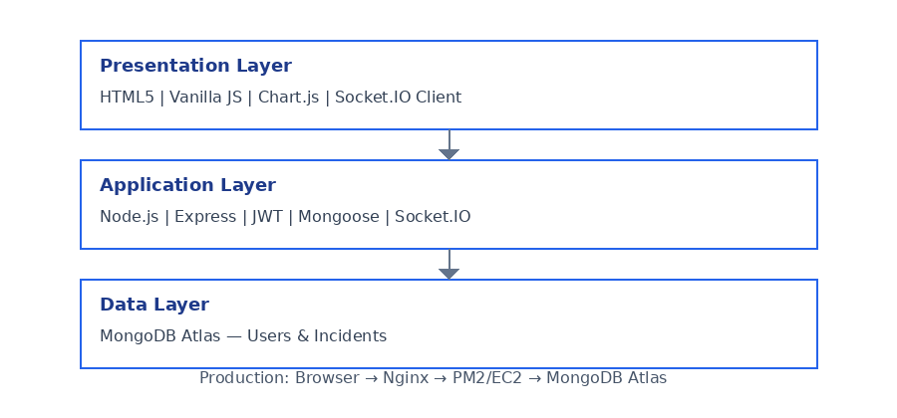
System Architecture
Three-tier SPA + REST API + MongoDB Atlas
Browser SPA
Vanilla JS modules, Fetch API, Chart.js (Mozilla Developer Network, 2024a)
Express API
Routes → Controllers → Mongoose models (Express.js, 2025)
Production path
Nginx :80 → PM2 → Node :5000 → MongoDB Atlas
Mahendra Shabade | B9IS109 | Cloud Incident Monitoring Platform
3 / 7
Notes:
Point at the diagram. Say backend owns validation and auth; frontend only calls APIs.

Slide 4
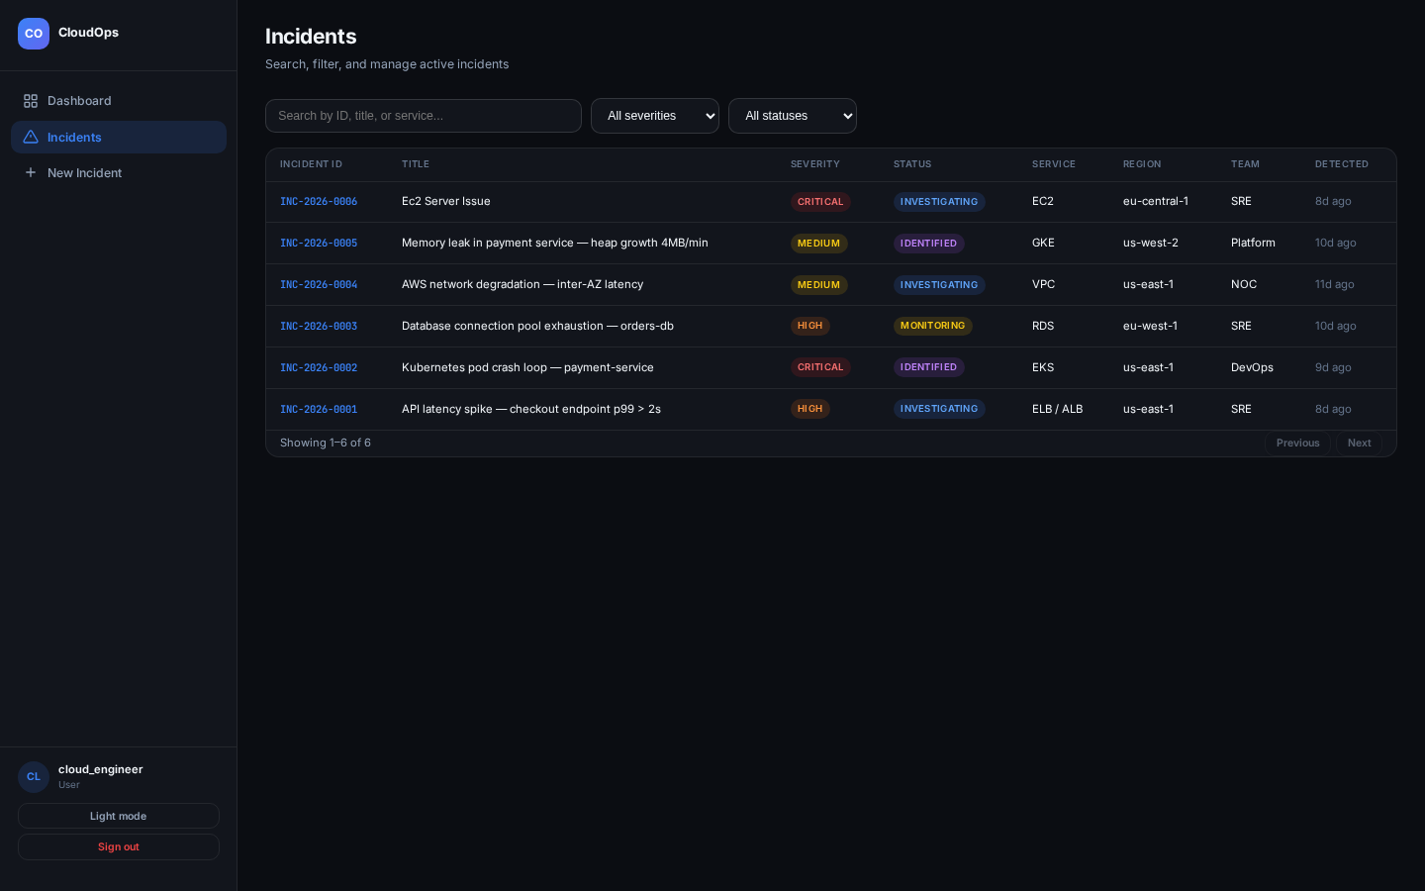
CRUD & Data Model
Report §5–§6 — core incident lifecycle
Incident document (MongoDB)
incidentId, severity, status, cloudProvider, timeline[], comments[]
REST endpoints
POST /api/incidents — Create (201)
GET /api/incidents — Read list with search & pagination
PUT /api/incidents/:id — Update + timeline entry
DELETE /api/incidents/:id — Admin only (403 for others)
Code: server/routes/incidentRoutes.js → incidentController.js
Mahendra Shabade | B9IS109 | Cloud Incident Monitoring Platform
4 / 7
Notes:
Open incidentRoutes.js in IDE if asked. Show createIncident and restrictTo on delete.

Slide 5
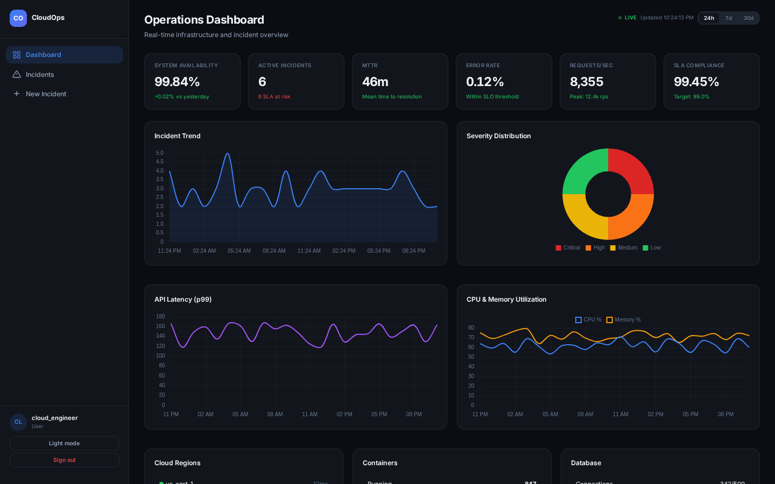
Dashboard & Key Features
Report §7 — operational visibility
KPI cards — active incidents, MTTR, availability, error rate
Chart.js graphs — trends, latency, CPU, memory (Chart.js, 2025)
Socket.IO — live refresh when any user creates/updates (Socket.IO, 2025)
SLA countdown + full timeline on incident detail page
Code: client/js/dashboard.js + server/controllers/incidentController.js (getMetrics)
Mahendra Shabade | B9IS109 | Cloud Incident Monitoring Platform
5 / 7
Notes:
Demo the dashboard live. Open second browser to show real-time sync.

Slide 6
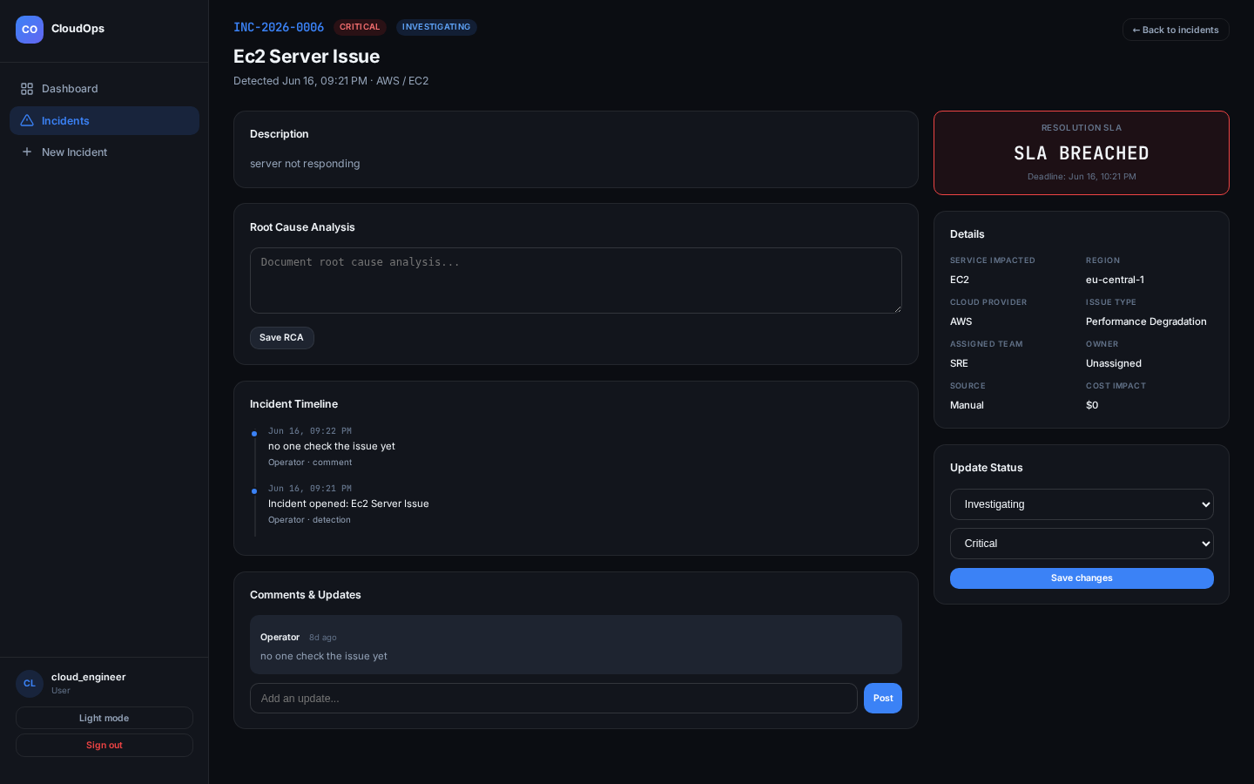
Security, Testing & Integration
Report §8–§9
Security
JWT login, bcrypt passwords, Helmet, rate limiting (Helmet, 2025; OWASP, 2021)
Server-side RBAC — protect + restrictTo middleware
External integration
POST /api/incidents/webhook — CloudWatch/Azure alerts via shared secret
Optional COST_API_URL for billing data with offline fallback
Testing
Manual E2E — login, CRUD, RBAC 403, webhook curl, /api/health on EC2
Code: authMiddleware.js, webhookAuth.js, server/server.js
Mahendra Shabade | B9IS109 | Cloud Incident Monitoring Platform
6 / 7
Notes:
Show guest gets 403 on delete. Mention webhook for external API requirement.

Slide 7
Live Demo & References
Code guide: docs/demo-code-guide.md
Live demo flow
1. Login as engineer@platform.com (User)
2. Dashboard → Incidents → Create → Update status
3. Logout → ops@platform.com (Admin) → Delete
4. Show code: incidentRoutes.js + authMiddleware.js
Demo accounts (password: SecurePassword123)
ops@platform.com — Admin | engineer@platform.com — User
guest@platform.com — Guest (read-only)
Key references
Fielding, R.T. (2000) Architectural Styles and the Design of Network-based Software Architectures.
MongoDB Inc. (2025) MongoDB Atlas Documentation.
Express.js (2025) Express Documentation.
Socket.IO (2025) Socket.IO Documentation.
Chart.js (2025) Chart.js Documentation.
PagerDuty (2024) PagerDuty Documentation.
Mahendra Shabade | B9IS109 | Cloud Incident Monitoring Platform
7 / 7
Notes:
Run the demo confidently. If asked where code lives, open docs/demo-code-guide.md. Thank you.

