Slide 1
SSE
£33bn
Scottish and Southern Energy plc
5-Year Investment Plan
Interview Preparation Guide
83,000+
Prepared for Muhammad Shaheer Riaz
Jobs Supported
MSc Electrical & Electronics Engineering · Anglia Ruskin University
FTSE 100
HQ: Perth, Scotland
£20.93bn Market Cap
£7M Invested Daily
16 GW
Renewables by 2032
25%+
UK Offshore Wind 2030
Tailored to your CV · Includes real candidate insights from TheStudentRoom · AptitudePrep · SSE Careers

Slide 2
YOUR PROFILE
Meet the Candidate — Muhammad Shaheer Riaz
MSc Electrical & Electronics Engineering (Merit expected) · Chelmsford, UK · IET Student Member
🎓 EDUCATION
🔧 INDUSTRIAL EXPERIENCE
🔬 MSc DISSERTATION
MSc Electrical & Electronics Eng. Anglia Ruskin University (2025–26) Merit expected Distinctions: • Industrial Process Control • Digital Systems (VHDL/FPGA) • Sensing & Sensor Fusion BSc EE — Institute of Space & Technology, Pakistan
Instrumentation & Control Engineer Fauji Fertilizer Co. (FFC), Pakistan Turnaround + Internship placements • DCS & ESD field wiring loop-checks • Triconex safety-system PLC programming • Flow/pressure/level/temp calibration • Commissioning new I&C equipment • 100% accurate cable tagging
Deep Learning for Predictive Maintenance in EV Li-Ion Batteries ANN vs. LSTM architectures for battery state-of-health & remaining useful life prediction NASA degradation datasets Python · TensorFlow/Keras · vs. Kalman Filter
CORE TECHNICAL SKILLS
DCS / ESD Systems
PLC (Triconex, Ladder, FBD)
Power Conversion Systems
FPGA / VHDL Design
Field Instrument Calibration
PCB & Circuit Design
Python / ML (ANN, LSTM)
DSP & Sensor Fusion
HMI Design
MATLAB / Proteus
Embedded (Arduino, C++)
Motor Control Systems
💡 Your instrumentation/control + power conversion + battery ML profile maps onto three SSE divisions — see next slide.
Overview
Divisions
Projects
Investment
Impact
Values
EE Masters
Interview

Slide 3
COMPANY OVERVIEW
What is SSE plc?
A FTSE 100 energy company at the heart of the UK's net zero transition
💷 £20.93bn
👷 83,000+
⚡ ~£7M/day
📍 Perth
Market Capitalisation
Jobs Supported
Daily Investment
HQ, Scotland
History & Background
"Providing the energy needed today while building a better world of energy for tomorrow."
• Formed in 1998 from merger of Scottish Hydro-Electric & Southern Electric • Listed on London Stock Exchange — constituent of FTSE 100 • Strategic pivot since 2018: sold household supply to focus entirely on low-carbon electricity infrastructure • Operates across UK and Ireland with growing international renewables presence • Uniquely positioned as a pure-play energy transition business
— SSE plc, Annual Report
Why SSE is Different from Other Energy Companies
• NOT a consumer-facing energy supplier (sold that business) • 100% focused on infrastructure: grids, wind, flexible generation • One of the UK's largest single private capital investors • Regulated revenue streams provide long-term stability • Engineers work on projects at the frontier of the energy transition
Overview
Divisions
Projects
Investment
Impact
Values
EE Masters
Interview

Slide 4
BUSINESS DIVISIONS
How SSE is Structured
Five principal units — know which one you are interviewing for
SSE Renewables
SSEN Transmission
SSEN Distribution
SSE Thermal
SSE Energy Solutions
Onshore/offshore wind, hydro, solar, battery storage
HV electricity transmission network, north Scotland
DNO: south England + north Scotland
Flexible generation: gas, CCS, hydrogen, EfW
B2B low-carbon local energy infrastructure
9GW by 2027 → 16GW by 2032 25%+ of UK 2030 offshore wind target Dogger Bank: world's largest OWF
£22bn investment planned 11 Pathway to 2030 projects 20%+ of UK networks investment
3.9M homes & businesses served £5bn planned investment Smart grid & EV network upgrades
Peterhead CCS: Scotland's first 910MW + 1.5Mt CO₂/yr captured Hydrogen transition ready
EV charging, heat networks, solar PV Private wire networks for industry Energy-as-a-service
Overview
Divisions
Projects
Investment
Impact
Values
EE Masters
Interview

Slide 5
KEY PROJECTS
Flagship Programmes You Must Know
Name these projects in your interview — shows genuine research depth
1
Dogger Bank Wind Farm
2
Viking Wind Farm
3
Peterhead CCS Power Station
4
Pathway to 2030
WORLD'S LARGEST OFFSHORE WIND FARM
EUROPE'S LARGEST ONSHORE WIND FARM
SCOTLAND'S FIRST CCS PLANT
SSEN TRANSMISSION GRID PROGRAMME
Phases A+B+C = 3.6GW + Phase D = 1.5GW Partners: SSE, Equinor, Vårgrønn Yorkshire coast, North Sea Haliade-X 13MW+ turbines Foundations complete: Dec 2025
443MW onshore — Shetland Islands Operational: August 2024 Required dedicated HVDC interconnector (first ever subsea link to Shetland) Major Scottish energy milestone
910MW gas + carbon capture Up to 1.5M tonnes CO₂/yr by 2030 SSE Thermal + Equinor partnership Part of Acorn Carbon Cluster Hydrogen economy enabler
11 major grid projects in north Scotland Core of £22bn transmission investment New OHL, substations, HVDC cables Enables renewable power to flow south Delivering RIIO-T2 & future RIIO-T3
Overview
Divisions
Projects
Investment
Impact
Values
EE Masters
Interview

Slide 6
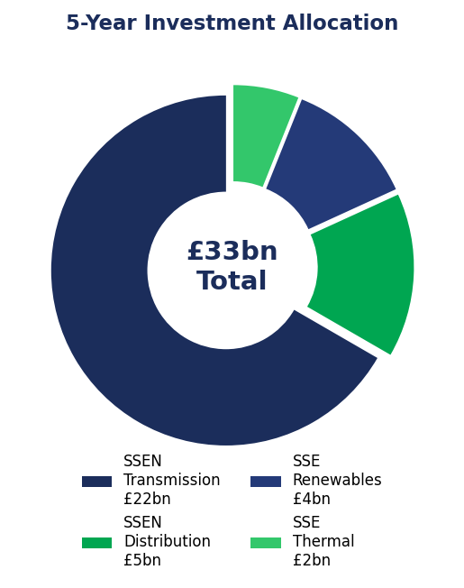
INVESTMENT & STRATEGY
SSE's £33bn Five-Year Investment Plan
Announced November 2025 — one of the UK's largest private infrastructure programmes
£22bn
SSEN Transmission
67% of total — grid upgrades in north Scotland
£5bn
SSEN Distribution
15% of total — smart grid & EV network
£4bn
SSE Renewables
12% of total — new wind, solar, storage
£2bn
SSE Thermal + Other
6% of total — CCS, hydrogen, flexibility
80% of the entire plan goes directly into the electricity grid — this is fundamentally a grid engineering story.
Overview
Divisions
Projects
Investment
Impact
Values
EE Masters
Interview

Slide 7
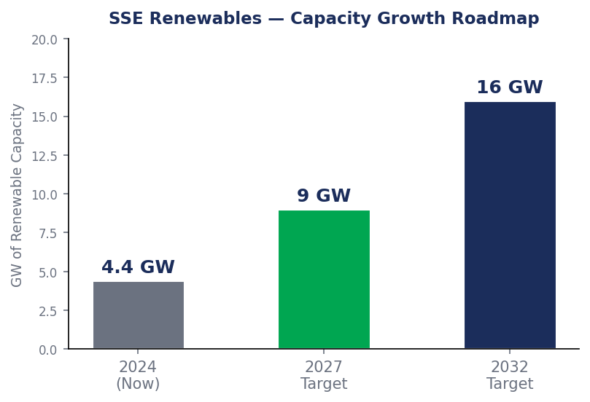
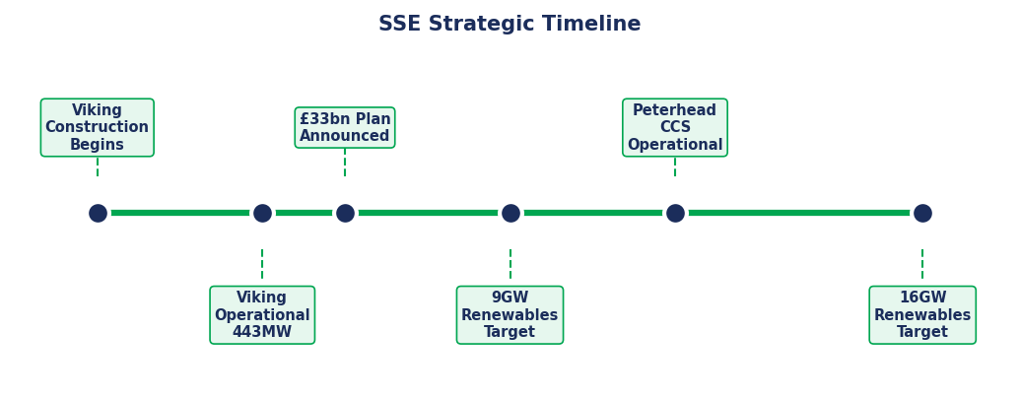
INVESTMENT & GROWTH
Renewable Capacity Roadmap + Strategic Timeline
SSE is targeting a fivefold increase in renewables output by 2032
2024
2025
2027
~2029
2032
Viking Wind Farm Operational
£33bn Plan Announced
9GW Target
Peterhead CCS Online
16GW Target
Overview
Divisions
Projects
Investment
Impact
Values
EE Masters
Interview

Slide 8
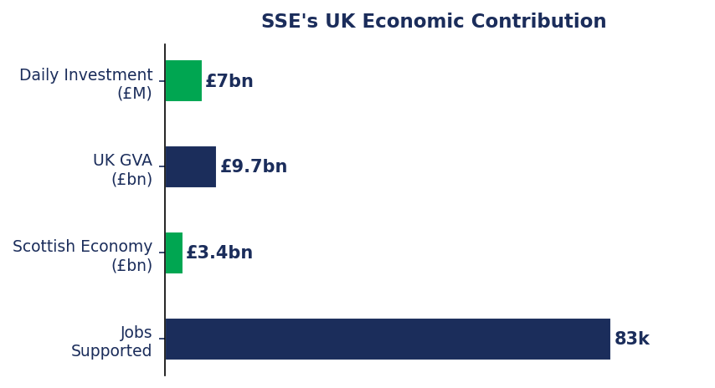
UK IMPACT
How SSE Has Transformed Britain's Energy Landscape
From infrastructure investment to jobs and economic growth
Energy Security
Job Creation
Reduces UK exposure to volatile global energy markets by building homegrown generation & infrastructure
83,000+ jobs in engineering, construction, operations and supply chains across Scotland and England
Net Zero Leadership
Economic Output
Delivering 25%+ of UK's 2030 offshore wind target and 20%+ of all electricity network investment
£9.7bn GVA added to UK economy; £3.4bn specifically to Scottish economy annually
Overview
Divisions
Projects
Investment
Impact
Values
EE Masters
Interview

Slide 9
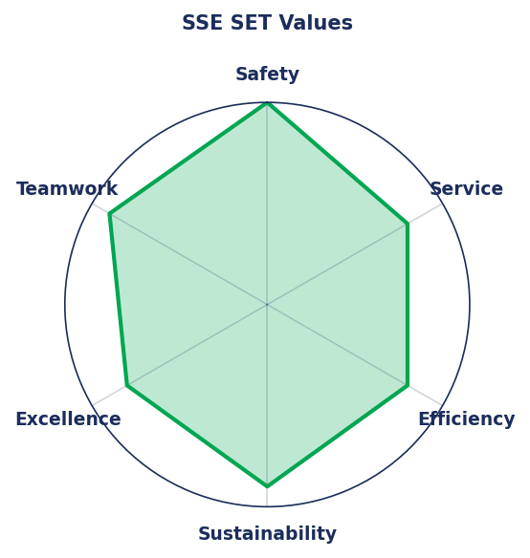
COMPANY VALUES
SSE SET — What SSE Stands For
These values underpin every competency question. Know them cold.
Safety
Service
S
TOP PRIORITY
S
COMMUNITY FOCUS
Non-negotiable in HV environments. Mention this FIRST if asked about SSE's values. Demonstrate a safety-first mindset in every competency answer.
Serving communities, customers and stakeholders. SSE operates licensed infrastructure with obligations to the public.
Efficiency
Sustainability
E
OPERATIONAL EXCELLENCE
S
NET ZERO LEADERSHIP
Responsible stewardship of capital — critical when spending £7M every day on infrastructure.
Every investment decision is judged against long-term environmental impact and 2050 net zero targets.
Excellence
Teamwork
E
ENGINEERING STANDARDS
T
CROSS-DISCIPLINE COLLABORATION
Setting and maintaining the highest professional standards — directly relevant to your EE Masters.
Multidisciplinary teams: engineers, project managers, environmental, commercial, policy.
"Doing the Right Thing" — SSE's overarching leadership ethos underpinning all six values
Overview
Divisions
Projects
Investment
Impact
Values
EE Masters
Interview

Slide 10
YOUR FIT
Why You Are a Strong Fit for SSE
Connecting your specific experience to SSE's divisions and flagship projects
SSE Thermal
Peterhead Carbon Capture (910MW) and SSE's gas fleet run on exactly these control & emergency-shutdown systems. Your hands-on plant turnaround and commissioning experience is directly transferable — and your safety-critical mindset matches SSE's #1 value.
◆ Your edge
Your DCS/ESD & Triconex safety-system experience at FFC
SSE Renewables
SSE is rapidly expanding grid-scale battery storage. Your ANN/LSTM predictive-maintenance and state-of-health work applies directly to battery asset management, while Power Conversion Systems underpins the inverters and HVDC converters in wind & storage.
◆ Your edge
Your EV Li-Ion battery ML dissertation + Power Conversion module
SSEN Transmission
Protection relays, SCADA, substation commissioning and condition monitoring across the £22bn Pathway to 2030 programme need exactly these digital-design, instrumentation and signal-processing skills. Your calibration experience transfers to substation work.
◆ Your edge
Your FPGA/VHDL, calibration & sensor-fusion skills
Overview
Divisions
Projects
Investment
Impact
Values
EE Masters
Interview

Slide 11
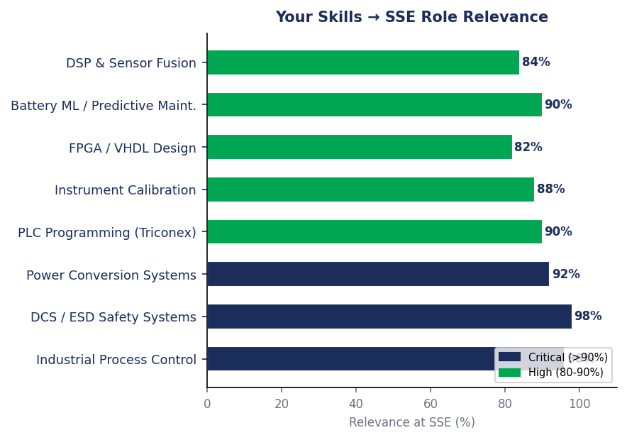
YOUR EE MASTERS
How Your Degree Maps to SSE's Needs
Link every skill to a named project or SSE business unit in your answers
Your Skill → SSE Role Mapping
YOUR SKILL
SSE RELEVANCE
Industrial Process Control (Dist.)
Power station control — SSE Thermal, Peterhead
DCS / ESD Safety Systems
Emergency shutdown & control — SSE Thermal fleet
Power Conversion Systems
HVDC, inverters — offshore wind & battery storage
PLC Programming (Triconex)
Safety-critical automation across SSE assets
Field Instrument Calibration
Substation commissioning — SSEN Transmission
FPGA / VHDL Design
Protection relays & digital control systems
Battery ML Dissertation
Grid-scale storage health — SSE Renewables
DSP & Sensor Fusion (Dist.)
Condition monitoring of network assets
💡 Your line: "My Power Conversion module + battery dissertation map straight onto SSE's grid-scale storage and offshore inverters."
Overview
Divisions
Projects
Investment
Impact
Values
EE Masters
Interview

Slide 12
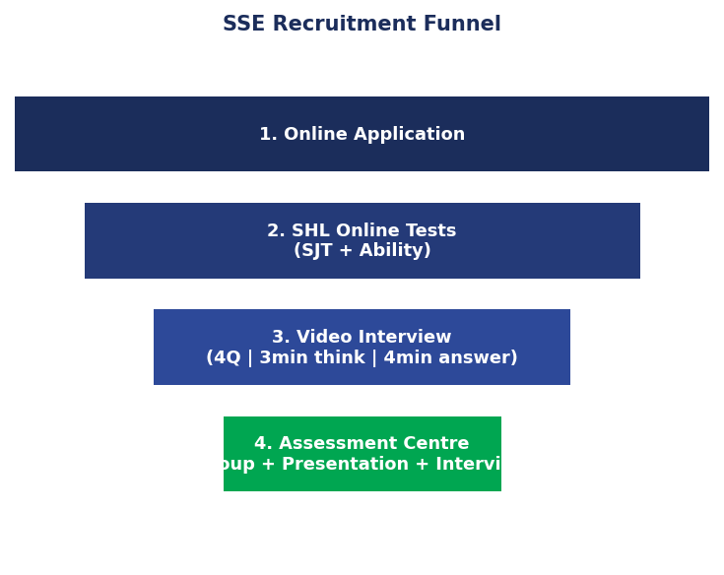
INTERVIEW PREP
The Full SSE Recruitment Process
Sourced from real candidates on TheStudentRoom & AptitudePrep
Online Application
1
CV + motivation questions Tailor to your specific division (Transmission, Renewables, Thermal, Distribution) ~200 graduates hired per year — competitive but achievable
SHL Online Tests
2
• SJT: 16 questions (values alignment) • Ability Test: 24 numerical/analytical/deductive questions • Described by candidates as "absolutely brutal — timed out at Q8" • Practice at shl.com — same format as NatWest, KPMG etc. • No verbal reasoning for engineering roles
Video Interview
3
• 4 questions | 3 min think | 4 min answer per question • Real questions asked: "Why this division?", "3 energy challenges" • Competency: Safety + Initiative • Can be pre-recorded or live • Professional background, test audio beforehand
Assessment Centre
4
• Group discussion + individual presentation + role play • Presentation brief is "intentionally vague" — structure it yourself • Transmission final stage was "more technical than expected" • Virtual or in-person — ask recruiter for format in advance • ⚠ No visa sponsorship for graduate engineering roles
Overview
Divisions
Projects
Investment
Impact
Values
EE Masters
Interview

Slide 13
INTERVIEW PREP
STAR Method + Key Questions
SSE officially recommends STAR — prepare your answers before the 3-minute think time
The STAR Technique
COMMON INTERVIEW QUESTIONS — MODEL ANSWER STRUCTURES
S
Situation
Set the scene — context, when, where
Q1: Why SSE / this division?
Your DCS/ESD + power conversion + battery ML background → SSE Thermal control or Renewables storage; cite Peterhead / £33bn scale
T
Task
Your specific responsibility or challenge
Q2: 3 energy challenges facing SSE?
Thermal: grid intermittency, CCS economics, hydrogen transition Transmission: N-S bottlenecks, supply chain lead times, planning
A
Action
"I" not "we" — your specific decisions
Q3: Time you demonstrated SAFETY?
R
Result
Outcome — quantify where possible
Your FFC turnaround: loop-checking DCS/ESD wiring, 100% accurate cable tagging before energising — SSE's #1 value
Q4: Complex engineering problem solved?
Your STAR Example (Safety — FFC):
Your MSc dissertation: ANN vs LSTM for EV battery health, or Arduino-PLC module — explain your thinking process
"During a plant turnaround at FFC [S], I was responsible for loop-checking DCS and ESD field wiring across multiple marshalling cabinets [T]. I systematically verified every cable tag and termination before energising [A], achieving 100% accurate tagging and helping minimise plant downtime with zero safety incidents [R]." → Link to SSE Thermal's safety-critical control systems.
Q5: Example of teamwork?
Collaborating with senior engineers on FFC commissioning, or Hult Prize leadership — adapt style for non-specialists
Q6: Energy sector in 10 years?
Offshore wind dominance, grid transformation (SSE's 80% bet), hydrogen, digitalisation, battery storage revolution
Q7: Questions to ask SSE?
"What would you expect from me in the first 90 days?" — directly recommended by SSE's own recruiter blog
Overview
Divisions
Projects
Investment
Impact
Values
EE Masters
Interview

Slide 14
INTERVIEW PREP
Key Facts to Nail + Red Flags to Avoid
Walk in knowing these — walk out having impressed
✓ KEY FACTS TO DROP IN THE INTERVIEW
✗ RED FLAGS TO AVOID
✓
Know your exact SSE division & its lead projects by name
✗
Not knowing which SSE business unit you applied for
✓
Name-drop: Dogger Bank, Viking, Peterhead CCS, Pathway to 2030
✗
Generic "I like renewable energy" without naming specific projects
✓
Cite the £33bn five-year plan — 80% goes to the electricity grid
✓
"Safety is SSE's number one value" — say this naturally
✗
Confusing SSE plc with Stockholm School of Economics
✓
Use "energy transition" and "net zero" confidently throughout
✗
Bluffing on technical questions — say "I'd approach it by..."
✓
SSE targets 16 GW renewable capacity by 2032 (fivefold increase)
✓
SSE delivers 25%+ of UK's 2030 40GW offshore wind target
✗
Not preparing STAR answers before the 3-min think window
✓
Grid intermittency makes flexible generation + storage essential
Overlooking Safety as your #1 competency example
✗
✓
Ask: "What would you expect from me in the first 90 days?"
✓
83,000+ jobs supported — SSE is a major UK economic engine
Overview
Divisions
Projects
Investment
Impact
Values
EE Masters
Interview

Slide 15
You're Ready.
SSE Interview Preparation — Complete
Company
FTSE 100 | Perth | £20.93bn | Est. 1998
Investment
£33bn 5-year plan | 80% grid | £7M/day
Projects
Dogger Bank · Viking · Peterhead CCS · Pathway to 2030
Values
Safety (first) · Service · Efficiency · Sustainability · Excellence · Teamwork
Process
Application → SHL Tests → Video Interview → Assessment Centre
Your Edge
DCS/ESD safety systems · power conversion · battery ML · calibration
Good luck — the energy sector needs engineers who understand both the grid and the transition.

