Slide 1

UI/UX Project
By Muhammad Shayan

Slide 2
Here’s a competitive analysis for social media apps. Let's choose the following apps:
App A: Instagram
App B: Twitter (now X)
App C: TikTok
Instagram: A visual-centric platform focusing on photos and short videos with strong social interaction features.
Twitter (X): A text-based platform known for real-time updates, news, and public discussions.
TikTok: A video-sharing platform known for short-form, engaging, and often viral content.
Report:
1. Instagram
Strengths: Strong visual appeal, diverse content options, excellent for community engagement.
Weaknesses: Cluttered with ads, some navigation challenges, especially with newer features like Reels.
2. Twitter (X)
Strengths: Efficient for real-time updates and discussions, clean interface.
Weaknesses: Can be overwhelming with constant updates, lacks deep engagement features like rich media content.
3. TikTok
Strengths: Highly engaging, easy content creation, strong algorithms for content discovery.
Weaknesses: Content can feel repetitive, limited depth beyond short-form videos, and accessibility issues.
Step 4: Conclusion
Instagram excels in visual content and community engagement but can be overwhelming with its numerous features.
Twitter is unmatched for real-time conversations and updates but may lack the rich, engaging features found in more media-centric apps.
TikTok is a powerhouse for viral content and user engagement but can fall short in providing depth and variety over time.
Criteria | App A: Instagram | App B: Twitter (X) | App C: TikTok
UI Design | Visually appealing, intuitive layout, but sometimes cluttered with ads | Clean and minimalistic, but can feel text-heavy | Engaging and dynamic, but sometimes overwhelming
Navigation | Easy to use, clear icons, but story and reels navigation can be confusing | Simple navigation, but information overload can be a challenge | Intuitive swipe navigation, but discovery of new content can be repetitive
Accessibility | Good use of alt text, but needs improvement in color contrast | Decent accessibility options, but lacks robust features | Limited accessibility features, relies heavily on visual content
User Flow | Smooth, especially for content consumption, but creation tools can be complex | Efficient for browsing and tweeting, but engagement with content can be cumbersome | Seamless user flow for content creation and consumption
Unique Features | Stories, Reels, Shopping features, Explore feed | Threads, Lists, Spaces for live audio discussions | Duets, Filters, For You Page, and Viral challenges
Performance | Generally fast, but can slow down with too much content loading | Fast and responsive, but occasionally lags during high traffic | Smooth and quick, but can crash with heavy video usage
Strengths | Strong visual appeal, wide range of content types, community engagement | Real-time updates, concise communication, public discourse | Highly engaging content, viral trends, strong content discovery
Weaknesses | Cluttered interface with ads, confusing navigation between features | Overwhelming amount of content, difficult to filter | Repetitive content, limited depth in content types

Slide 3
Personas
1. Talha
2. Abdul Baseer
3. Wali
4. Sajeel

Slide 4
1. Talha
Age: 22
Occupation: College Student
Location: Pakistan
Goals and Motivations:
Connect with friends and share daily life moments.
Discover and follow influencers and trends.
Use social media to build her personal brand and network for future career opportunities.
Frustrations and Pain Points:
Overwhelmed by ads and sponsored content.
Finds it difficult to keep up with constant updates and notifications.
Behavior Patterns:
Spends 3-4 hours daily on social media, mostly on Instagram and TikTok.
Frequently engages with stories and short videos, rarely posts long-form content.
Technology Comfort Level: High, comfortable using advanced features like video editing tools and story filters.

Slide 5
Wali
Age: 22
Occupation: Student
Location: Pakistan
Goals and Motivations:
Use social media to promote his business and engage with customers.
Stay updated on industry trends and competitors.
Leverage social media analytics to improve marketing strategies.
Frustrations and Pain Points:
Finds it challenging to keep personal and business accounts separate.
Struggles with creating engaging content that stands out.
Behavior Patterns:
Uses social media for 2 hours daily, primarily on Facebook and LinkedIn.
Regularly posts updates, engages with customers, and monitors competitors.
Technology Comfort Level: Moderate, proficient with basic social media tools but finds advanced analytics challenging.

Slide 6
Abdul Baseer
Age: 23
Occupation: Freelance Graphic Designer
Location: Pakistan
Goals and Motivations:
Showcase her portfolio and attract new clients.
Network with other creatives and stay inspired.
Share her design process and creative projects with her audience.
Frustrations and Pain Points:
Struggles with the discoverability of her work due to social media algorithms.
Finds it time-consuming to maintain a consistent posting schedule.
Behavior Patterns:
Spends 2-3 hours daily on social media, especially on Instagram and Behance.
Engages with visual content, follows design trends, and interacts with fellow designers.
Technology Comfort Level: High, uses social media as a professional tool and is comfortable with content creation and editing software.

Slide 7
Sajeel
Age: 22
Occupation: Student
Location: Pakistan
Goals and Motivations:
Connect with family and friends, especially those who live far away.
Share educational content and stay updated on teaching methods.
Discover new ideas and resources for her classroom.
Frustrations and Pain Points:
Finds some features and settings confusing, especially privacy controls.
Frustrated by the lack of meaningful interactions and the prevalence of superficial content.
Behavior Patterns:
Spends 1 hour daily on social media, mostly on Facebook and Pinterest.
Engages with posts from family and friends, shares educational content, and looks for creative teaching ideas.
Technology Comfort Level: Low to moderate, uses social media primarily for personal connections and light content consumption.

Slide 8

Problem Statement:
Problem Statement: "Current social media platforms overwhelm users with excessive notifications and irrelevant content, complicating the user experience and making it difficult to focus on meaningful interactions. Additionally, professionals struggle with poor content discoverability and confusing navigation, which hinders their ability to effectively manage and differentiate between personal and professional accounts. There is a need for a user-friendly social media platform that simplifies content filtering, enhances discoverability for professional users, and provides intuitive tools for content creation and account management."

Slide 9
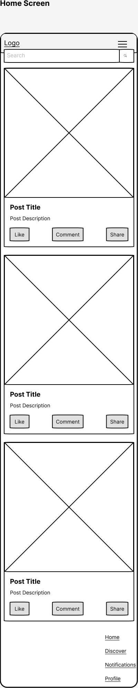
Talha's Home Screen Wireframe( Low Fidelity):
Key Features: Search Bar, Notifications, Content Feed, Mute Ads Toggle

Slide 10
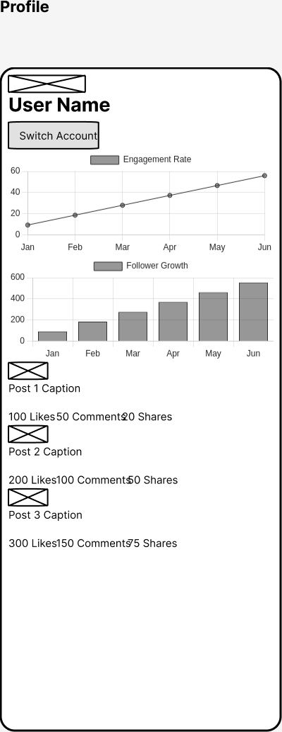
Abdul Baseer's Profile and Analytics Wireframe(Low- Fidelity)
Key Features: Profile Picture, Account Switcher, Analytics Overview, Edit Options

Slide 11
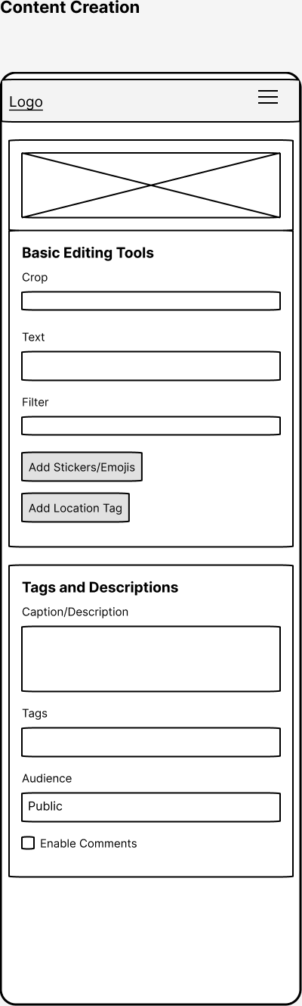
Wali's Portfolio and Discoverability Wireframe(Low-Fidelity)
Key Features: Portfolio Header, Customizable Layout, Boost Visibility Button

Slide 12
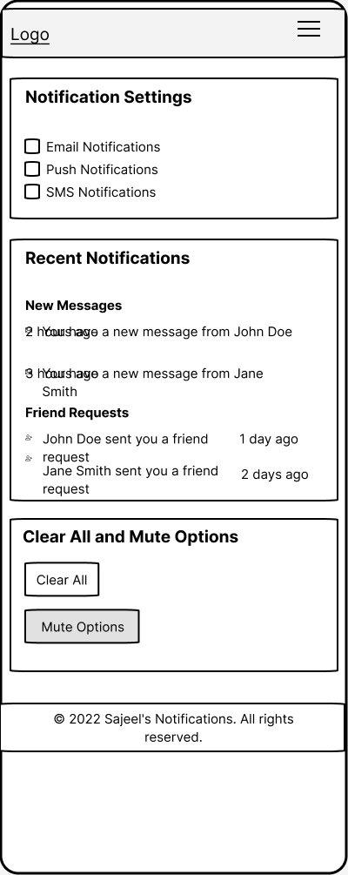
Sajeel's Resource Sharing and Collaboration Wireframe(Low-Fidelity)
Key Features: Search Bar, Filter for Educational Content, Collaborate Button

Slide 13

Usability Testing and Feedback
Collect Feedback
Feedback :
Talha:
"The feed is clean, but I struggled to find the option to mute notifications."
"Posting was easy, but the ad placements were distracting."
Abdul Baseer:
"Switching between accounts was seamless, but I couldn’t easily find the analytics."
"The content creation tools are basic; I wish there were more templates."
Wali:
"Uploading the project was straightforward, but I wasn’t sure how to improve its discoverability."
"The portfolio layout is nice, but it could use more customization options."
Sajeel:
"I found it hard to distinguish between educational and irrelevant content."
"Sharing resources was easy, but I wish there was a way to collaborate more directly with colleagues."

Slide 14
Usability Testing and Feedback
Key Changes:
Notification Management: A more intuitive notification settings button is added to the top-right corner.
Simplified Feed: The feed layout remains clean, but now includes a prominent "Mute Ads" toggle to reduce distractions.
Prominent Analytics Button: A dedicated button for Analytics is placed in the profile section, making it easier to find and use.
Enhanced Content Creation Tools: The content creation screen includes advanced templates for professional posts.
Portfolio Customization: More customization options for the layout, such as grid view, list view, and section headers.
Improved Discoverability: A "Boost Visibility" button is added to the portfolio, helping Aisha promote her work.

Slide 15
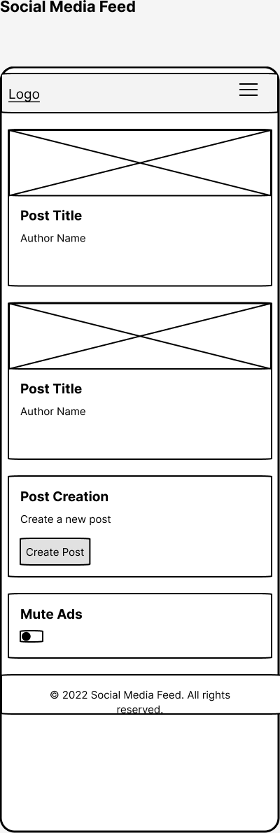
Talha's Home Screen Wireframe ( High Fidelity):
Key Features: Search Bar, Notifications, Content Feed, Mute Ads Toggle

Slide 16
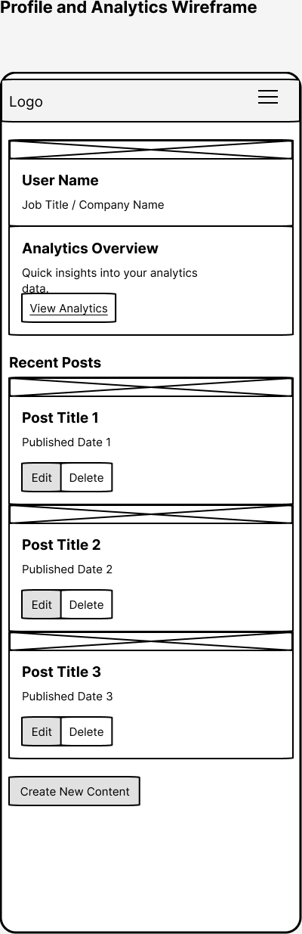
Abdul Baseer's Profile and Analytics Wireframe(High- Fidelity)
Key Features: Profile Picture, Account Switcher, Analytics Overview, Edit Options

Slide 17
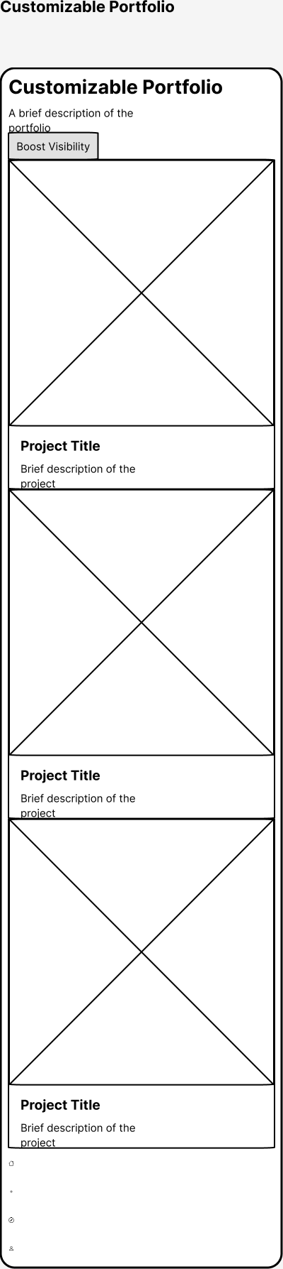
Wali's Portfolio and Discoverability Wireframe(High-Fidelity)
Key Features: Portfolio Header, Customizable Layout, Boost Visibility Button

Slide 18
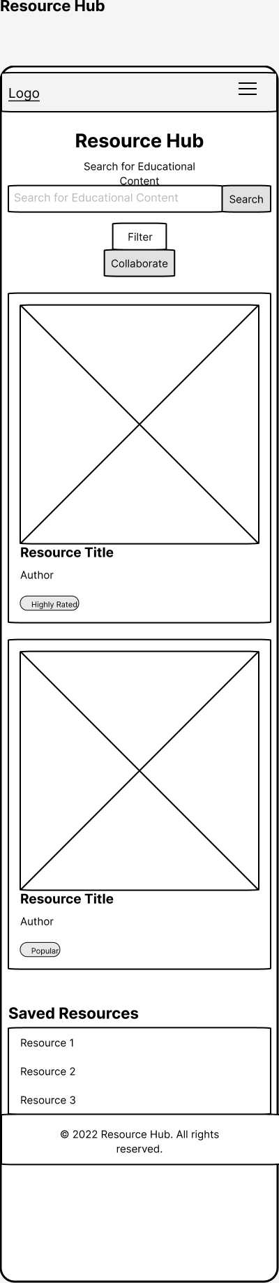
Sajeel's Resource Sharing and Collaboration Wireframe(High-Fidelity)
Key Features: Search Bar, Filter for Educational Content, Collaborate Button

Slide 19
High-Fidelity Mockups Overview
1. Talha: Home Screen with Bright Youthful Colors
2. Abdul Baseer: Professional Analytics and Profile Layout
3. Wali: Creative and Stylish Portfolio
4. Sajeel: Clear and Professional Resource Sharing

Slide 20
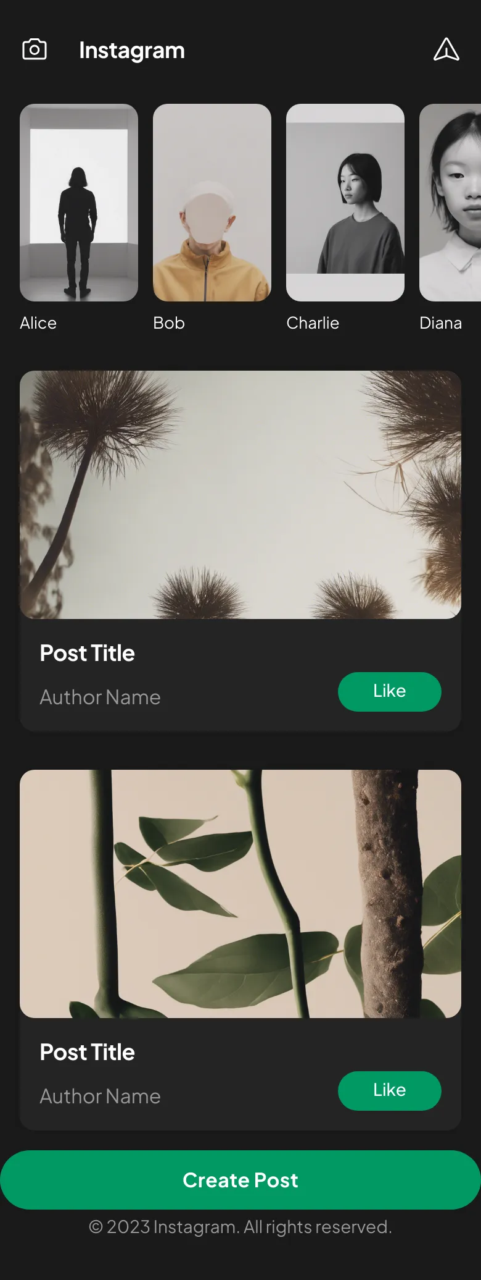
Talha's Home Screen Mockup:
Key Features: Search Bar, Notifications, Content Feed, Mute Ads Toggle

Slide 21
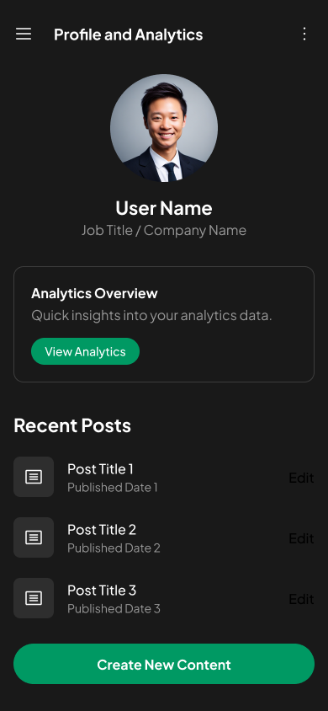
Abdul Baseer's Profile and Analytics Mockup
Key Features: Profile Picture, Account Switcher, Analytics Overview, Edit Options

Slide 22
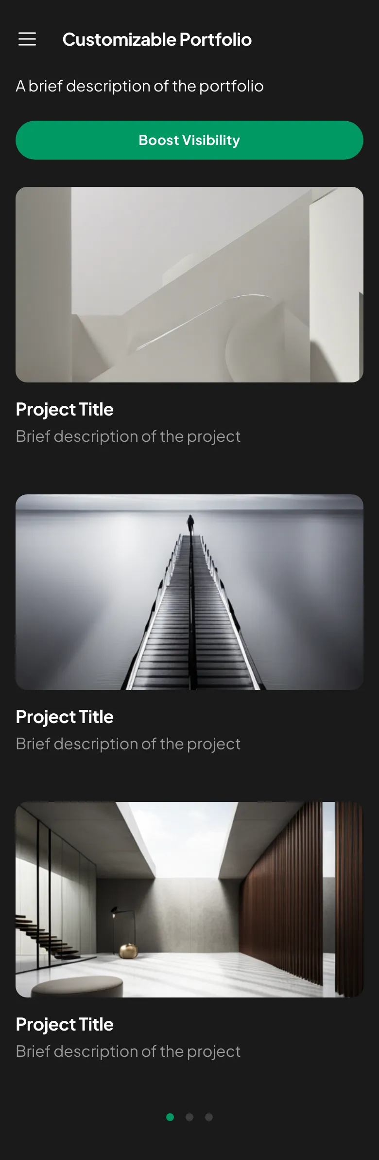
Wali's Portfolio and Discoverability Mockup
Key Features: Portfolio Header, Customizable Layout, Boost Visibility Button

Slide 23
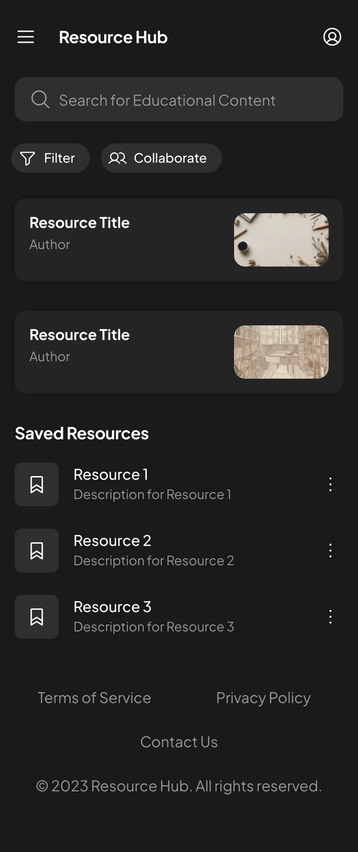
Sajeel's Resource Sharing and Collaboration Mockup
Key Features: Search Bar, Filter for Educational Content, Collaborate Button

Slide 24


