Slide 1



Agentic Detection of Security Antipatterns in Microservices Architectures
Analysing Security Vulnerabilities in Human Written and AI generated Microservices
M. Shazil Khan, Ahsen Tahir, Francis Palma​
SE+AI Research Lab, Faculty of Computer Science, UNBF​

Slide 2
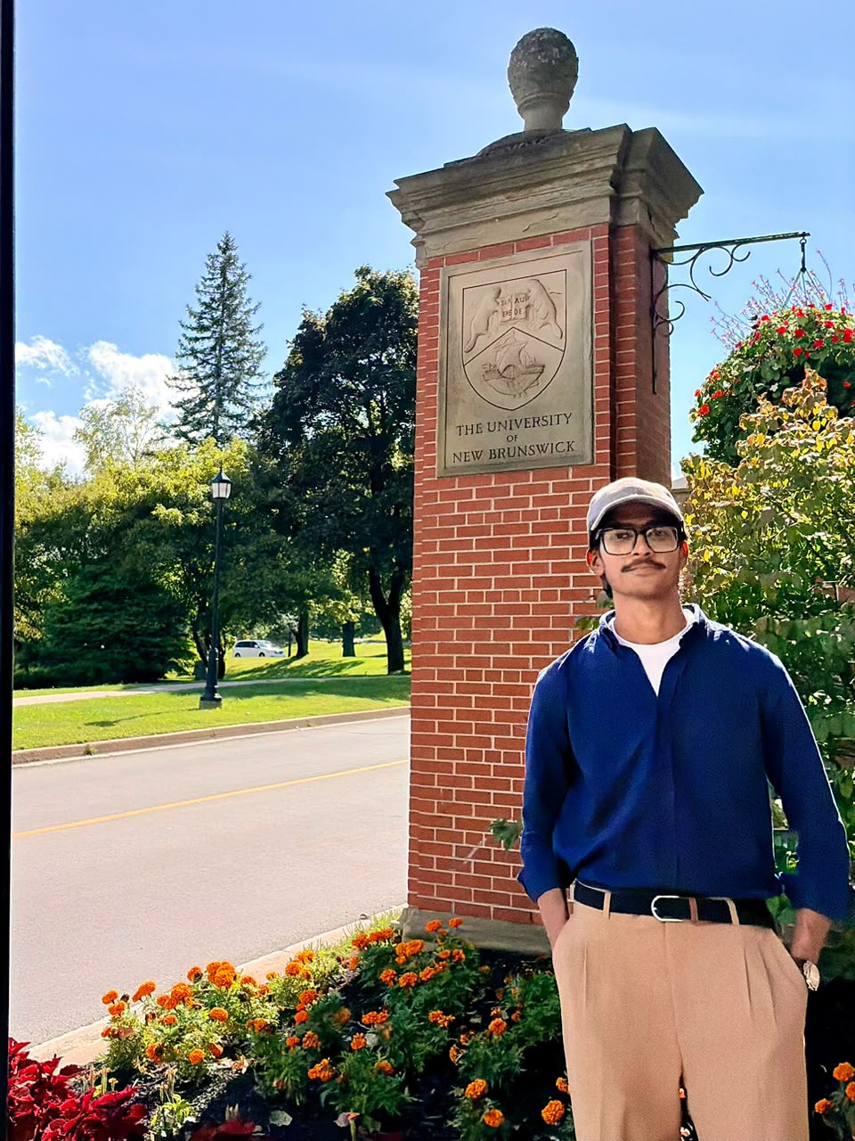


Hello, I'm
Muhammad Shazil Khan
Visiting AI Researcher From Pakistan at University of New Brunswick, Fredericton
Working under the supervision of Prof. Francis Palma
https://mshazilkhan.vercel.app/

Slide 3
Context
  Different microservices in Software Engineering world
  Multiple security vulnerabilities exists in microservices
  Code level and Design level Vulnerabilities
  Detection of these security vulnerabilites is important

Slide 4
The Problem
  Microservice security flaws often come from architectural decisions, not coding bugs
  Examples: bypassing the API gateway, services with excessive privileges
  Static analysis tools and LLM code-security studies focus on code-level weaknesses
  Design-level security antipatterns are largely unexamined

Slide 5
9 Design Level Security Antipatterns
1
Centralized Authorization
2
Insufficient Access Control
3
Multiple Inconsistent Authentication
4
No API Gateway
5
Non-Secured Service-to-Service Communication
6
Publicly Accessible Microservices
7
Unauthenticated Traffic
8
Unnecessary Privileges
9
Unvalidated Service Registration

Slide 6
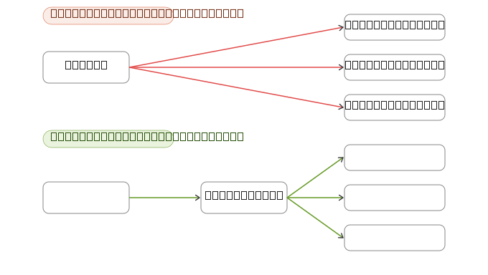
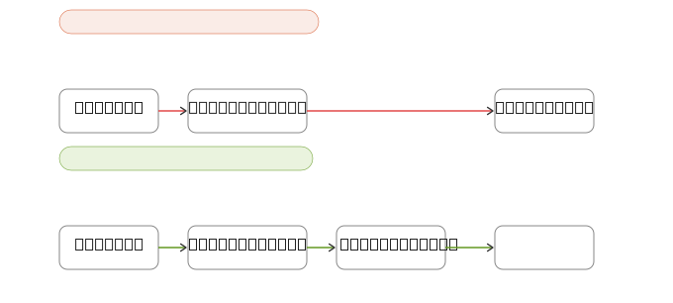
Antipattern Example
No Api Gateway
Insufficient Access Control

Slide 7
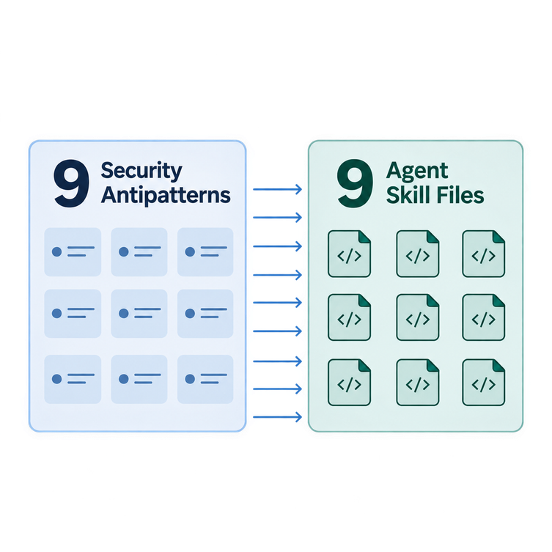
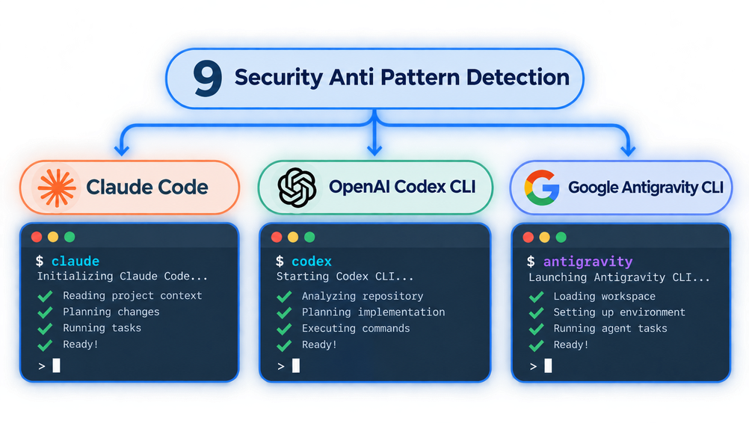
Research Methodology: Overview
  9 security antipatterns, each with detection criteria and not-applicable conditions
  3 coding agents run through their CLIs: Claude Code, OpenAI Codex CLI, Google Antigravity CLI

Slide 8
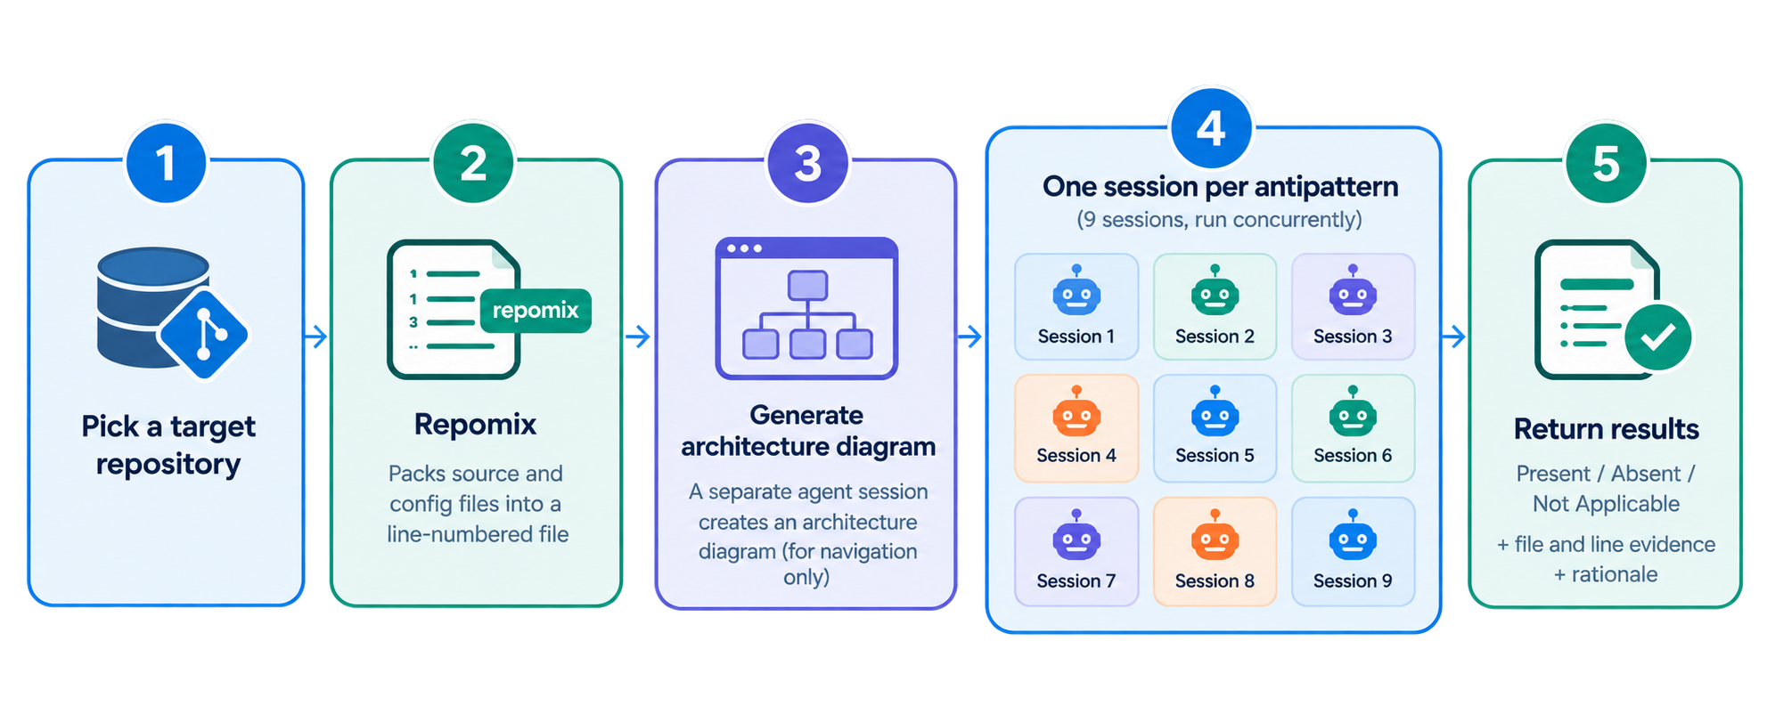
Research Methodology: Detection Pipeline​

Slide 9
Dataset Creation and Ground Truth
  20 open-source microservice repositories
  Two independent expert raters annotate each repository
  The result is the human-validated ground truth for benchmarking the agents
  A third expert adjudicates disagreements

Slide 10
Research Questions
RQ1: Prevalence
RQ2: Model Comparison
How prevalent are security antipatterns in developer-written microservices?
How does the choice of coding agent affect the security antipattern profiles of AI-generated microservices?
RQ3: Prompting Effects
RQ4: Detection Effectiveness
How do different prompting strategies affect the security of AI-generated microservices?
How effectively can our proposed ADAM method detect security antipatterns in microservices?

Slide 11
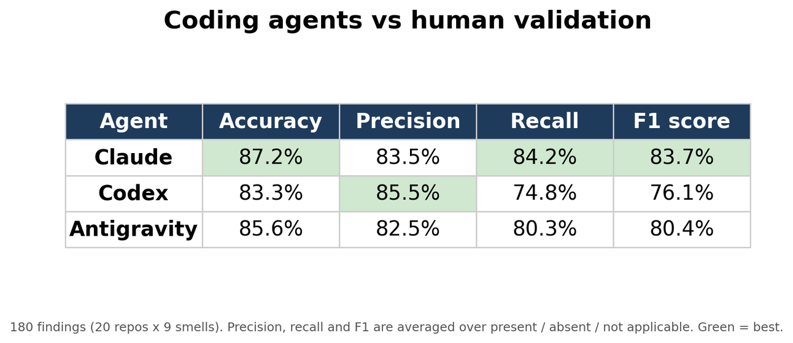
Preliminary Results
  Experiments completed on the 20 repositories with all 3 AI agents
  Metrics: Accuracy, precision, recall, F1-score per agent

Slide 12
Ongoing Work
  Generating Microservices via AI agents
  Running the detecting pipeline on AI generated Microservices
  Comparing different Prompting Strategies on the microservice generation
  Analysing Detection capabilites on individual microservices

Slide 13
Thank You
Do you have any question? Feel free to ask.

