Slide 1

Files Arriving at an Inconvenient Time? Let SAS® Process Your Files with FILEEXIST While You Sleep
Matthew Shotts
Educational Testing Service
SAS and all other SAS Institute Inc. product or service names are registered trademarks or trademarks of SAS Institute Inc. in the USA and other countries. ® indicates USA registration. Other brand and product names are trademarks of their respective companies.

Slide 2
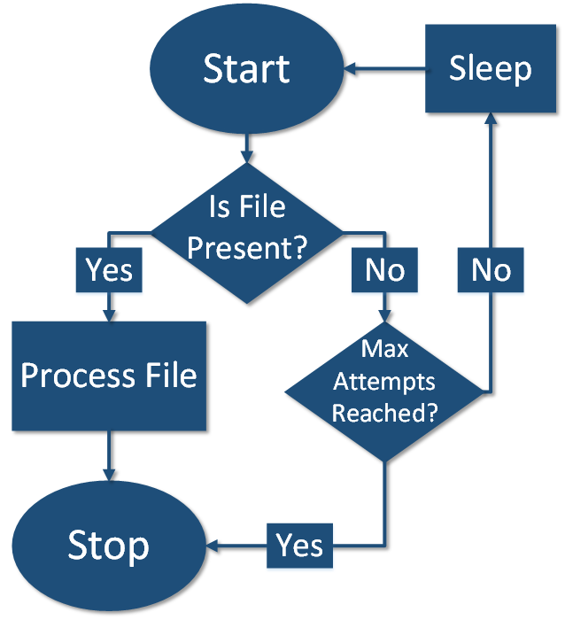
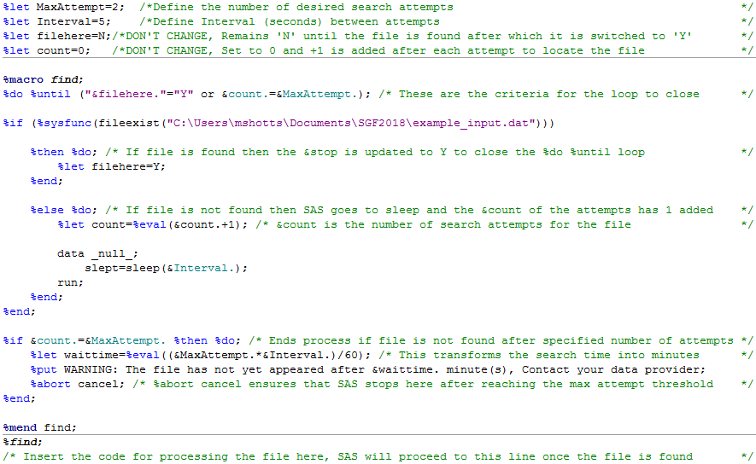
Files Arriving at an Inconvenient Time? Let SAS® Process Your Files with FILEEXIST While You Sleep
Matthew Shotts
Educational Testing Service
ABSTRACT
The FILEEXIST and SLEEP functions can be paired together to iteratively scan a location on a network drive for the arrival of a file. This paper provides a simple framework to control the interval between these attempts to locate the file and also control the acceptable number of scans to perform before ceasing the operation. These controls are accomplished through parameters defined in %LET statements and executed through a %DO %UNTIL processing loop. The example provided can be a stepping stone for beginner or intermediate programmers to understand the basics of macro processing and do loops while also providing them with a helpful tool to automate their file processing.
METHOD (PROCESS DETAILS)
METHOD (PROCESS FLOW)
METHOD (EXAMPLE CODE)
Place the example code in front of the code you would typically use to process a file.
START: The %do %until conditions are not met since the macros &filehere and &count are set to ‘N’ and 0 (respectively) on initial execution. SAS moves to the fileexist step and searches for the file.
STOP: If the file is found then &filehere is updated from ‘N’ to ‘Y’ which closes out the %do %until loop. SAS will then progress on to the code you typically use to process the file.
If the file is not found then &count has +1 added, SAS sleeps for the specified &Interval, and then the loop resumes at the beginning.
STOP: If the loop runs enough times to make &count match the specified &MaxAttempt then a warning is posted to the log and operations are cancelled.
SAS and all other SAS Institute Inc. product or service names are registered trademarks or trademarks of SAS Institute Inc. in the USA and other countries. ® indicates USA registration. Other brand and product names are trademarks of their respective companies.

Slide 3
Files Arriving at an Inconvenient Time? Let SAS® Process Your Files with FILEEXIST While You Sleep
Matthew Shotts
Educational Testing Service
Description of the functions used in example code
%DO %UNTIL
The %do %until function can be used to create a loop of various actions which conclude once a criteria is met. For the example here, there are two criteria for closing the loop: either the file is found via fileexist or the number of attempts defined in &MaxAttempts is reached. %Do %Until must be enclosed within a macro in order to function. The %macro find is filling this role in the example. All %do commands also need to be closed out with a corresponding %end.
METHOD (EXAMPLE CODE)
FILEEXIST
The Fileexist procedure can be used to determine if a file is present at a given location. In the example, fileexist is used as a gatekeeper. If file is present, the gate is opened and SAS processes the file. If not present, the gate remains closed.
%IF %THEN %DO and %ELSE %DO
Conditional processing such as if-then do isn’t just for the data step. You can also take advantage of %if %then %do to conditionally execute whole data steps and procs. As with %do %until above, these must be enclosed within a macro and any %do commands closed out with an %end. In the example, if the file is present then the &filehere is updated to ‘Y’ to close out the loop. If not present, the &count of the attempts has +1 added and SAS goes to sleep.
This is followed by another %if %then %do to determine if the maximum number of attempts has been reached. If so, SAS aborts processing but remains open through the use of %abort cancel.
SLEEP
The Sleep function can be used to make SAS pause processing for a specified interval. Please note that SAS defaults to seconds as the unit of time. This can easily be adjusted to minutes or hours by multiplying against the &Interval in the sleep statement (i.e. slept=sleep(&Interval.*60); would turn the sleep interval into minutes).
In the example, sleep is used to create a period of inactivity in between each attempt to locate the file.
SAS and all other SAS Institute Inc. product or service names are registered trademarks or trademarks of SAS Institute Inc. in the USA and other countries. ® indicates USA registration. Other brand and product names are trademarks of their respective companies.

Slide 4
Presenter Contact Information:
Matthew Shotts
mshotts@ets.org
SAS and all other SAS Institute Inc. product or service names are registered trademarks or trademarks of SAS Institute Inc. in the USA and other countries. ® indicates USA registration. Other brand and product names are trademarks of their respective companies.

