Slide 1

Smart and Secure Attendance System Using RFID with Motion-Activated Readers, Automated Notifications
Department of Computer Science And Engineering
Third Review
Batch No : 06
DATE : 22/05/2025
Presented by
M Sivananthan - 410621104096
V Swetha - 410621104104
M Bhuvanesh - 410621104019
M Md Hasan Billal - 410621104063
Supervisor
Dr. M Sree Rajeswari
Assistant Professor

Slide 2
Agenda/Outline
Problem Statement
Objective
Abstract
Project Overview
List Of Modules
Module Description
Functional Block Diagram
Architecture Diagram
Algorithm Explanation
Coding Explanation
Test Report
Screenshot
Conclusion And Future Enhancement
Reference

Slide 3
Problem Statement
Traditional attendance systems in corporate MNCs are inefficient and insecure due to manual processes, suscept to fraud (proxy attendance, data manipulation), and reliance on physical contact.
The lack of real-time communication, intelligent motion detection, and automated notifications hinders accurate workforce management and timely oversight at scale.

Slide 4
Objective
Limitations of Manual Systems
Prone to errors and fraud, lacking real-time data access.
RFID Technology
Radio Frequency Identification enables automated and contactless data capture.
Motion Sensors
Complement RFID by detecting physical presence and unauthorized movement.
Need for Automation
Automated notifications streamline management and reduce delays.

Slide 5
Abstract
Need for Innovation: Traditional attendance methods are outdated and inefficient, necessitating a smarter, automated solution.
  IoT Integration: Utilizes Internet of Things to connect RFID readers to cloud servers for seamless data transmission and accessibility.
  System Features: Includes automatic data logging, real-time updates, and alert notifications to stakeholders.
  Application Scope: Designed for educational institutions but scalable to corporate and event settings.

Slide 6
Project Overview
Login Module: Handles user authentication and access control with role-based interface.
  Admin Module: Enables addition/deletion of users, management of RFID cards, and system settings.
  Attendance Module: Captures RFID data, checks against database, and records attendance.
  Report & Notification Module: Generates reports and sends notifications via email.

Slide 7
List of Modules
Login Module: Handles user authentication and access control with role-based interface.
  Admin Module: Enables addition/deletion of users, management of RFID cards, and system settings.
  Attendance Module: Captures RFID data, checks against database, and records attendance.
  Report & Notification Module: Generates reports and sends notifications via email.

Slide 8
Module Description
RFID Hardware Module: Comprises RFID tags and MFRC522 reader interfaced with Atmega328P for ID capture.
  Login Interface Module: Developed using Tkinter in Python for secure access and navigation.
  Admin Control Module: Manages user credentials, assigns RFID, and maintains user database.
  Attendance Tracking Module: Communicates with the database to mark and verify attendance in real time.

Slide 9
Functional Block Diagrams
Start
RIFID tag sends DATA to RFID reader
Reader decrypts message and sends to attendance application
Yes
Attendance Validation
Attendance is not taken
No
Fig: Functional Block Diagrams.
Attendance is Taken

Slide 10
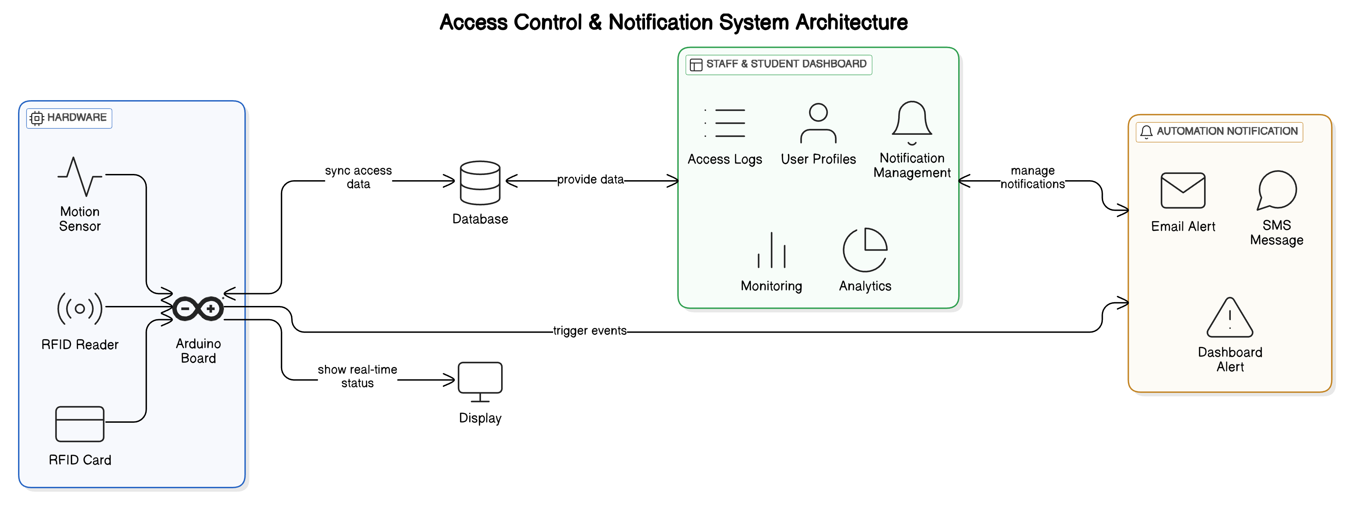
Architecture Diagrams
Fig: Smart Attendance System Using RFID Architecture.

Slide 11
Algorithm Explanation
Slotted ALOHA
Concept: Tags transmit in random time slots within a fixed frame.
How it works:
  The reader sends a frame with n slots (e.g., 16).
  Each tag randomly selects a slot to transmit its ID.
  Single response in a slot = tag identified.
  Multiple responses = collision → reader asks for retransmission.
  No response = empty slot.
Frequency / Time Division Multiplexing (FDM/TDM)
Concept: Divides the communication bandwidth (FDM) or time (TDM) among tags.
How it works (Time Division):
  Reader defines time slots in a frame.
  Each tag randomly selects one slot to respond.
  Similar to Slotted ALOHA but can be pre-assigned or coordinated.

Slide 12
Coding Explanation
Software
FRONT END TOOLS | Python (Tkinter for GUI)
BACK END TOOLS | MySQL, Google Sheets API, Python
MARKUP LANGUAGES | HTML
SCRIPTING LANGUAGES | JS, Python
MIDDLEWARE TECHNOLOGIES | REST APIs
IDE | Arduino IDE, Visual Studio Code
SIMULATION TOOLS | Proteus, Tinker cad Circuits
NETWORK/WIRELESS TECHNOLOGIES | Wi-Fi / Raspberry Pi
ANY OTHER | SMTP, Google Sheets API
Hardware
RFID reader (MFRC522), Atmega328P microcontroller, power module, and student ID tags.

Slide 13
Test Report
Smart Attendance Using RFID – Test Report
Attendance Test Report for employee name Bhuvanesh
Test Date: 20 May 2025
Tested By: Bhuvanesh
Hardware: Arduino UNO, MFRC522 RFID Reader, RFID Tags
Software: Arduino IDE, Serial Monitor
Attendance Test Report for employee name Dinesh Kumar
Test Date: 20 May 2025
Tested By: Dinesh Kumar
Hardware: Arduino UNO, MFRC522 RFID Reader, RFID Tags
Software: Arduino IDE, Serial Monitor

Slide 14
Test Report
Key Test Cases:
Test Case | Input | Expected Output | Result
System Initialization | Power ON | "Scan your RFID card" | Pass
Valid RFID Tag Scan | Known UID | "Student: Swetha - Present" | Pass
Unknown RFID Tag Scan | Unknown UID | "Unknown Tag" | Pass
No Tag Scan | No input | No output | Pass
Multiple Tag Scans | Multiple UIDs | Correct student names displayed | Pass

Slide 15
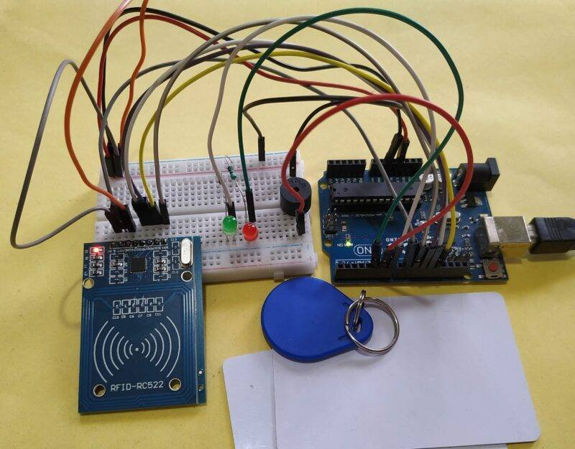
Screen Shots
Fig: Working Model Of RFID for Secure Attendance.

Slide 16
Conclusion and Future Work
The Smart and Secure Attendance System provides an efficient, contactless, and automated solution for attendance tracking.
By integrating RFID with motion-activated readers and automated notifications, it enhances security, eliminates proxy attendance, and improves real-time monitoring.
This system ensures accuracy, reliability, and transparency, making it an ideal solution for schools, workplaces, and secure environments.

Slide 17
References
Base Paper Reference:
Lijuan Zheng; Chunlei Song; Ning Cao; Zhaoxuan Li; Wenfeng Zhou; Jianyou Chen.”A New Mutual Authentication Protocol in Mobile RFID for Smart Campus”,vol.6,IEEE, 14 October 2024
Reference Paper:
Keerthana Sanath, Meenakshi K, Muktha Rajan, Varshini Balamurugan, M.E.Harikumar.”RFID and Face Recognition based Smart Attendance System”, IEEE, 2021.
K. Aravindhan, S.K.B. Sangeetha, K. Periyakaruppan, K.P. Keerthana, V. Sanj ay Giridhar and V.Shamaladevi.”Design of Attendance Monitoring System Using RFID”, IEEE, 2021.
Inturi Meghana, J.D.N.V.L. Meghana and Ramesh Jayaraman.”Smart Attendance Management System using Radio Frequency Identification”, IEEE, 2020.
Qianwen Miao, Fu Xiao, Haiping Huang, Lijuan Sun and Ruchuan Wang. “Smart Attendance System Based on Frequency Distribution Algorithm with Passive RFID Tags”, vol.8, IEEE, 2020, pp.217-206.

Slide 18


Slide 19
THANK YOU

