Slide 2

What it is?
Distributed Heterogenous Configuration Platform
(WMI ->CIM)
PowerShell
Another Group Policy?
Notes:
Devops – there werer chef, puppet etc – MS did not have anything, starting to change that
Platform – additional products on top of it, so rather api, raw tool, so other providers can plug in; Ms was always expeceted to come with product rather than platform - interesting
CIM: Common Information Model (CIM) is the DMTF standard [DSP0004] for describing the structure and behavior of managed resources such as storage, network, or software components.
WMI: Windows Management Instrumentation (WMI) is a CIM server that implements the CIM standard on Windows.
WS-Man: WS-Management (WS-Man) protocol is a SOAP-based, firewall-friendly protocol for management clients to communicate with CIM servers.
WinRM: Windows Remote Management (WinRM) is the Microsoft implementation of the WS-Man protocol on Windows.
With Windows Server 2012, Windows has shifted its focus to become a Cloud OS. In a datacenter running a private or public cloud – there are always set of devices and servers from different vendors. We strongly believe that the only way to reduce the cost of running datacenters is through automation built on top of standards. There is less learning and less chances of error when IT Pros are able to automate heterogeneous environment using same set of tools that they have learned for Windows.
Work closely with Chef
Peaople that now stuff can write resource
Visible also in MSDn – when not only how to do this in UI but also PS, moe console oriented they become (tfs 2015 builds – task runners ftw)
GP – goal is the same but easier to maintaint trak chagnes, develop against etc, not necesaryy AD (but much easier), ‚and i want to know it heppend’ which is not that obvious in gp
Repeatable prcess, control etc

Slide 3
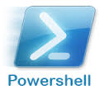
Prerequisites
Windows 8.1, Server 2012 R2
WMF 5 (previews…)
WinRM (build on CIM)
Remoting enabled
Script execution enabled
Changes…
Notes:
CIM – common information model
Winrm – enable remorintg and nothing more in AD, or psecific listerens, session, authentcation modes etc
Remoting on by default in servers
Better on windows server 2012 as servermanage module is there some missing on windows 8 so not all resources will work

Slide 4
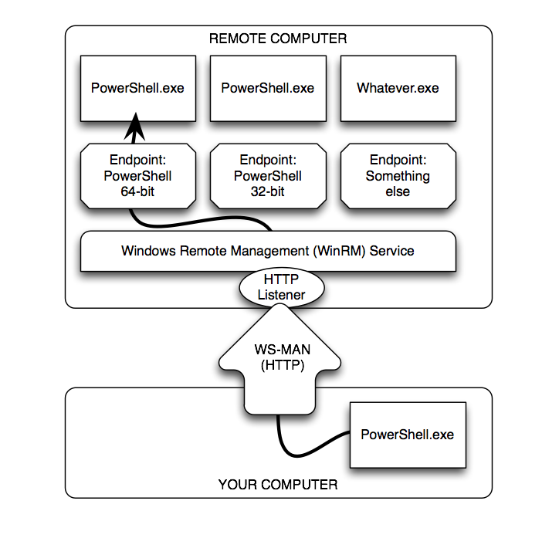
WinRM
Notes:
■ At the bottom of the figure is your computer, or more properly your client. This is where you physically sit, and it's where you'll initiate most of your Remoting activities.
■ Your computer will communicate via the WS-MAN, or Web Services for Management, protocol. This is an HTTP(S)-based protocol that can encapsulate a variety of different communications. We've illustrated this as using HTTP, which is Remoting's default configuration, but it could just as easily be HTTPS.
■ On the remote computer, in the proper terminology the server (which does not refer to the operating system), the Windows Remote Management (WinRM) service runs. This service is configured to have one or more listeners. Each listener waits for incoming WS-MAN traffic on a specific port, each bound to a specific protocol (HTTP or HTTPS), and on specific IP addresses (or all local addresses).
■ When a listener receives traffic, the WinRM service looks to see which endpoint the traffic is meant for. For our purposes, an endpoint will usually be launching an instance of Windows PowerShell. In PowerShell terms, an endpoint is also called a session configuration. This is because, in addition to launching PowerShell, it can auto-load scripts and modules, place restrictions upon what can be done by the connecting user, and apply additional session specific settings not mentioned here.
SOAP – good for firewalls

Slide 5
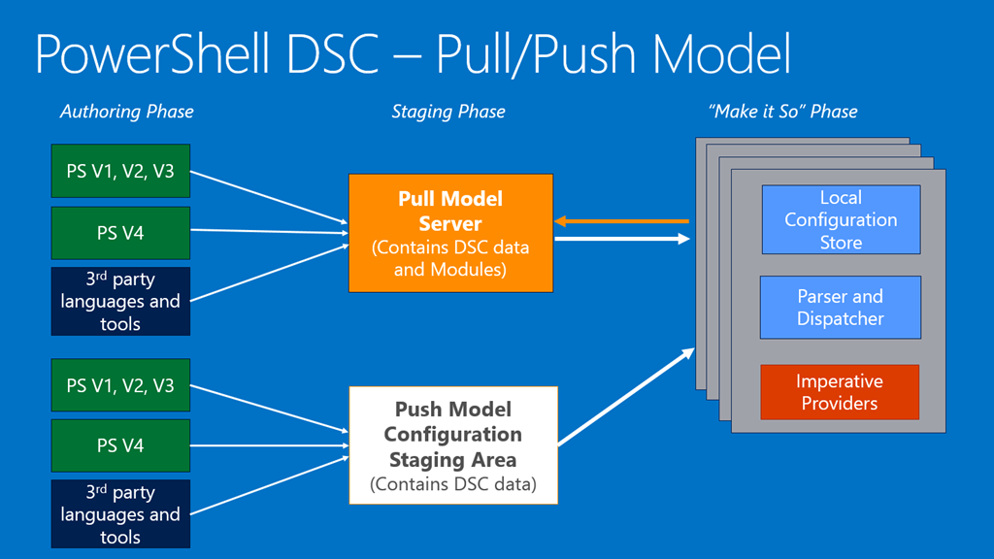
Architecture
Notes:
3 phases, 3rd party – MOF standard, using standards
LCM that is looking at things and run tchem
WMI has open source version calls - OMI– open managemnt interface, WMI is specific version of WMI
CIM

Slide 6
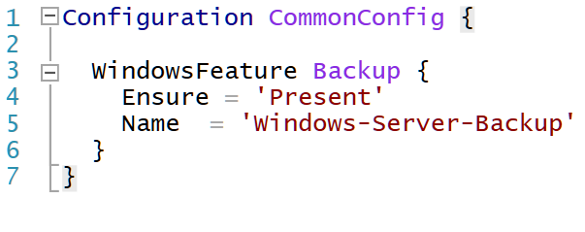
Configuration Definition
Notes:
Function „name” == Configuration „name”

Slide 7
Push configuration & Resources
Demo
Notes:
In-the-box ~12
Resource is a module
X – experimental – often breaking changes
C – community resources – intelectual proeprty

Slide 8
Pull configurations
SMB
HTTP(S)
Demo
Notes:
http – rest api, odata, load balance is easier, clous etc odate – set of convetnios on rest, so reduces a chaos
Smb – netowrk share looks for specifi file
Names based on guids – because it is only a platform not a product, so in some products might be hidden by nice names
HTTPS:
Need to generate certificate – easy if you have Pki in AD, if not use digicert etc- so mutual authenticaion between server and client
- CA must be trusted and thumbprint must be part of configuration

