Slide 1
Olist Brazilian E-Commerce Data Analysis
A comprehensive data engineering and analytics project by DEPI, ITC Online Group 3, Team 3. From raw Kaggle dataset to interactive Power BI dashboard analyzing 96.5K orders across Brazil — January 2017 through August 2018.
96.5K
93.4K
Orders Analyzed
Unique Customers
15.4M
4
Total Revenue (BRL)
Core DB Tables
Database Design
Data Engineering
Normalized 4-table SQL schema from 9-table source
Python ETL pipeline with UTF-8 encoding and validation
Power BI Dashboard
Analytical Insights
15+ DAX measures across 3 analytical pages
Revenue, customer retention, and delivery performance

Slide 2

Project Objective & Dataset
Primary Goal
Dataset: Olist Brazilian E-Commerce
Transform raw e-commerce data into a structured relational database and build an interactive Power BI dashboard to analyze sales performance, customer behavior, and delivery operations across Brazil.
Sourced from Kaggle — a public dataset covering 100K orders with full order lifecycle data including customers, orders, items, products, payments, and geographic dimensions across multiple Brazilian states.
Scope of Work
Why This Dataset?
Database design and normalization
Data cleaning and ETL pipeline
Power BI measures and dashboard development
Insights on revenue, customer patterns, and delivery
Complete Lifecycle
Purchase → payment → delivery → review captured end-to-end
Geographic Depth
State and city-level data enabling regional performance analysis
Temporal Range
20-month window (Jan 2017–Aug 2018) supporting trend analysis

Slide 3
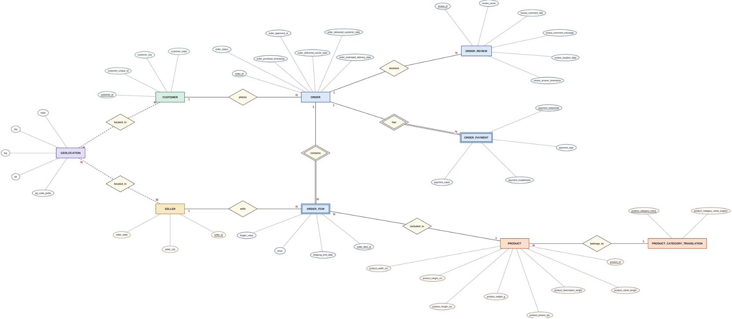
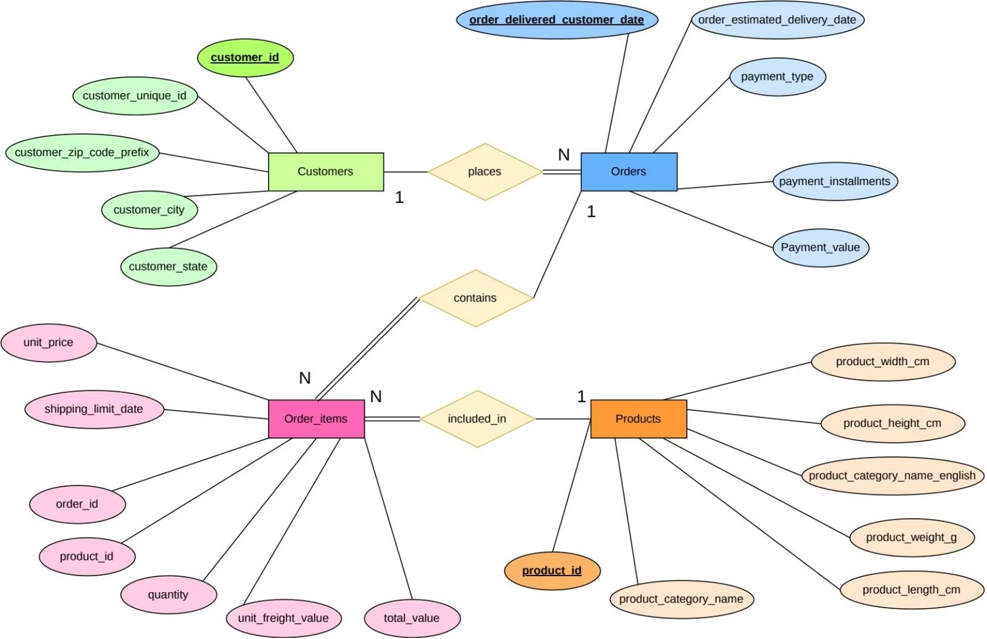

Data Discovery & Database Design
Original Dataset — Chen ERD (9 Tables)
Target Analytics Schema (4 Tables)
The source schema comprised 9 interconnected tables: Customers, Orders, Order Items, Products, Payments, Reviews, Sellers, and Geolocation — representing the full operational data model of the Olist marketplace.
Optimized for analytical queries by selecting the 4 core tables: Customers, Orders, Order_items, Products. Key design decision: payment_installments converted from numeric to Boolean to reduce redundancy and simplify aggregation logic.
Trade-off: Simplified schema improves query performance but excludes seller, review, and geolocation granularity from the analytical layer.

Slide 4


Data Cleaning & SQL Implementation
1
2
Cleaning Operations
Relational Validation
Removed empty rows and duplicate records
Converted all text fields to UTF-8 encoding
Standardized column names and corrected data types
Flagged suspicious records for manual review
Verified referential integrity: orders → customers, items → products
Checked date consistency across order lifecycle fields
Validated payment totals against line-item sums
Confirmed geographic accuracy of state/city codes
3
4
SQL Schema Design
Core Lesson
Four normalized tables with PRIMARY KEY and FOREIGN KEY constraints
NOT NULL constraints on critical fields
Python notebooks for ETL with parameterized queries
Automated pipeline from raw CSV to loaded database
Data quality requires validating relationships between tables and consistency across temporal and geographic dimensions — not just cleaning individual cells in isolation.

Slide 5


Power BI Measures & Calendar
Calendar Dimension Table
Advanced & Time-Intelligence Measures
A continuous date dimension spanning Jan 2017 – Aug 2018 was constructed to enable time-based slicing and aggregations. Attributes include Year, Month, Quarter, and Day of Week — essential for time-intelligence functions in DAX.
YTD Sales
Year-to-date cumulative revenue using DATESYTD
Month-over-Month %
Core KPI Measures
MoM growth with guard clause for low-volume periods to prevent misleading spikes
Revenue
Volume
Total, Product Sales, Freight Value
Delivered Orders, Units Sold
Delivery Performance
Average Delivery Days, Late Delivery Rate, On-Time Rate
Customers
Customer logic: Unique customers use customer_unique_id; repeat customers defined as those with more than 1 order on record.
Unique Customers, Avg Order Value, Revenue per Customer

Slide 6

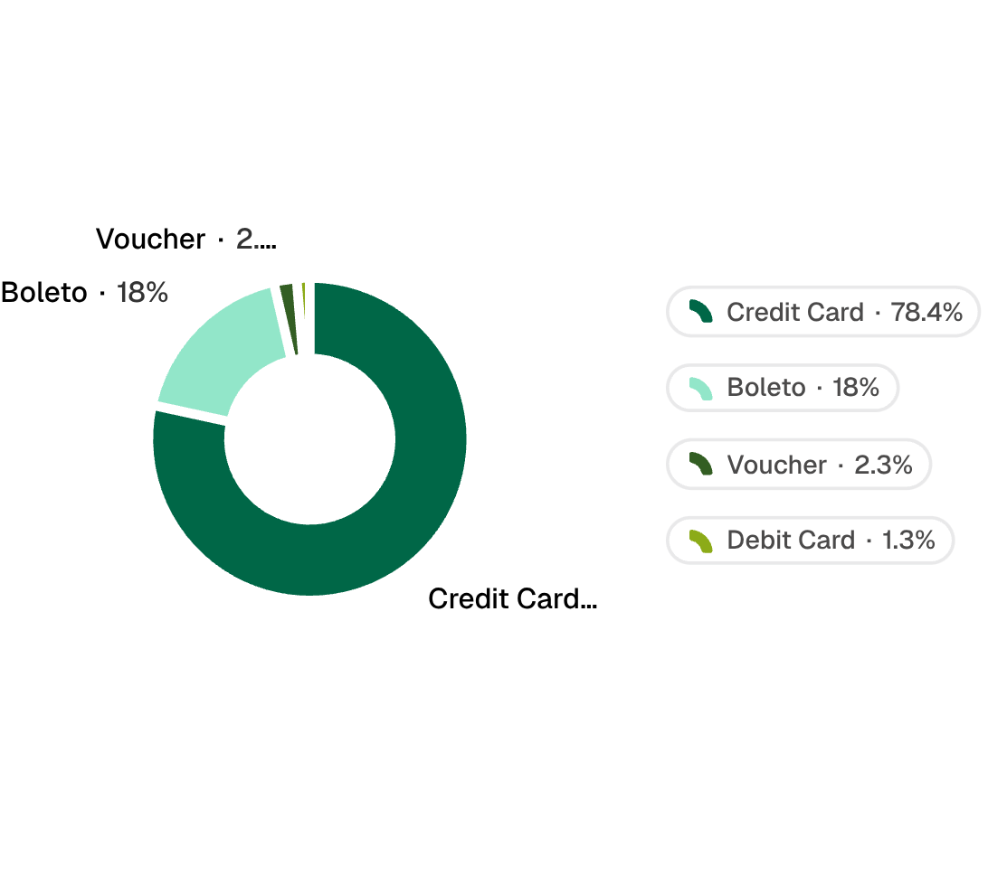
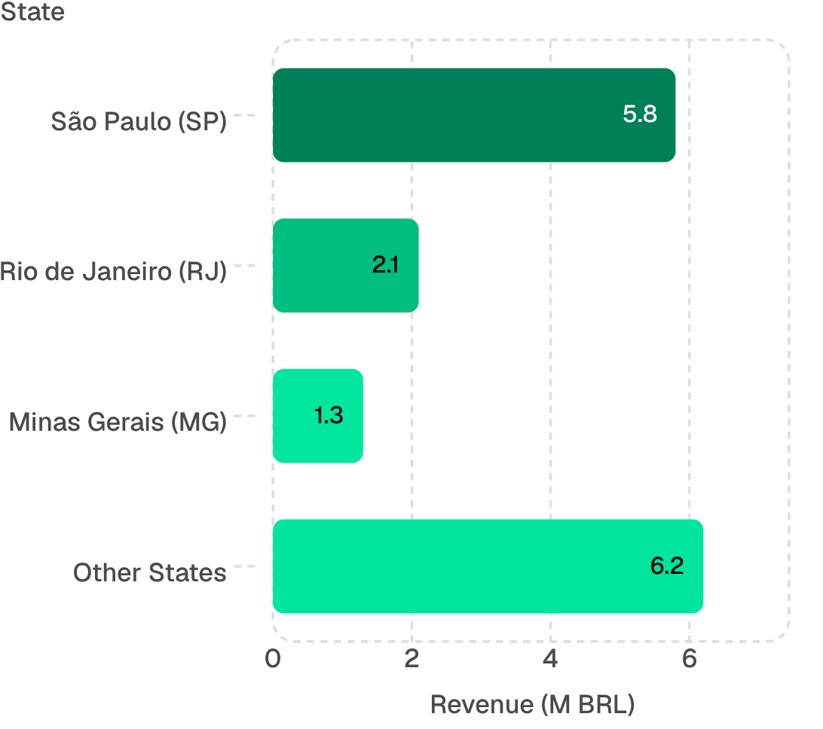
Power BI Dashboard: Executive Overview
15.4M
96.5K
Total Revenue (BRL)
Delivered Orders
13.2M product + 2.2M freight
93.4K
137
Unique Customers
Avg Order Value (BRL)
Monthly Revenue Trend
Payment Methods
Geographic Concentration
Growth from 0.1M (Jan 2017) to a peak of 1.2M (Nov 2017), then stabilizing at approximately 1.0M/month through Aug 2018 — indicating market maturation after initial rapid growth.
Top 3 states (SP, RJ, MG) account for approximately 60% of total revenue.

Slide 7
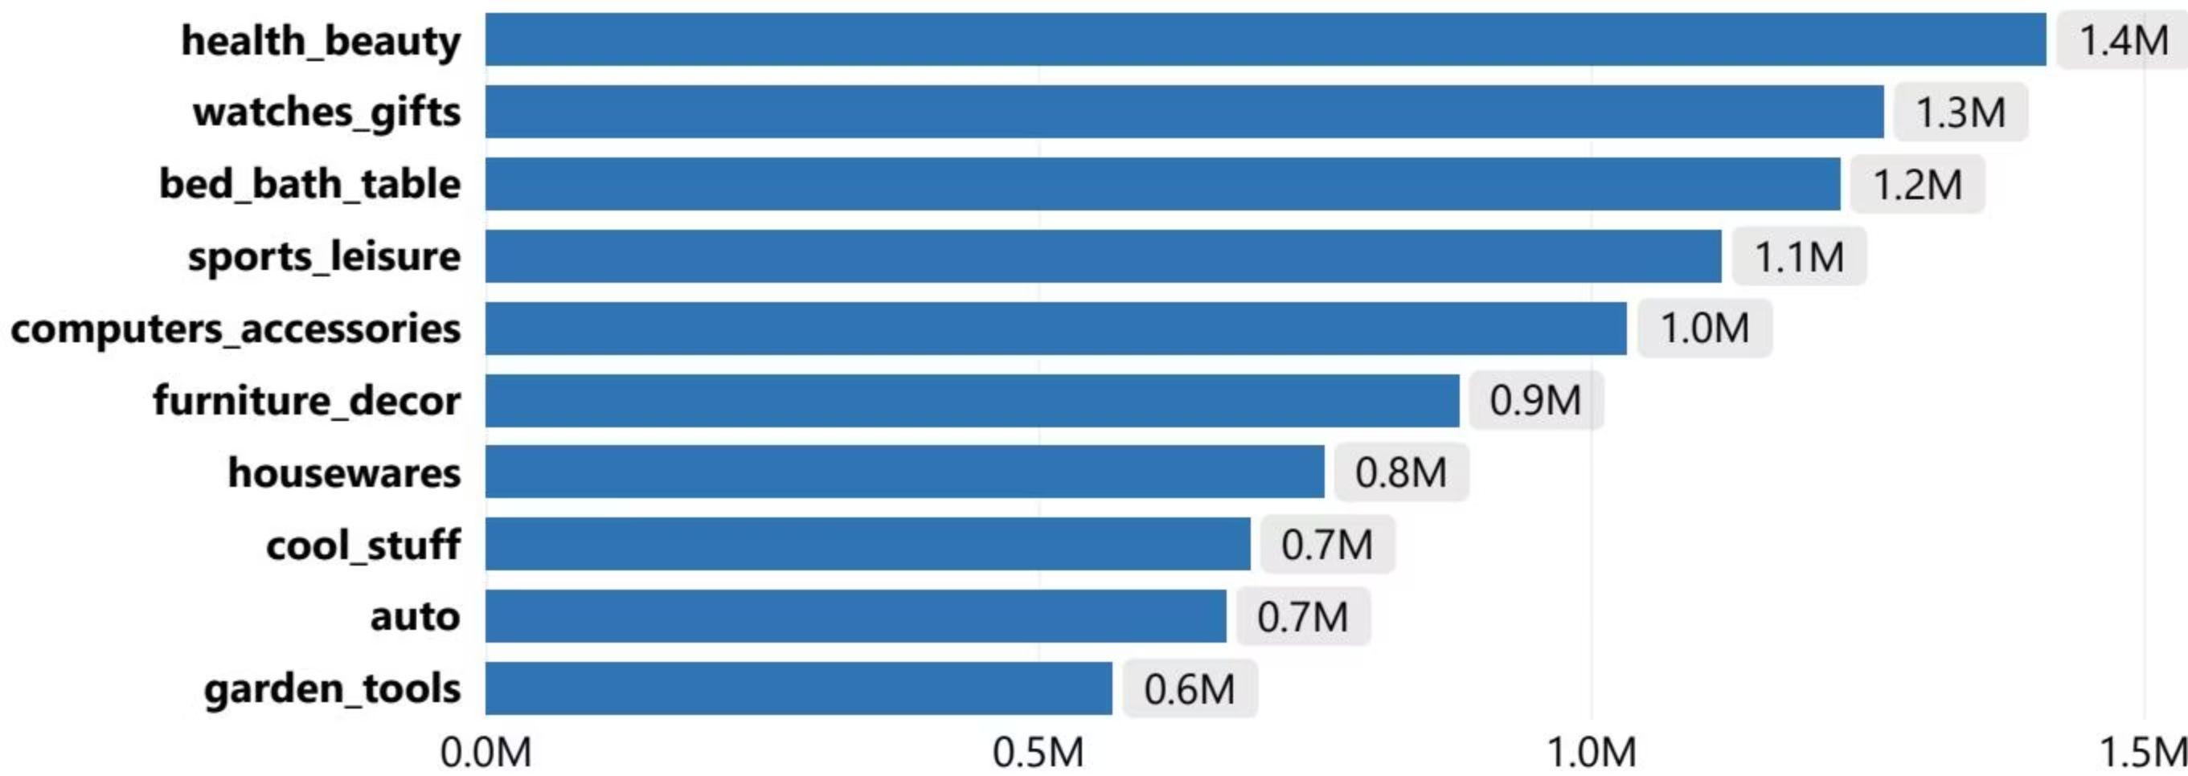
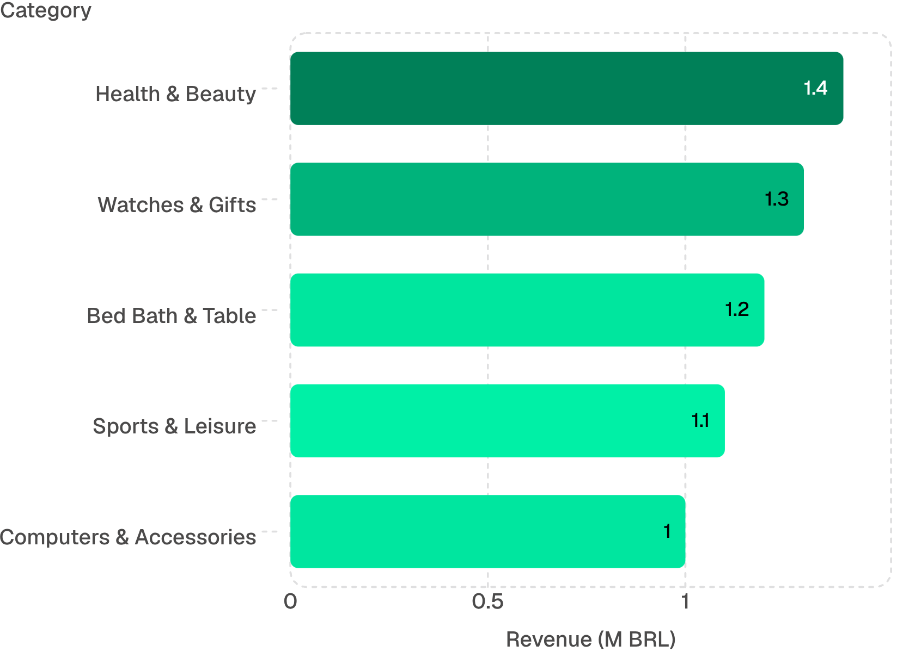
Products & Customers Page
Product KPIs
Customer KPIs
74
110K
165
Product categories
Units sold
Revenue / Customer (BRL)
Top 5 Revenue Categories
3%
Repeat Customer Rate
Geographic Customer Concentration
São Paulo city alone accounts for 15.5K customers. The top 10 cities represent approximately 45% of the entire customer base — mirroring the revenue concentration pattern observed at the state level.
Strategic insight: A 3% repeat rate signals a predominantly transactional customer base. Retention programs targeting high-value segments could materially improve lifetime value metrics.
Top 5 categories account for approximately 39% of total revenue.

Slide 8
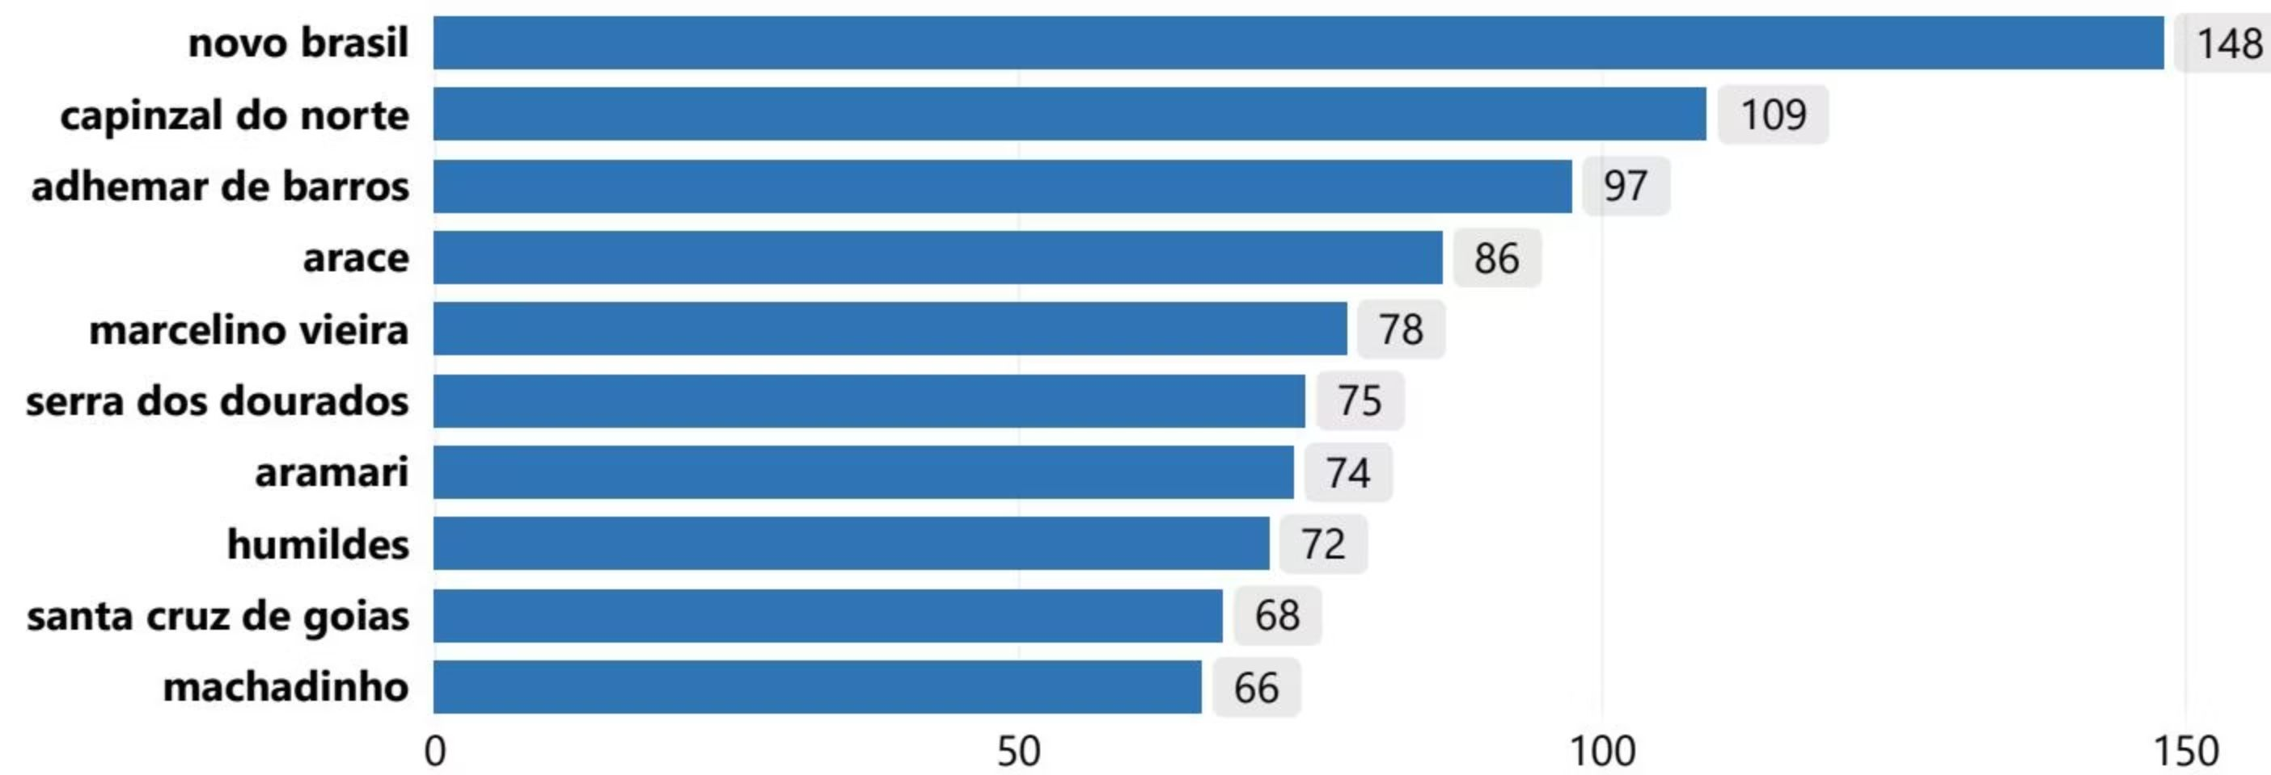
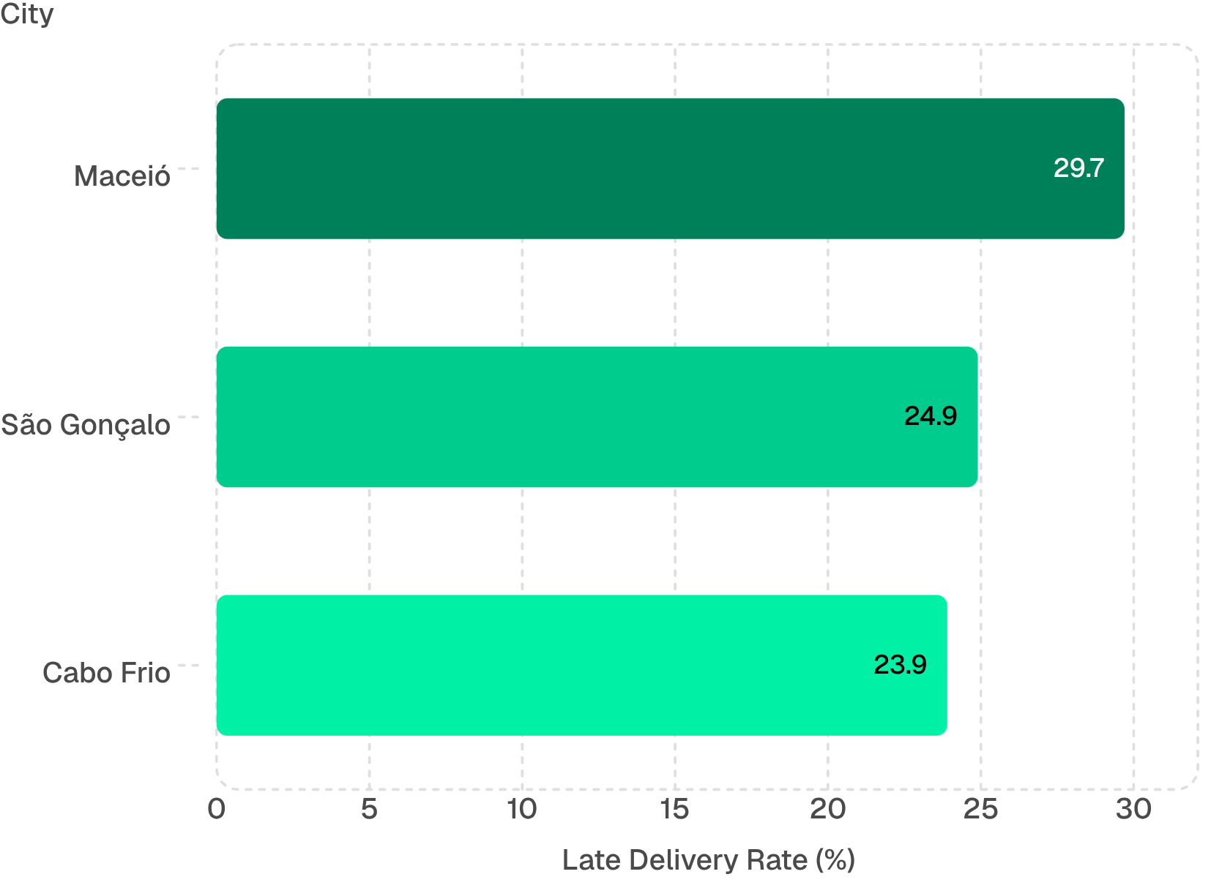
Operations & Delivery Page
12.6
91.9%
Avg Delivery Days
On-Time Rate
8.1%
7.8K
Late Delivery Rate
Late Orders
Geographic Delivery Disparity
Late-Delivery Hotspots
Remote municipalities exhibit extreme delivery delays relative to urban centers. Observed outliers include Novo Brasil (148 days) and Capinzal do Norte (109 days) — likely reflecting last-mile logistics constraints in underserved regions rather than systemic carrier failure.
Small municipalities with few orders produce statistically unreliable averages. A minimum sample threshold of ≥10 orders is recommended before drawing operational conclusions.
These urban hotspots suggest carrier or logistics challenges rather than geographic remoteness. Late delivery may also reflect inaccurate delivery estimates or address data issues — causality requires further investigation.

Slide 9


Key Findings & Limitations
Descriptive Findings
Analytical Limitations
Revenue Concentration
Scope Reduction
São Paulo = 38% of revenue. Geographic diversification could reduce concentration risk and unlock growth in underserved states.
4 of 9 source tables selected; seller, review, and geolocation data excluded from the analytical layer.
Boolean Conversion
Customer Dynamics
payment_installments converted from numeric to Boolean — installment-count granularity is lost.
93.4K unique customers, 3% repeat rate, avg order value 137 BRL. Low loyalty signals a retention opportunity — not a confirmed churn problem.
Small-Sample Bias
Delivery Performance
Niche categories and small municipalities produce unreliable averages; minimum thresholds required.
91.9% on-time overall, but extreme geographic variation. Late delivery ≠ carrier fault; may reflect inaccurate estimates or address data quality issues.
Identity Accuracy
Repeat-customer definition depends on customer_unique_id accuracy — unverifiable from public data.
All findings are descriptive observations and hypotheses. No causal relationships are claimed without further controlled analysis.

Slide 10




Team Contributions & Deliverables
Mohamed Sokarno (Lead)
Mahmoud Al-Nabawi
Mohamed El-Gml
Dataset discovery and selection
SQL schema design and data loading
UTF-8 encoding resolution
Project review and documentation
Source ERD in Chen notation
Data dictionary compilation
Python data cleaning and preparation
ETL notebook development
Mahmoud Saqr
Mostafa Salem
Calendar table construction
15+ Power BI KPI measures
Time-intelligence DAX functions
Four-page Power BI dashboard
Executive Overview, Products & Customers, Operations & Delivery pages
Project Deliverables
SQL Database
Python ETL Pipeline
96.5K orders, 93.4K customers
Automated cleaning and loading
Power BI Dashboard
Documentation
3 analytical pages, 15+ measures
ERD, data dictionary, insights report

Slide 11
Thank you
& Questions

