Slide 1
MSU Human Resource MGT System Proposal
Myles Spillers, Johnny Wilson, Alonzo Reed

Slide 2
Overview
Purpose
Technical Details
High Level System Interaction
Proposed User Interface

Slide 3
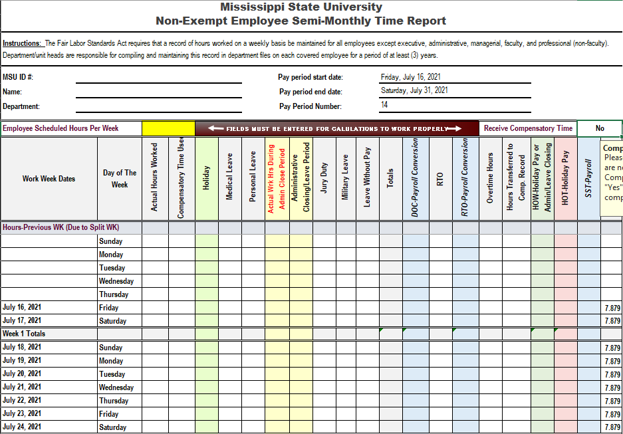
Purpose
Supplement existing time reporting
Provide an efficient user interface
Decrease user frustration and commitment
Provide traceability through auditing

Slide 4
Technical Details
React.js - User Interface
Node.js – Database Interactions
SQL Database – Auditing

Slide 5
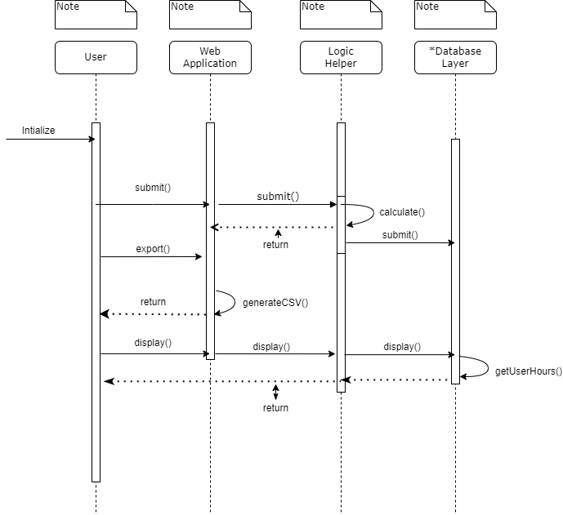
High-Level System Interaction

Slide 6
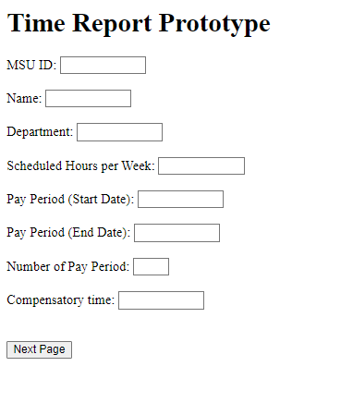
User Interface

Slide 7
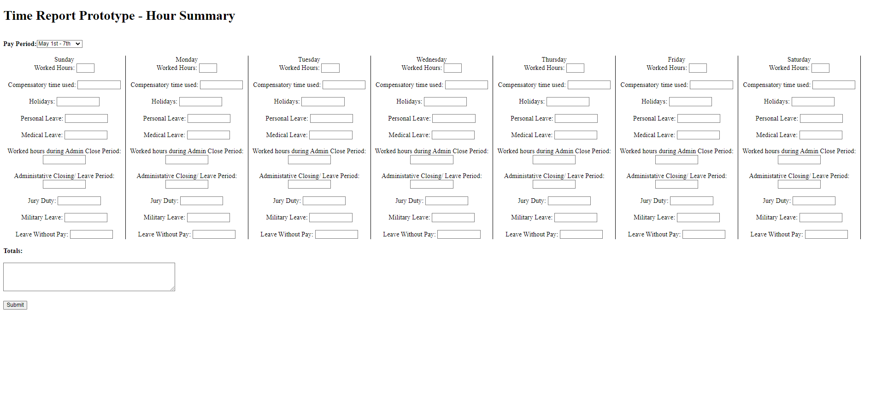
User Interface

Slide 8
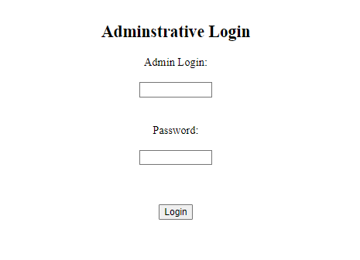
User Interface

