Slide 1
Process-Algebraic Models of Multi-Writer
Multi-Reader Non-Atomic Registers
Myrthe Spronck and Bas Luttik
CONCUR, 22 September 2023

Slide 2
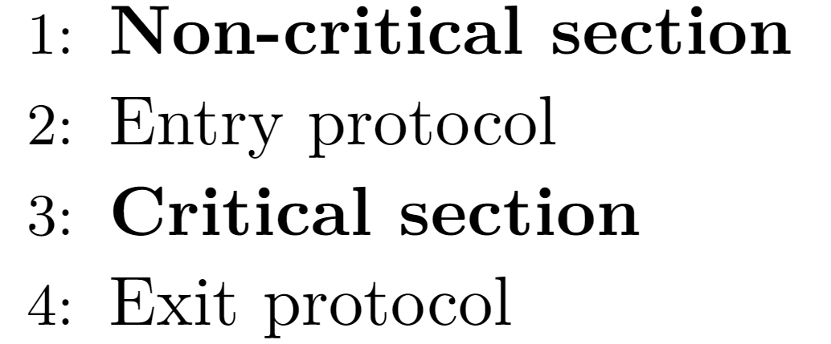
N threads wish to access some resource
Critical section: part of a thread’s code in which the resource is accessed
Mutual Exclusion: at any one time, at most one thread is in its critical section
Insert entry and exit protocol to guarantee mutex property
E. W. Dijkstra. Solution of a problem in concurrent programming control. Communications of the ACM, 8(9):569, 1965
Mutual Exclusion

Slide 3
Dijkstra’s original presentation assumes atomic registers
Atomic register: reads and writes behave as though they occurred in some order, reads return the last written value
  Definition given by Lamport for single-writer, also applicable to multi-writer
read 2
read ?
read 0
read 0
read 0
read ?
read 2
write 0
write 2
L. Lamport. On Interprocess Communication: Part II - Algorithms. Distributed Computing, 1(2):86, 1986
Mutual Exclusion

Slide 4
Many algorithms solve mutex with atomic registers:
  Peterson’s algorithm
  Dekker’s algorithm
  Dijkstra’s algorithm
  Etc.
Mutual Exclusion

Slide 5
According to Lamport:
  Atomic operations behave in mutual exclusion
  Atomic registers require an underlying solution to mutual exclusion
  Assuming atomicity to solve mutual exclusion is unsatisfactory
L. Lamport. The Mutual Exclusion Problem: Part I - A Theory of Interprocess Communication, Journal of the ACM 33(2):313, 1986
Mutual Exclusion

Slide 6
Lamport provides a formalism for reasoning without atomicity
  Single-writer multi-reader register definitions
atomic
regular
safe
L. Lamport. On Interprocess Communication: Part II - Algorithms. Distributed Computing, 1(2):86, 1986
Mutual Exclusion

Slide 7
Algorithms solve mutex with non-atomic registers:
  Lamport’s bakery algorithm
  Lamport’s 3-bit algorithm
  Aravind’s BLRU algorithm
  and others
Such algorithms are difficult to analyse and prove
  Lamport: “[Informal reasoning] is quite unreliable.
  […] This is especially true of algorithms using our nonatomic communication primitives”
Mechanical verification by model checking
  Model non-atomic registers
L. Lamport, The Mutual Exclusion Problem: Part II - Statement and Solutions, Journal of the ACM 33(2):327, 1986
Mutual Exclusion

Slide 8
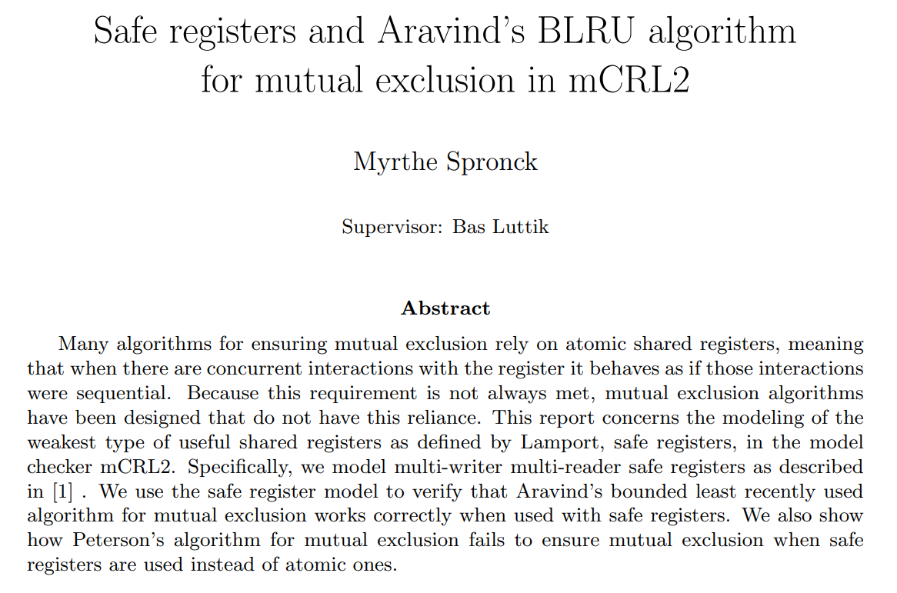
Project: analyse Aravind’s BLRU algorithm in mCRL2
Need models of MWMR safe registers and the algorithm
Results
  Model of MWMR safe registers
  Model of Aravind’s BLRU algorithm
    Satisfies mutex with safe registers
    analysed up to 3 threads
  Model of Peterson’s algorithm
    Counterexample for mutex with
    safe registers
Read CONCUR paper instead
Bachelor Project (2021)

Slide 9
Single-writer safe registers: a read not concurrent with a write returns the most recently written value
  Values of reads concurrent with writes are independent
read ?
read 0/1/2
read 0
read 0/1/2
read ?
write 0
write 2
L. Lamport. On Interprocess Communication: Part II - Algorithms. Distributed Computing, 1(2):86, 1986
Safe Registers

Slide 10
Single-writer safe registers: a read not concurrent with a write returns the most recently written value
For several algorithms, need multi-writer registers
  Extension by Raynal
  In our models: stabilises to single value
 | Not concurrent with write | Concurrent with write
Read | Return last written value | Return arbitrary value in domain
Write | Set intended value | Set arbitrary value in domain
write 1
read 0/1/2
read 0/1/2
write 0
M. Raynal, Concurrent Programming: Algorithm, Principles, and Foundations, Springer Publishing Company, Incorporated, 2013
Safe Registers

Slide 11
Modelling, informally
  Operations split between start and finish actions
  Register tracks current value d
  Additionally tracks for each thread if there was a concurrent write during the current operation
 | Not concurrent with write | Concurrent with write
Read | Return last written value | Return arbitrary value in domain
Write | Set intended value | Set arbitrary value in domain
sr₀
fr₀(0)
d := ?
read 0
read 2
read 1
write 1
read 2
T0:
write 0
write 2
write 0
T1:
d := 0
sw₁(2)
fw₁
+ d := 2
d := 2
Safe Registers

Slide 12
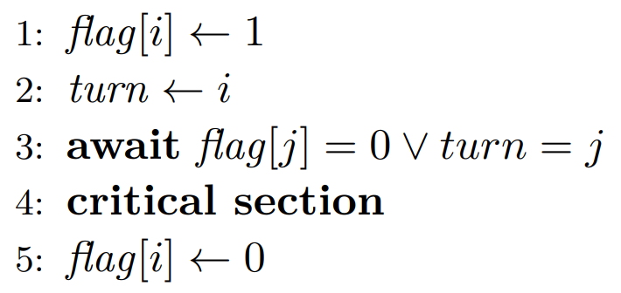
Counterexample trace for Peterson’s
Peterson assumes atomic registers
Illustrate complexities of non-atomic registers
noncrit
flag[0] ← 1
turn ← 0
flag[1] = 1
turn = 1
crit
T0:
T1:
noncrit
flag[1] ← 1
turn ← 1
flag[0] = 1
turn = 0
crit
Safe Registers

Slide 13
Find weakest assumption required for correctness
Single-writer regular register: a read returns either the last written value, or the value of a concurrent write
  Possible to first read new value, then old
read 0/2
read ?
read ?
read 0
read 0/2
write 0
write 2
L. Lamport. On Interprocess Communication: Part II - Algorithms. Distributed Computing, 1(2):86, 1986
Regular Registers

Slide 14
Multi-writer regular registers
  With concurrent writes, what is the “last written value”?
Multiple interpretations possible, we introduce one
Our considerations:
  Reduce to single-writer definition
  Stronger than safe, weaker than atomic register
  Bounded tracked information, for explicit-state model checking
Regular Registers

Slide 15
Our multi-writer regular registers, informally
  Concurrent writes behave as though they occurred in some order
  A read returns either the value of a concurrent write, or the last-written value according to this ordering
read 1/2
write 1
read 2
read 0
read ?
write 0
write 2
Regular Registers

Slide 16
Modelling, informally
  Operations split between start and finish actions
  order write actions to generate ordering on-the-fly
  Register tracks current value d, updated on order
  Additionally tracks for active reads which values can be returned
    Bounded by number of threads and domain of registers
d := 1
sr₀
fr₀(0)
{0, 2}
{2}
{1}
read 0
read 2
read 2
write 1
read 1
T0:
write 0
{0}
write 2
write 0
T1:
d := 0
sw₁(2)
ow₁
+ d := 2
fw₁
d := 0
Regular Registers

Slide 17
Counterexamples show how order write actions must be placed
Counterexample for Peterson’s algorithm,
with the order actions
  Peterson assumes atomic registers
noncrit
flag[0] ← 1
turn ← 0
flag[1] = 1
turn = 1
crit
T0:
T1:
noncrit
flag[1] ← 1
turn ← 1
flag[0] = 1
turn = 0
crit
Regular Registers

Slide 18
Other interpretations of multi-writer regular registers
Shao et al. present four variants
  weak, write-order, reads-from, no-inversion
Not yet modelled these, some may require unbounded information
Counterexample of Peterson’s is invalid for write-order
atomic
write-order
reads-from
no-inversion
our definition
weak
C. Shao, J. L. Welch, E. Pierce, and H. Lee, Multiwriter Consistency Conditions for Shared Memory Registers. SIAM Journal on Computing, 40(1):28, 2011
proven in paper
Regular Registers

Slide 19
We modelled MWMR safe, regular and atomic registers in mCRL2
  Shared interface and algorithm-independent
Properties:
  Mutex: no two threads can simultaneously enter their critical sections
  Reach: if a thread wants access to its critical section, then until it gets access it is always possible for it to eventually get access
Found unexpected results
Verifying Mutual Exclusion

Slide 20
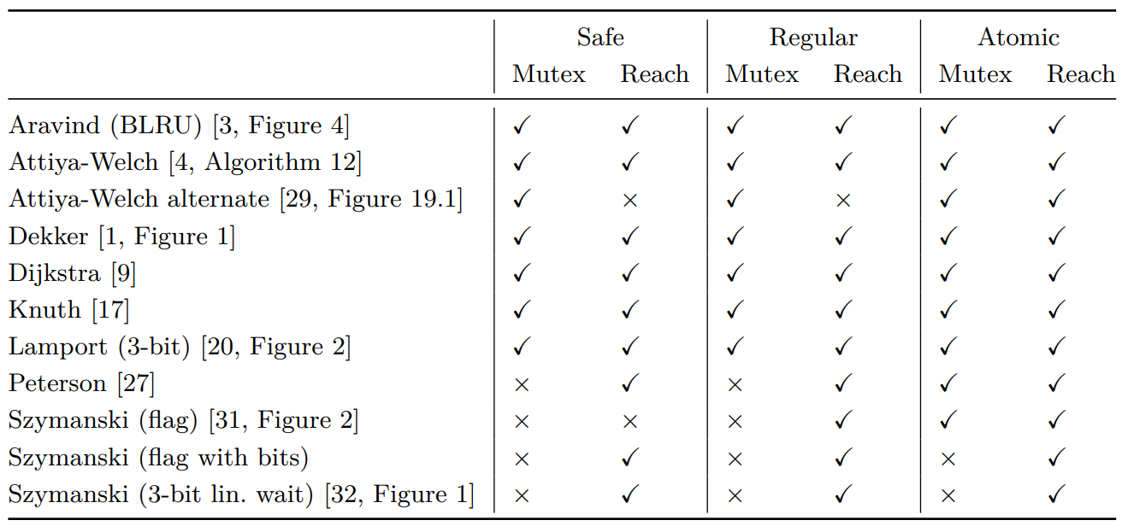
Core issue: re-reading a register vs. checking a local copy
Detailed counterexamples in full version
Original presentation correct, minor alteration introduces flaw
Variant of Peterson’s
Only with 3+ threads: detail in exit protocol, can be fixed
Both claimed correct under flickering bits (safe registers)
Two reads concurrent with one write, new-old inversion
Old-new inversion
Correctness hinges on minor implementation detail
Only with 3+ threads: unsure how to fix
Verifying Mutual Exclusion

Slide 21
Verification with Shao et al.’s definitions of MW regular registers?
Consider robustness to other failures
  Premature termination, malfunctioning threads
Verify liveness properties such as starvation freedom
  Will discuss difficulties and plans tomorrow at YR-CONCUR
Future Work

