Slide 1
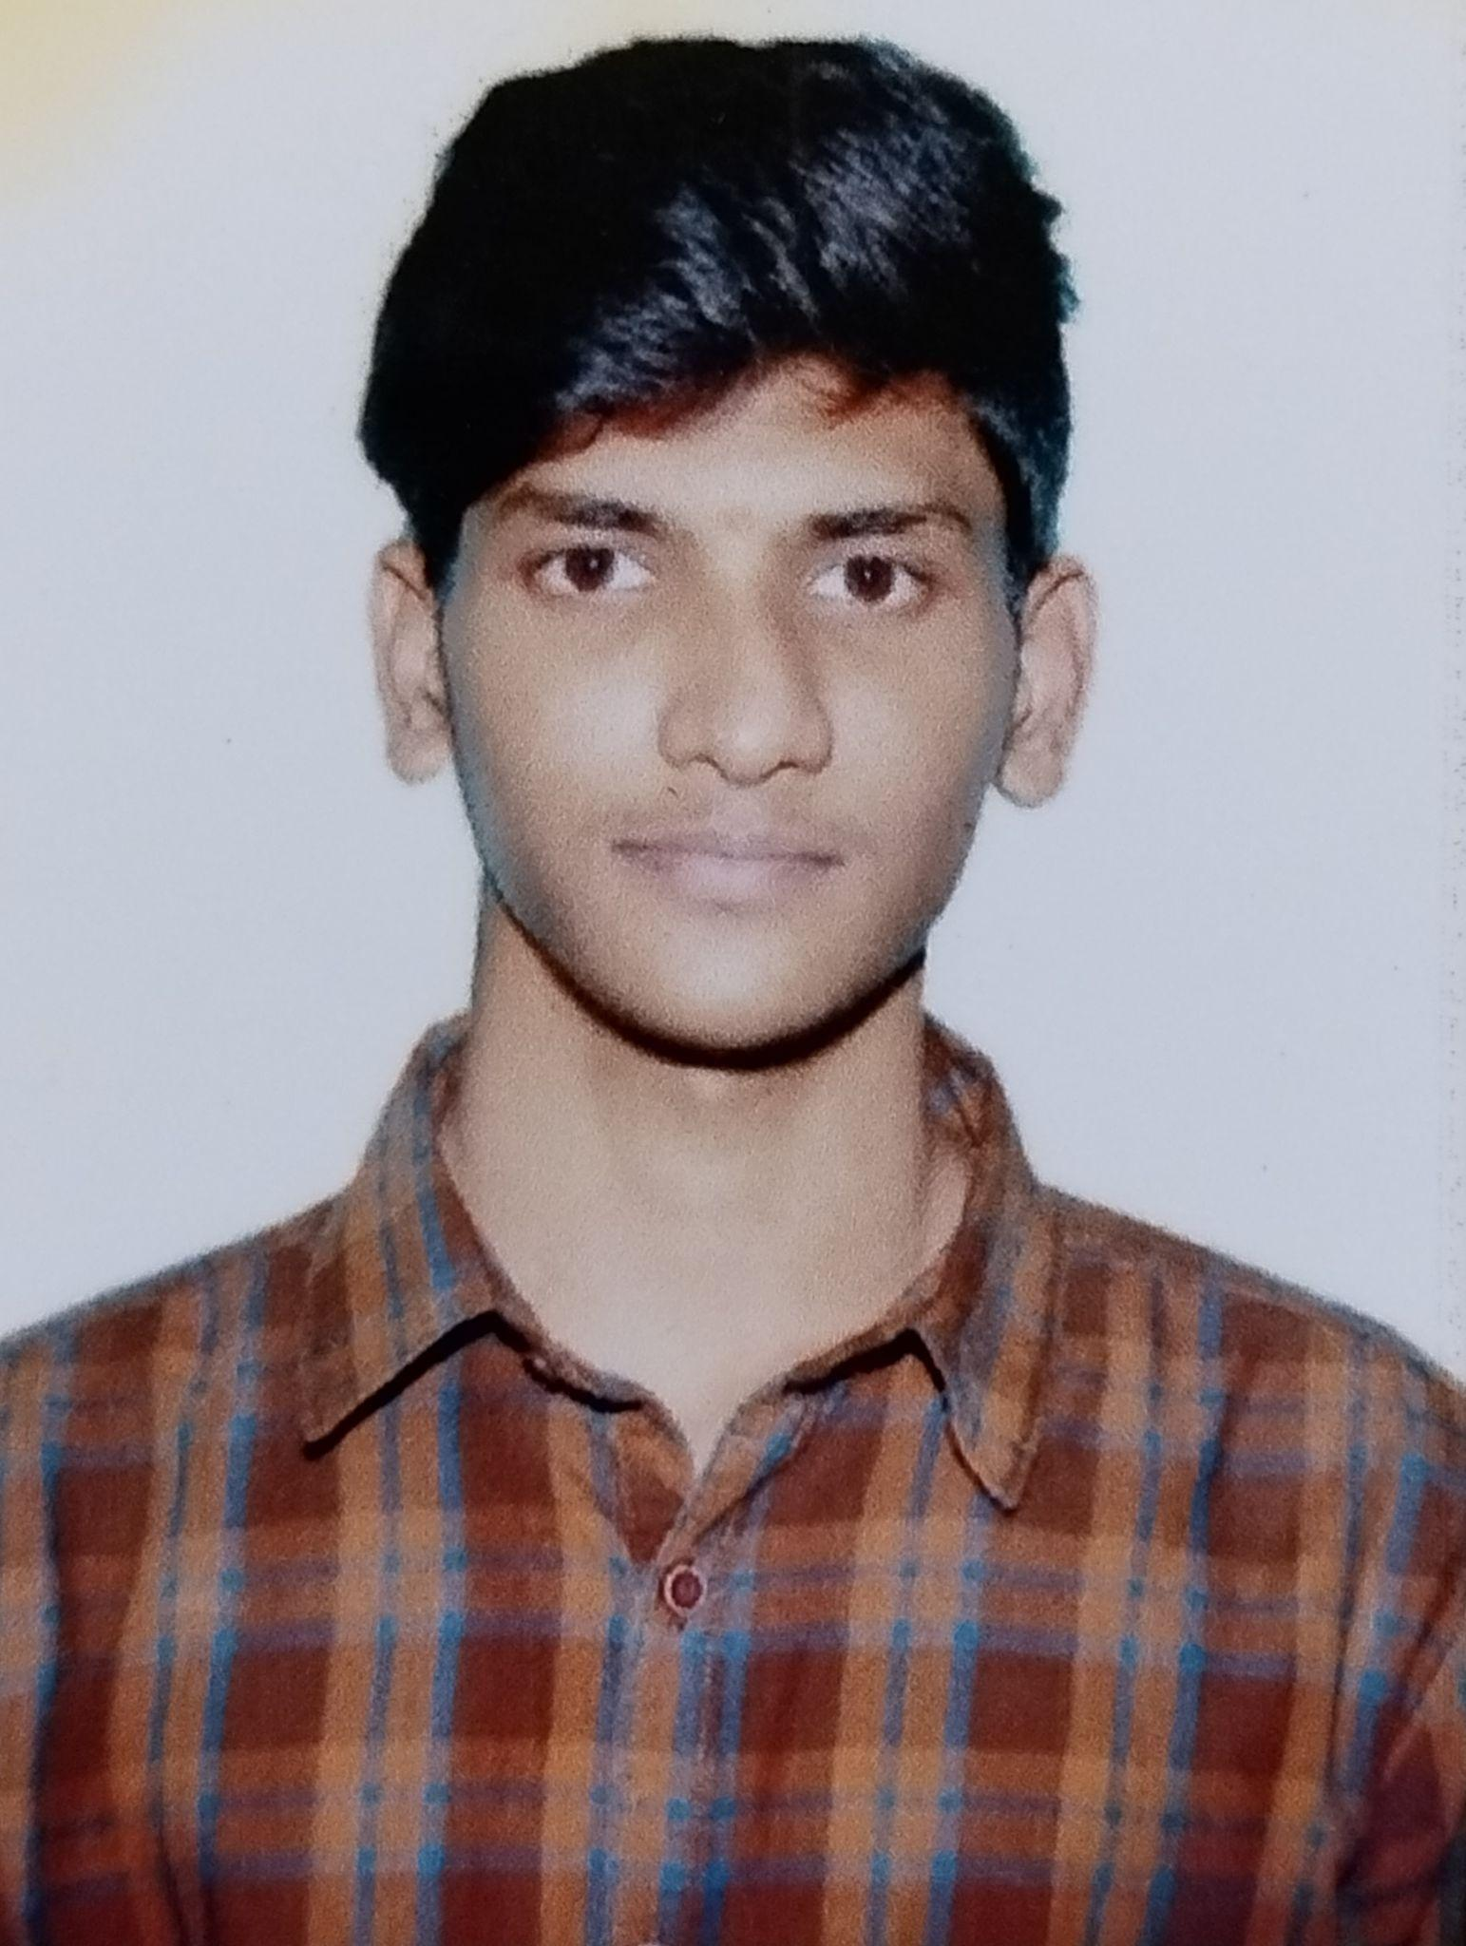


Khyathi Mahesh Dutta
Analyst/Software Engineer
Bachelor of Engineering
Computer Science : 2019 - 2022
Skills
Bangalore
Java 8 /J2EE | Java Basics, OOPS, Generics, Collections, Arrays, Loops, Lambda Exp, Stream API Junit, Mockito, Servlets
Spring core | IOC & Dependency Injection, Autowire
Spring REST | REST controllers, Implementation of GET, POST, PUT & DELETE, Bean Validation & Exception Handling, Testing Services, Controller & Repository layer
Spring Data JPA | Implement DAO layer using spring Data repositories, Transaction Management
Spring Boot Microservices | Spring Boot Starters, annotations, Messaging Service, Sync/Async comms, Swagger API specifications
Spring Cloud | Eureka, Netflix Ribbon, Feign Client, Hystrix, Zuul & Config Server
React | Components, Hooks, Event handling, Redux, Reducers, Testing using Jasmin & Karma
Database | MongoDB No Sql Advanced My SQL RDS Basics
UI Tech | HTML 5 & CSS 3,JavaScript, ES6 & TypeScript Reusable templates, Optimized UI Designed
Tools | Git, Postman, Maven, IDE,PMD,Checkstyle
Add On skills | Communications, Team management. Peer learning
khyathimnsree368@gmail.com
8639027299
A4
Full Stack Developer
Hands on experience in creating microservices with Springboot, Spring Security, Spring Cloud API Gateway, Eureka server, load balancing
Hands on experience in building web pages using Html, Css, Bootstrap and working knowledge on ReactJS with react hooks,reactive forms,routing and Material UI.
Experience in creating documentation with Java docs and swagger and in unit testing using Junit, Mockito
Development experience using intellij, VS Code, pgAdmin for postgress, postman Api connection and MangoDB Atlas.
Agriculture Crop System Application
Completed end to end case study of Agriculture Crop System Application along with JWT authentication,Swagger documentation and payment integration with testing using Junit and mockito, responsive UI with Material UI and ReactJS used for user interface, MongoDB Atlas as DatabaseOnline Bus Booking Application
Aws Certified Cloud practitioner
Completed Aws Certified Cloud Practitioner Certification

