Slide 1

Under the supervision of: Miss.M. Soumya(Asst.prof), Department of CSE.
HOMY
TEAM MEMBERS:
M. Pranay Kumar Reddy (O160164)
M. Sreelatha (O161315)
B. Jeenath (O161615)
G. Elumalai (O162089)
M. Jitendar (O161050)

Slide 2
Contents
Abstract
Problem Statement
Existing System
Proposed System
Advantages
Disadvantages
Software Requirements
Hardware Requirements
Usecase diagram
Conclusion
Future Enhancement
References

Slide 3
Abstract
The home rental system is done through the manual system and the work done through illegal intermediate person. This leads to customer into more trouble, cost, dishonest and time wastage.
Online Housing Rental System(HOMY) is website that provides all the services that are needed for a common person who is in need for a rental house by a user login process.

Slide 4
Problem Statement
A person needed to search for a house to rent without knowledge over cites. It is a long process until a certain house is fixed for rent and needs much physical strength.
Up to now the rental process is done by manually using some intermediate person between the owner and rented person. This leads to some disrupts, time wastage.

Slide 5
Existing System
If you needed a home for rent, you’ll find a place that is suited for your requirements or desires then you will navigate a certain place ask for vacant properties to be rent on.
Manual monitoring of houses is not easy all and it will occupy a lot of time and patience. There will be conflicts that you will encounter along the way, like the availability is not certain, requirements are not suited, rent is high etc.

Slide 6
Proposed System
In proposed system, it overcomes all the difficulties in the existed system.
Online Housing Rental System(HOMY) is a website that provides all the services that are needed for a common person who is in need for a rental house.
This system consists of a user login process, it provides all the information needed to the customer to rent a house in his desired location.

Slide 7
Advantages
Get the multiple options of houses and complete details of home for rent in your desired location.
See the rent process status instantly.
It will keep the daily and the history record details of the customers need in proper Database.
Will generate proper available home for customers at the time.

Slide 8
Disadvantages
No Online payment feature is present for “Homy”.
You need internet access to use our website “Homy” .

Slide 9
Software Requirements
Operating System : Windows 7 or Windows 10 or Ubuntu
Frontend : HTML and CSS
Backend : PHP and Javascript
Local Server : XAMPP
Database : MySQL

Slide 10
Hardware Requirements
Processor: Intel i5 Core
RAM: Minimum 2GB
Space on Hard Disk: 1 GB

Slide 11
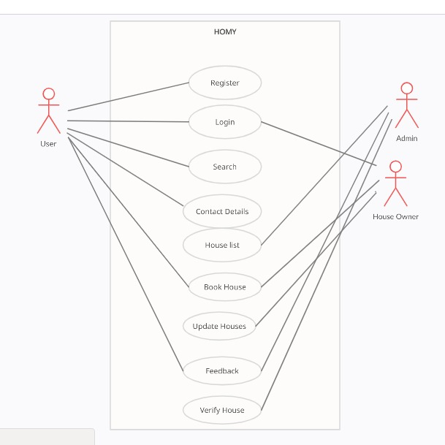
USE CASE DIAGRAM OF HOMY

Slide 12
Conclusion
The main motto of “Online Housing Rental System(HOMY)” is to let the users can get the services that are needed for a common person who is in need for a rental house.
When the user login to the system, it provides all the information needed to the customer to rent a house in his location.

Slide 13
Future Enhancement
Some of the future enhancements that can be done to “Known Hospital” are:
Based on the future security issues, security can be improved using emerging technologies.
Online payment module and Google Maps can be added.

Slide 14
References
[1]
https://pdfcoffee.com/house-rental-management-system-report-pdf-free.html
[2]
https://www.javatpoint.com/creating-mysql-database-with-xampp
[3]
https://developer.mozilla.org/en-US/docs/Web/HTML

Slide 15
THANK YOU

