Slide 1

Under the supervision of: Miss.M. Soumya(Asst.prof), Department of CSE.
KNOWN HOSPITAL
TEAM MEMBERS:
M. Pranay Kumar Reddy (O160164)
M. Sreelatha (O161315)
B. Jeenath (O161615)
G. Elumalai (O162089)
M. Jitendar (O161050)

Slide 2
Contents
Abstract
Existing System
Proposed System
Software Requirements
Hardware Requirements
Usecase and Sequence diagrams
Sample Images
Conclusion
Future Enhancement
References

Slide 3
Abstract
Now a days the people from rural areas face the problem for selecting the hospital for their related health diseases and availability of doctors because of lack of communication between hospital and patient.
“ Known Hospital” will give solution for above problem by collecting the information from different hospitals in their locality and broadcast it to all the people everyday through a web application.
It helps to find best hospital, specialist doctor for medical emergencies.

Slide 4
Existing System
If a patient wants to consult a doctor, he can visit there till his chance called.
It is time consuming process and we don’t have proper updates of doctor availability.
Especially in rural areas there is no online appointment booking process.
In Existing systems, there are the details about single hospital.

Slide 5
Proposed System
In proposed system, it overcomes all the difficulties in the existed system.
We will provide all the hospital information within a region unlike a particular hospital as in existed one.
“Known Hospital” allows users to search for a hospital by using hospital name, region, disease name, doctor’s name.
Appointments will provide for emergency without any login credentials.

Slide 6
Software Requirements
Operating System : Windows 7 or Windows 10 or Ubuntu
Frontend : HTML and CSS
Backend : PHP and Javascript
Local Server : XAMPP
Database : MySQL

Slide 7
Hardware Requirements
Processor: Intel i5 Core
RAM: Minimum 2GB
Space on Hard Disk: 1 GB

Slide 8
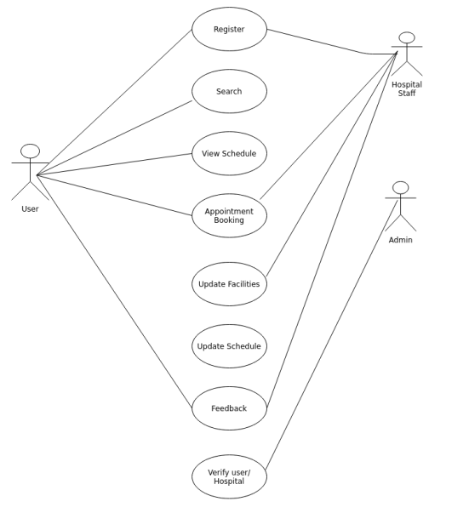
USE CASE DIAGRAM OF KNOWN HOSPITAL

Slide 9
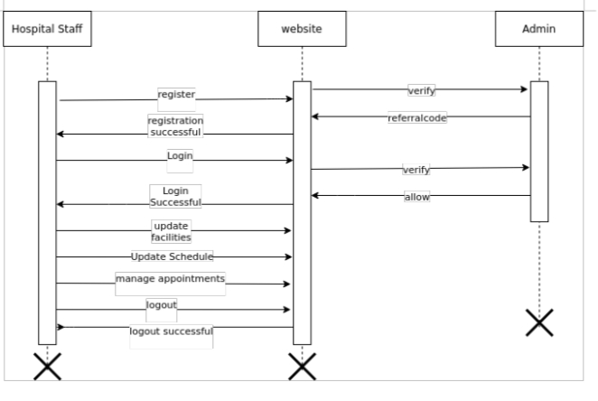
SEQUENCE DIAGRAM OF KNOWN HOSPITAL

Slide 10

HOME PAGE OF KNOWN HOSPITAL

Slide 11
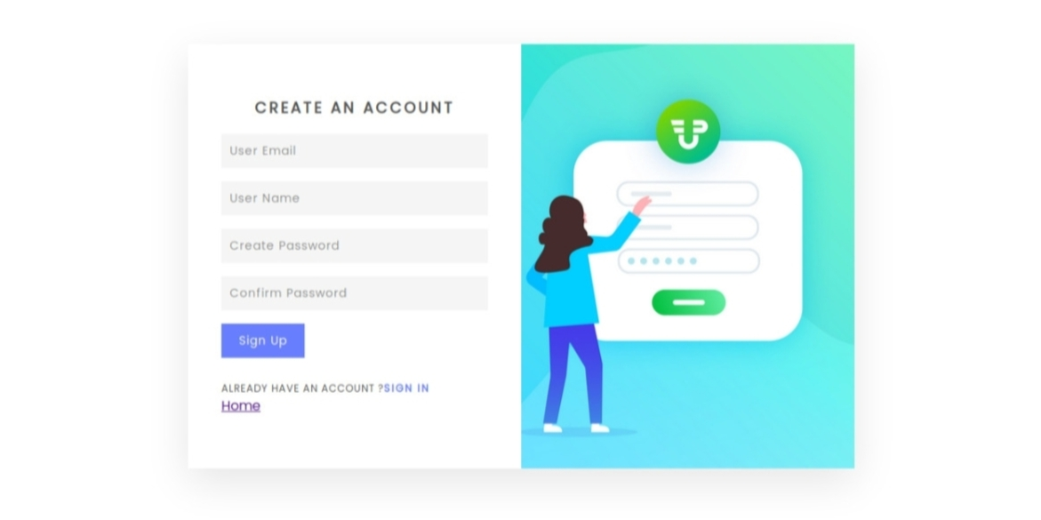
USER SIGNUP PAGE OF KNOWN HOSPITAL

Slide 12
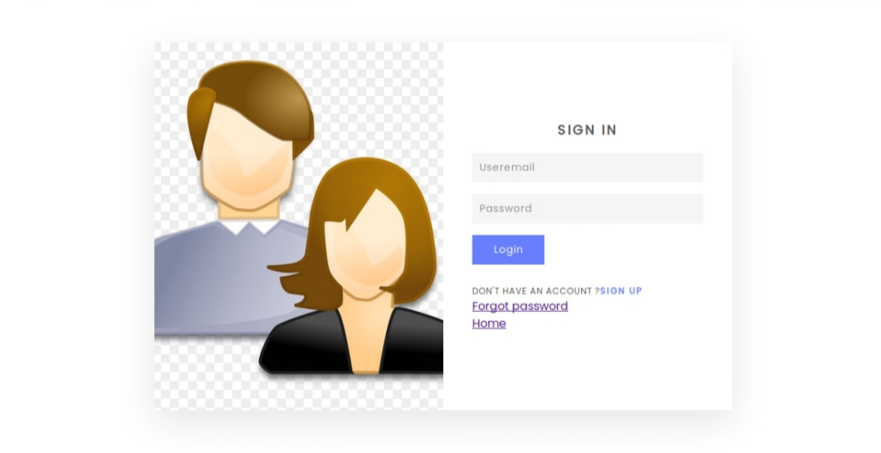
USER LOGIN PAGE OF KNOWN HOSPITAL

Slide 13
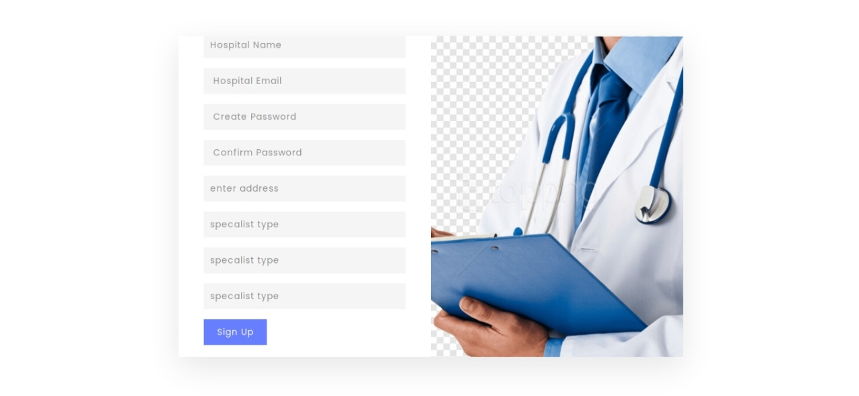
HOSPITAL SIGNUP PAGE OF KNOWN HOSPITAL

Slide 14
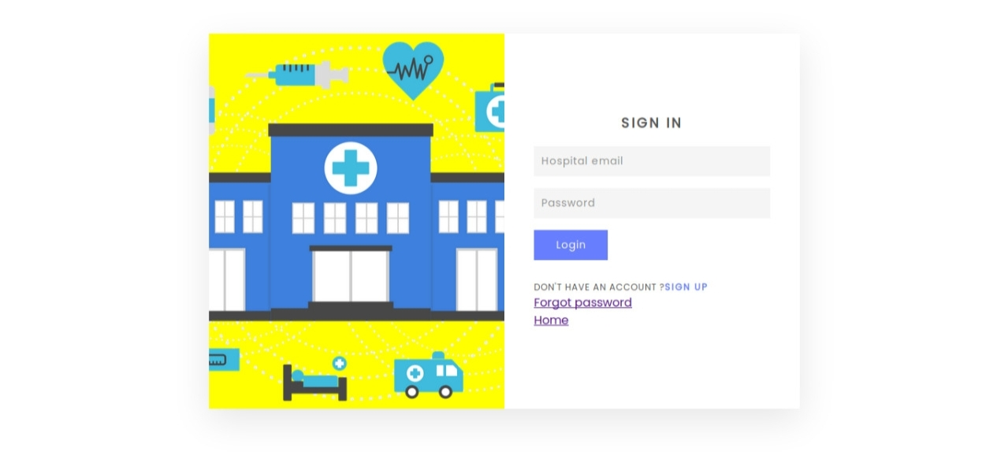
HOSPITAL LOGIN PAGE OF KNOWN HOSPITAL

Slide 15
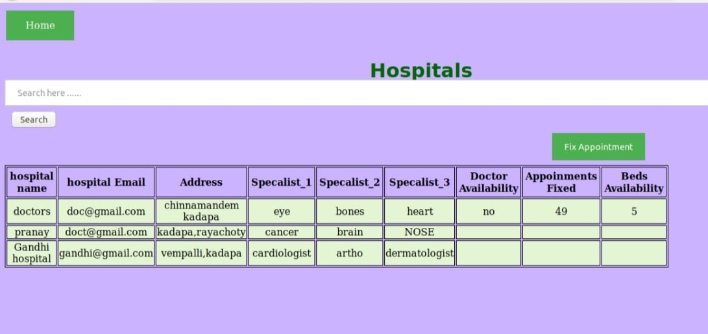
HOSPITALS LIST PAGE OF KNOWN HOSPITAL

Slide 16
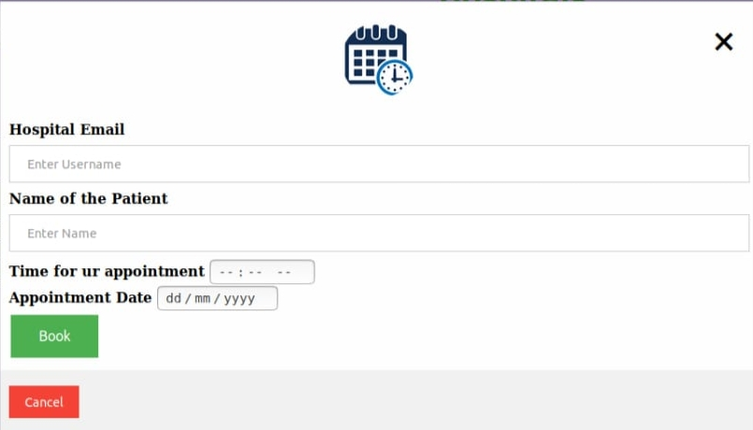
EMERGENCY APPOINTMENT BOOKING PAGE OF KNOWN HOSPITAL

Slide 17
Conclusion
The main motto of “Known Hospital” is to let the users can get the information about the hospital and availability of doctors without stepping out.
The users can appoint their OP using “Known Hospital”.
Another best feature in “Known Hospital” is that the users can even book their appointment in emergency cases without any login/signup credentials.

Slide 18
Future Enhancement
Some of the future enhancements that can be done to “Known Hospital” are:
Based on the future security issues, security can be improved using emerging technologies.
Online payment module and Google Maps can be added.

Slide 19
References
[1] https://www.academia.edu/36406675/Hospital_Management_System_Project_report
[2]
https://www.javatpoint.com/creating-mysql-database-with-xampp
[3]
https://developer.mozilla.org/en-US/docs/Web/HTML

Slide 20
THANK YOU

