Slide 1
TITLE
“ KNOWN HOSPITAL “

Slide 2

KNOWN HOSPITAL
Presented by:
M. Pranay kumar reddy (O160164)
M. Sreelatha (O16131
B. Jeenath (O161615)
G. Elumalai (O162089)
M. Jitendar (O161050)
Under the supervision of:
Miss. M. Soumya (Asst.Prof), Department of CSE.

Slide 3
ABSTRACT
Now a days the people from rural areas face the problem for selecting the hospital for their related health diseases and availability of doctors because of lack of communication between hospital and patient.
“Known Hospital” will give solution for above problem by collecting the information from different hospitals in their locality and broadcast it to all the people everyday through a web application, which helps to find best hospital, specialist doctor for medical emergencies.

Slide 4
EXISTING SYSTEM
If a patient wants to consult a doctor, he can visit there till his chance called. It is time consuming process.
And we don’t have proper updates of doctor availability. Especially in rural areas there is no online appointment booking process.
There are the details about a single hopsital. In the Existing system there is no information about doctors availability. It allows users to search using the Hospital name only.

Slide 5
PROPOSED SYSTEM
In proposed system, it overcomes all the difficulties in the existed system. We will provide all the hospital information within a region unlike a particular hopsital as in existed one.
“Known Hospital” allows users to search for a hospital by using hospital name, region, disease name, doctor’s name. Appointments will provide for emergency without any login credentials.

Slide 6
SOFTWARE REQUIREMENTS
Operating System: Windows7, Windows10, Ubuntu.
Frontend: HTML and CSS
Backend: PHP and JAVASCRIPT
Local server: XAMPP
Database: Mysql

Slide 7
FRONTEND
Hypertext Markup Language(HTML): ”Hypertext” refers to hyperink and “Markup language” refers to the way that tags are used to define layout and elements of the page.
Cascading Style Sheet(CSS): CSS is used to define text styles, table sizes and other aspects of webpages that previously could only be defined in HTML pages.

Slide 8
BACKEND
PHP: PHP is a HTML embedded language. When a PHP page is accessed, the PHP code is read or "parsed" by the server the page resides on. The output from the PHP functions on the page are typically returned as HTML code, which can be read by the browser.
JAVASCRIPT: JavaScript is a programming language, which is influenced by Java, the syntax is more similar to C and is based on ECMAScript, a scripting language developed by Sun Microsystems.

Slide 9
LOCAL SERVER(XAMPP)
XAMPP:
  It is an open-source package of web solutions that includes Apache distribution for many servers and command-line executables along with modules such as Apache server, MariaDB PHP, and Perl.

Slide 10
DATABASE(MYSQL)
MYSQL:
  It is based on the structure query language (SQL), which is used for adding, removing, and modifying information in the database. Standard SQL commands, such as ADD, DROP, INSERT, and UPDATE can be used with MySQL.

Slide 11
HARDWARE REQUIREMENTS
Processor: Intel i5 Core
RAM: Minimum 2GB
Storage space : 580 MB

Slide 12
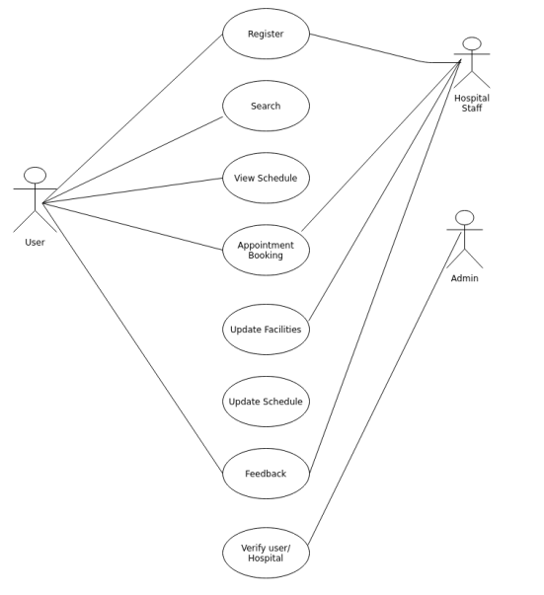
USE CASE DIAGRAM OF KNOWN HOSPITAL

Slide 13
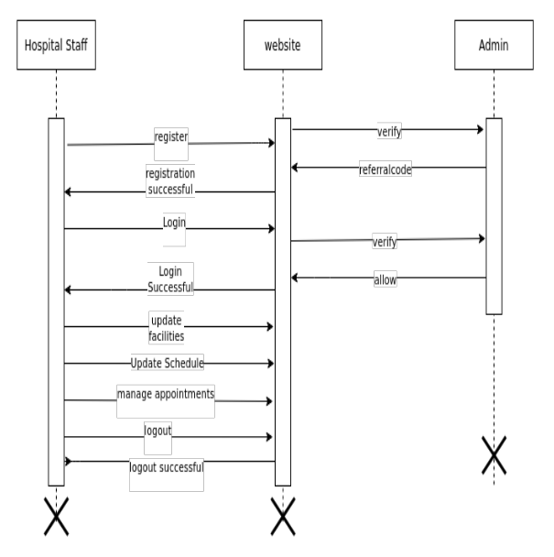
SEQUENCE DIAGRAM OF KNOWN HOSPITAL

Slide 14
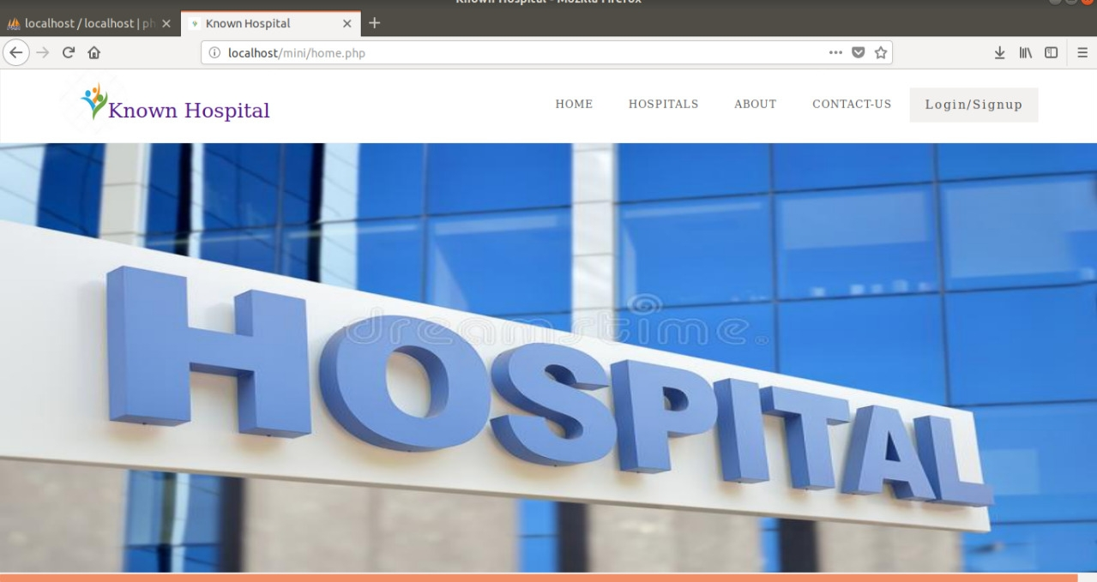
HOME PAGE OF KNOWN HOSPITAL

Slide 15
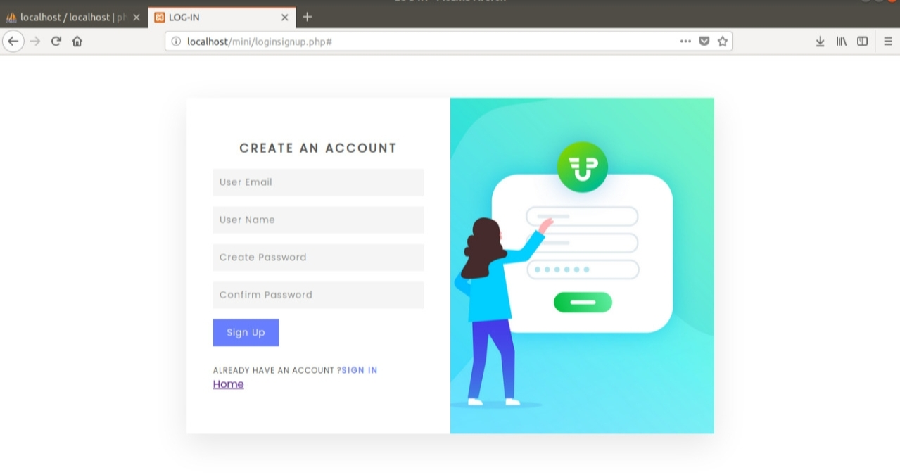
USER SIGNUP PAGE

Slide 16
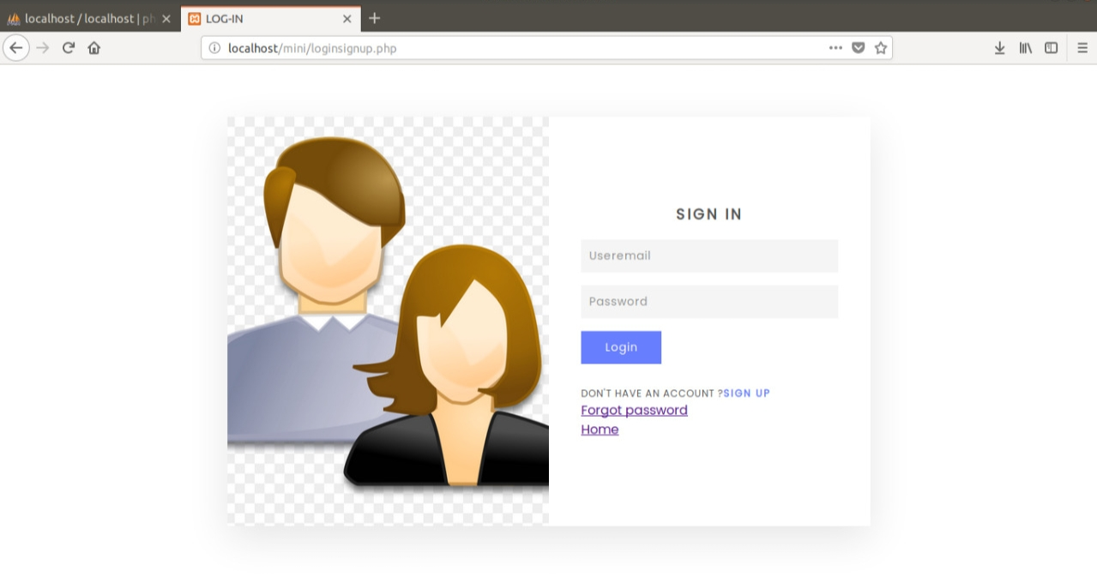
USER LOGIN PAGE

Slide 17
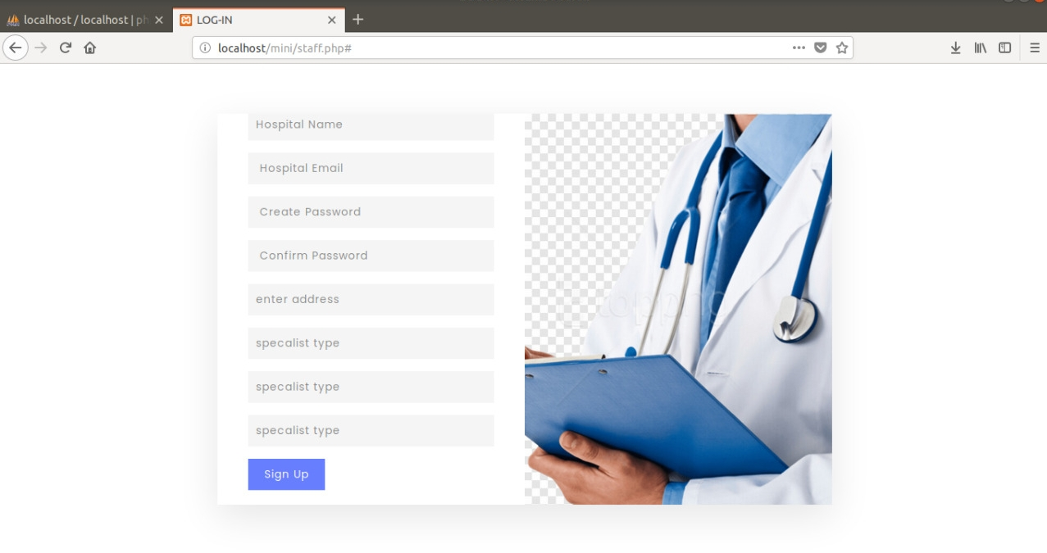
SIGNUP PAGE FOR KNOWN HOSPITAL

Slide 18
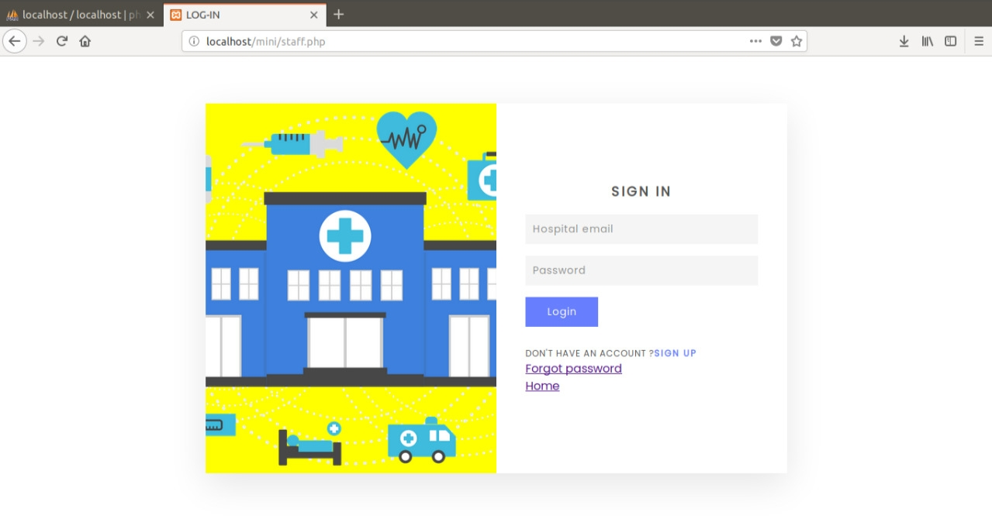
HOSPITALS LOGIN PAGE

Slide 19
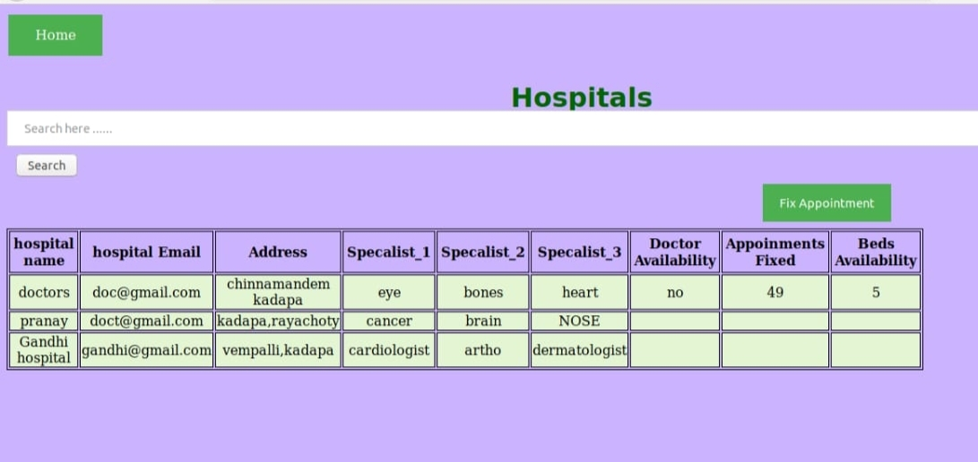
HOSPITAL LIST PAGE

Slide 20
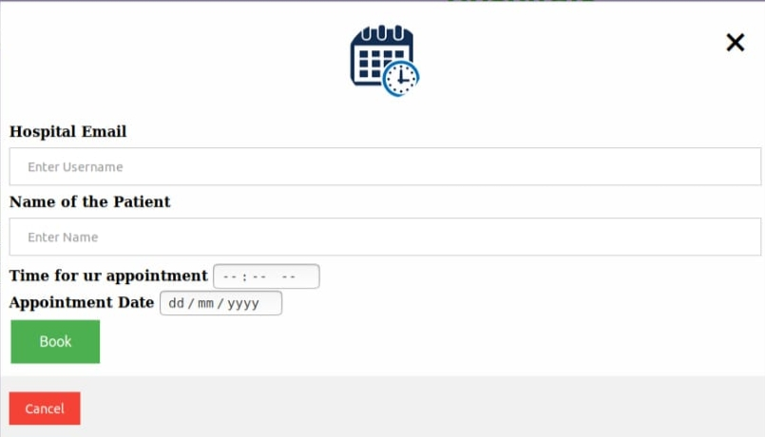
EMERGENCE APPOINTMENT BOOKING PAGE

Slide 21
FUTURE ENCHANCEMENT
Some of the future enhancements that can be done to “Known Hospital” are:
Based on the future security issues, security can be improved using emerging technologies.
Online payment module can be added.
Google maps will be included.

Slide 22
CONCLUSION
The main motivation of this app is to let the users know all the details of a particular hospital and availability of doctors before they are going to visit the hospital that they prefer related to their treatment/disease.
The Users can appoint their OP using “Known Hospital” so they do not need to invest their time near hopsitals of hours and hours. So that they do not waste their time near hopsitals for doctors for thier treatment.

Slide 23
REFERENCES
[1] https://www.academia.edu/36406675/Hospital_Management_System_Project_report.
[2]
https://www.google.com/search?q=html+and+php+database+connections&rlz=1C1SQJL_enIN820IN820&oq=html+and+php+database+connections&aqs=chrome..69i57j33i22i29i30l3.21978j1j7&sourceid=chrome&ie=UTF-8

Slide 24
THANK YOU

