Slide 1
GROUP MEMBERS
M. PRANAY KUMAR REDDY(O161064)
M. SREELATHA(O161315)
B. JEENATH(O161615)
G. ELUMALAI(O162089)
M. JITENDAR(O161050)
                Under the Supervision of
                Ms. M. SOUMYA

Slide 2


Slide 3
TITLE
“ KNOWN HOSPITAL ”

Slide 4
ABSTRACT
Now a days the people from rural areas face the problem for selecting the hospital for their related health diseases,availability of doctors because of lack of communication between hospital and patient. “Known Hospital” will give solution for above problem by collecting the information from different hospitals in their locality and broadcast it to all the people everyday through a web application, which helps to find best hospital, specialist doctor for medical emergencies.

Slide 5
EXISTING SYSTEM
If a patient wants to consult a doctor, he can visit there till his chance called. It is time consuming process. And we don’t have proper updates of doctor availability. Especially in rural areas there is no online appointment booking process. There are the details about a single hopsital. In the Existing system there is no information about doctors availability. It allows users to search using the Hospital name only.

Slide 6
PROPOSED SYSTEM
In proposed system, it overcomes all the difficulties in the existed system. We will provide all the hospital information within a region unlike a particular hopsital as in existed one. “Known Hospital” allows users to search for a hospital by using hospital name, region, disease name, doctor’s name.Appointments will provide for emergency without any login credentials.

Slide 7
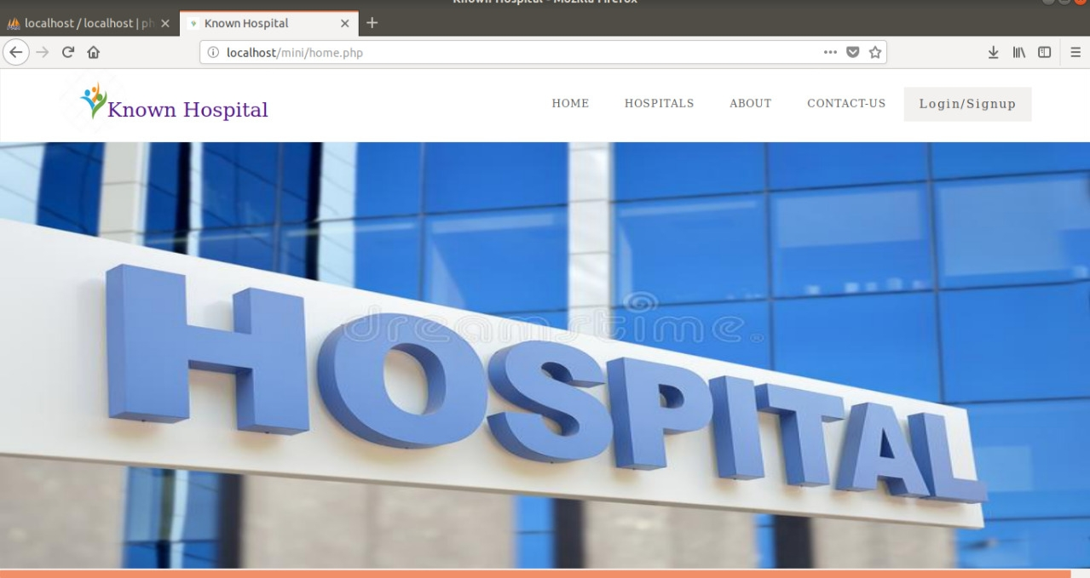
HOME PAGE OF KNOWN HOSPITAL

Slide 8
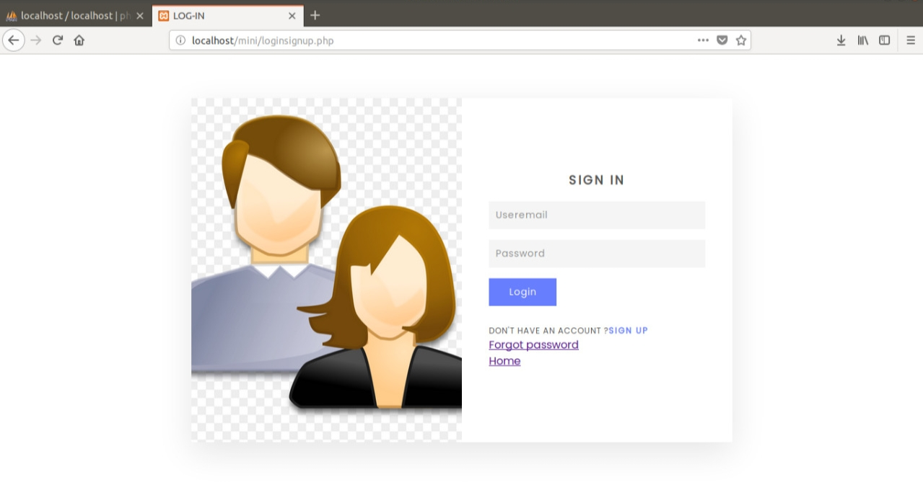
USER LOGIN PAGE

Slide 9
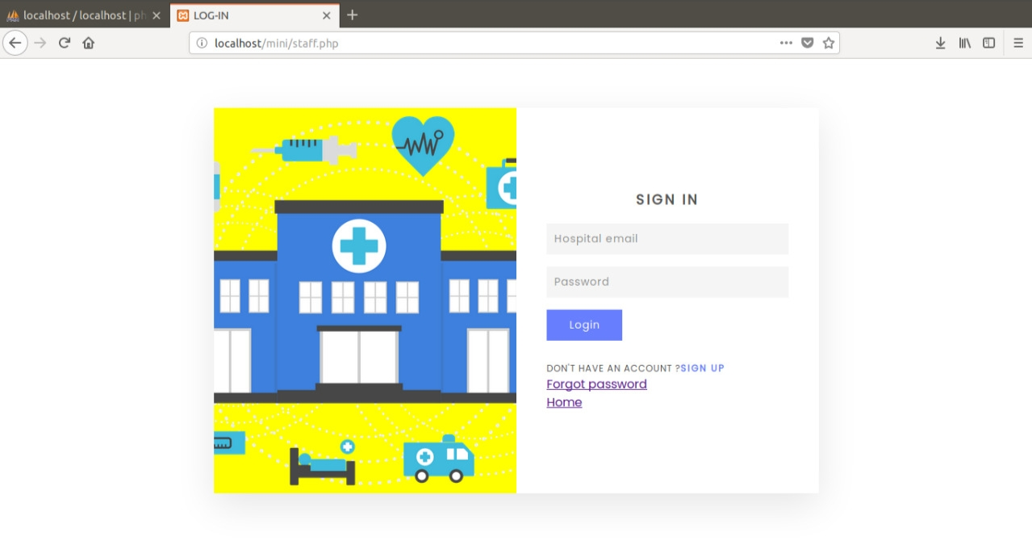
HOSPITALS LOGIN PAGE

Slide 10
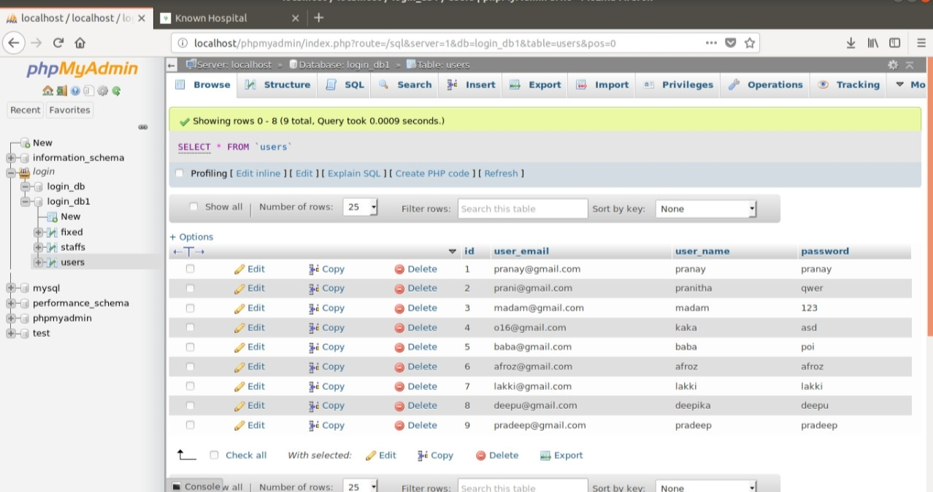
USER DATABASE

Slide 11
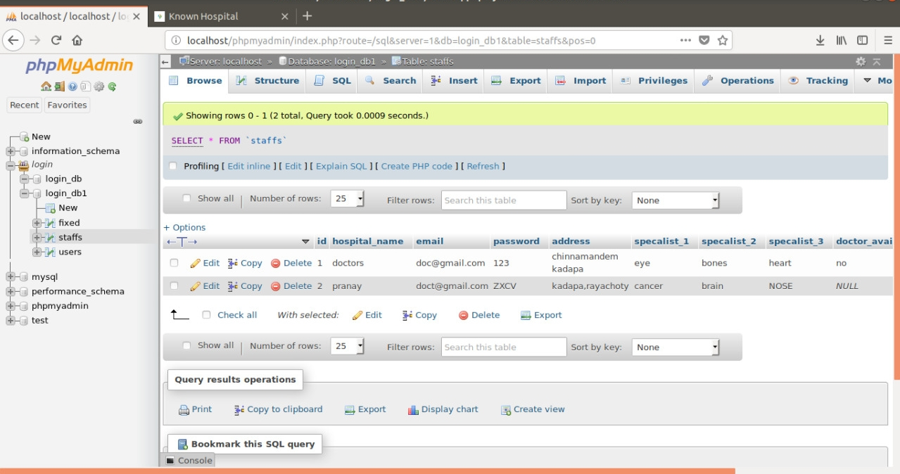
HOSPITALS DATABASE

Slide 12
CONCLUSION
The main motivation of this app is to let the users know all the details of a particular hospital before they are going to visit the hospital that they prefer related to their treatment/disease. Users are known about the hospital details, availability of doctors. The Users can appoint their OP using a website so they do not need to invest their time near hopsitals of hours and hours. They get to know the doctors availability who are specialists in a particular course of treatement. So that they do not waste their time near hopsitals for doctors for thier treatment.

Slide 13
THANK YOU

