Slide 1

Under the supervision of : Miss.N.Madhavi Latha Assistant Professor, Department of CSE, RGUKT-ONGOLE.
PLAYSORTS
TEAM MEMBERS:
M. Pranay Kumar Reddy (O160164)
M. Sreelatha (O161315)
B. Jeenath (O161615)
G. Elumalai (O162089)
M. Jitendar (O161050)

Slide 2
Contents
Abstract
Problem Statement
Existing System
Proposed System
Advantages and Disadvantages
Software Requirements
Hardware Requirements
Data Flow and Use Case Diagrams
Sample Images
Conclusion
Future Enhancement
References

Slide 3
Abstract
If we have to learn the sorting algorithms, we need to refer the books related to that and it is like rote learning and it reminds for a short time only.
Playsorts is a website that illustrates the internal working theorem of different sorting algorithms in a visualization mode.
Playsorts helps students from any stream to easily understand the working process of sorting so that it enhances learning the subject and to master it by having a picturization proposal.

Slide 4
Problem Statement
It is hard for anyone to learn the sorting algorithms by byharding or rote learning.
It is not such a good practice to learn the subject and to learn anything new by rote learning as it remains in the brains of students for such a short period of time.

Slide 5
Existing System
The sorting algorithms will be learned when taught by lecturers or by studying the book related to sorting algorithms.
The lecturers will discuss about the sorting algorithms on the board in oral manner.
Students need to clarify their doubts instantly.
By this method, we get the knowledge about sorting algorithms theoretically but not practically.

Slide 6
Proposed System
With the problems arising in the existing system, we implemented Playsorts, a visualization of sorting algorithms.
Playsorts is a web application that can be accessible for anyone who wants to learn sorting algorithms in a visualization mode while having fun.
Playsorts has different user interfaces that are needed to work with algorithms like list size, delay speed and we will be able to find the time and space complexities in their worst, average and best cases also.

Slide 7
Advantages of Playsorts
Students can remember it for long time and learns the subject.
Anyone can easily understand the platform.
Playsorts is portable.
Playsorts is user-friendly.
Playsorts contains graphical representation to understand easily.

Slide 8
Disadvantages of Playsorts
Playsorts has limited algorithms.
The user input array is not possible.

Slide 9
Software Requirements
Operating System : Linux or Windows version7 or above
Frontend : HTML and CSS
Backend : JavaScript
Software : Visual Studio

Slide 10
Hardware Requirements
Processor: Intel i3 or above versions
RAM: Minimum 2GB
Space on Hard Disk: Minimum 5GB

Slide 11
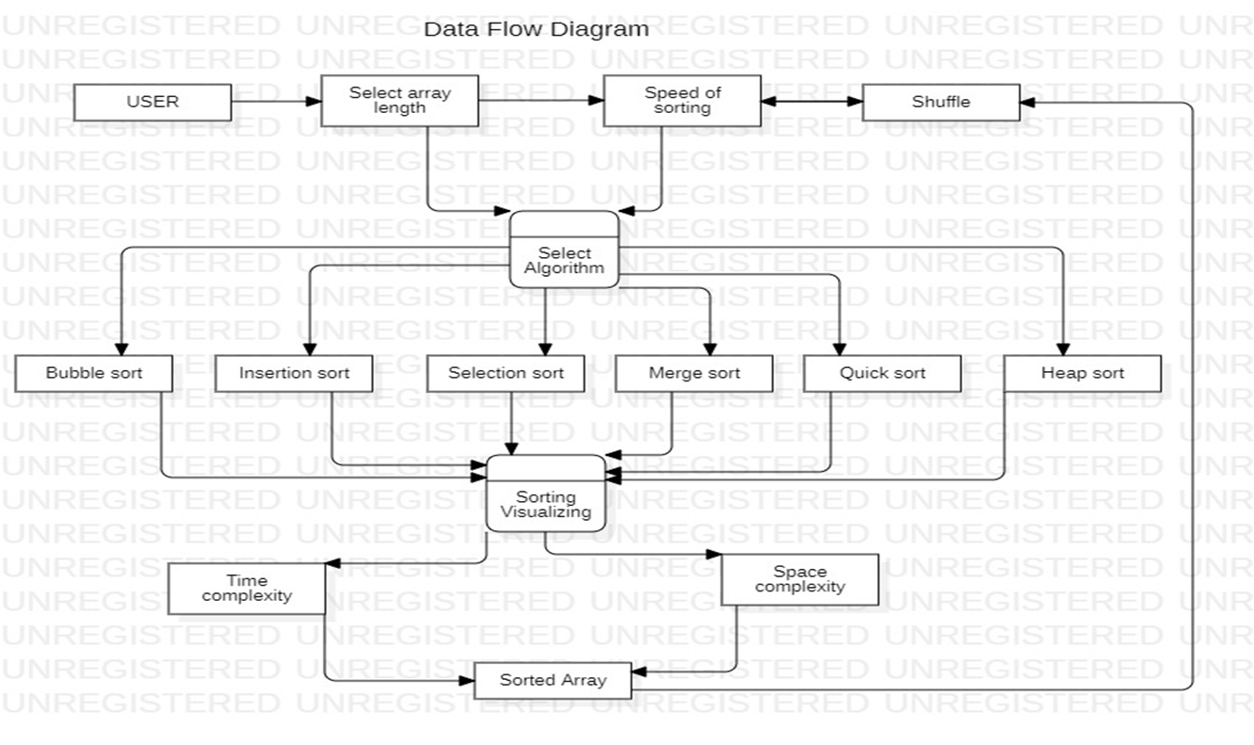
Data Flow Diagram of Playsorts

Slide 12
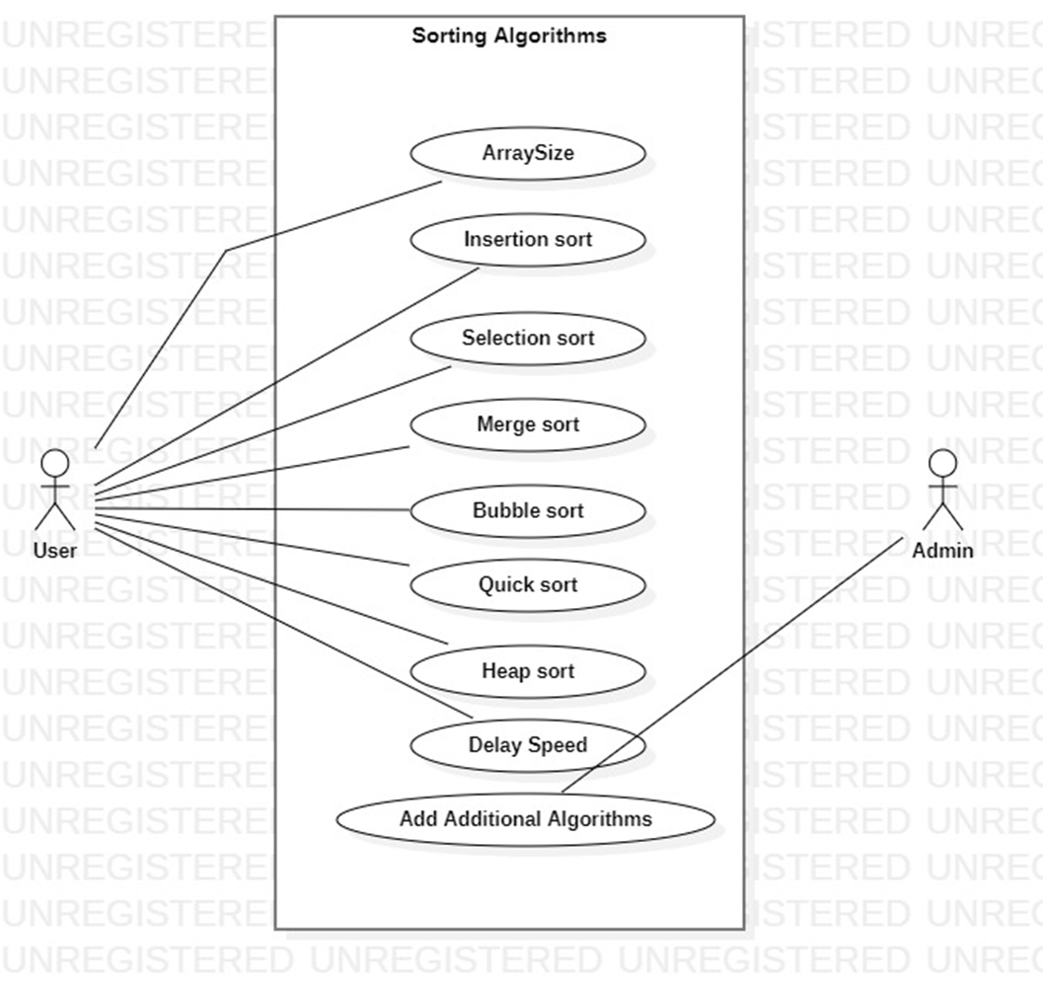
Usecase Diagram of Playsorts

Slide 13
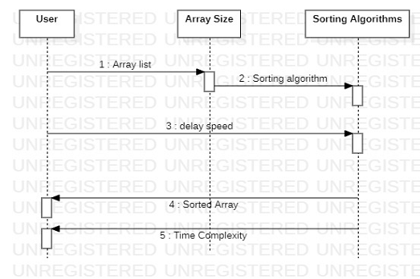
Sequence Diagram of Playsorts

Slide 14
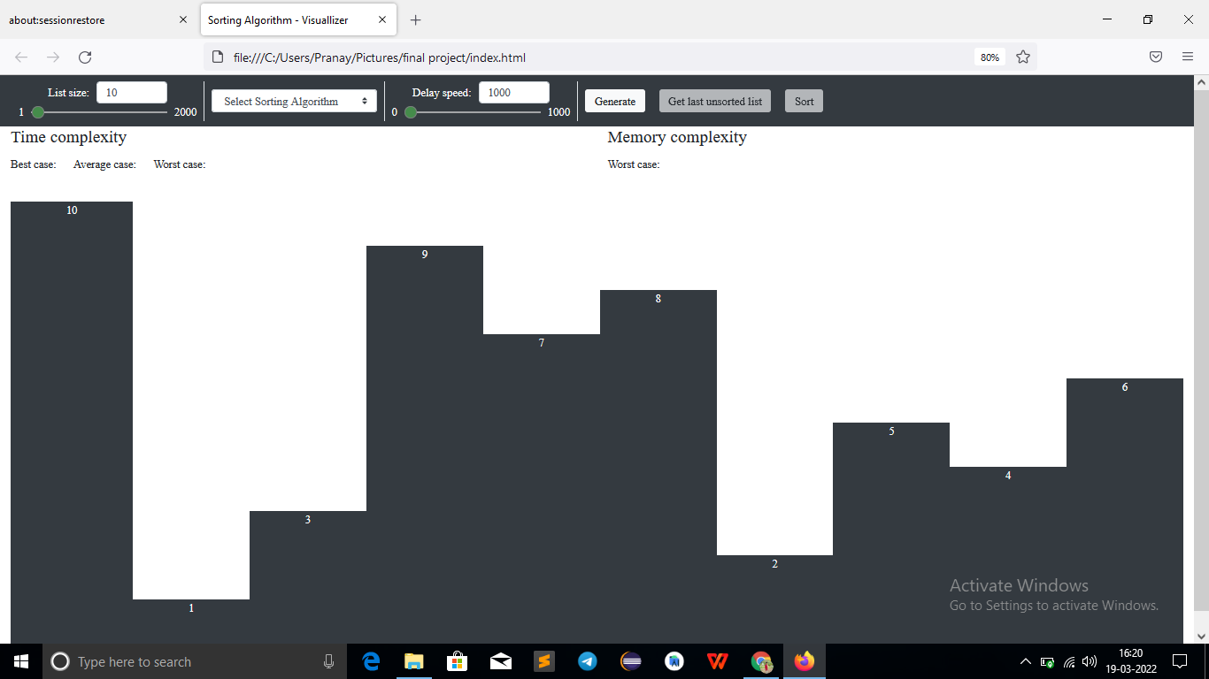
Home page of Playsorts

Slide 15
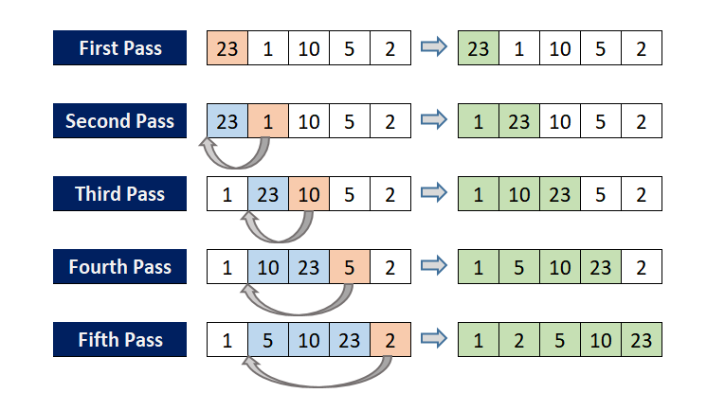
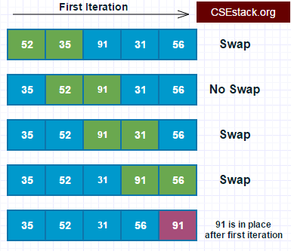
Bubble Sort Insertion Sort

Slide 16
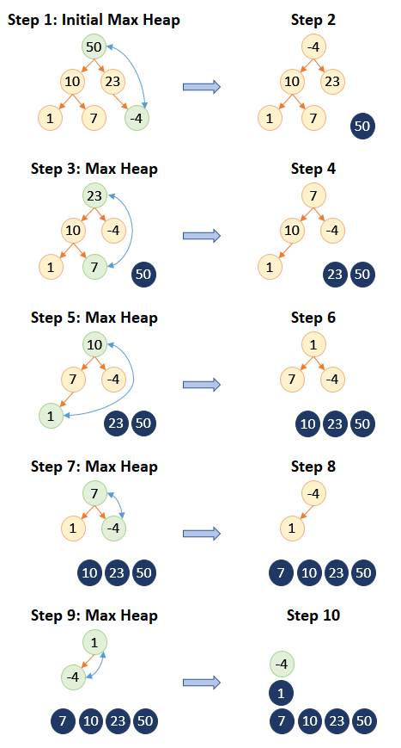
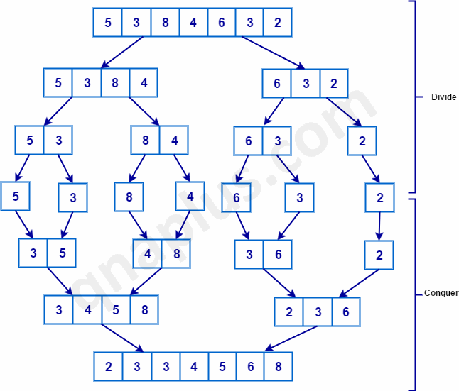
Heap Sort Merge Sort

Slide 17
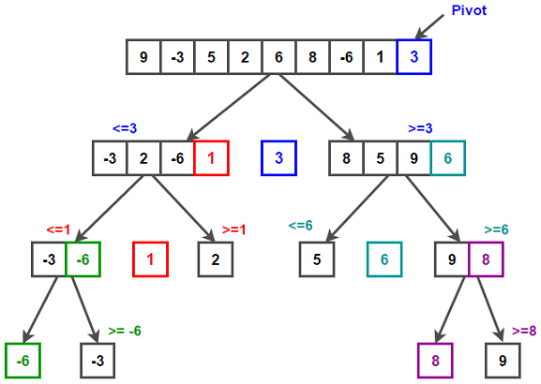
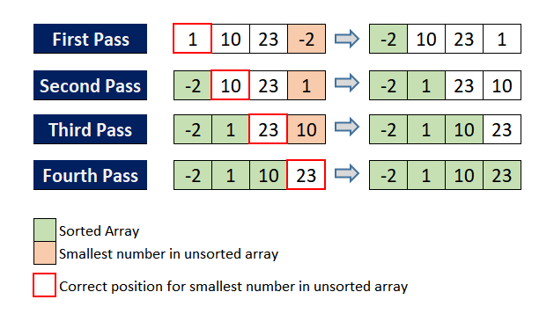
Quick Sort Selection Sort

Slide 18
Conclusion
Playsorts helps everyone to understand the sorting algorithm’s functionality and its working principle in an easy way so that students can focus on enhancing their learning type and learn the subject rather than byhearting the logic of sorting algorithms for grades or something.

Slide 19
Future Enhancement
Some of the future enhancements that can be done to “Playsorts” are:
We can also add the description for every sorting algorithms briefly.
We can add Data Structures, Searching algorithms and many more to understand their implementation and working principles.

Slide 20
References
[1]
https://www.csestack.org/different-types-sorting-algorithms
[2]
https://www.tutorialspoint.com/javascript/javascript_overview.htm
[3]
https://developer.mozilla.org/en-US/docs/Web/HTML

Slide 21
THANK YOU

