Slide 1

HIDING AND RETREIVING DATA IN IMAGES
DEPARTMENT OF COMPUTER SCIENCE AND ENGINEERING
UNDER THE GUIDANCE OF
Ms. N. Madhavi Latha,
Assistant Professor,
Department of CSE,
RGUKT-ONGOLE.
PRESENTED BY
M. Pranay Kumar Reddy (O161064),
M. Sreelatha (O161315),
B. Jeenath (O161615),
G. Elumalai (O162089)
M. Jitendar (O161050)

Slide 2
CONTENTS
ABSTRACT
PROBLEM STATEMENT
INTRODUCTION
SOFTWARE TOOLS
HISTORY OF IMAGE
PROPOSED SYSTEM
APPLICATIONS
ADVANTAGES
DISADVANTAGES
FUTURE SCOPE
CONCLUSION

Slide 3
ABSTRACT
Data hiding is the art of hiding data for various purposes such as; to maintain private data, secure confidential data and so on.
In this project we propose a LSB(Least Significant Bit) steganographic method for hiding the data by applying Least Significant Bit (LSB) algorithm for embedding the data into the images which is implemented through PYTHON and its modules.
Keywords: Least Significant Bit, Steganography.

Slide 4
PROBLEM STATEMENT
How can we send a message secretly to the destination with securely?
In this study, we proposed a new framework of an image steganography system to hide a digital text of secret message.

Slide 5
INTRODUCTION
The growing use of internet needs to take attention while we send & receive personal information in a secured manner.
In encryption, existence of data is not hidden.
By giving enough time, unreadable encrypted data may be converted in to its original form.
A solution to this problem can be achieved by “steganography” technique.

Slide 6
SOFTWARE TOOLS
Python is a high-level programming language often used to build websites and software, automate tasks, and conduct data analysis.
PIL(Python Imaging Library) is a free and open-source additional library for python programming language that supports opening, manipulating and saving different image file formats

Slide 7
HISTORY OF IMAGE
A pixel is the smallest item of information in an image. They are arranged in a 2-D grid, represented using squares.
A digital color image pixel is just numbers representing a RGB data value.
Each 8-bit RGB component can have 256 possible values, ranging from 0 to 255.
Varying in LSB values, results undetectable to human eye whereas opposite with MSB.

Slide 8

PROPOSED SYSTEM
This proposed system provides the user with two options encrypt and decrypt.
In encryption, we provide secret info and that secret information will be hide in image file.
Decryption is getting the hidden information from the image file.

Slide 9
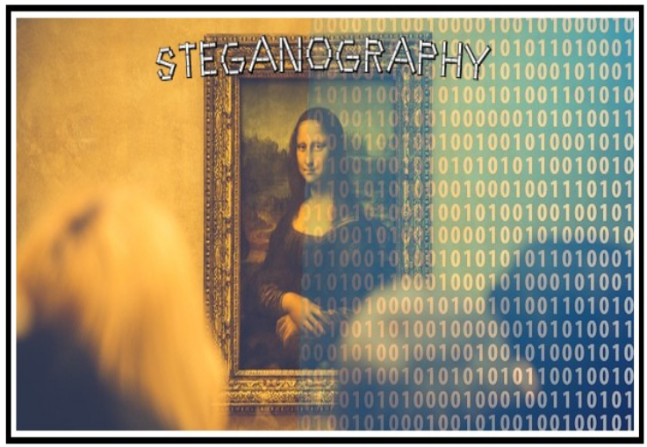

Slide 10
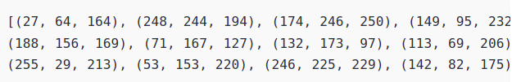
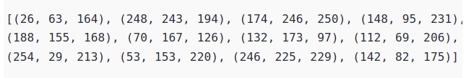
ENCODING
For example : Suppose the message to be hidden is ‘ Hii ‘.
H-72-01001000 and i-105-01101001
change the pixel to odd for 1 and even for 0

Slide 11
27=0001 1011
The LSB Bit i.e., 1 is replaced by the first bit[0] in
H-72-01001000
Then the value becomes 0001 1010 which is equal to 26.
64=0100 0000
The LSB Bit i.e., 0 is replaced by the second bit[1] in
H-72-01001000
Then the values become 0100 0001 which is equal to 63.
164=1010 0100
The LSB Bit i.e., 0 is replaced by the third bit[0] in
H-72-01001000
Then the values become 1010 0100 which is equal to 164 itself.

Slide 12
In this way, the original pixel (27,64,164) changes to (26,63,164).
The same process is done to all the pixels.
In this way the image is encoded and the text is embedded into the image.
And the text or message which we are going to transfer gets hidden into
the Image.

Slide 13
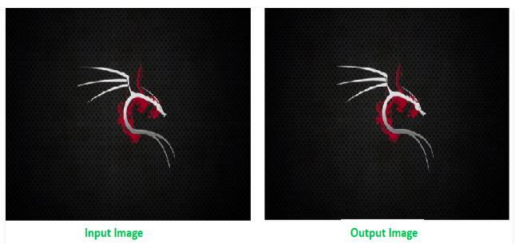
DECODING
To decode, Every 3-pixels contain a binary data, which can be extracted by the same encoding logic.
If the value if odd the binary bit is 1 else 0.

Slide 14
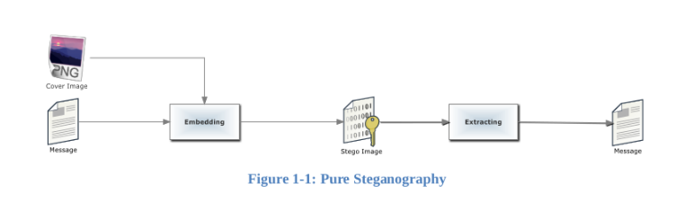
WORK FLOW

Slide 15
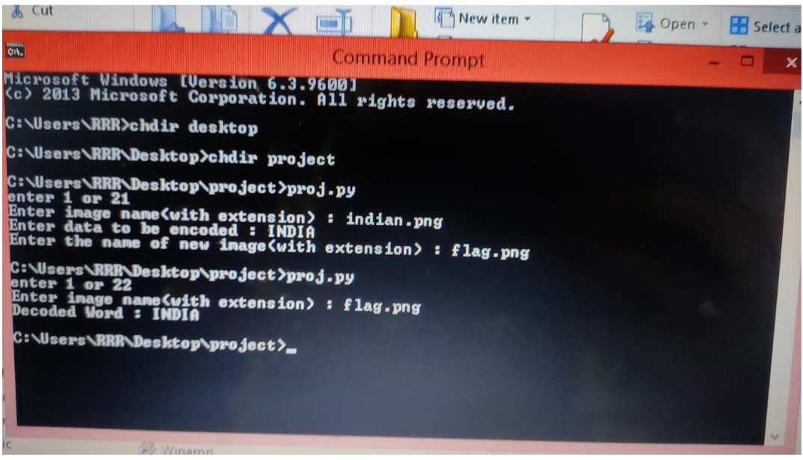
Execution in Command Prompt

Slide 16
APPLICATIONS
Confidential communication and secret data storing. ...
Protection of data alteration. ...
Access control system for digital contents distribution. ...
Media Database systems.

Slide 17
ADVANTAGES
It is used in the way of hiding not the information but the password to reach that information.
Difficult to detect. Only receiver can detect.
Can be applied differently in digital image, audio and video file.

Slide 18
DISADVANTAGES
Huge number of data, huge file size, so there is a possibility of suspection
If this technique is gone into wrong hands like hackers, terrorists, criminals then this can be extremely dangerous for all.

Slide 19
CONCLUSION
In this present world, the data transfers using internet is rapidly growing because it is easier and faster.
This gave an introduction about steganography and the meaning of hiding
data; also, the problem research and the importance of Steganography in transmit the data over the network, for that reason in this we propose a system to hiding and
retreiving the data in images.

Slide 20
FUTURE SCOPE
The future work on this project is to improve the compression ratio of the image to text.
This project can be extended to a level such that it can be used for different types of image formats like .JPEG, .bmp, .tif etc,
The security using LSB algorithm is good, but we can improve the level to a certain extent by varying carriers, As well as using different keys for encryption and decryption.

Slide 21
THANK YOU

