Slide 1
BILLPULSE PRO
Standardized POS Billing & Platform Admin Suite
Statement of Work (SOW), UI Visual Blueprint, Postpaid Razorpay Engine & 22-Day Build Plan
2 Applications Only
• 1 Offline-First Desktop POS
• 1 Web Admin Control Center
• Zero Accounting Vouchers
100% Postpaid Revenue
• Rs. 20 / month base fee
• Rs. 0.50 or Rs. 1.00 per order
• Razorpay UPI month-end
Fast Delivery
• Clickable Skeleton: Ready Now
• Full Build: 22 Working Days
• Team: 2 Dedicated Developers

Slide 2
BILLPULSE PRO SOW
Two-Application System Architecture
Built to run on 2 GB RAM Windows PCs offline while giving you centralized web control.
Application 1: Merchant Desktop App (5 Screens)
• Tech: Tauri 2.0 (~8 MB installer, <50 MB RAM) + React + Tailwind
• Local DB: Encrypted SQLite WAL Mode (<3 ms local write latency)
• Screen 1: Hardware-Bound License Activation (Serial + Key)
• Screen 2: Shop Configuration & Business Type Presets
• Screen 3: Visual Product Catalog Manager (F6 Quick Pills)
• Screen 4: Split-Screen Express POS & Live Thermal/A4 Receipt (F4)
• Screen 5: Month-End Razorpay Settlement & 7th-to-11th Guard
• 100% Offline-First: Keeps billing even when Wi-Fi is down for days
Application 2: Web Admin Panel (6 Screens)
• Tech: React 19 + Vite + Fastify API + PostgreSQL 16 (Supabase)
• Screen 1: Global Dashboard (Merchants, Orders, Revenue, Unpaid)
• Screen 2: Merchant Registry (Search, Filter, Grant / Suspend / Revoke)
• Screen 3: Per-Merchant Order Logs & Dues Breakdown Drill-Down
• Screen 4: Revenue Reports & Verified Razorpay Webhook Ledger
• Screen 5: Day 7 Warning & Day 11 Block Enforcement Audit Logs
• Screen 6: 1-Click Serial Number & Activation Key Generator
• Direct Razorpay UPI Webhook Integration: Unlocks counters in <2 sec
BillPulse Pro — Statement of Work & Blueprint | 2-App Architecture | Slide 2 of 10

Slide 3
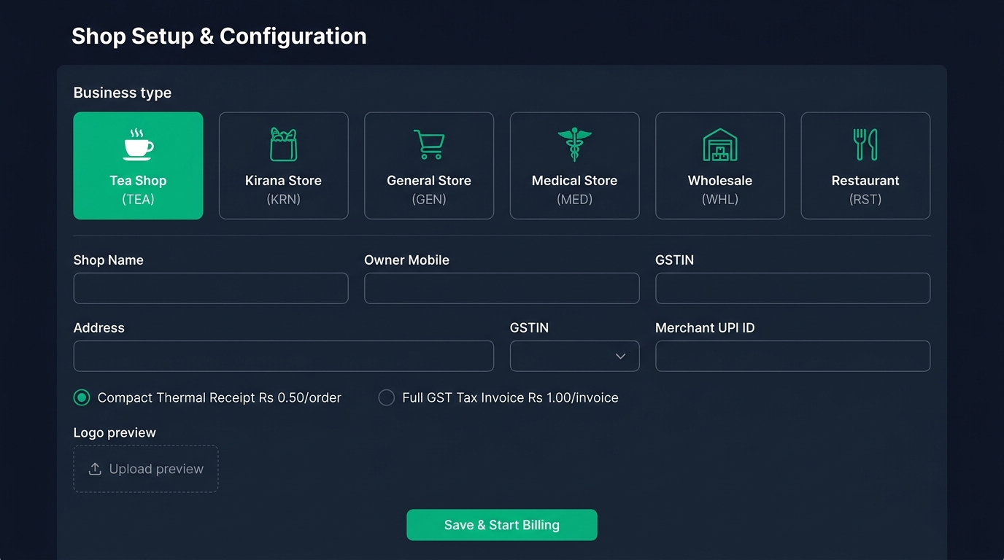
BILLPULSE PRO SOW
Desktop Screen 2: Business-Type Configuration
Tea Shops, Kiranas, and Wholesalers configure once and start billing immediately.
Zero-Jargon Setup Presets
• Tea Shop (TEA): Auto-loads Tea, Coffee, Samosa, Biscuit (5% GST, Rs. 0.50/bill)
• Kirana Store (KRN): Auto-loads Rice, Oil, Atta, Dal, Milk (5% GST, Rs. 0.50/bill)
• Wholesale (WHL): Bulk bags/tins, A4 GST Invoice (18% GST, Rs. 1.00/bill)
• Also included: General Store, Medical, Restaurant, Bakery, Stationery, Hardware
• Upload Shop Logo & Stamp (compressed automatically for offline printing)
• Customer UPI ID generates payment QR directly on every receipt
BillPulse Pro — Statement of Work & Blueprint | 2-App Architecture | Slide 3 of 10

Slide 4
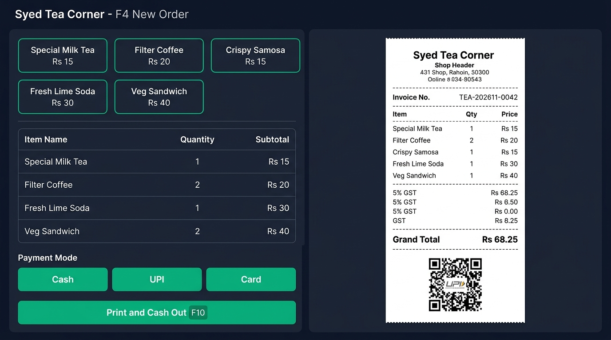
BILLPULSE PRO SOW
Desktop Screen 4: Express POS Billing (F4)
Keyboard-driven checkout with live 1:1 receipt preview and thermal printing.
Counter Speed & Reliability
• 1-Tap Quick Item Pills (F6) or fast keyboard search
• Keyboard Hotkeys: F4 New, F6 Catalog, F7 Setup, F10 Print & Cash Out
• Live 58mm/80mm Thermal & A4 GST Tax Invoice Preview
• Collision-Free Numbering: TEA-202611-0042
• Dynamic Customer UPI QR on every printed slip
• Accrues Rs. 0.50 or Rs. 1.00 locally without internet lag
BillPulse Pro — Statement of Work & Blueprint | 2-App Architecture | Slide 4 of 10

Slide 5
BILLPULSE PRO SOW
100% Postpaid Month-End Revenue Model
No prepaid wallet friction. Merchants pay only at month-end via Razorpay UPI.
Exact Monthly Billing Formula
• Total Month-End Dues = Rs. 20.00 (Fixed Base Fee) + (Total Orders Generated × Rs. 0.50 or Rs. 1.00)
• Example (Tea Shop with 412 orders): Rs. 20.00 + (412 × Rs. 0.50) = Rs. 226.00 settled once at month-end via Razorpay UPI QR
Tier 1: Compact Thermal
• Rate: Rs. 20/mo + Rs. 0.50/order
• Target: Tea Shops, Kiranas, Bakeries, Food Stalls
• Print Format: 58mm / 80mm USB Thermal
• Zero upfront wallet top-up required
Tier 2: Full GST Invoice
• Rate: Rs. 20/mo + Rs. 1.00/invoice
• Target: Wholesalers, Distributors, Hardware
• Print Format: A4 / A5 Laser GST Invoice
• Includes HSN table, Logo & Stamp
Scale Revenue Projection
• At 100 Shops (300 orders/mo avg):
• Base (Rs. 2,000) + Orders (Rs. 15,000) = Rs. 17,000/mo
• At 1,000 Shops (300 orders/mo avg):
• Base (Rs. 20,000) + Orders (Rs. 1.5L) = Rs. 1.70L/mo
BillPulse Pro — Statement of Work & Blueprint | 2-App Architecture | Slide 5 of 10

Slide 6
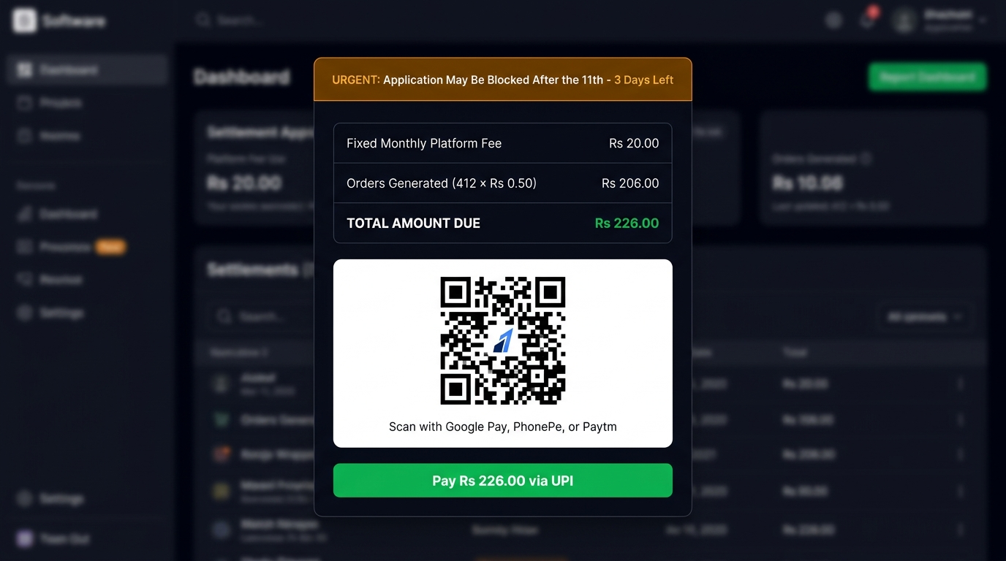
BILLPULSE PRO SOW
Desktop Screen 5: 7th-to-11th Grace & Block Policy
Automated warning notifications from Day 7 to 11, followed by hard block on Day 11.
Phase 1: Days 1 to 7 (Soft Reminder)
• Billing continues normally.
• Green banner reminds merchant of month-end dues.
Phase 2: Days 7 to 11 (Urgent Warning)
• Orange full-screen popup on every open:
• 'Your app may be blocked after the 11th! Pay now.'
Phase 3: Day 11+ (Hard Block + QR)
• New bill creation disabled.
• Razorpay UPI QR on lock screen; unlocks in 2s on pay.
BillPulse Pro — Statement of Work & Blueprint | 2-App Architecture | Slide 6 of 10

Slide 7
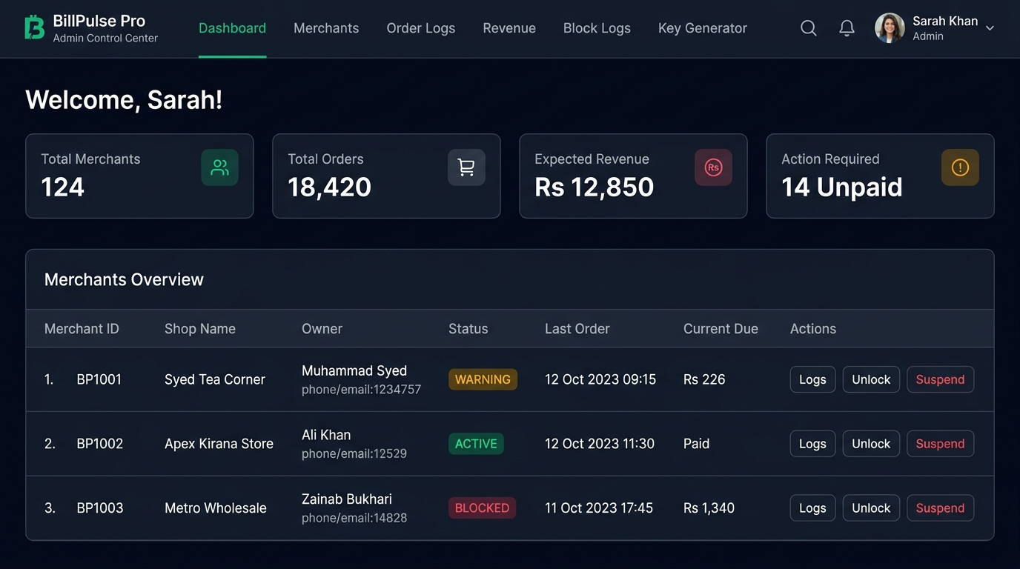
BILLPULSE PRO SOW
Web Admin Control Center (6 Screens)
Full visibility across every merchant, order log, unpaid due, and remote license control.
Admin Capabilities
• Global KPIs: Total Shops, Orders, Expected Revenue, Unpaid Count
• Filter Merchants: All / Paid / Warning / Blocked
• Remote License Control: 1-Click Grant, Unlock, Suspend, or Revoke
• Order Audit Logs: Inspect every bill synced by any shopkeeper
• 7th & 11th Block Logs: Track every warning and lock event
• Key Generator: Issue new Serial & Activation keys in 5 seconds
BillPulse Pro — Statement of Work & Blueprint | 2-App Architecture | Slide 7 of 10

Slide 8
BILLPULSE PRO SOW
SOW Scope Boundaries (In-Scope vs. Out-of-Scope)
Keeping v1.0 focused so 2 developers deliver in 22 working days.
Included in v1.0 Scope
• 5-Screen Desktop POS (Tauri 2.0 + Encrypted SQLite WAL)
• 10 Business-Type Configuration Presets (Tea Shop, Kirana, etc.)
• 58mm/80mm ESC/POS Thermal + A4 GST Laser Printing
• Monotonic Clock Anti-Tamper + Hardware Fingerprint Binding
• 7th-to-11th Warning & Day 11 Hard Block Engine
• Razorpay Dynamic UPI QR + Automated Webhook Unblocking
• 6-Screen Cloud Web Admin Control Center
• Fastify Sync API + PostgreSQL 16 (Supabase)
Explicitly Out of Scope (Deferred to v2.0)
• Complex double-entry accounting vouchers (Journal, Contra, Notes)
• Prepaid wallet top-up flows (Replaced by 100% postpaid model)
• Multi-godown inventory transfers & manufacturing BOMs
• Native iOS / Android mobile billing apps
• Bank reconciliation feeds & payroll management
• Multi-language regional UI translations (English UI for v1.0)
BillPulse Pro — Statement of Work & Blueprint | 2-App Architecture | Slide 8 of 10

Slide 9
BILLPULSE PRO SOW
Delivery Timeline: Skeleton vs. Production Build
Clickable skeleton is ready now for review; full production takes 22 working days.
Phase 0: Clickable Interactive Skeleton — READY TODAY (1–2 Days Effort)
• Standalone browser prototype (apps/skeleton/index.html) covering all 5 Desktop screens & 6 Admin screens with live business presets, cart math, and policy testers.
Sprints 1–2 (Days 1–8)
• Days 1–4: Tauri shell, SQLite WAL, Hardware ID, Activation & Shop Config UI
• Days 5–8: Guard Engine (7th/11th), YYYYMM Numbering, Catalog F6 & POS F4 UI
Sprints 3–4 (Days 9–16)
• Days 9–12: Fastify Sync API, Supabase DB, Thermal ESC/POS Print, Settlement UI
• Days 13–16: Razorpay UPI QR, Webhook Unlocker, Admin Dashboard & Merchants
Sprint 5 & QA (Days 17–22)
• Days 17–20: Admin Order Logs, Revenue Reports, Block Logs & Key Generator
• Days 21–22: 2 GB RAM Windows VM stress test, printer QA & signed .exe installer
BillPulse Pro — Statement of Work & Blueprint | 2-App Architecture | Slide 9 of 10

Slide 10
BILLPULSE PRO SOW
Acceptance Criteria & Next Steps
Clear milestones to verify quality before final production launch.
v1.0 Acceptance Criteria
• 50 consecutive bills created & printed offline on 2 GB RAM Windows PC
• Tea Shop vs Kirana configuration completed in under 60 seconds
• Guard warns on Days 7–11 and blocks creation strictly on Day 11+
• Razorpay UPI scan unlocks counter automatically within 5 seconds
• Admin Web Panel reflects synced orders and enforces Suspend/Unlock
Immediate Next Actions
• 1. Open & explore the live clickable Skeleton (apps/skeleton/index.html)
• 2. Review & approve this Statement of Work (docs/SOW.md)
• 3. Confirm Razorpay Business API keys & Supabase project setup
• 4. Kick off Sprint 1 with the 2-developer team (22-Day countdown)
BillPulse Pro — Statement of Work & Blueprint | 2-App Architecture | Slide 10 of 10

