Slide 1
iOS Development- Lecture 1

Slide 2
Overview
Class logistics
Introduction to iOS Development
Hello World/Hello World 2

Slide 3
Class Logistics
Email Did you get it? This is TEST run. The only thing you have to do is put in the appropriate amount of credit hours.
How many hours? Amount of Credits you are taking x 3 = hours per week.
MCommunity
Bi-Weekly Reports
Lectures One a week, around one hour long.
Register for Apple Dev Account Go to http://developer.apple.com Free account, trying to get paid student accounts
Apps You Will Build: Hello World/Hello World 2 Personal Resume Twitter Client Your Own App

Slide 4
Why Develop on iOS?
As of October 4th, 2011: 250 million iOS Devices had been sold.
Don’t need to spend thousands of dollars to have your app seen (App Store does that)
Gives independent software developers a market where they can make an incredible amount of money without having to be a part of a large company.
Gives bigger software companies the opportunity to distribute their software to an even larger amount of people.
Developers get 70% of app profits (Apple gets the last 30%)

Slide 5
The Things You Will Need
Intel-based Macintosh running Lion (you can develop on Leopard or Snow Leopard but Lion is recommended)
Sign up to become a registered iOS developer http://developer.apple.com
Xcode Apple’s IDE that has many tools essential to developing iOS applications.
An iOS Device The simulator can not do all of the things a device can.

Slide 6
Final Project
Last 3-4 weeks of the semester.
Must propose a project by the 7th Lecture.
Can be anything you want (ie. Game, Productivity App, Travel App, Educational, ect)
How much work should you put in? Credit hour rule. Amount of Credits * 3 = hours you should work on it per week.

Slide 7
What You Need To Know
Cocoa Touch is object oriented at it’s core. You need to know the core concepts of object orientation VERY WELL.
Strong programming knowledge/implementation skills.
Be Familiar With: Classes Instances Methods Inheritance Protocols

Slide 8
Objective C
Reflective, object-oriented programming language
Similar to Smalltalk, so it brings messaging to the family of C programming languages.
Messaging? A form of communication used in object-oriented programming. Objects send and receive messages to other objects.
The most unique/different language out of all the C’s.
Some similar aspects to C++, but very different syntax.

Slide 9
iOS
A variant of Apple’s Mac OS X operating system which has been adapted to run on the iPhone, iPod Touch and iPad.
Build on a “UNIX-like” foundation called Darwin. Darwin is made up of the Mach kernel, core services, media layers and Cocoa Touch interface.
Used to be called “iPhone OS” until release of iPad in 2010, and the name officially changed to “iOS”.
Has four main “Layers”, Cocoa Touch, Media, Core Services, Core OS

Slide 10
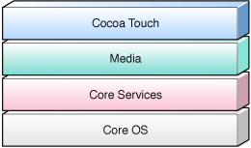
Layers of iOS
Bottom layer of iOS Operating system
Core OS: Kernel Power Management Mach 3.0 Keychain Access BSD Certificates Sockets File System Security Bonjour

Slide 11
Layers of iOS
Second layer of iOS Operating system
Core Services: Collections Core Location Address Book Net Services Networking Threading File Access Preferences SQLite URL Utilities

Slide 12
Layers of iOS
Third layer of iOS Operating system
Media: Core Audio JPEG,PNG,TIFF OpenAL PDF Audio Mixing Quartz(2D) Audio Recording Core Animation Video Playback OpenGL ES

Slide 13
Layers of iOS
Top layer of iOS Operating system
Cocoa Touch: Multi-Touch Alerts Core Motion Web View View Hierarchy Map Kit Localization Image Picker Controls Camera

Slide 14
Cocoa Touch Layer
Is at the top of the iOS stack, iOS developers commonly use the frameworks in the Cocoa Touch Layer.
Based on the Mac OS X “Cocoa” API (used to write Mac applications) and is mostly written in Objective C.
Most of the frameworks we use this year will be from the Cocoa Touch Layer.

Slide 15
UIKit Framework
An incredibly important framework written in Objective C. Most of the work that goes into making an application has to do with this framework.
http://developer.apple.com/library/ios/#documentation/UIKit/Reference/UIKit_Framework/_index.html
What does it contain? User interface elements Application lifecycle/event handling Hardware API’s

Slide 16
Foundation Framework
Provides a set of useful primitive object classes.
Adds functionality not covered by the Objective-C Language .
Makes software development easier by introducing consistent conventions.
Example, The Class NSArray is the object representing an Array in the Foundation Framework.
Object Oriented at it’s core. Includes the root object Class (NSObject), classes representing basic data types such as strings (NSString), collection classes for storing other objects (NSArray), and classes representing system information such as dates (NSDate)

Slide 17
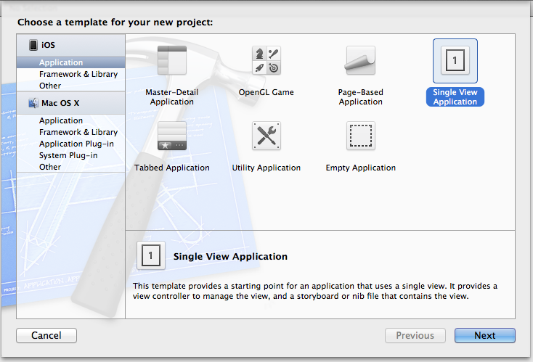
Hello World
Open Xcode…Chose “Single View Application”

Slide 18
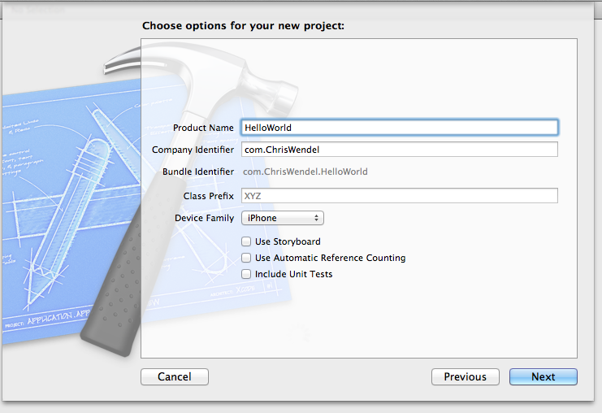
Hello World
Name project “HelloWorld”, de-select “use storyboard” and “include unit tests”, then pick destination. Set Device Family to “iPhone”

Slide 19
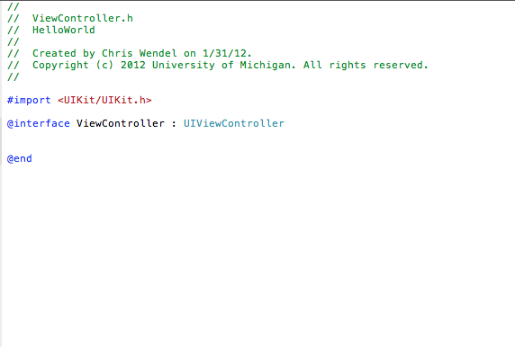
Hello World
Open up “ViewController.h” so we can declare our UI elements

Slide 20

ViewController.h
#import <UIKit/UIKit.h>
@interface ViewController: UIViewController {
IBOutlet UILabel *hello_label;
}
@property(nonatomic,retain) IBOutlet UILabel *hello_label;
@end
Declares a UILabel that corresponds to one you put in your XIB file
Declares the property “hello_label”

Slide 21
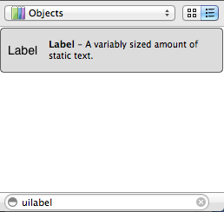
ViewController.xib
Interface builder file for the main view, in bottom right: search for “UILabel”

Slide 22
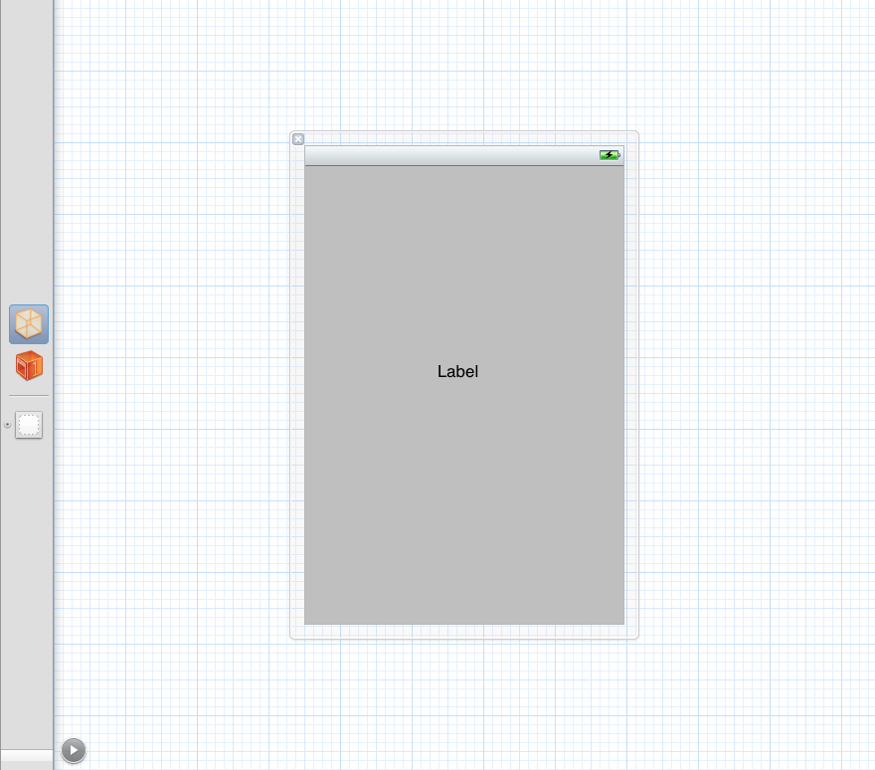
ViewController.xib
Drag UILabel to center of grey view

Slide 23
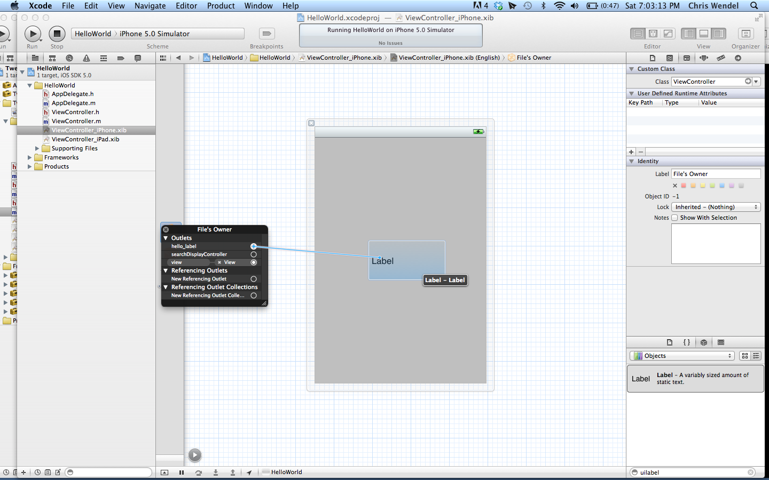
ViewController.xib
Right click on yellow cube icon “File’s Owner”. Drag “hello_label” outlet to UILabel on the view.

Slide 24
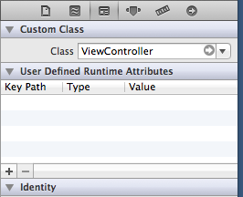

File’s Owner?
Each .xib file has a file’s owner
Corresponds to source file that “IBOutlets” and “IBActions” are in
For example, in “ViewController.xib” click the file owner and then the “Show the identity inspector” on the right of the screen. Under “Custom Class” should be the name of the file that contains the “ViewController” class

Slide 25
ViewController.m
#import “ViewController.h” @implementation ViewController @synthesize hello_label;
-(void)viewDidLoad {
[super viewDidLoad];
[hello_label setText:@”Hello World!”];
}
@end
Creates getter and setter methods for a property
Calls UILabel’s “setText” method to set the text of the label to “Hello World!”

Slide 26
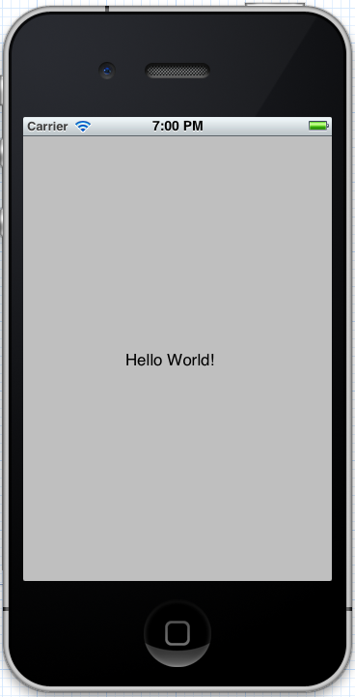
Hello World
If everything worked correctly…..the label on the screen should read “Hello World!”. Congratulations, you made your first app!

Slide 27
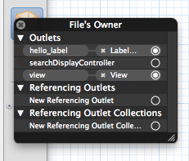
Common Problems
The “File’s Owner” does not point to the right file Check by clicking the “File’s Owner” yellow cube icon in your XIB file and looking at it’s “Custom Class”
You forgot to link up your IBOutlet with the UI Element on the view Right click on the “File’s Owner” yellow cube icon in you XIB file.
“hello_label” connected to “Label” on View
“view” connected with “View” (this should be set up automatically by Xcode)

Slide 28
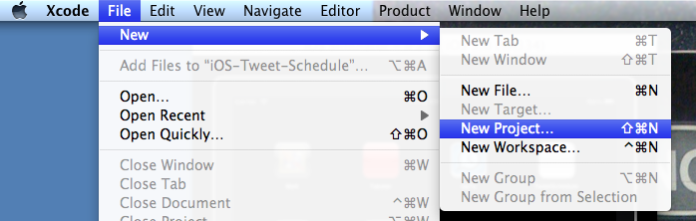
Hello World – Pt.2
Open a new project…

Slide 29
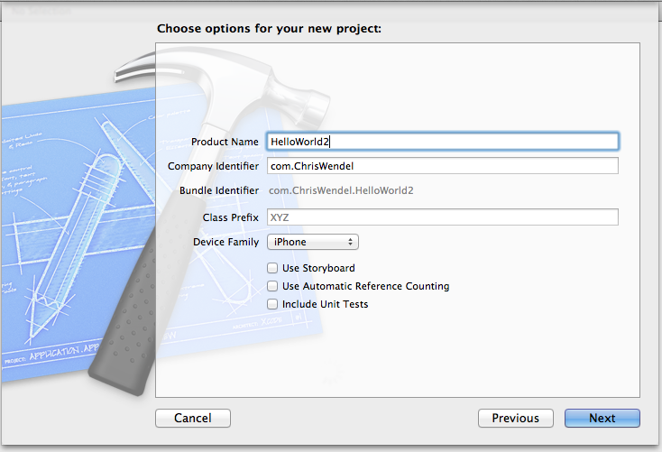
Hello World – Pt.2
Pick “Single-View” Application again, name it “HelloWorld2”

Slide 30
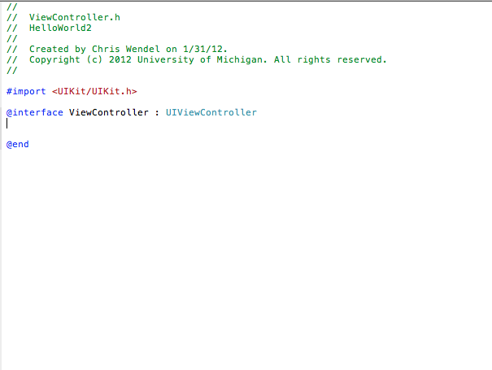
Hello World – Pt.2
Once again, open up “ViewController.h”

Slide 31
ViewController.h
#import <UIKit/UIKit.h> @interface ViewController : UIViewController {
IBOutlet UITextField *textField; IBOutlet UILabel *label;
}
@property(nonatomic,retain)IBOutlet UITextField *textField; @property(nonatomic,retain)IBOutlet UILabel *label; -(IBAction)buttonPressed:(id)sender;
@end
Declares UI elements that we will use in the XIB file
The method that gets called when our button is pressed. Also must be set up in the XIB file

Slide 32
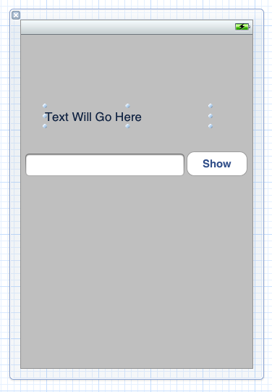
ViewController.xib
Drag a Label, Text Field and Button onto the View, double click on the label to set it’s initial text. Double click on the button to set it’s initial text.

Slide 33
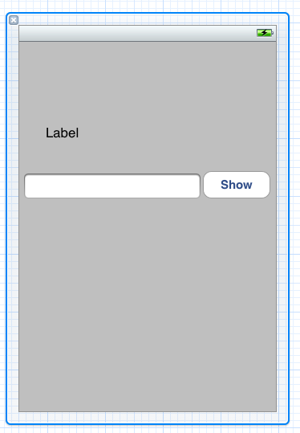
ViewController.xib
Connect the Label and Text Field as we did in HelloWorld 1. Then under “received actions”, connect “buttonPressed” to the Button, and select “Touch up inside” on the window that pops up.
Now the button knows to call the “buttonPressed” method in the “ViewController” file when the user touches the “Show” button.

Slide 34
ViewController.m
#import “ViewController.h” @implementation ViewController @synthesize textField, label;
...
-(IBAction)buttonPressed:(id)sender {
}
...
@end
Write method name and room for implementation in .m file

Slide 35
ViewController.m
#import “ViewController.h” @implementation ViewController @synthesize textField, label;
...
-(IBAction)buttonPressed:(id)sender {
NSString *stringFromTextField = textField.text; [label setText:stringFromTextField];
}
...
@end
Declare a string object and set it to the text that is currently in the Text Field
Use the label’s “setText” method to set the label’s text to the string object we just set

Slide 36
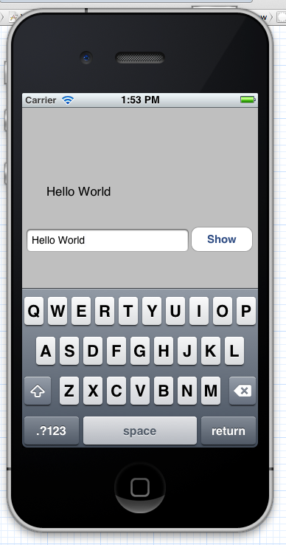
Hello World – Pt.2
Run your application, press the Text Field to bring up the keyboard. Write “Hello World”(or anything else for that matter) and press the button. If all went well the label should display your text!

