Slide 1
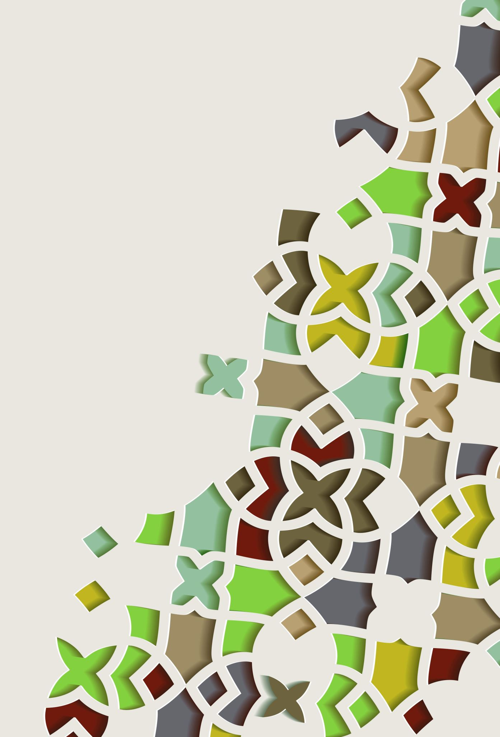
FOCP Project
2048 Game with a simple GUI

Slide 2
Members
Member 1:
Muhammad Sunaam
Game Engine and integrating GUI
Member 2:
Abdul Basit
GUI and Integration
Member 3:
Qazi ShujaUllah
Testing and slides

Slide 3
Introduction
2048 is a mathematical game developed by Gabriele Cirulli.
The objective of the game is to slide numbered tiles on a grid to combine them to create a tile with the number 2048.
It was developed in CSS and JavaScript. We have created an offline version of this game.
This mathematical puzzle game is a great exercise for the brain.

Slide 4
Environment and packages
Python
Environment:
Visual Studio Code
Pakcages/Libraries:
Pygame
Time
Pygame_menu
Random
Copy

Slide 5
Comparision
My 2048 Project | Original 2048
Offline game, can be played anytime | Web based game, requires internet
User can save his game in a file | Game is not saved if quit
Uses a modern GUI to make the game interactive | Also uses a modern GUI
Easy to play | Easy to play
Not popular | Popular

Slide 6
Why 2048?
We wanted to create something fun and intuitive.
Although this game already existed, it was a fun challenge to solve this game on our own.
This game is a good exercise for the brain and is fun. This is a great way to kill time instead of wasting time on Social Media.
Implements all the basic fundamentals of programming, so it is a great way to practise our skills.

Slide 7
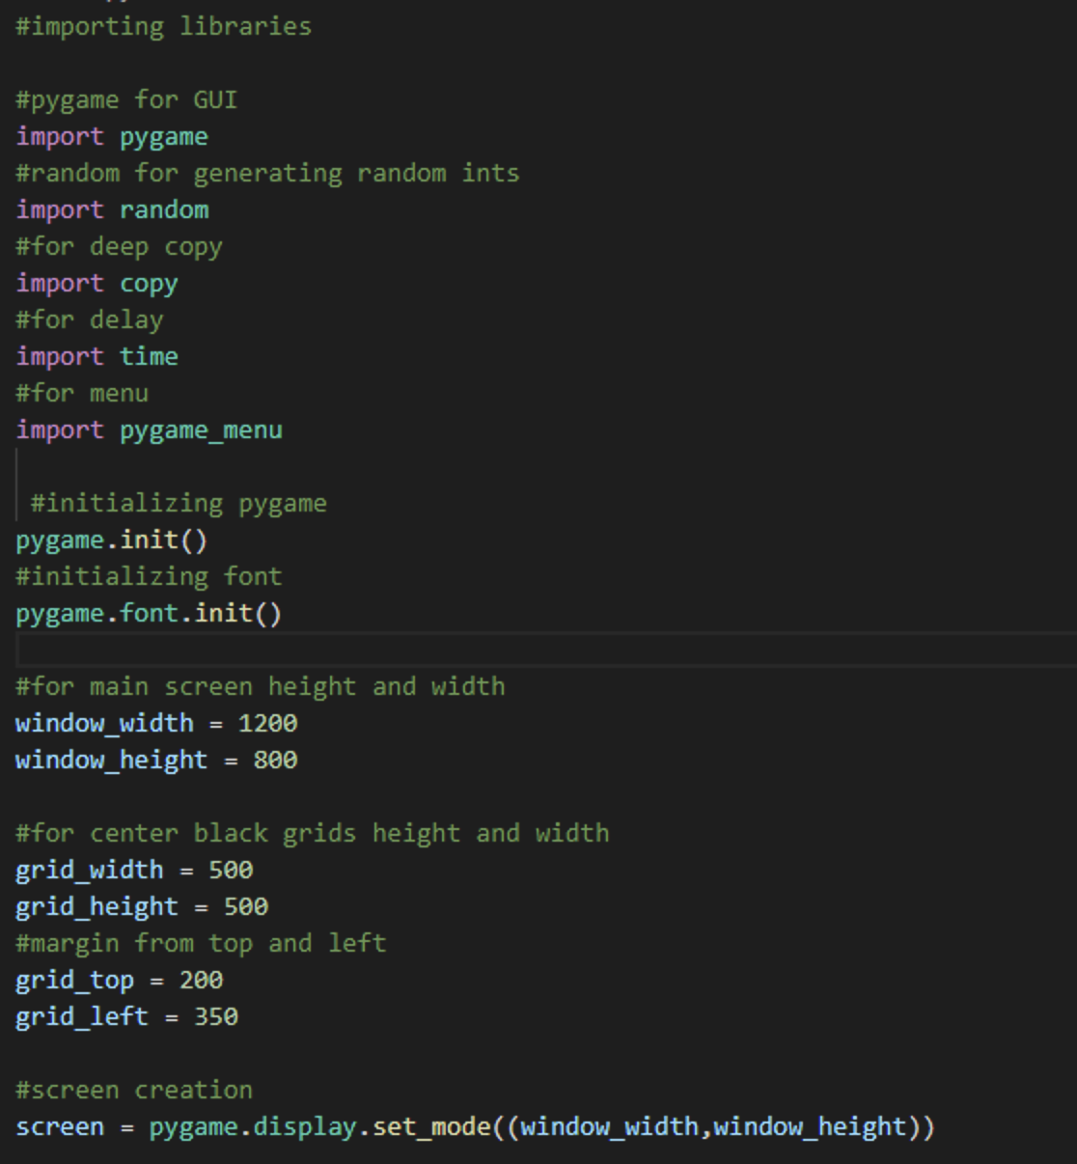
ScreenShots
Importing Libraries
Creating game window and starting game

Slide 8
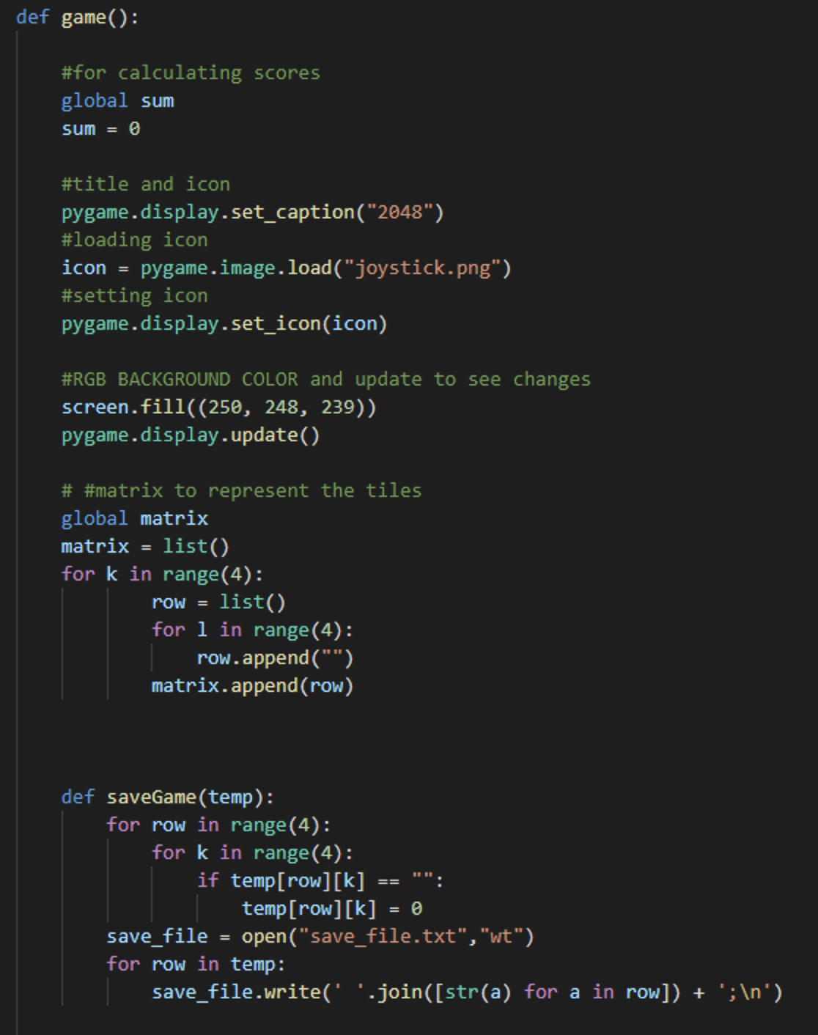
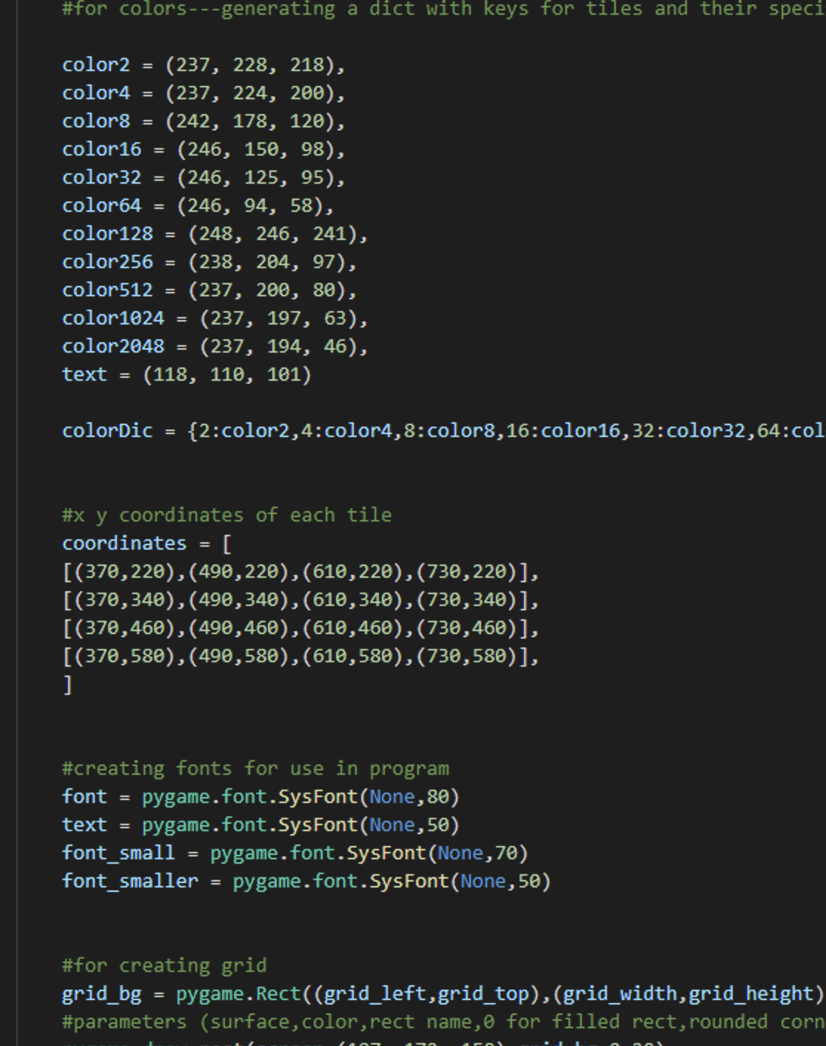
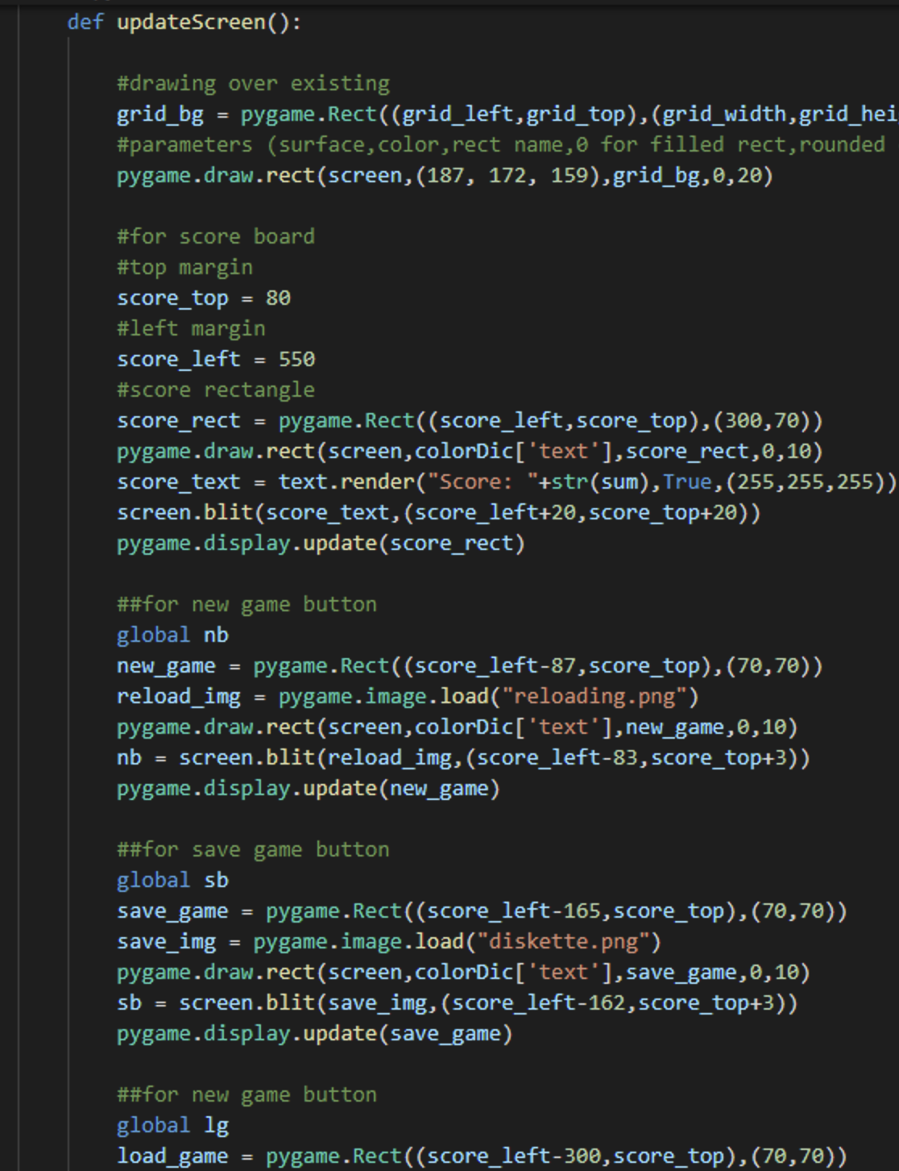
ScreenShots

Slide 9
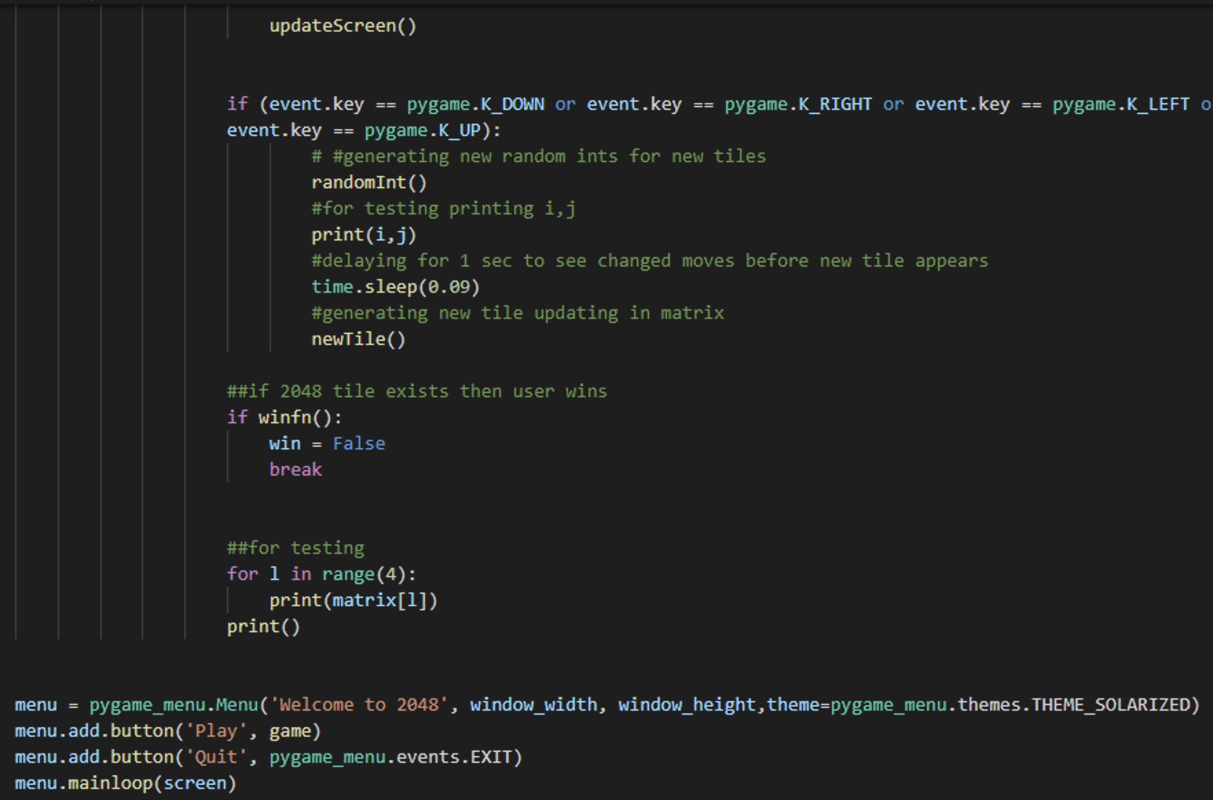
Screenshots
Menu using pygame_menu library

Slide 10
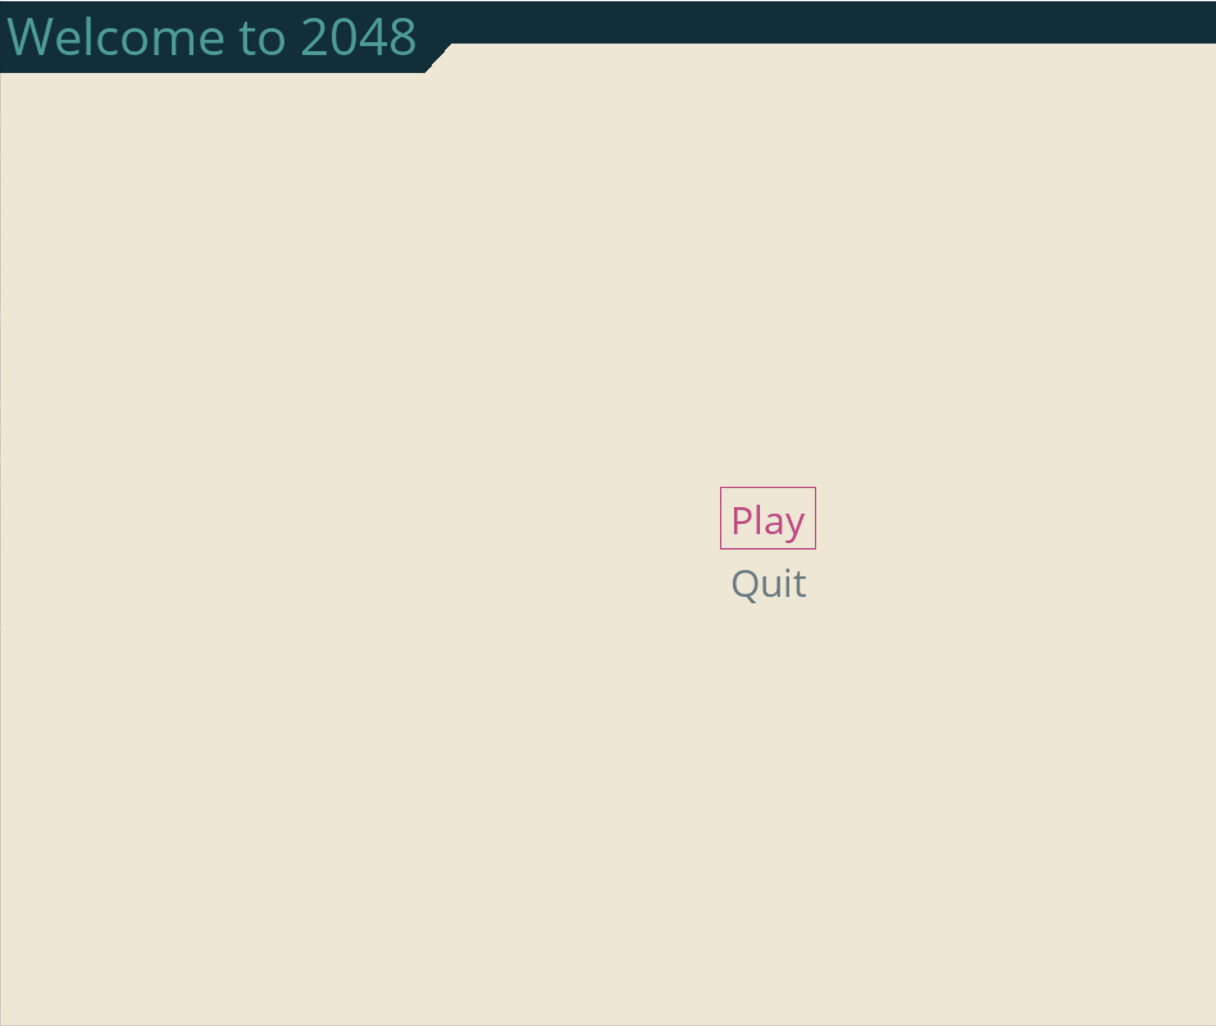
GUI

Slide 11
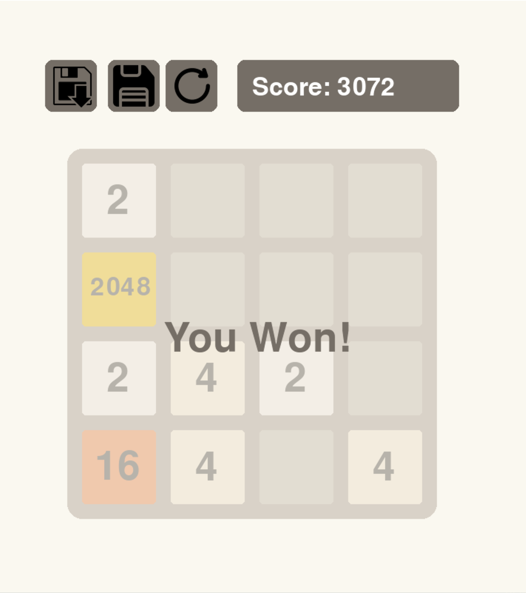
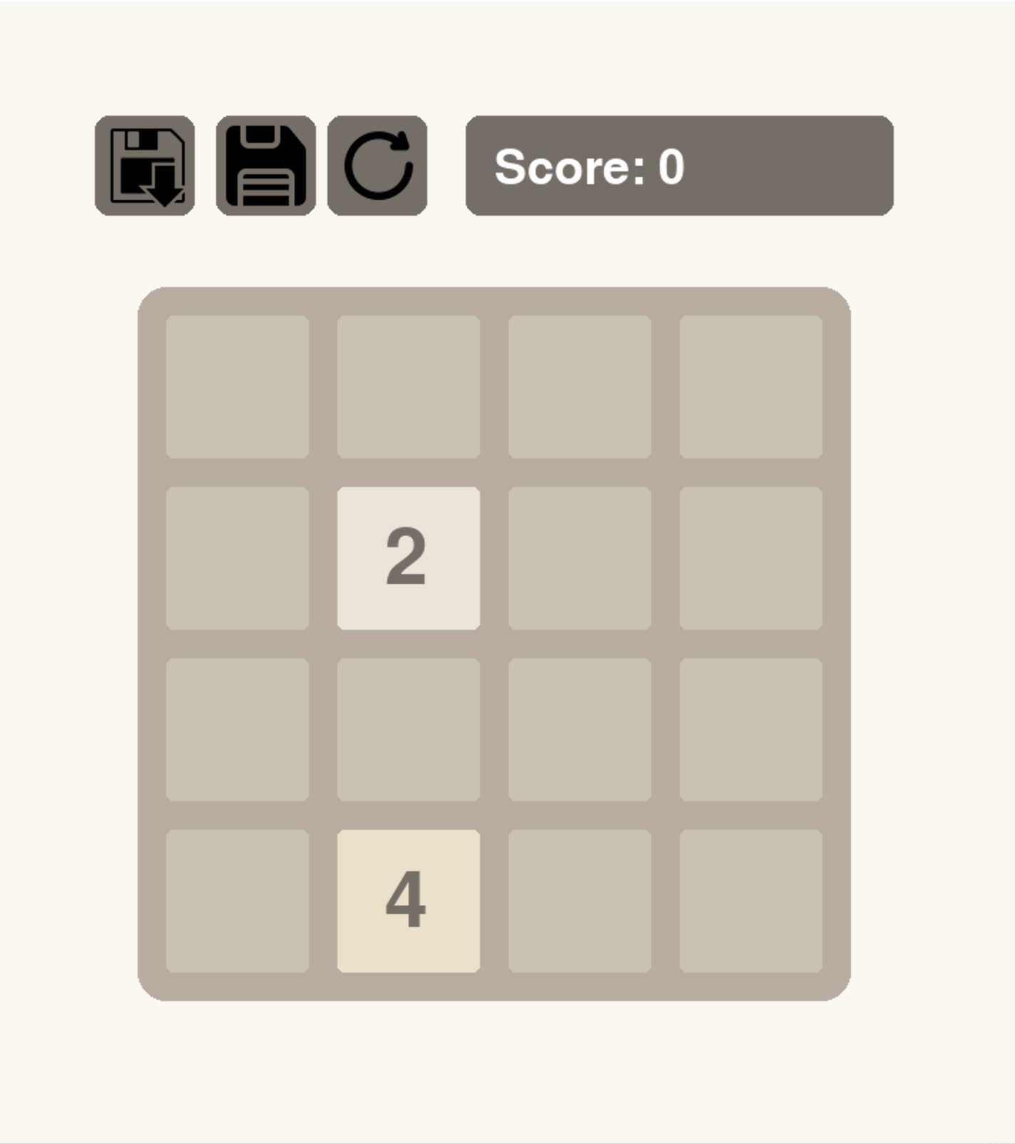

Slide 12
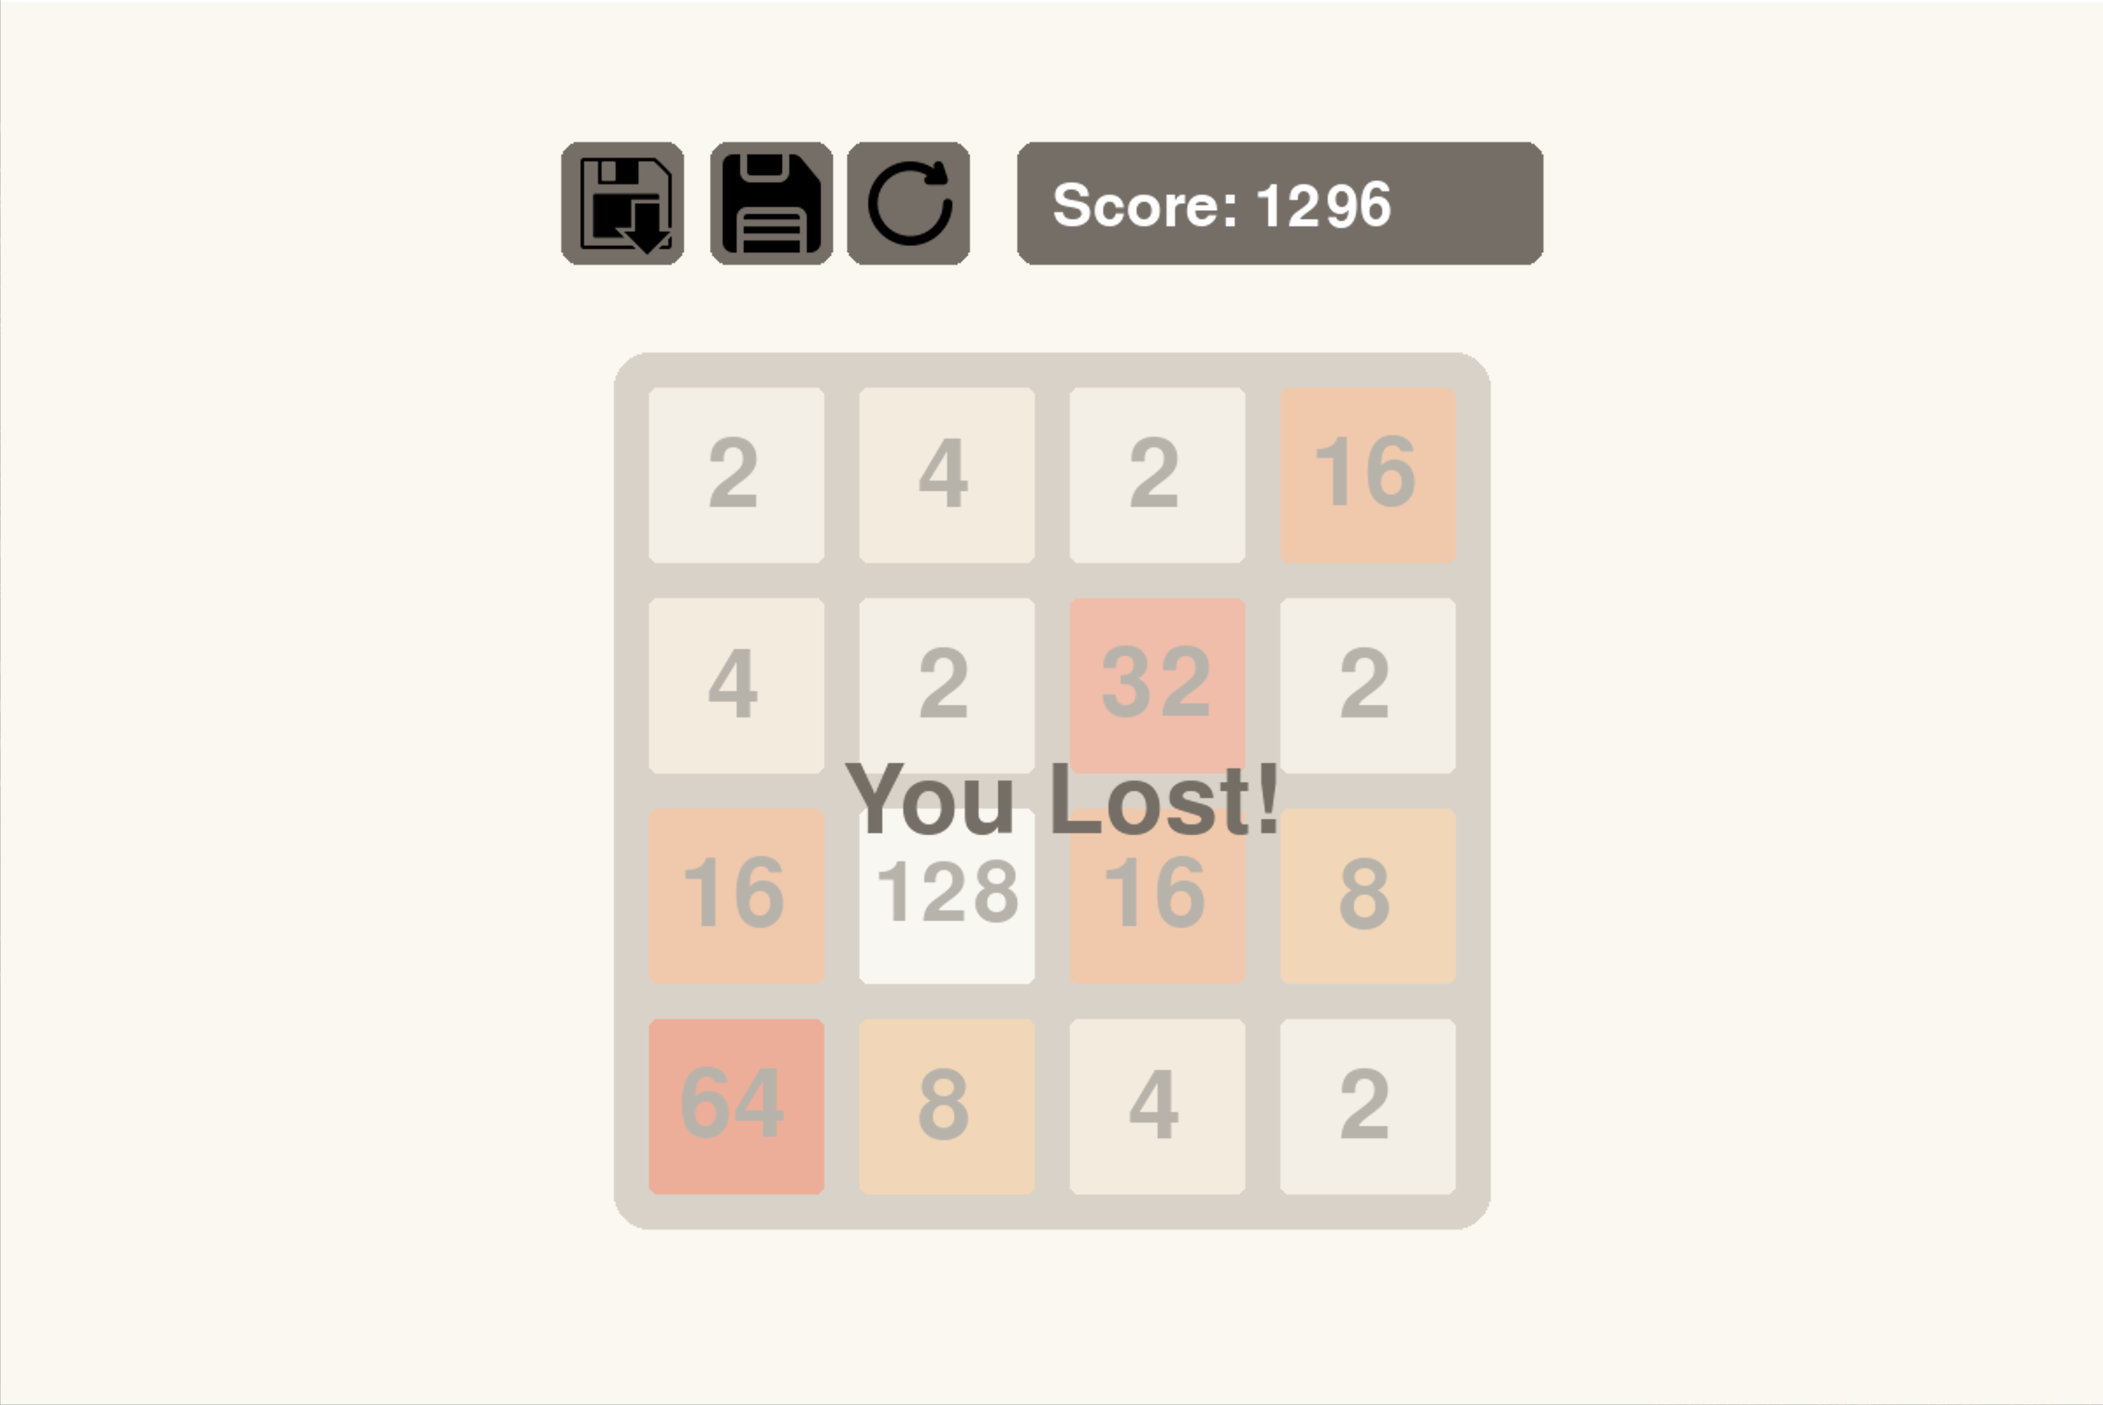

Slide 13
Future & Outcomes
In the Future we want to extend this game by making the animation and GUI better.
We learned a lot from this project. We implemented all of the fundamentals and honed our skills.
We learned useful libraries like pygame.
This project peaked our interest in Game Development.

Slide 14

Thank You!

