Slide 1
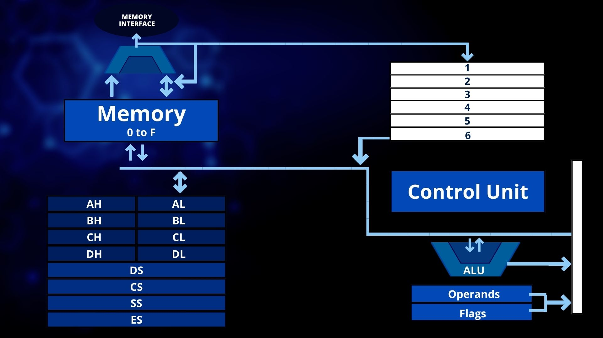


Slide 2

MOV AX,BX
For 1st Instruction
Data From Reg BX is copied which is pass to control unit which further decides to move it to AX

Slide 3
MOV AX,[123h]
For 2nd Instruction
Data From Memory is copied which is pass to control unit which further decides to move it to AX

Slide 4
INC [AX],[101]
For 3rd Instruction
Data From Reg Memory AX is copied which is pass to control unit, which further decides to move it to ALU which increments it and pass it to AX and store it

Slide 5
AND [AX],[BX]
For 4th Instruction
Data From Memory Reg BX is copied which is pass to control unit which further decides to move it to ALU which operates and it with AX and pass back to store it in AX

Slide 6
