Slide 1
Blood Donation Sytem
Group Members:
Muhammad Sunaam
Rohail Zulfiqar
Shehroz Khan

Slide 2
Introduction
Maintain a History of Blood Donations.
Maintain Records of Blood Banks, Patients, and Donors.
GUI for admin user.

Slide 3
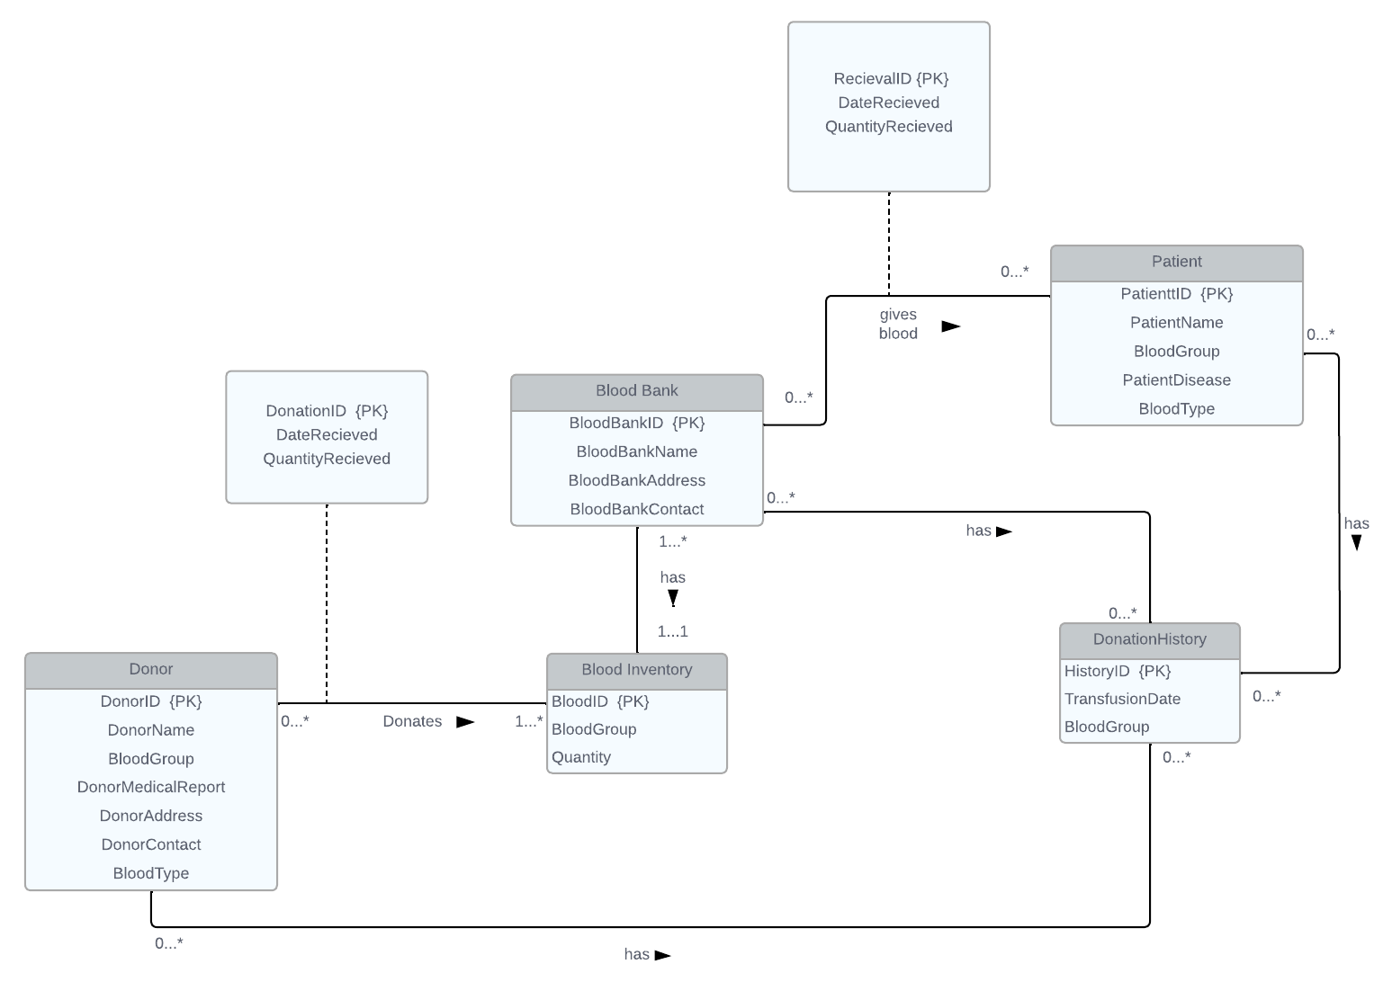
ER-Diagram of database

Slide 4
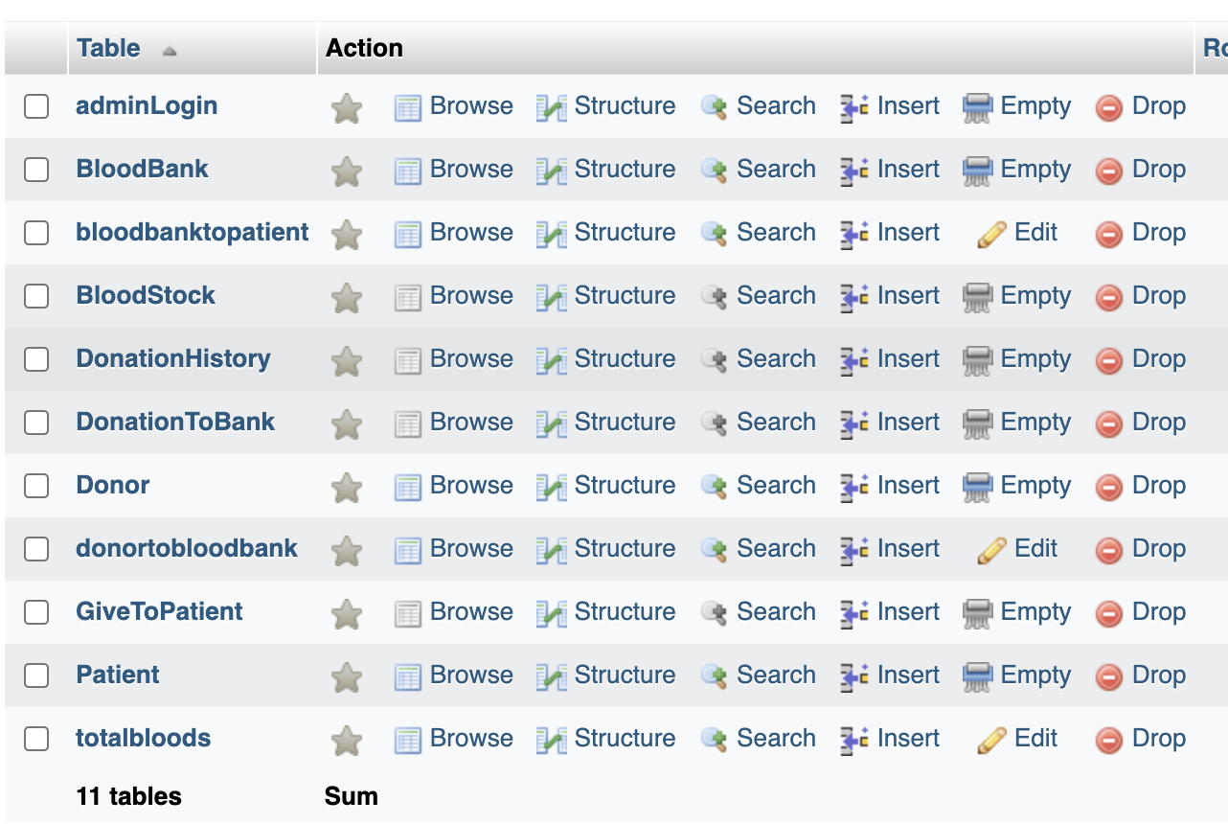
Relational Schema

Slide 5
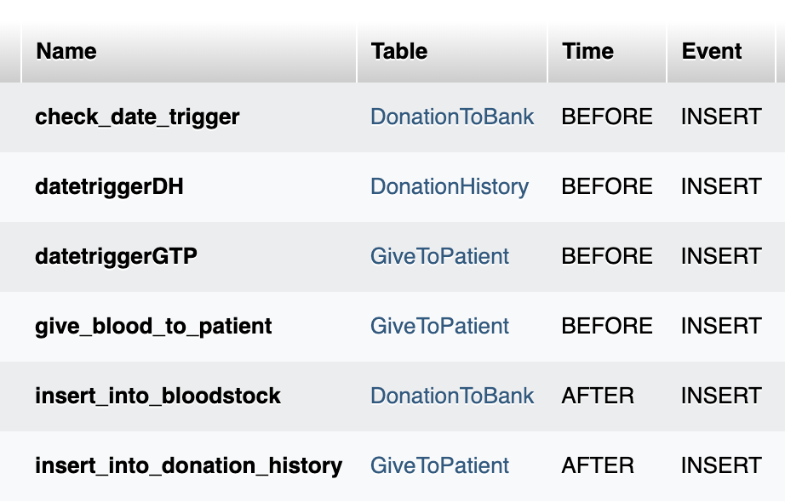
Triggers

Slide 6
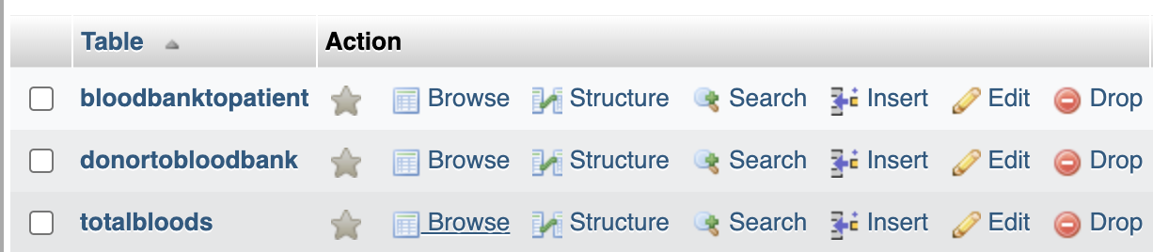
Views

Slide 7
GUI
Flutter based IOS-Application.
Primarily for admin use.
May be upgraded for patients and donors as well.

Slide 8
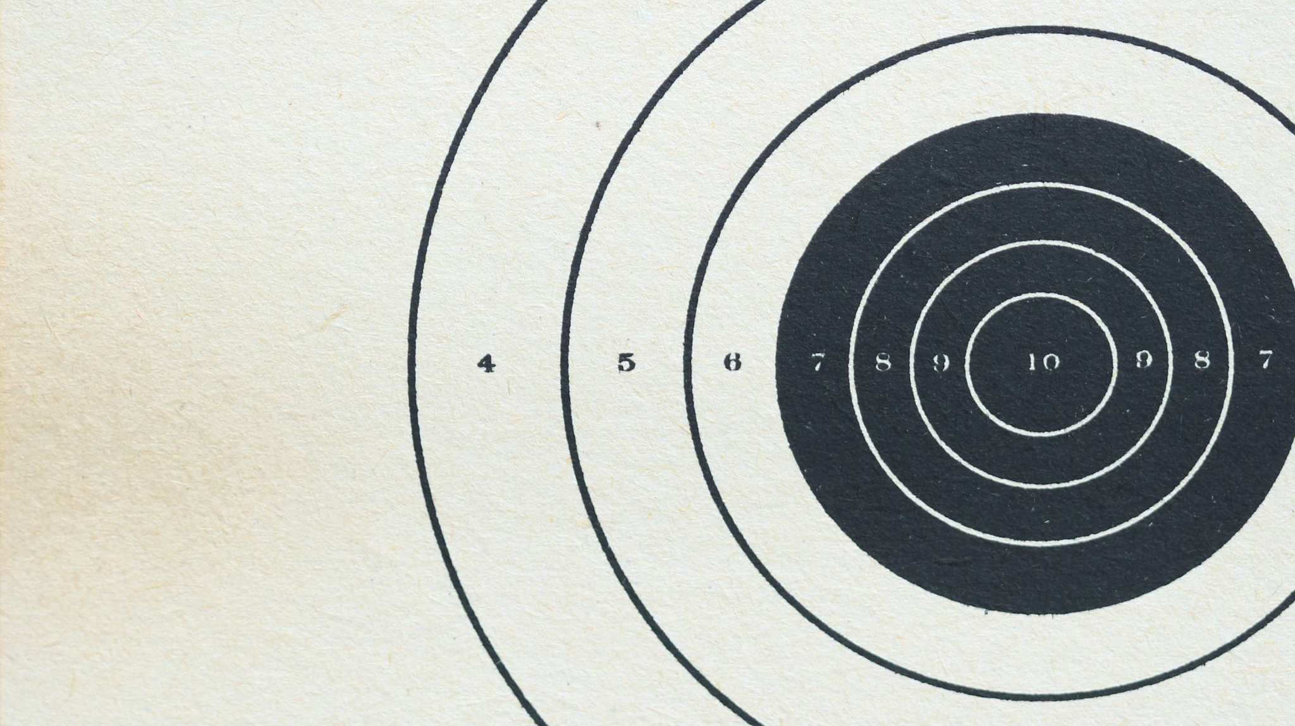
DEMO

Slide 9

Thank You

