Slide 1

R-CNN, Fast R-CNN and Faster R-CNN Architectures for Object Detection
Prepared by :
Mujahid, Abdullah Al
ID : 22-92340-1

Slide 2
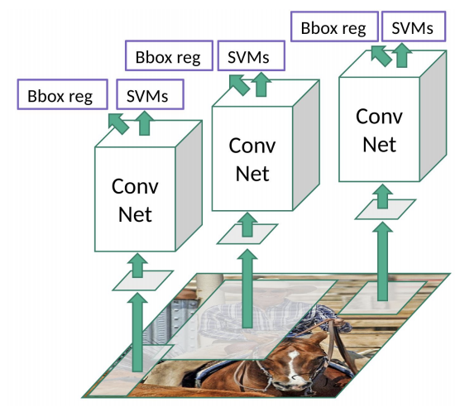
R-CNN Architecture
A 2-stage object detection architecture
Proposed by Ross Girshick et al. in 2014

Slide 3
R-CNN Architecture : Steps
Finding Regions
Object classification

Slide 4
R-CNN Architecture : Region Proposals
Selective search is used
Each candidate region is given to a different CNN
Approximately 2000 different CNNs used for 2000 candidate regions

Slide 5
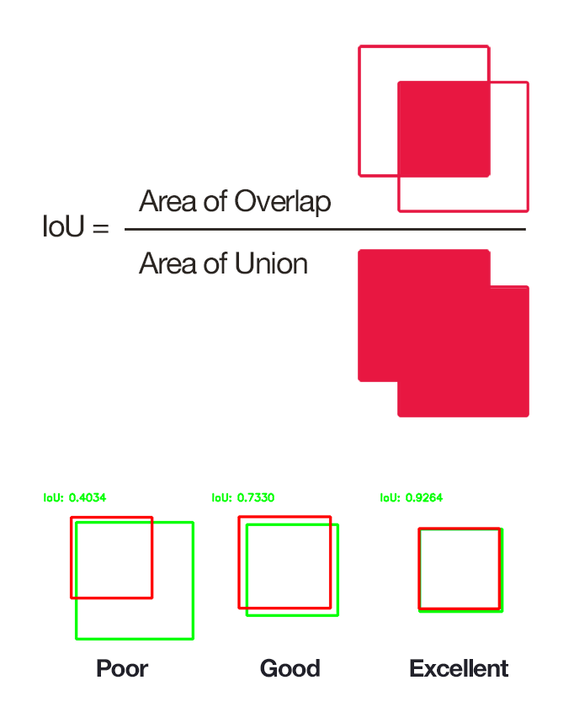
R-CNN Architecture : IoU
Intersection over Union score refers to accuracy of the predicted regions/bounding boxes.

Slide 6
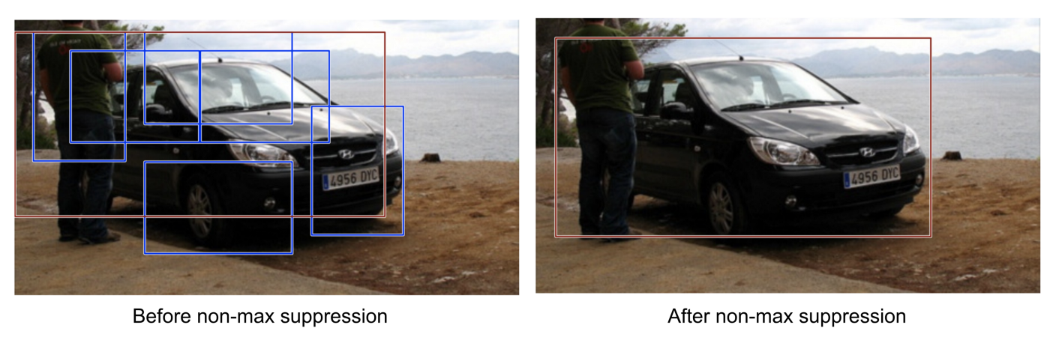
R-CNN Architecture : Non Max Supression
Regions with IoU less than or equal to 0.5 are discarded and suppressed
If there are multiple regions with IoU greater than 0.5, the region with max IoU stays, others are suppressed
Improves the identification process of which regions should be used

Slide 7
R-CNN : Problems
Each image needs to classify 2000 region proposals. So, it takes a lot of time to train the network
Takes a lot of disk space
Takes a lot of GPU resources

Slide 8
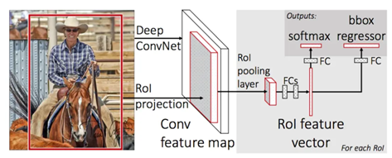
Fast R-CNN
A single CNN for all regions which reduces the need to train many CNNs
A combination of CNN, SVM and Regressor is used instead of selective search

Slide 9
Fast R-CNN : Problems
It works about 10 times faster than R-CNN but still slow and can be improved.

Slide 10
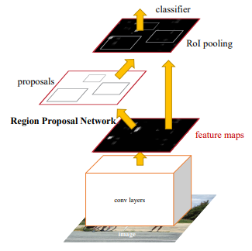
Faster R-CNN
Region Proposal Network (RPN) is used instead of selective search

Slide 11
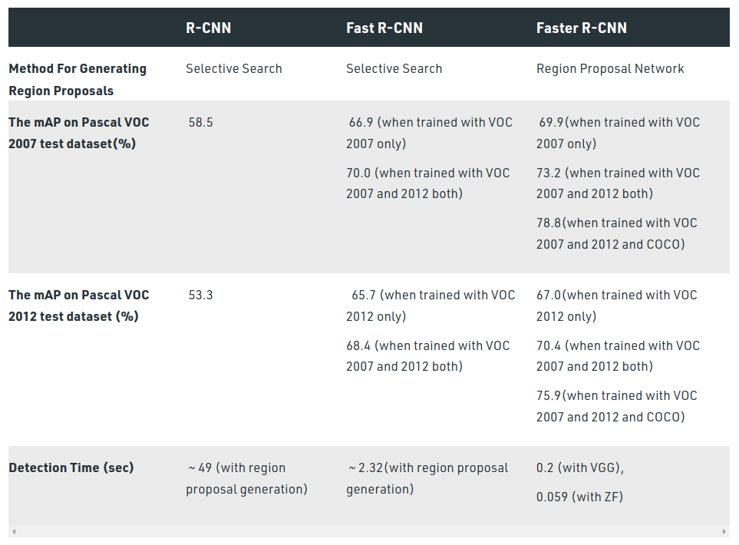
A Comparison : R-CNN vs Fast R-CNN vs Faster R-CNN

Slide 12
References
R-CNN
Fast R-CNN
Faster R-CNN
https://medium.com/mlearning-ai/a-brief-overview-of-r-cnn-fast-r-cnn-and-faster-r-cnn-9c6843c9ffc0

Slide 13

Thank You

