Slide 1
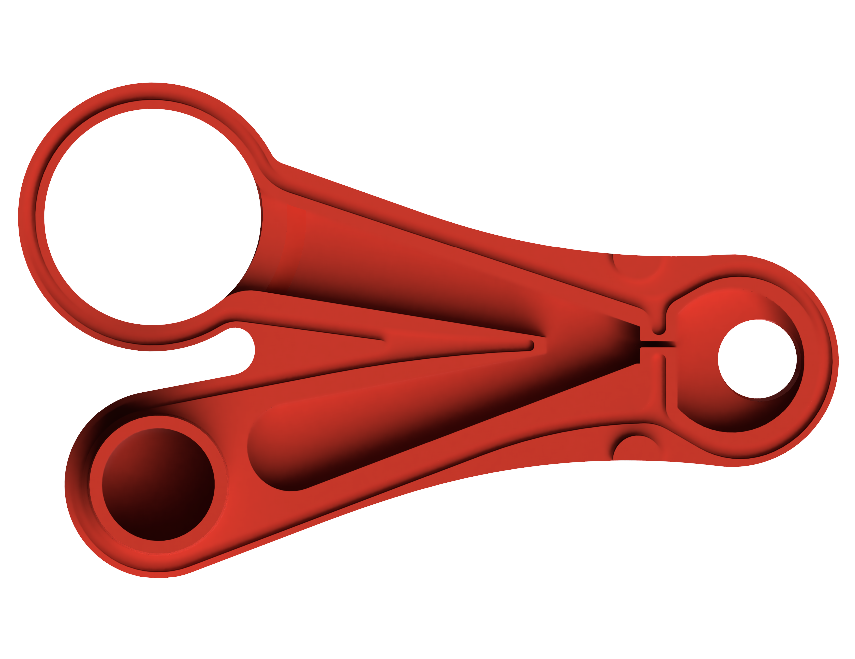
Vent
Diffuser
Diffuser
Input
Patient Port

Slide 2
Compressor
Fixed 50 PSI Output
Pressure Regulator
0 – 2 psi
3 Gallon Tank
(optional)
Handheld Pressure Gauge
Lung Model
1L
Added Lung Volume (optional)
Y-VENT
Flow Sensor (SFM3000)
Pressure Sensor (MPX7025G)

Slide 3
