Slide 1
AIR-AD: EVS Concept Notes

Slide 2
Rapidly manufactured ventilator system specification:
https://www.gov.uk/government/publications/coronavirus-covid-19-ventilator-supply-specification/rapidly-manufactured-ventilator-system-specification
Notes:
ICU min req specs:
1) volume control: you can set the tidal volume for each breath
2) set the respiratory rate
3 be able to set the PEEP, or at least a constant PEEP that is chosen by manufacturing team
Preferably able to do these:
A) set inspiratory flow
B) measure PIP (peak inspiratory pressure)

Slide 3
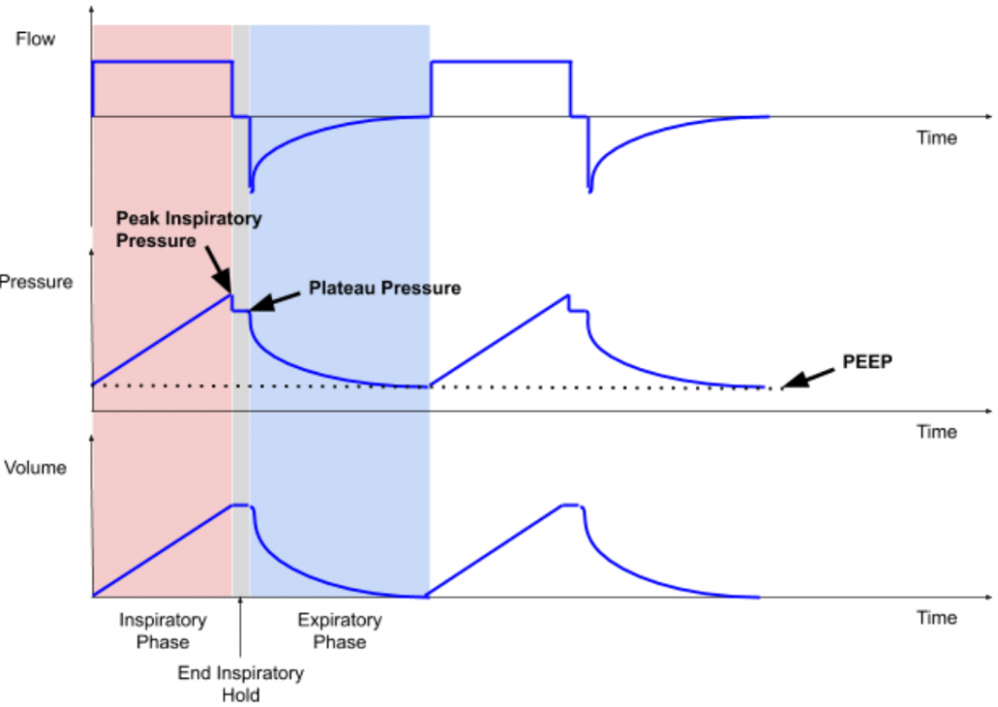
Design Inputs Summary - Ventilation
General
Mode: volume or pressure control mode (Volume preferred)
Volume control: 250ml – 500ml (+/- 50ml) in at least 2 increments (ex 350 ml and 450 ml)
Breathing Rate: 10-40 Breaths per minute
Inspiratory/Expiratory (I:E) ratio fixed at 2 or adjustable 1.0 to 3.
Set PEEP: 5-20 cmH2O or one fixed (setting accuracy of PEEP (+/- 10%))
Maximum PIP 40-50 cmH2O
Optional:
Measure PIP (peak inspiratory pressure) 50 cmH2O
Flow, pressure, and volume waveforms
Notes:
ICU min req specs:
1) volume control: you can set the tidal volume for each breath
2) set the respiratory rate
3 be able to set the PEEP, or at least a constant PEEP that is chosen by manufacturing team
Preferably able to do these:
A) set inspiratory flow
B) measure PIP (peak inspiratory pressure)

Slide 4
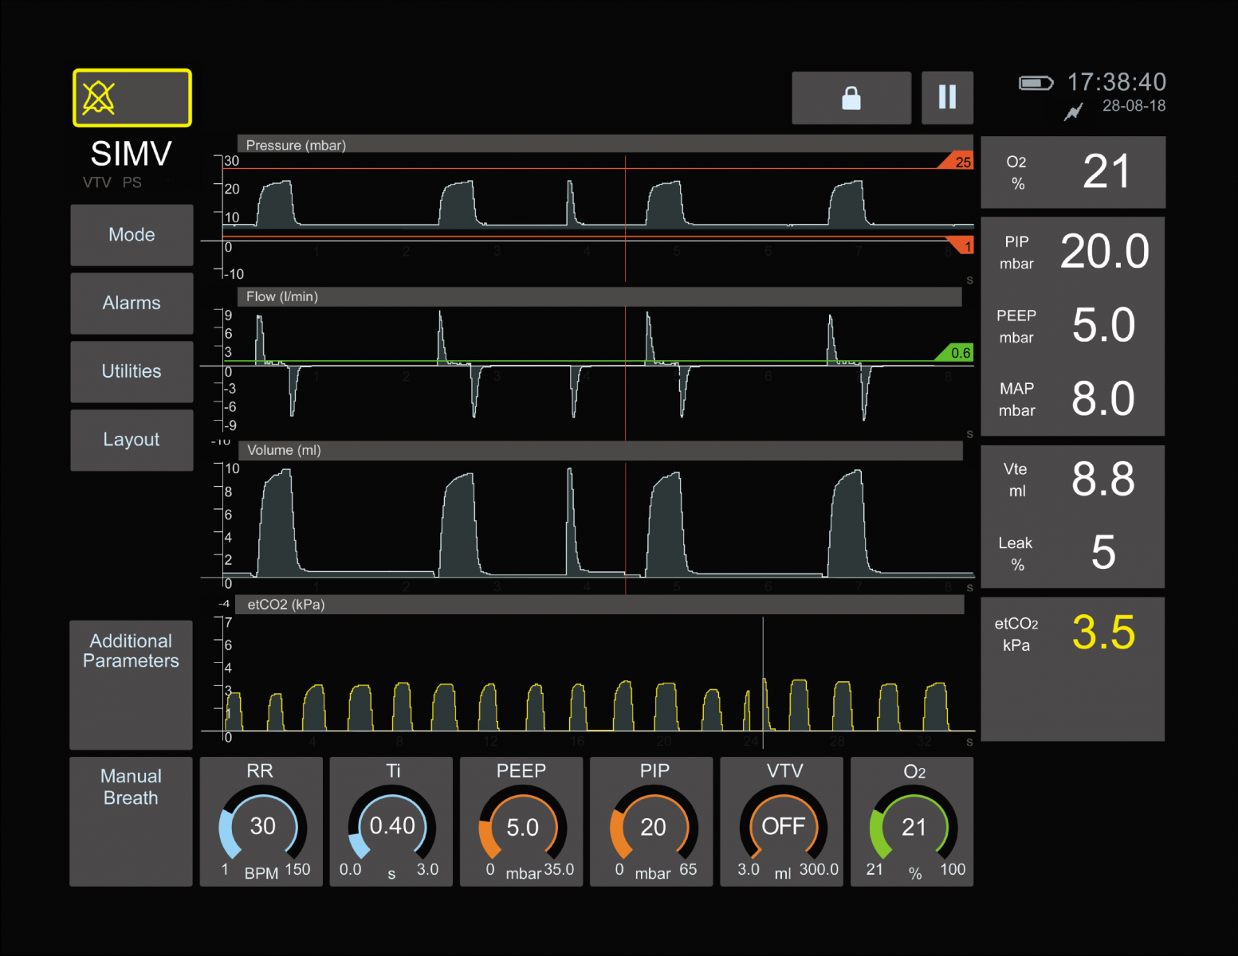
Design Inputs Summary - Operation
The devices is valuable if it can reliably provide the clinical function, while not introducing substantial risk
Must interface with standard pneumatic connectors
Can’t interfere or damage other equipment
Must operate reliably 24 hours a day for at least 14 days.
Must be intuitive to use for medically trained professional

Slide 5
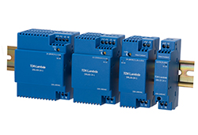
Design Inputs Summary – Part Availability
Part or direct substitute must be available in quantities of 120
Device should use standard, industrial, certified components whenever possible
Device should be built using a modular architecture allowing for swapping of components based on availability

Slide 6
Power Subsystem
(Optional)
OFF SWITCH
SSR Latch
CONTROLLER
AC PLUG
ON/OFF
SWITCH
AC to 24 VDC
ACTUATOR DRIVER
OUTSIDE
DEVICE
(Keep External)
BATTERY
24V UPS

Slide 7
Pneumatic Subsystem
O2 Mixer
Air Input
Emergency Air Input
Pressure Port Barb
22mm Air Port
OUTSIDE
DEVICE
Anti asphyxiation Valve
Overpressure Valve 40 cmH2O
ACTUATOR
(electrically powered)
Ambubag/Cylinder
Pump
One-way Valve
Overpressure Valve 60 cmH2O
(optional)

Slide 8
External Air Circuit
PEEP Valve
Mask/Tube
Patient Tubing
O2 Mixer
(find is available)
O2 Cylinder
Pressure Port Barb
22mm Air Port
OUTSIDE
DEVICE

Slide 9
Control Subsystem:
DEVICE
Position Feedback
Sensor
Output Flow Sensor
Controller
(PLC unitronix)
Actuator Driver
Actuator
Ambubag/Cylinder
Pump
Endstop
Patient Pressure Sensor
GUI Screen
(optional)
Auxiliary Pressure Sensor
Tidal Vol Pot. (#1)
Breathing Rate Pot. (#2)
I/E Potentiometer (#3)
On-Demand Inhale Button
(optional)

Slide 10
User Interface Concept
Inlet Port & Emergency Inlet
Air and Pressure Port
Handle
AC Cord Wrap Handles
Programmable LCD Display
AC IN
Push On
Tidal
Rate
I/E
Power Switch
Critical User Interface
Notes:
ICU min req specs:
1) volume control: you can set the tidal volume for each breath
2) set the respiratory rate
3 be able to set the PEEP, or at least a constant PEEP that is chosen by manufacturing team
Preferably able to do these:
A) set inspiratory flow
B) measure PIP (peak inspiratory pressure)

Slide 11
Piston Actuator Concept #1
Linear Actuator
Stroke 3-5”
Stroke vs max reps vs freq
Flow rates can be linear
Physical limit switches
Some linear actuators have encoder
Plate sitting on 4 shafts with bearings
Complexity:
How to lead the actuator
Tolerance between the cylinder
Can be adressed with shafts
Plate
Bellows
Check Valve #1
Check Valve #2
Cylinder
Notes:
ICU min req specs:
1) volume control: you can set the tidal volume for each breath
2) set the respiratory rate
3 be able to set the PEEP, or at least a constant PEEP that is chosen by manufacturing team
Preferably able to do these:
A) set inspiratory flow
B) measure PIP (peak inspiratory pressure)

Slide 12
Piston Actuator Concept #2
Linear Actuator
Stroke 3-5”
Floating O-Ring
Plate
Look into piston pumps
Existing components
Like cylinders
Check Valve #1
Check Valve #2
Cylinder
Notes:
ICU min req specs:
1) volume control: you can set the tidal volume for each breath
2) set the respiratory rate
3 be able to set the PEEP, or at least a constant PEEP that is chosen by manufacturing team
Preferably able to do these:
A) set inspiratory flow
B) measure PIP (peak inspiratory pressure)

Slide 13
Piston Actuator Concept #3
Plate
Stroke 3-5”
Bellows
Linear Actuator
Check Valve #1
Check Valve #2
Cylinder
Notes:
ICU min req specs:
1) volume control: you can set the tidal volume for each breath
2) set the respiratory rate
3 be able to set the PEEP, or at least a constant PEEP that is chosen by manufacturing team
Preferably able to do these:
A) set inspiratory flow
B) measure PIP (peak inspiratory pressure)

Slide 14
Piston Actuator Concept #4
Cylinder
O-Ring
Check Valve #1
Plate
Check Valve #2
Scissor type linkage
Notes:
ICU min req specs:
1) volume control: you can set the tidal volume for each breath
2) set the respiratory rate
3 be able to set the PEEP, or at least a constant PEEP that is chosen by manufacturing team
Preferably able to do these:
A) set inspiratory flow
B) measure PIP (peak inspiratory pressure)

Slide 15
Penn ICU Design Inputs :
Main:
Volume control – set tidal volume breathing
Set respiratory rate
PEEP set
Optional:
Set inspiratory flow
Measure PIP (peak inspiratory pressure)
Notes:
ICU min req specs:
1) volume control: you can set the tidal volume for each breath
2) set the respiratory rate
3 be able to set the PEEP, or at least a constant PEEP that is chosen by manufacturing team
Preferably able to do these:
A) set inspiratory flow
B) measure PIP (peak inspiratory pressure)

