Slide 1
How to:
Nucleoside Digestion + HPLC vial transfer on the Andrew+
261009

Slide 2
Automation of Nucleoside Digestion and HPLC Vial Transfer Overview
General Workflow
Quantify RNA concentration by Nanodrop (single or multichannel). (By hand)
Setup 30uL (45ng) nucleoside digestion reactions in 96well plate:
  Transfer 45ng of RNA from starting plate -> target destination plate and dilute to a final volume of 26uL with Nuclease Free H2O. (Andrew +)
  Add 3uL 10x Nucleoside Digestion Buffer. (Andrew+)
  Add 1uL nucleoside digestion mix. (Andrew+)
  Incubate at 37C for 1 hour on thermal cycler. (By hand)
Transfer 20uL (30ng) of nucleosides from 96well plate to Glass 0.2mL HPLC Vials. (Andrew+)
Nucleoside Digestion Protocol Materials
HPLC Vial Transfer Protocol Materials
Name | Product Number | Supplier | Supplier | Source
Plasticware
VWR PCR Plate 96 well Half-skirt ABI-type, single notch A12 | 83007-374 |  | VWR | Internal
1.5mL Eppendorf DNA LoBind Tubes |  |  | Eppendorf | Internal
Filter pipette tips (200uL) | Z757764 |  | Sartorius | External
Filter pipette tips (10uL) | Z757780 |  | Sartorius | External
Reagents
10x Nucleoside Digestion Mix Reaction Buffer | B0649S |  | NEB | Internal
Nucleoside Digestion Mix | M0649 |  | NEB | Internal
Nuclease Free H2O | AM9938 |  | Invitrogen | Internal
Name | Product Number | Supplier | Supplier | Source
Plasticware
MSCERT+ Kit 0.2ML CLR SCR 9mM HPLC Vials | 6PMCK30LVW |  | Thermo Scientific | Internal
Filter pipette tips (200uL) | Z757764 |  | Sartorius | External
Domino | Number
96 PCR Plate | 218.2212.136ZEV
Tip Insertion System (2x +) | B0649S
Storage plate + Black 48 vial HPLC Rack | 218.2901.1437UL
Domino | Number
96 PCR Plate | 218.2212.136ZEV
96-PCR Peltier+ | 520.4571.15N4N
Tip Insertion System (2x +) | B0649S
1.5mL Microtube Cooled | 218.245…..
NOTE: Many of our common consumables are NOT “registered” in OneLab software and we had to trick Andrew to use them. Start from the protocol templates which have the appropriate plasticware preset and the adjustments/offsets needed to use them.

Slide 3
Nucleoside Digestion Protocol

Slide 4

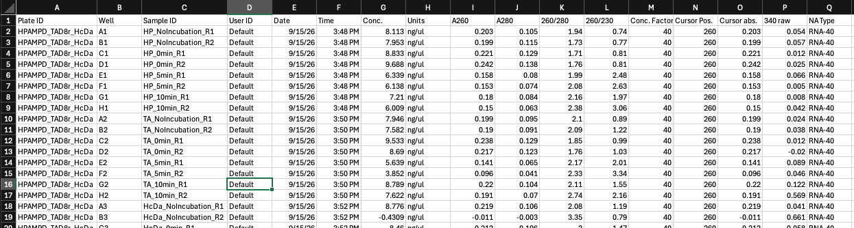
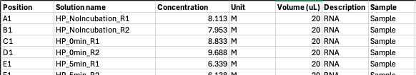
Step1: Prepare the RNA Sample List for Import into the OneLab Nucleoside Digestion Protocol
Starting from the nanodrop values obtained from the nanodrop (single or 8000), run the jupyter notebook Nanodrop8000_report_formatter.ipynb in VSCode and follow the instructions outlined in the markdown sections to generate formatted sample sheet for source plate.
  https://github.com/MSz999/Nucleoside_Digestion_Andrewplus/tree/main.
  Example template also available to fill out by hand (AndrewPlus_InitialPlate_Samplesheet_Template.xlsx)
Standard exported report from the Nanodrop 8000
Github QR Code
Nanodrop8000_report_formatter.ipynb
Andrew+ ready sample sheet for source plate
Columns Needed for Andrew+
Position = Plate well
Solution name = Sample name
Concentration = RNA concentration (In reality ng/ul but change it to M for OneLab)
Volume = Volume of RNA in plate
Description = Andrew+ Descriptor
Sample = Andrew+ Descriptor

Slide 5
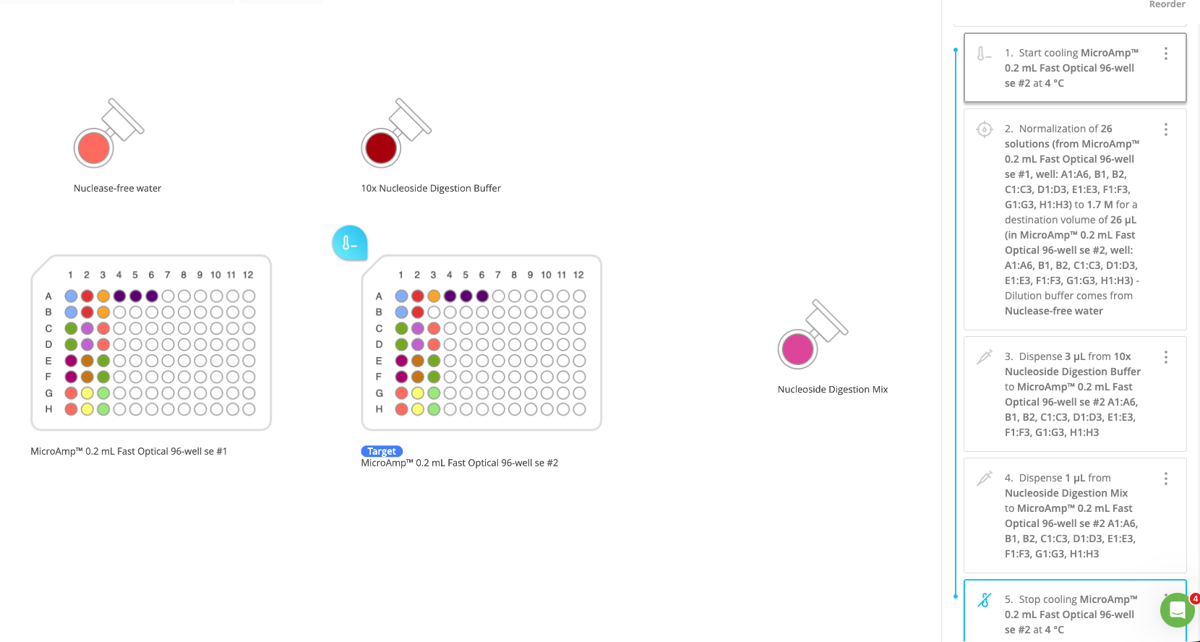
Step2: Open the OneLab Nucleoside Digestion Protocol for Editing
Open Onelab protocol: Nucleoside_Digestion_Template
  https://onelab.andrewalliance.com/
  Located in the Correa Lab home directory
    Projects/Automation Templates/Nucleoside_Digestion_Template
Nucleoside Digestion Steps:
Cool down 96well destination plate to 4C
Dilute RNA into target plate with nuclease free H2O (26uL total)
Add 3uL 10x Nucleoside Digestion Buffer
Add 1uL Nucleoside Digestion Mix
Stop cooling the 96 well destination plate
End
Designer Workspace
Protocol Steps
Notes:
Edit or duplicate protocol steps directly since they contain consumable specific parameter optimization.
  Click on (:) -> Edit
Add 1.25x the amount of reagent required to account for loss+ dead volume*
Put the passive cooling 1.5mL domino ice pack in the freezer 8hrs before
*There is no set percentage and is dependent on what consumables and pipettes are being used

Slide 6
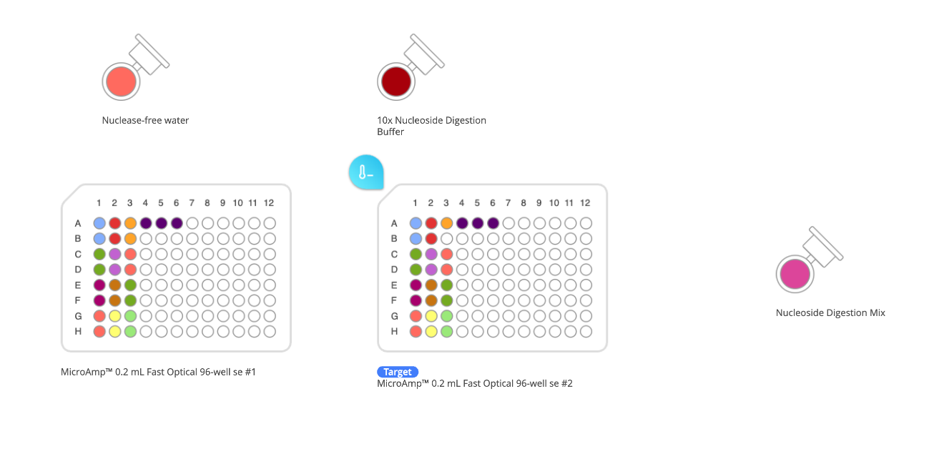
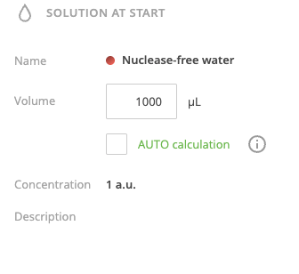
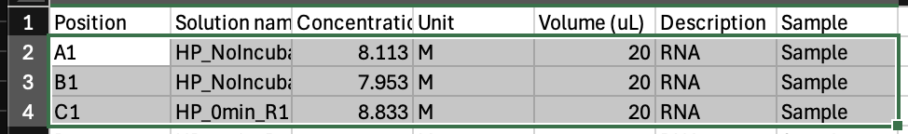
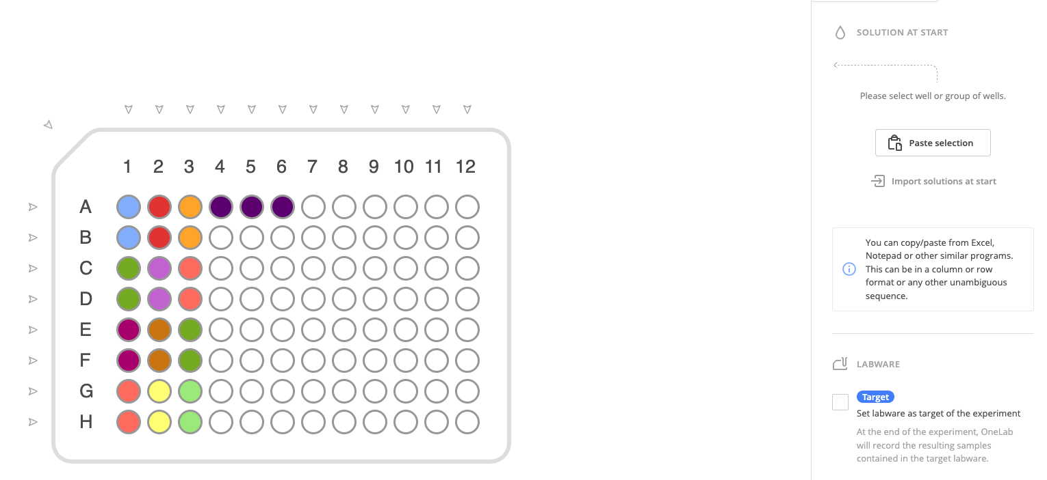
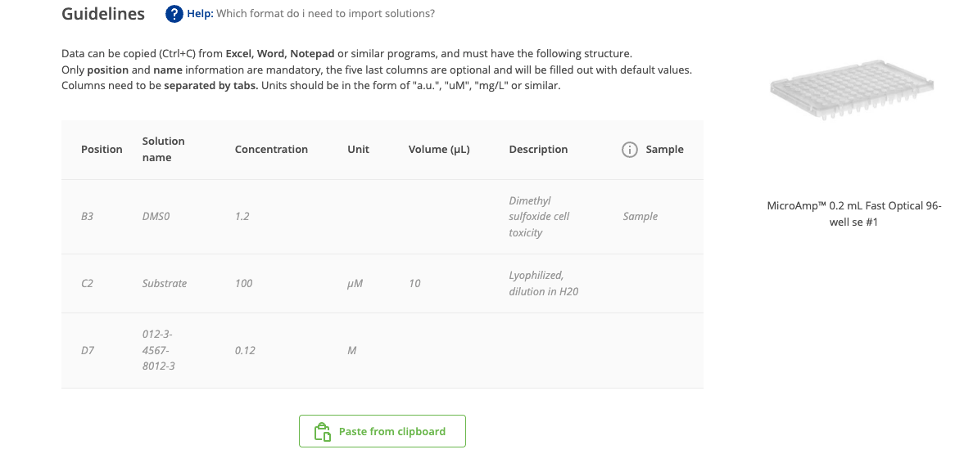
Step3-4: Setting Initial Reagent and RNA Volumes in Plates + Tubes
3. Click on each of the Eppendorf tubes to set the initial fill volume for each of the three reagents.
Notes:
Add 1.25x the amount of reagent required to account for loss+ dead volume*
1.
2.
3.
Copy Values to clipboard
4. Click on the source plate and paste in the RNA concentrations + volumes calculated from Step1.
Paste values from clipboard

Slide 7
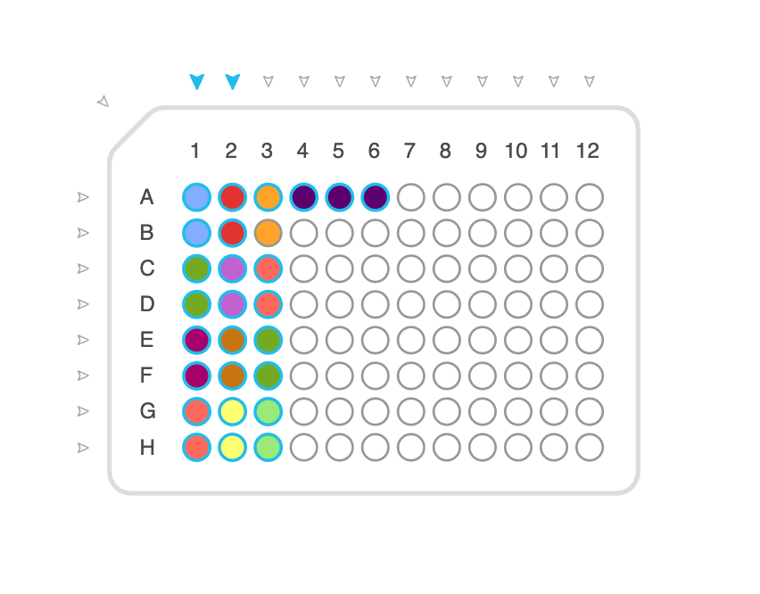
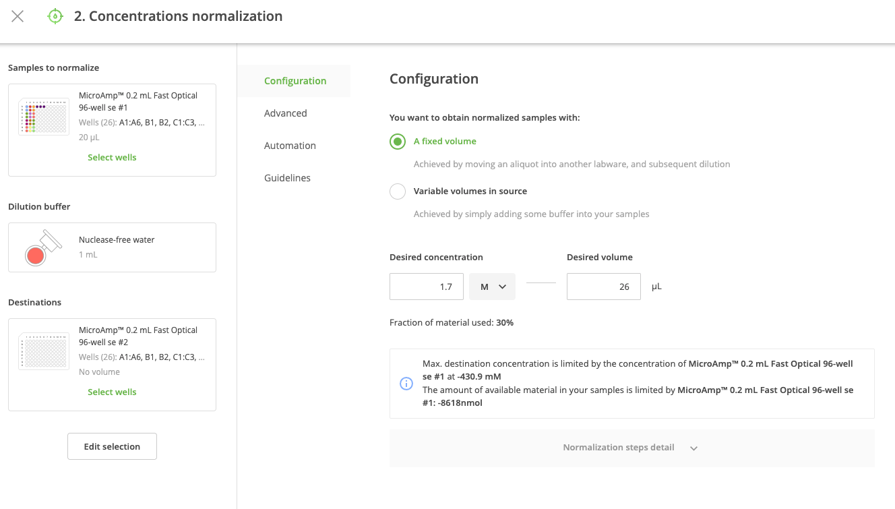
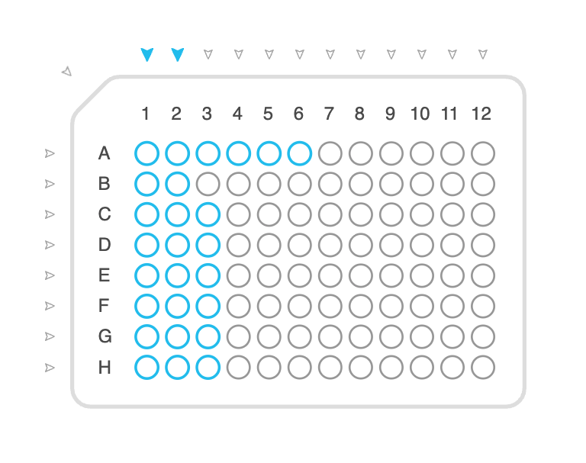
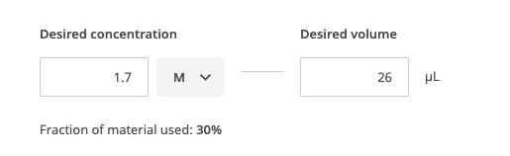
Step5: Edit protocol step 2 “Normalization” for RNA transfer + Dilution with H2O
5. Edit protocol step #2 and select the sample wells from the source plate to be transferred over and diluted in the destination target plate.
-Amount of sample from source plate is dynamically calculated based on its initial concentration and diluted to the fixed desired volume with H2O.
1. Select wells in Source plate
Click Edit on Protocol Step2
Fill in values for sections 1,2,3
1.
3.
2.
2. Select wells in Target plate
3. Set the amount of RNA based on concentration and desired volume
Notes:
These values can change and are set up for 30uL (45ng input RNA) Nucleoside Digestion reactions.
The volume of RNA + H2O are calculated dynamically based on the concentrations imported in the source plate.
H2O is aliquoted first, and then the RNA sample second

Slide 8
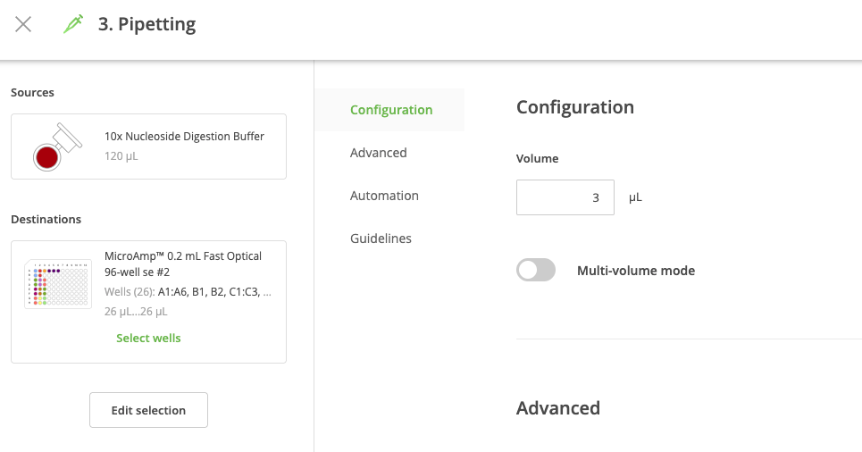
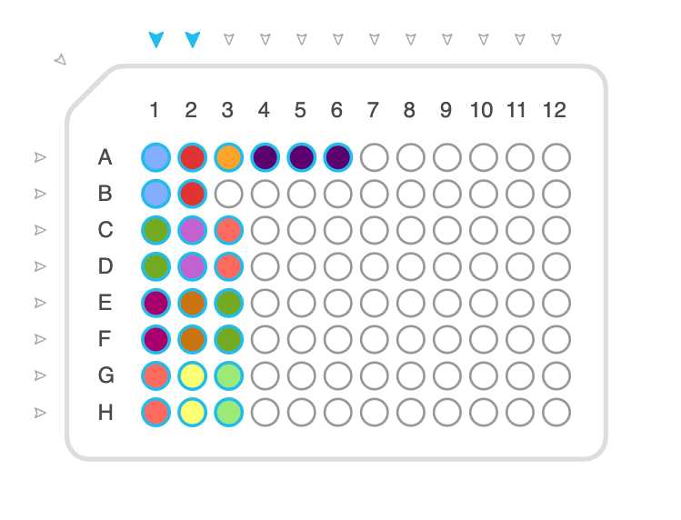
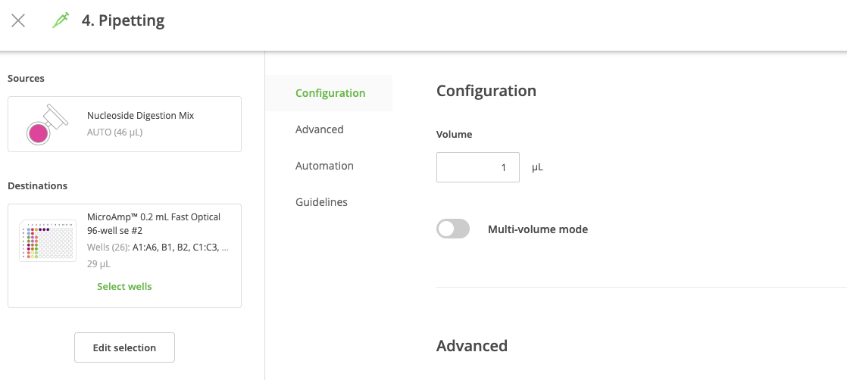
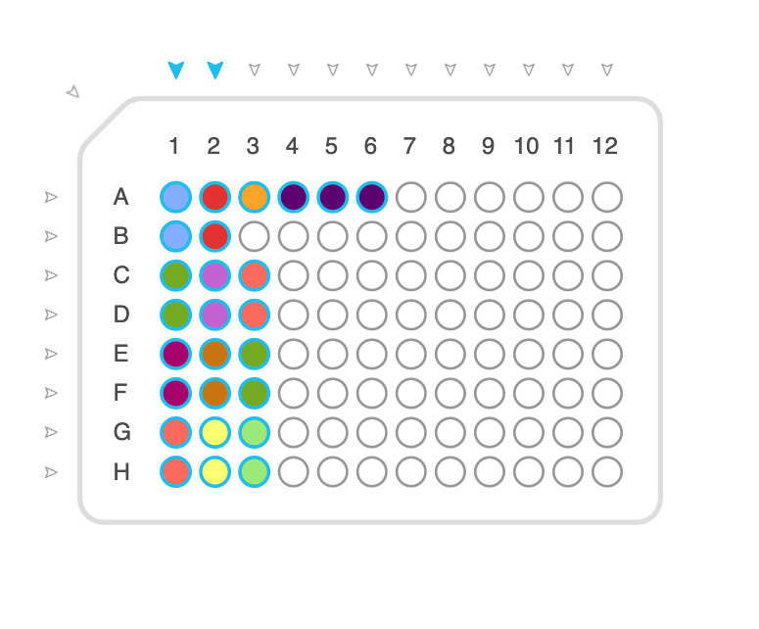
Step6-7: Select the target destination wells and volumes for the 10x buffer and NDM
6. Edit Protocol step 3 to select destination wells for pipetting XuL (3uL) 10x nucleoside digestion mix buffer
Protocol Steps
Notes:
Mixes 3x times (10uL) after pipetting buffer
7. Edit Protocol step 4 to select destination wells for pipetting XuL (1uL) Nucleoside Digestion Mix
Notes:
Mixes 5x times (10uL) after pipetting NDM

Slide 9
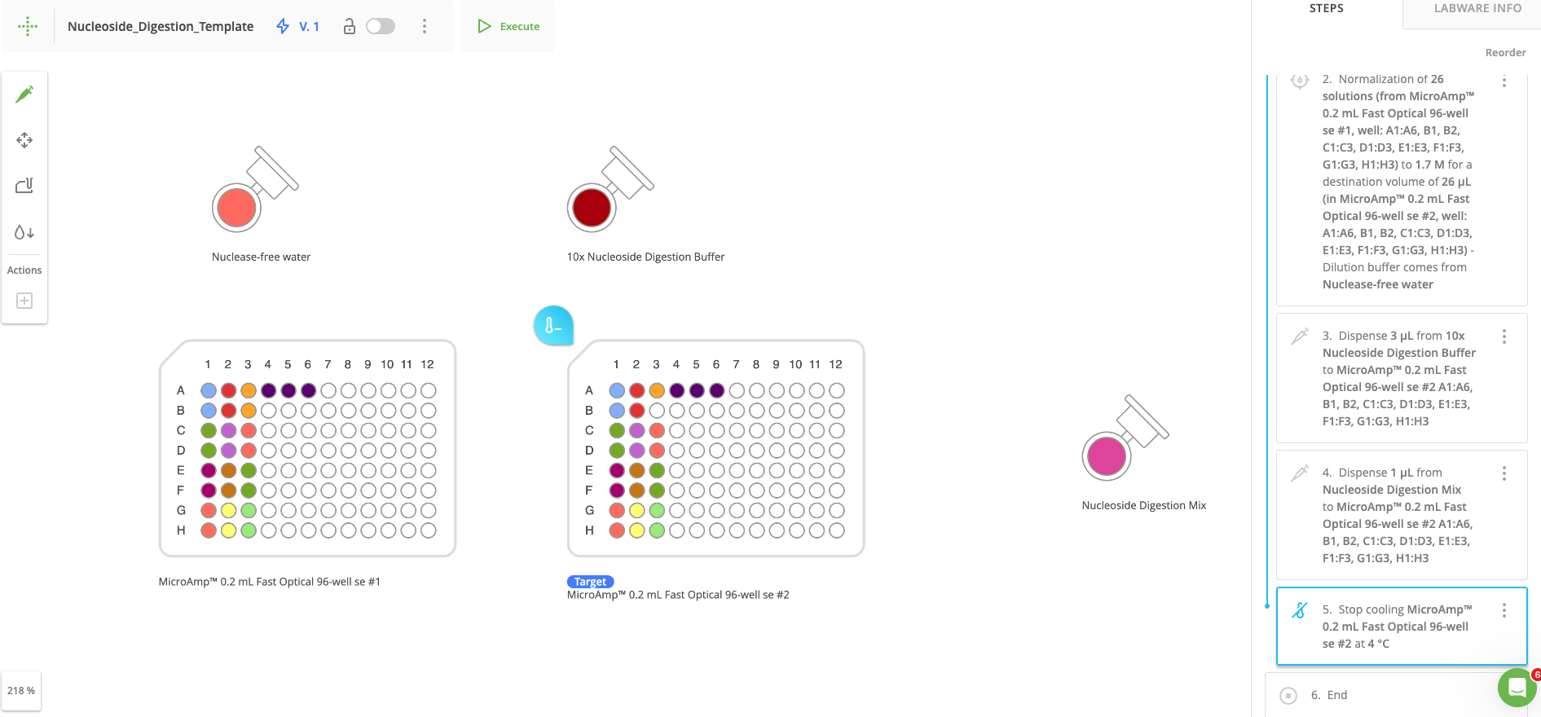
Step8-10: Double Check everything is correct and run the protocol.
8. Click on the protocol step 6 “END” to get a snapshot of what the final workspace will look like. You can click on the source plate and the target destination plate to see what is in each plate at the end of the protocol.
9. Once satisfied, click Execute at the top of the designer page to start the Andrew+ setup.
  There will be a ton of prompts directing you on where to put the dominos and reagents for the experiment.
  When setting up the dominos, make sure the left most domino is up against the flat part of the waste collection area. If not there will be an error saying that the workspace is invalid.
10. Seal plate and transfer to thermal cycler

Slide 10
Transferring Nucleosides from 96 well plate to HPLC vials

Slide 11
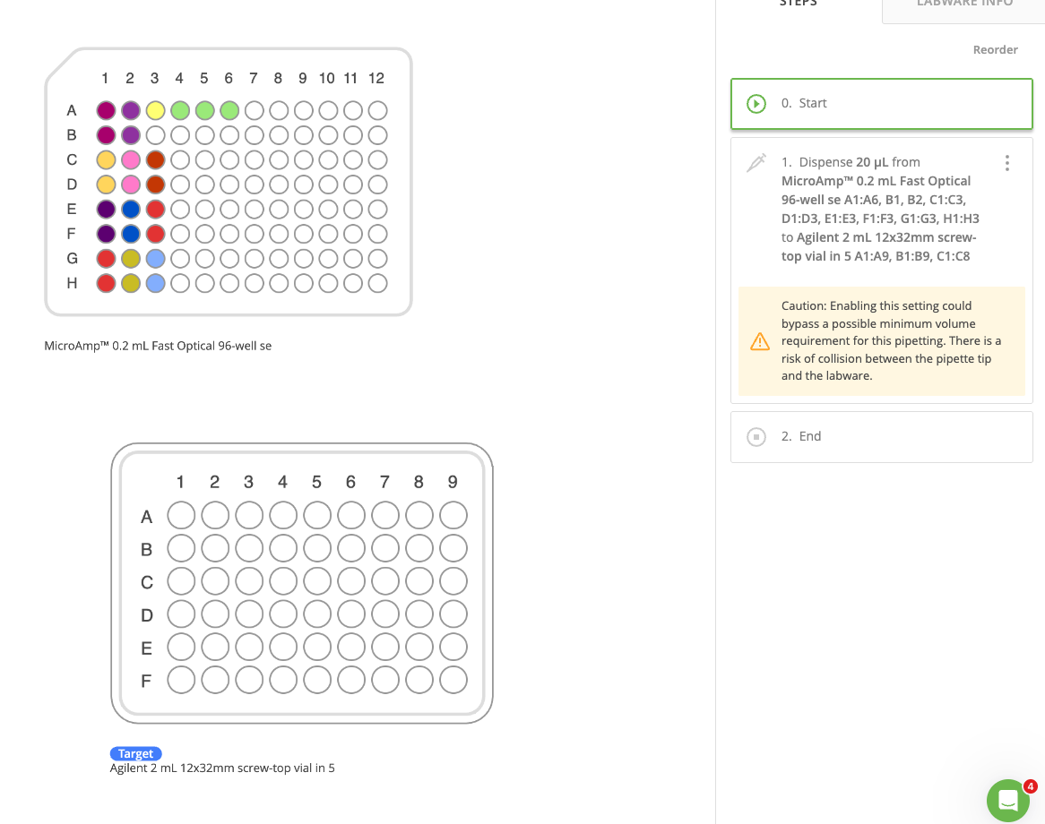
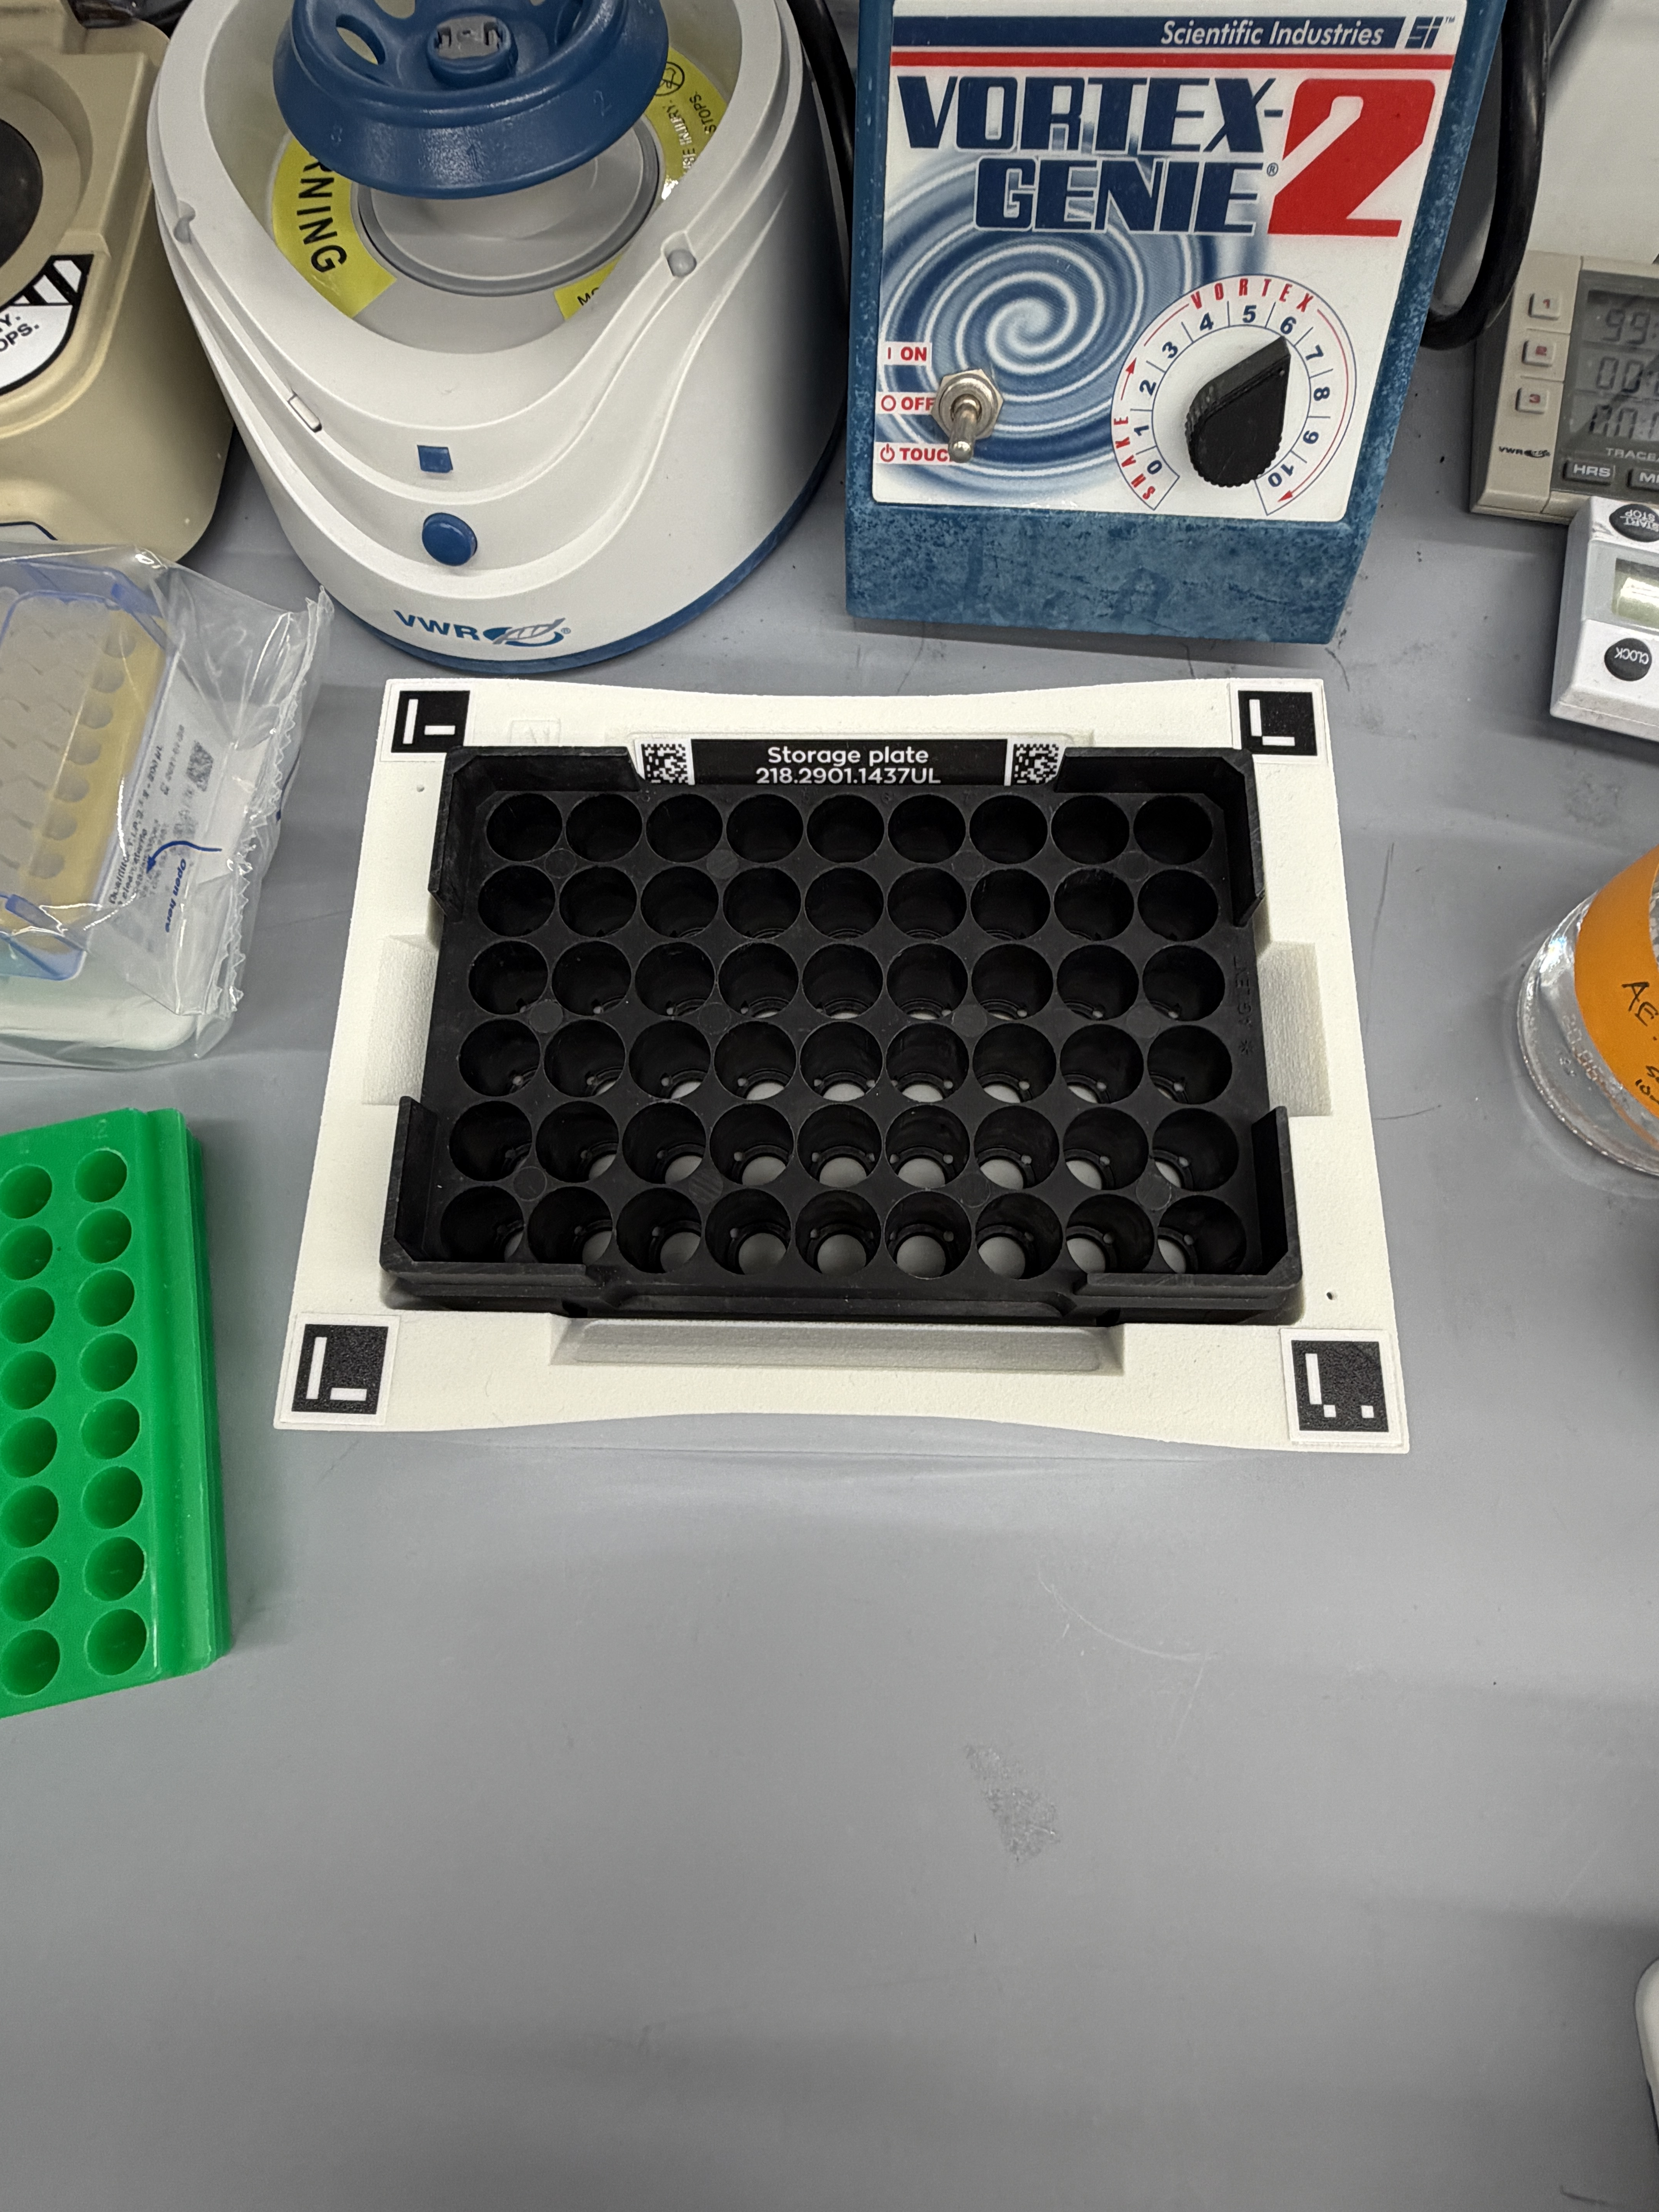
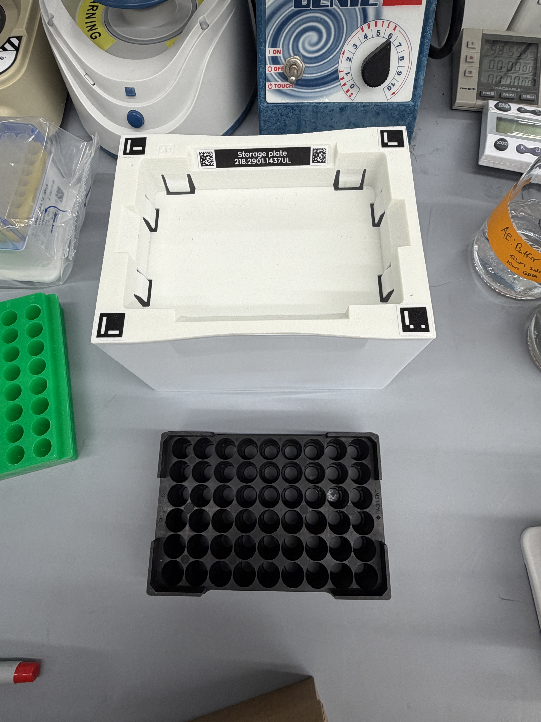
Step1: Open the OneLab Nucleoside Digestion Protocol for Editing
1. Open Onelab protocol: Transfer96well_HPLCvial_0.2mLGlass
  https://onelab.andrewalliance.com/
  Located in the Correa Lab home directory
    Projects/Automation Templates/Transfer96well_HPLCvial_0.2mLGlass
Notes:
We do not have the Agilent HPLC vial rack holder and the Glass 0.2mL Thermo HPLC vials are not in the Opentrons labware library.
We have to trick the Andrew+ and use similar labware that is available + offset adjustment for pipetting.
  HPLC vial rack domino -> Storage plate + HPLC rack
  Agilent 2mL 12x33mm -> Thermo 0.2mL Glass HPLC Vials
Storage Plate + HPLC Rack

Slide 12
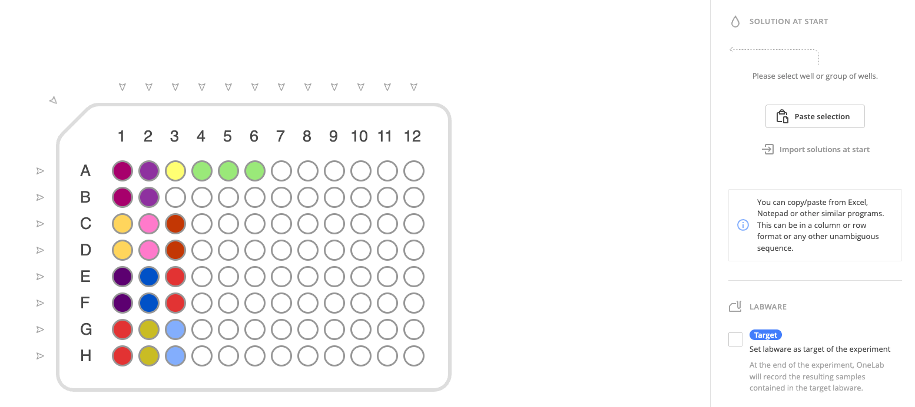
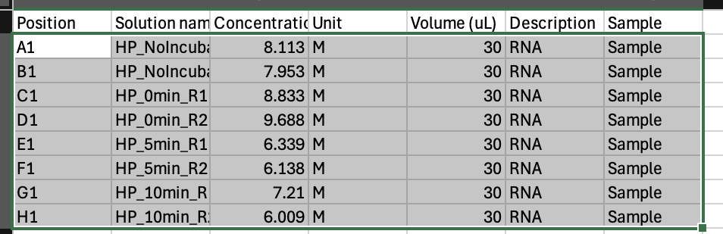
Step2: Input the samples and volumes of the nucleoside digestion into the source plate
2. Click on the source plate and paste in the information about the Nucleoside digestion reaction.
- I would just paste the exact sample sheet used for the Nucleoside Digestion Step4, but change the volume to what ever volume (30uL) the nucleoside digestion reaction was.
Source plate
Copy Values to clipboard
Paste values from clipboard
Notes:
The only values that are critical are the position, solution name, and the volume. Concentration really does not matter.

Slide 13
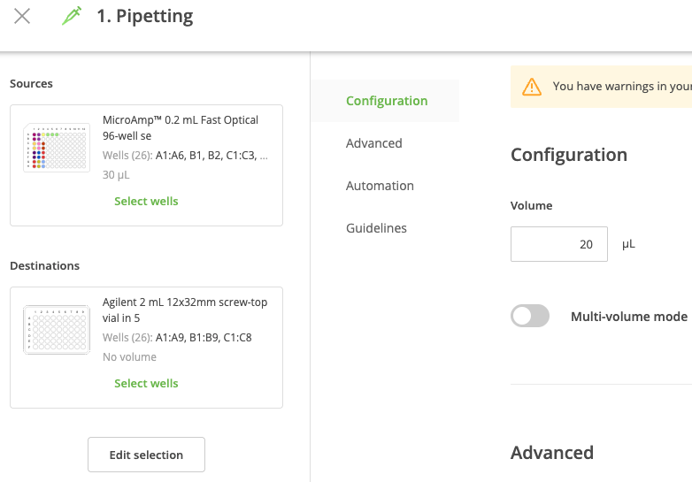
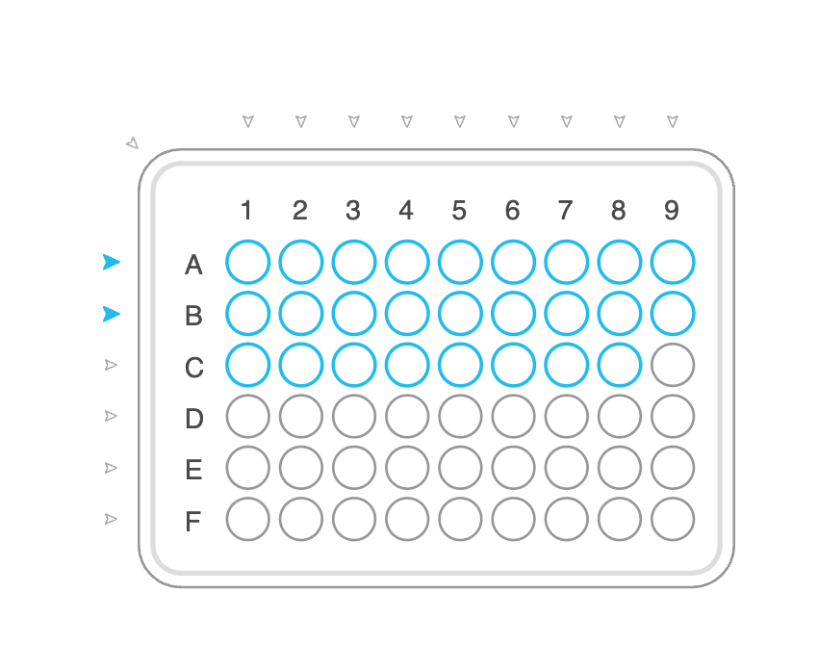
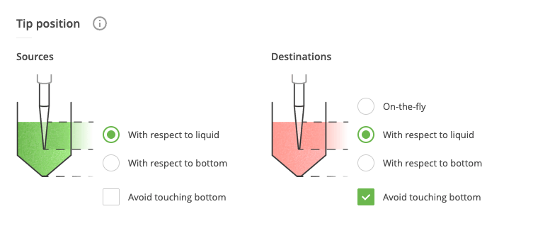
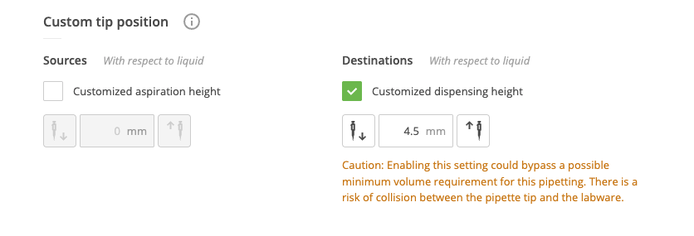
Step3: Edit Protocol Step 1 “Pipetting” with 96well source wells and destination HPLC vials to be transferred
3. Edit Protocol Step1 and select the source wells, destination HPLC vials, and the volume to be transferred.
- Selecting source wells is the same as above, but selecting the HPLC vials is a little different.
- in the editing page, double check the following offsets are properly configured.
Notes:
When selecting destination HPLC vials, they are added row by row instead of by columns.
For example:
  Samples in 96well: A1,A2, A3, B1,B2, C1
  HPLC vial destinations would be.
    A1 -> 96well A1
    A2 -> 96 well B1
    A3 -> 96 well C1
    A4 -> 96 well A2
    A5 -> 96 well B2
    A6 -> 96 well C1
IMPORTANT OFFSET CONFIGURATIONS
Notes:
If offsets are not properly configured, the pipette tip will get stuck in the HPLC vial and Andrew will eject the pipette tip+ vial into the waste container

Slide 14
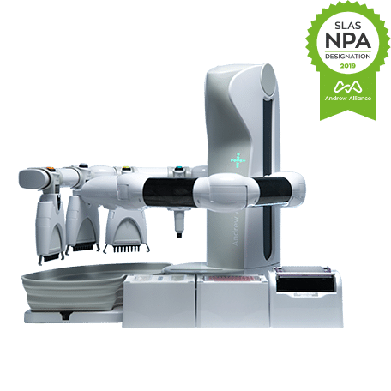
Step4: Double Check everything is correct and run the protocol.
4. Click on the protocol step2 “END” to get a snapshot of what the final workspace will look like. You can click on the source plate and the target destination plate to see what is in each plate at the end of the protocol.
- There is a non-zero chance that pipette tip might get stuck in the HPLC vial, but I had no errors in 2x runs once I changed all of the offsets.
- Label all of the HPLC vials before hand so you can recover them from the waste if this does happen and not loose any sample.

Slide 15
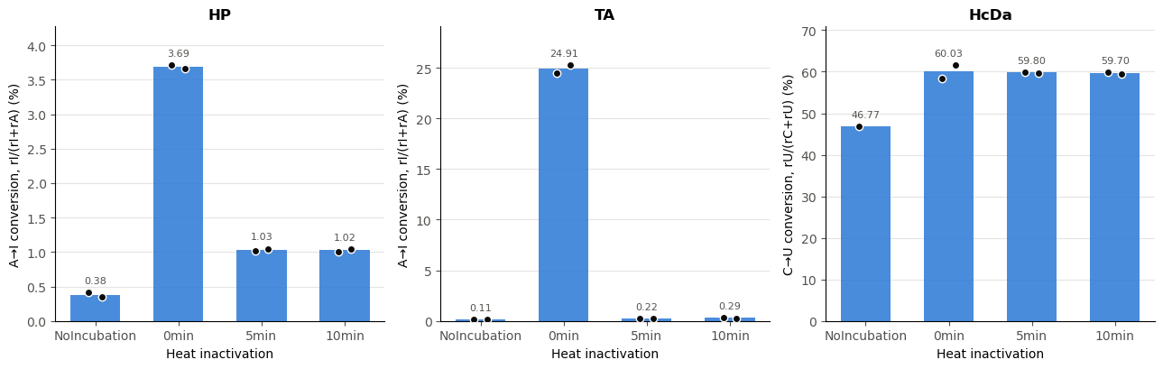
Example Results: Nucleoside digestion of Deamination Reactions.
HP = HPAMPD
TA = TadA8r
HcDa = HcDa
Enzyme | Condition | Metric | n | R1 (%) | R2 (%) | Mean (%) | SD (%) | CV (%)
HP | NoIncubation | rI/(rI+rA) | 2 | 0.410 | 0.345 | 0.378 | 0.046 | 12.17
HP | 0min | rI/(rI+rA) | 2 | 3.715 | 3.655 | 3.685 | 0.042 | 1.15
HP | 5min | rI/(rI+rA) | 2 | 1.015 | 1.050 | 1.033 | 0.025 | 2.39
HP | 10min | rI/(rI+rA) | 2 | 1.005 | 1.045 | 1.025 | 0.028 | 2.75
TA | NoIncubation | rI/(rI+rA) | 2 | 0.110 | 0.110 | 0.110 | 0.000 | 0.00
TA | 0min | rI/(rI+rA) | 2 | 24.520 | 25.290 | 24.905 | 0.544 | 2.18
TA | 5min | rI/(rI+rA) | 2 | 0.240 | 0.200 | 0.220 | 0.028 | 12.85
TA | 10min | rI/(rI+rA) | 2 | 0.290 | 0.285 | 0.288 | 0.004 | 1.23
HcDa | NoIncubation | rU/(rC+rU) | 1 | 46.770 | NaN | 46.770 | NaN | NA
HcDa | 0min | rU/(rC+rU) | 2 | 58.415 | 61.640 | 60.028 | 2.280 | 3.79
HcDa | 5min | rU/(rC+rU) | 2 | 59.860 | 59.735 | 59.798 | 0.088 | 0.14
HcDa | 10min | rU/(rC+rU) | 2 | 59.910 | 59.495 | 59.702 | 0.293 | 0.49

