Slide 1
Julius Baer Bank:
Introducing the Next-Generation Structured Product
Team Dashing Duck

Slide 2
Part A
Determine through quantitative methods whether there are truly differences between these two portfolios and to highlight those differences

Slide 3
Part A - Overview of two portfolios (Democratic)
Walmart Inc.
Home Depot Inc.
NextEra Energy Inc.
CSX Corp.
McDonald’s Corp.
Simon Property Group Inc.
First Solar Inc.
Norfolk Southern Corp.
The Democratic Portfolio
Exelon Corp
Ford Motor Co.
Aptiv PLC
Constellation Brands Inc
Estee Lauder Cos.
SunPower Corp.
Coca-Cola Co.

Slide 4
Part A - Overview of two portfolios (Republican)
Gilead Sciences Inc.
Amazon.com Inc.
Chevron Corp.
Facebook Inc.
Merck & Co.
PayPal Holdings Inc.
American Express Co.
Visa Inc
The Republican Portfolio
Honeywell International Inc.
Alphabet Inc.,
ConocoPhillips
Marathon Oil Corp.,
Citigroup Inc.
Salesforce.com Inc.,
QUALCOMM Inc.,

Slide 5
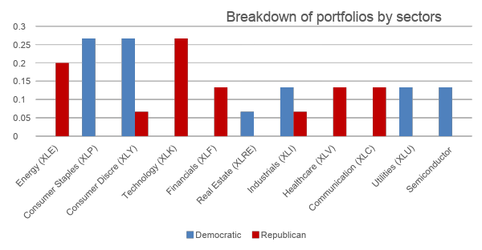
Part A – Differences by sectors

Slide 6
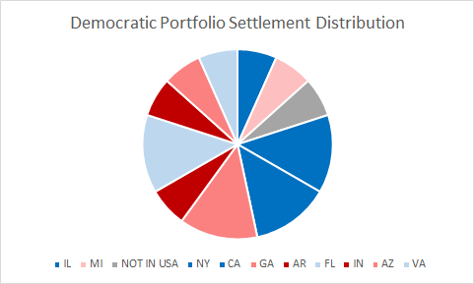
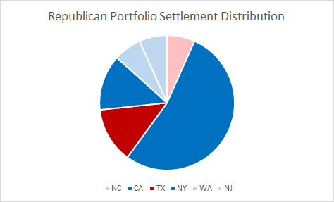
Part A – Differences by headquarter locations

Slide 7
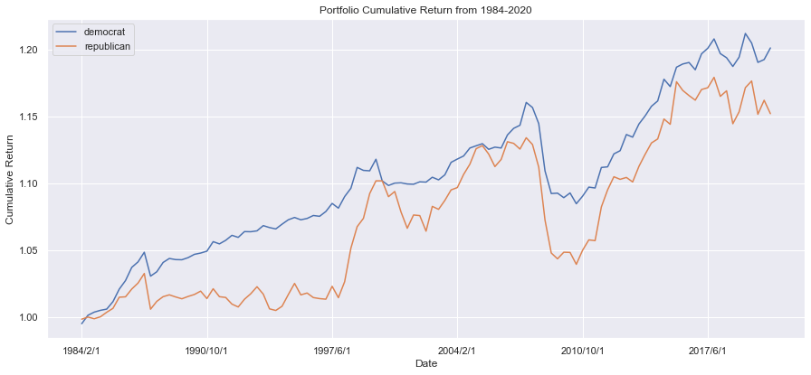
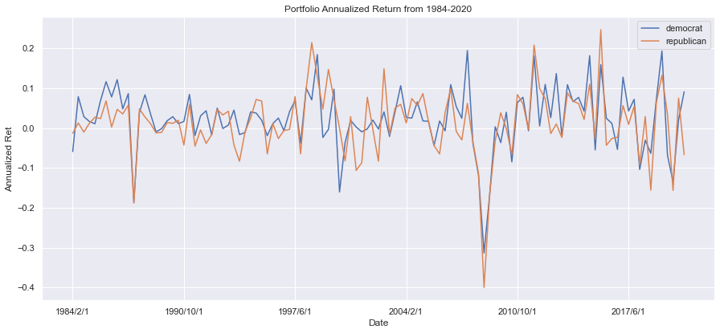
Part A – Differences of returns
Trends of cumulative return
Trends of annualized return

Slide 8
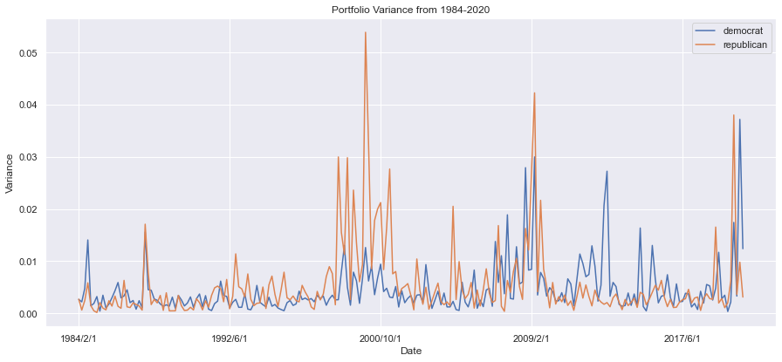
Part A – Differences of variances of returns

Slide 9
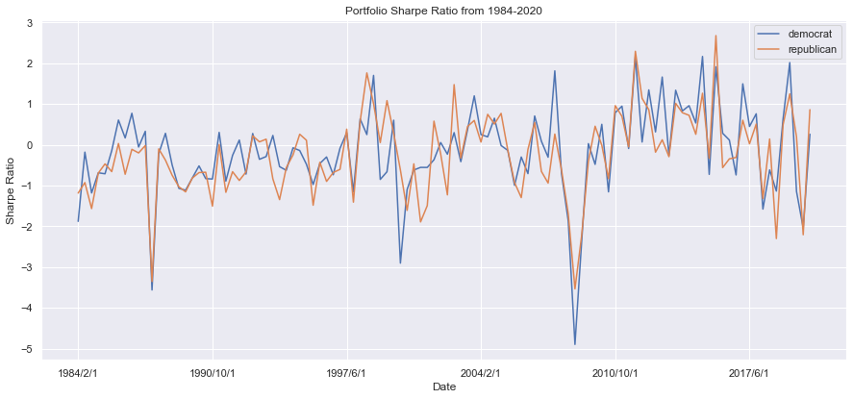
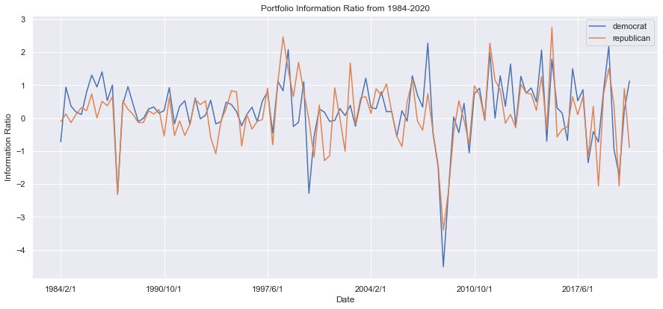
Part A – Comparing the Sharpe ratio and the Information ratio

Slide 10
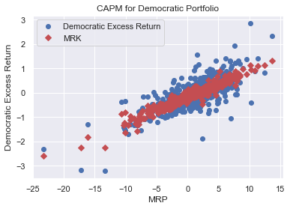
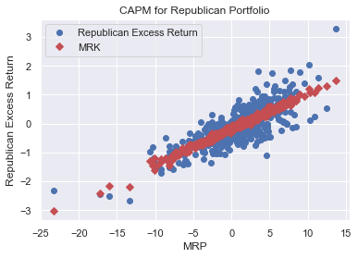
Part A – CAPM Fama-French Three Factor model
Coefficients | MRP | SMB | HML | intercept | R-squared
Democratic | 0.1155 | -0.0098 | 0.0414 | -0.1814 | 0.604
Republican | 0.1257 | 0.0021 | 0.0210 | -0.1880 | 0.638
Table A.6.1 CAPM data for two portfolios with S&P 500

Slide 11
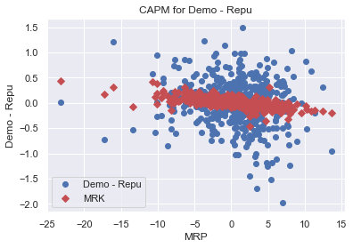
Part A – CAPM Fama-French Three Factor model
Coefficients | Dem - Rep | Std.error | P-value
MRP | -0.0102 | 0.005 | 0.770
SMB | -0.0119 | 0.008 | 0.047
HML | 0.0203 | 0.008 | 0.124
Intercept | 0.0065 | 0.022 | 0.009
Table A.6.2 CAPM for Democratic – Republican

Slide 12
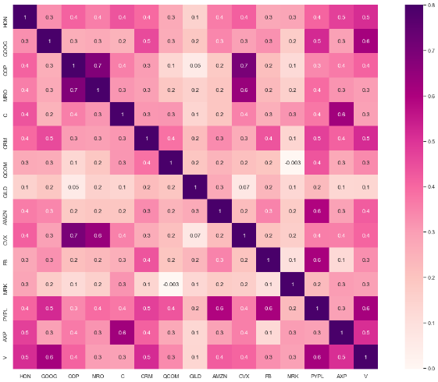
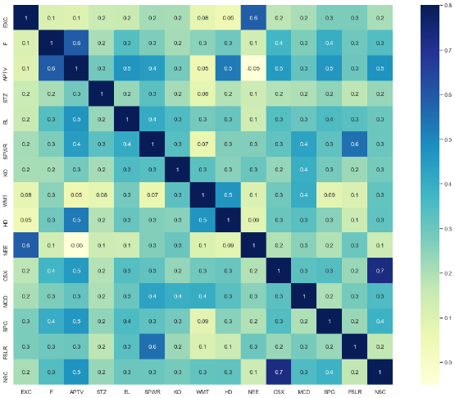
Part A – Correlation Analysis

Slide 13
PART B
Using quantitative methods to determine whether these portfolios should be expected to perform differently depending on whether the White House is occupied by a Republican or a Democrat (the term of the structured notes is one year starting from January 29, 2020).

Slide 14

I. Methodology
Kenton (2020) describes that “Multiple linear regression (MLR), also known simply as multiple regression, is a statistical technique that uses several explanatory variables to predict the outcome of a response variable”.
MULTIPLE LINEAR REGRESSION (MLR) MODEL
The general form of a multiple regression model is:
yi​ = β0 ​+ β1​xi1 ​+ β2​xi2​ + ... + βp​xip​ + ϵ
where, for I = n observations:
yi ​= dependent variable
xi ​= explanatory variables
β0 ​= y-intercept (constant term)
βp = slope coefficients for each explanatory variable
ϵ = the model’s error term (also known as the residuals)​

Slide 15
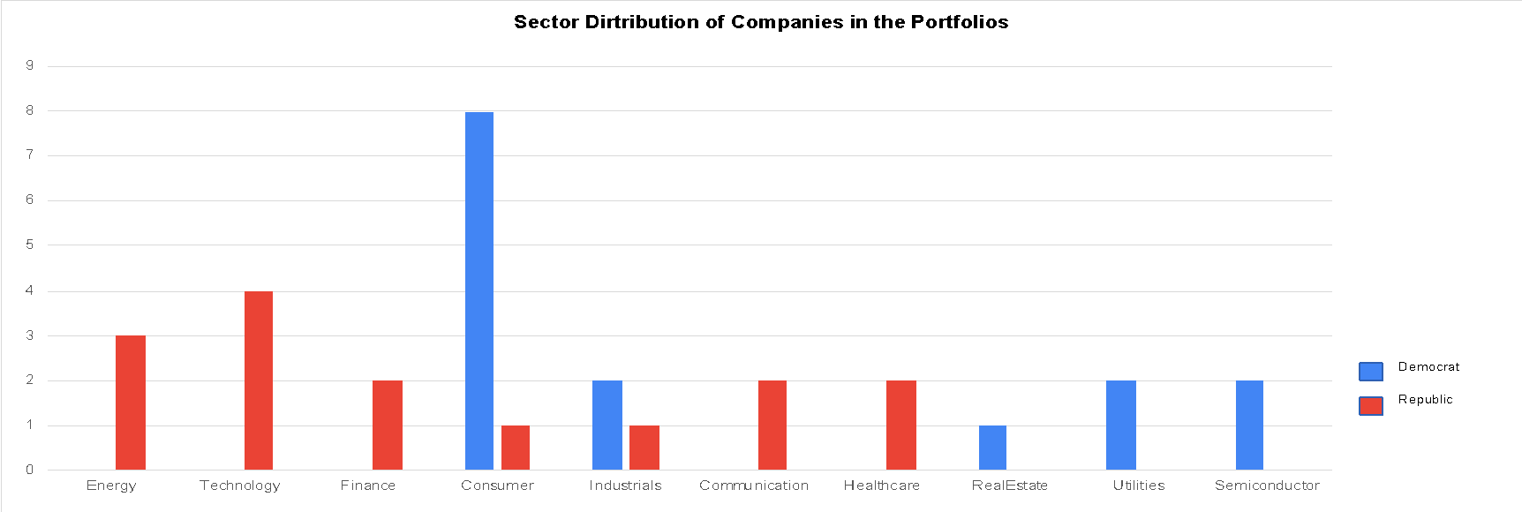
II. Choosing Factors in the Multiple Regression Model
Single Independent Variables
— US Presidential Election Result
— Sectors of Companies in These Portfolios

Slide 16





II. Choosing Factors in the Multiple Regression Model
Single Independent Variables
— Financial and Economic Factors
1. GSPC : The ticker symbol of the S&P 500 index, and it shows the movement and percentage change of stock prices in the S&P 500 index.
2. GDP : It is primarily used to assess the health of a country's economy .
3. CPI : A useful tool to measure of the inflation or deflation and also an indicator of the overall economy and financial condition.
4. Oil Price : By investigating companies that are included in the Democratic and Republican portfolios, some stocks are directly and indirectly related to the production and price of oil.;
Oil prices can impact the US stock market and affect investors behaviors as a whole.
5. Interest Rate: The stock market would be benefited if interest rate increases and be hurt if interest rate decreases.

Slide 17

II. Choosing Factors in the Multiple Regression Model
Interaction Terms
In addition to above individual independent variables to involved in the multiple regression model, their correlation and interaction should be considered as well.

Slide 18
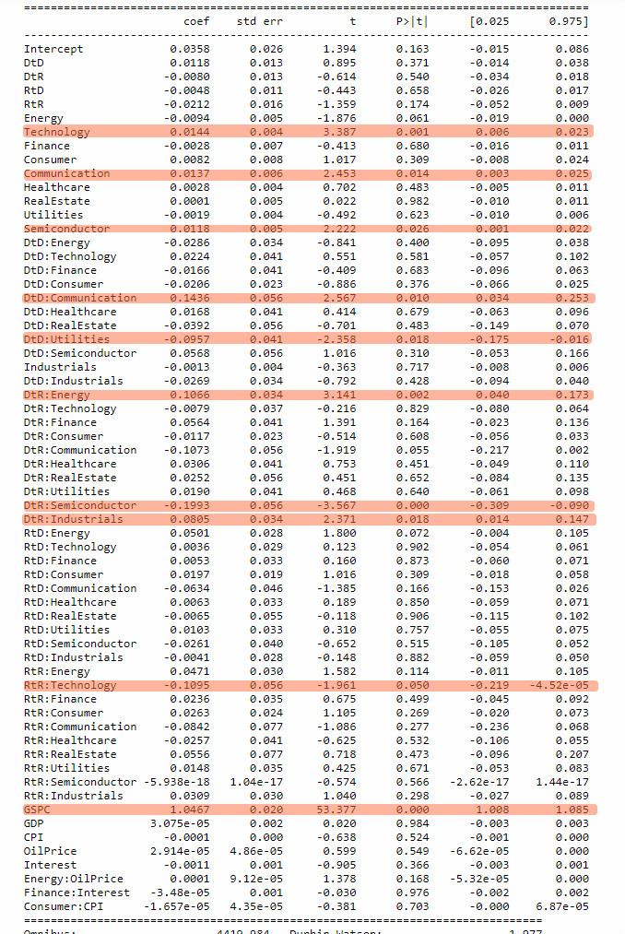
III. Test the Significance and Validation of the Multiple Regression Model
Significance of Coefficients (Assuming 5% Significance Level)
— It is necessary to find the value that is less than 0.05 in the column P > |t|.
— technology, communication, semiconductor are significant sector variables;
— GSPC is the important economic variable;
— DtD*Communication, DtD*Utilities, DtR*Energy, DtR*Semiconductor, DtR*Industrials, and RtR*Technology are meaningful interaction terms.

Slide 19
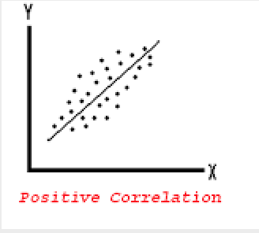
III. Test the Significance and Validation of the Multiple Regression Model
Values of Coefficients
— Single Independent Significant Factors
For Technology, Communication, Semiconductor, and GSPC, their coefficient values are all positive, which means that these factors are positively related to the portfolios’ performance and move with the portfolios’ returns in the same direction.
— Significant Interaction Terms
Results could be the implication that the performances of Democratic and Republican portfolios are not affected by whether the White House is occupied by a Republican or a Democratic.

Slide 20
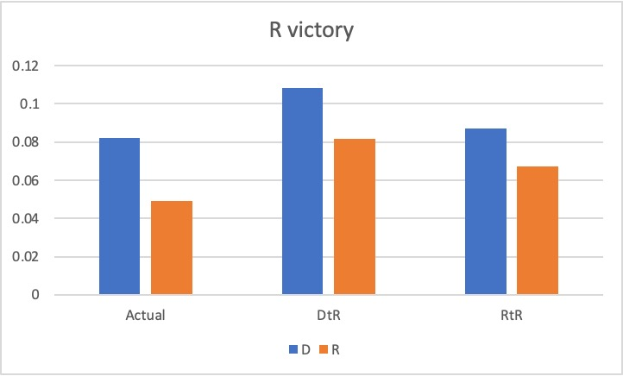
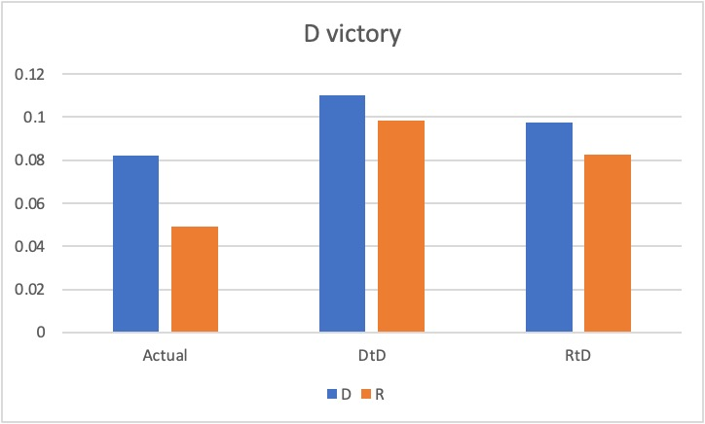
III. Test the Significance and Validation of the Multiple Regression Model
Result Analysis
— The Democratic portfolio would perform better than the Republican portfolio in either cases of Republic victory and Democrat victory, and independent on the last US Presidential Election result.

Slide 21

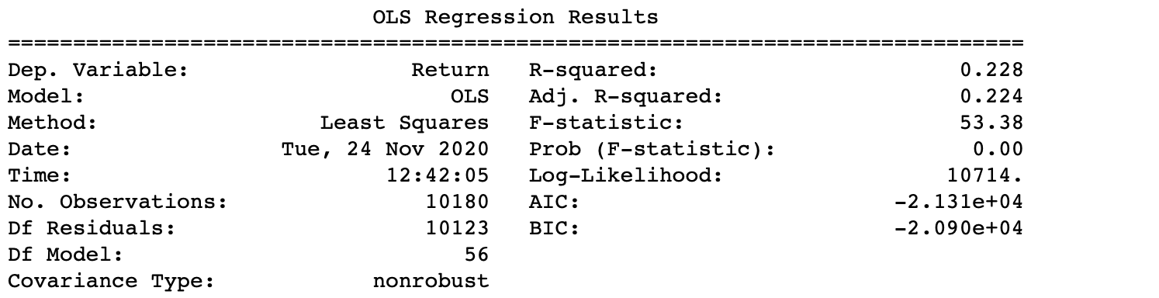
IV. CONCLUSION
• In conclusion, the multiple regression model and the actual result both indicate that the Democratic and Republican portfolios should not be expected to impact by whether the White House is occupied by a Republican or a Democrat, but since their stocks and companies are differently distributed on sectors, they may perform differently.

Slide 22
PART C
Construct structured notes from the portfolios which have a differentiated payoff depending on the outcome of the election.

Slide 23
Structured Notes
Zero-Coupon Bond – “Principal Protection”
Bull Spread – Stock Market Exposure
Portfolios are expected to have positive returns
Protects the investor from excess losses
Risk-free rate | 1.51%
Aa2 credit spread for JB | 0.78%
Discount rate | 2.29%
Value of ZCB | 977.6127
Balance of fund | 22.3873

Slide 24
Option Strategy Setup
Use Black-Scholes Model for call option pricing
Devise a portfolio price index using the average stock price within the portfolio, setting the issue month (January 2020) as the base month. The base month has an index of 100.
Calculate the portfolio volatility (sigma) using the historical prices of the past year.
S0 | 100
Democratic sigma | 0.26
Republican sigma | 0.27
Maturity | 1 year
Discount Factor | 1.51%

Slide 25
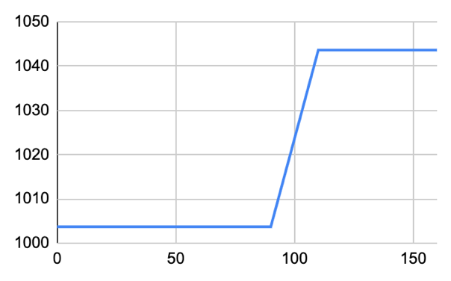
Democratic Bull Spread
Sell call option with strike price 110 | 7.03
Buy call option with strike price 90 | 16.39
Debt | -9.36
Max payoff | 10.64
Number of contracts | 2
Max: 1000+22.3873+10.64*2 = 1043.6697 | Min: 1000+22.3873-9.36*2 = 1003.6697

Slide 26
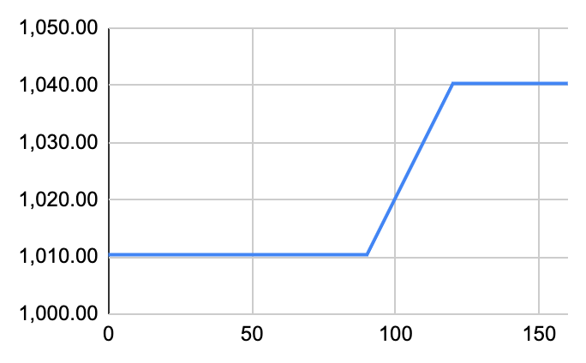
Republican Bull Spread
Sell call option with strike price 120 | 4.92
Buy call option with strike price 90 | 16.923
Debt | -12.01
Max payoff | 17.99
Number of contracts | 1
Max: 1000+22.3873+17.99 = 1040.38 | Min: 1000+22.3873-12.01 = 1010.38

Slide 27
Final Term Sheet
1-Year Democratic Structured Notes Term Sheet
1-Year Republican Structured Notes Term Sheet
Issuer | Julius Baer Bank
Principal | $1,000
Underlying Index | Democratic index
Maturity | One year
Maturity Date | Jan 29 2021
Coupon | zero
Issue Size | $40 million
Issue Price | $1,000
Redemption | The amount of a cash payment at the end of maturity date with each principal amount of $1,000: 1. Principal:$1,000 2. Bull spread payoff: -max( - 110, 0) + max( – 90, 0)
Issuer | Julius Baer Bank
Principal | $1,000
Underlying Index | Republican index
Maturity | One year
Maturity Date | Jan 29 2021
Coupon | zero
Issue Size | $40 million
Issue Price | $1,000
Redemption | The amount of a cash payment at the end of maturity date with each principal amount of $1,000: 1. Principal:$1,000 2. Bull spread payoff: -max( - 120, 0) + max( – 90, 0)

